Slide 1
ArrayList
… an ongoing example
… an experiment to determine “who cares?”

Slide 2
(simplified) BankAccount class:
public class BankAccount {
private String accountNumber;
private String accountHolder;
private double balance;
/**constructor*/
public BankAccount(String an,String ah,double b){
accountNumber=an;
accountHolder=ah;
balance=b;
}
/**copy constructor */
public BankAccount(BankAccount mybankAccount){
accountNumber=mybankAccount.getAccountNumber();
accountHolder=mybankAccount.getAccountHolder();
balance=mybankAccount.getBalance();
}
Accessors and mutators omitted
ADS2 Lecture 2

Slide 3
public class TestBankAccounts {
public static void main(String[] args) {
// Test BankAccount Class
BankAccount bankAccount1=new
BankAccount("1456","Michael Smith",300);
BankAccount bankAccount2=new BankAccount("1457","Jane
Edwards",1000);
BankAccount bankAccount3=new BankAccount("1458","Sam
Forge",2000);
BankAccounts myAccounts1 = new BankAccounts(3);
myAccounts1.setAccount(0,bankAccount1);
myAccounts1.setAccount(1,bankAccount2);
myAccounts1.setAccount(2,bankAccount3);
BankAccounts myAccounts2=new BankAccounts(myAccounts1);
myAccounts1.withdraw(0,250.0);
myAccounts1.withdraw(1,250.0);
myAccounts1.withdraw(2,250.0);
*
(ignore asterisks for now)
ADS2 Lecture 2

Slide 4


Slide 5
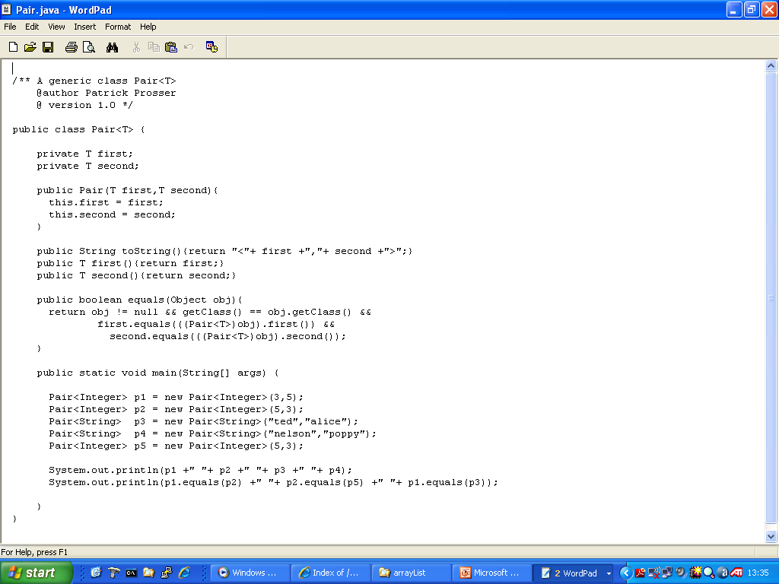
Classes …

Slide 6

I dream of ArrayLists

Slide 7
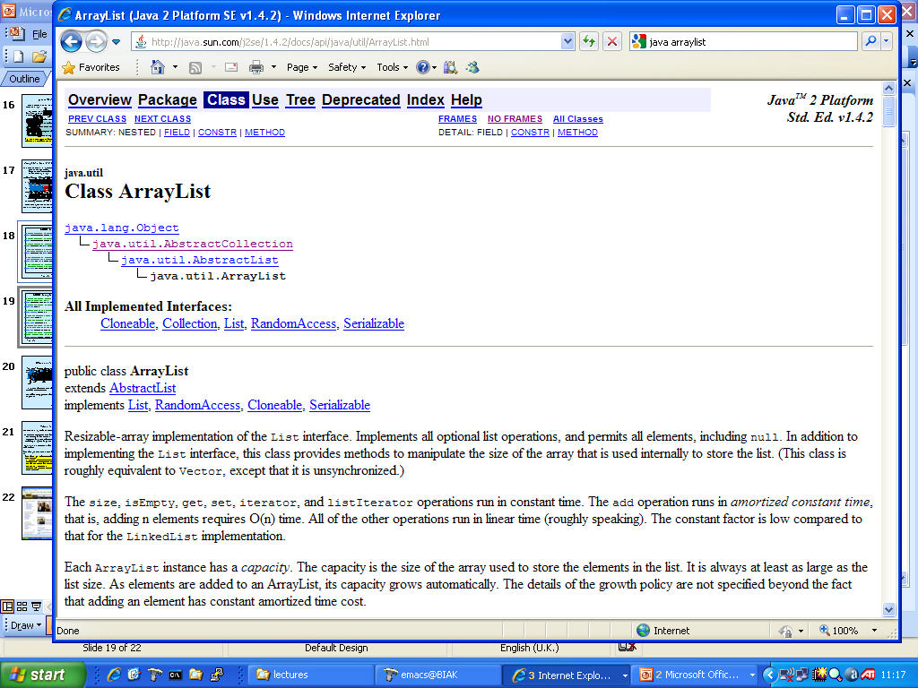

Slide 8
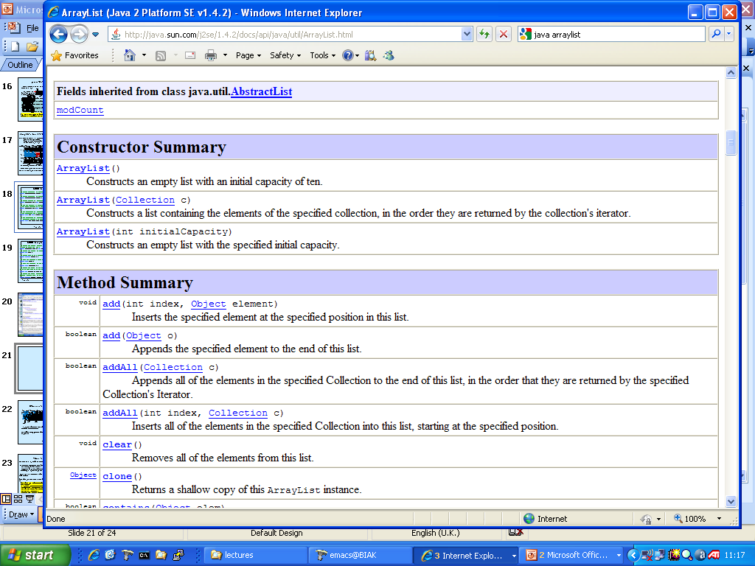

Slide 9
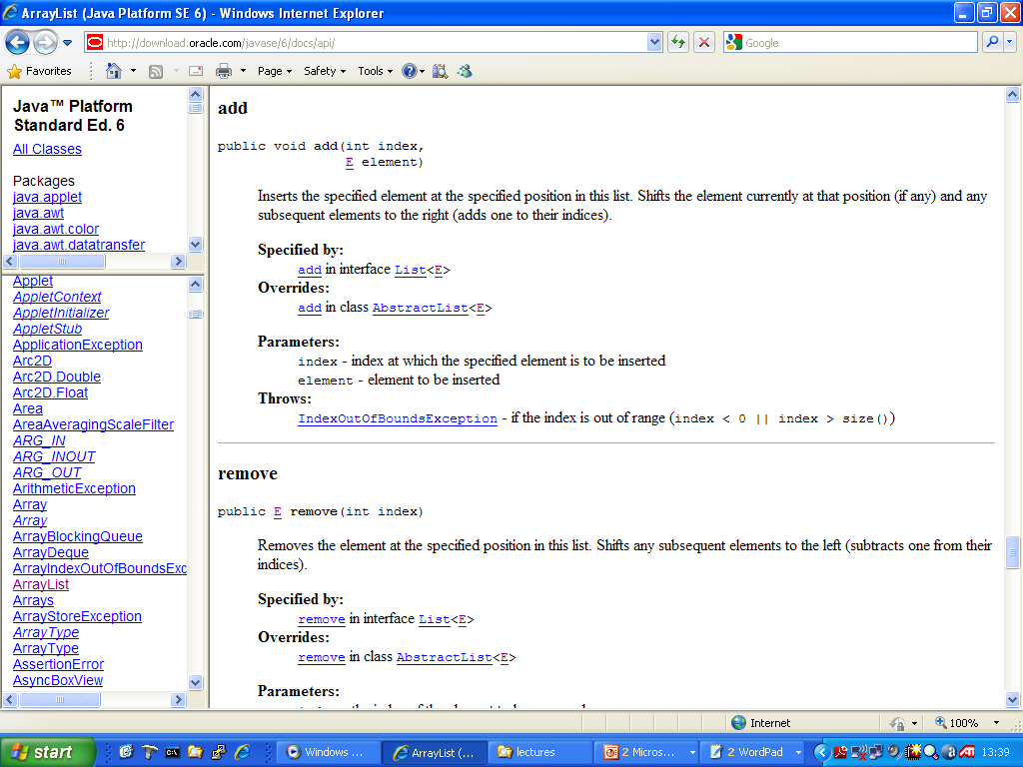

Slide 10
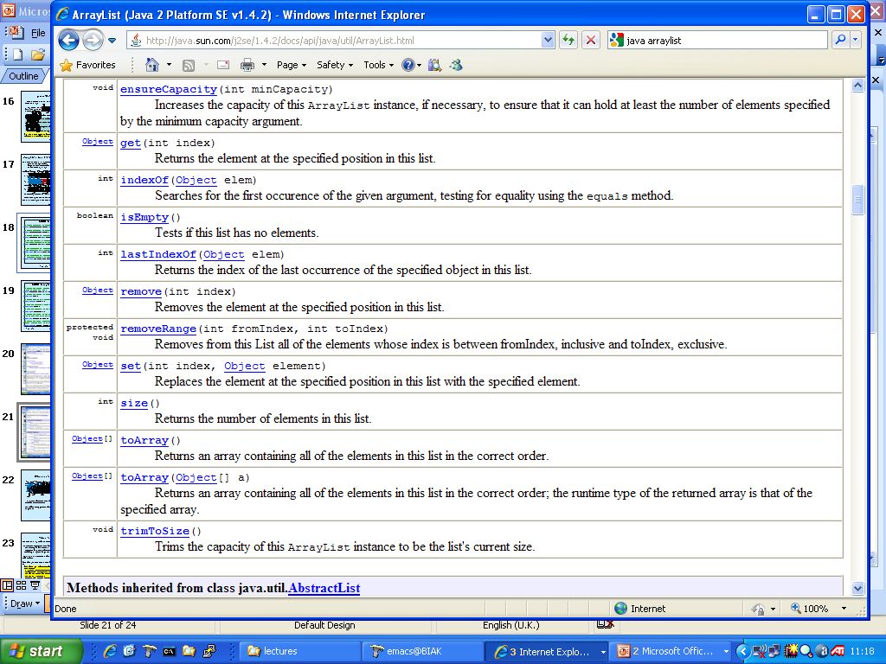

Slide 11
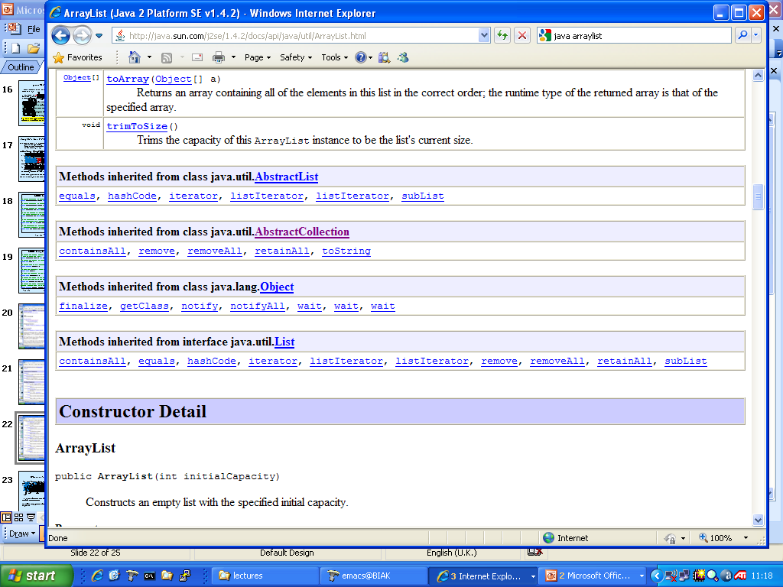

Slide 12
So, ArrayList created with space for 10 objects!
That’s enormous ☺

Slide 13
And when I add an object into a given position it shuffle things up. Is that for free? Does that take any time?

Slide 14
And what happens when I want to put in an 11th object into my ArrayList?

Slide 15
Other features of the ArrayList
“for each” loop can also be used here (and for other Java collections for which an iterator has been declared – see much later on in the course! )
e.g. from Crate example (JP2)
public void display(){
for (Crate c : stock)
System.out.println(“ Crate with load “ + c.getLoad());
}
ArrayList class is an example of generic class – actual type(s) must be supplied on instantiation.
We will be using generics a lot in ADS2. E.g. our interfaces for ADTs will be generic.
ADS2 Lecture 2

Slide 16
Example: processing data (DataSet)

Slide 17
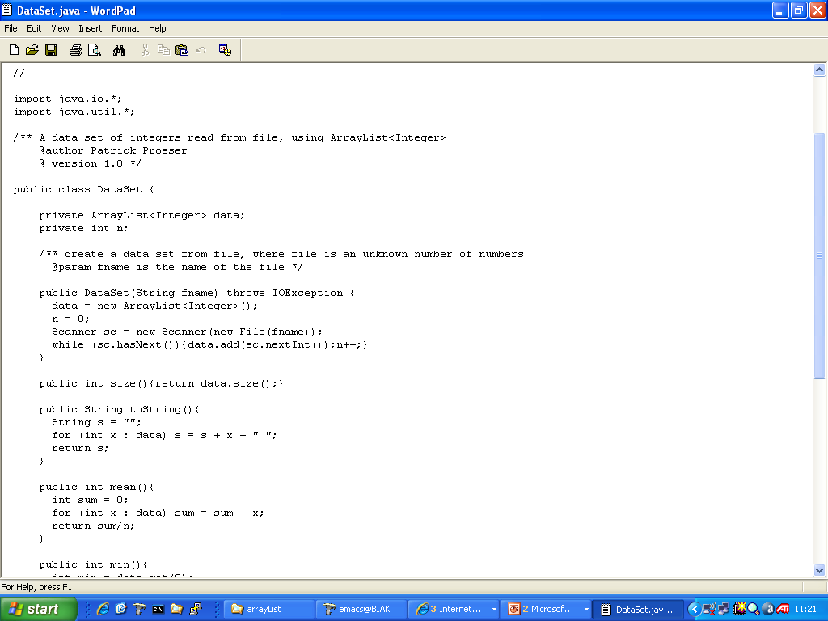
DataSet

Slide 18
DataSet
DataSet contains an unspecified
number of integers.
NOTE: ArrayList is a <“generic”> class

Slide 19
DataSet
Constructor, reads from file
integers, stopping when none left

Slide 20
DataSet
Look at how we iterate
over the array list. There are
other ways to do this

Slide 21
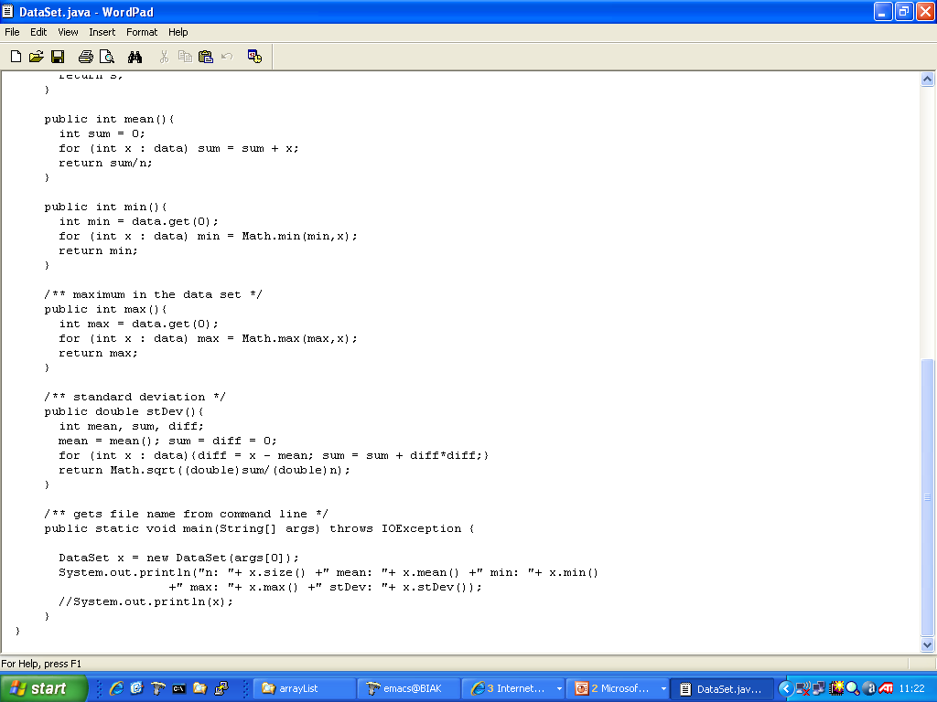
DataSet
Picks up from command line

Slide 22
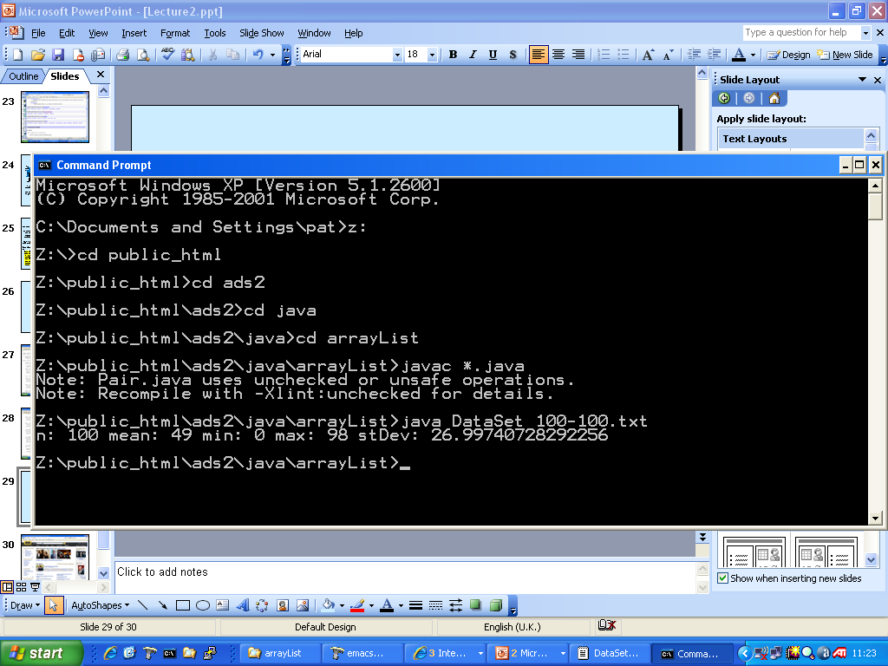
Run fat boy, run!
DataSet

Slide 23
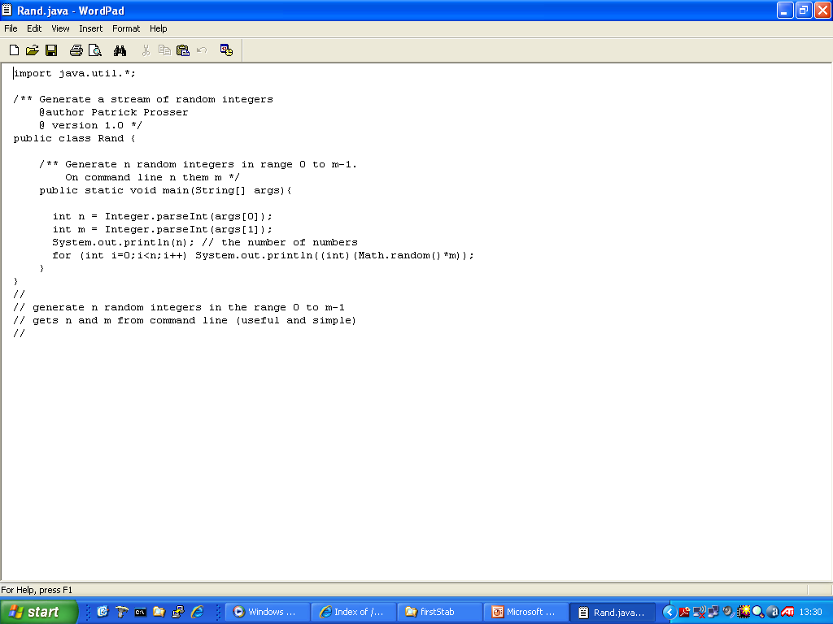
Making random data

Slide 24
ArrayList again

Slide 25
An ongoing example … the Internet Movie DataBase (IMDb)

Slide 26


Slide 27
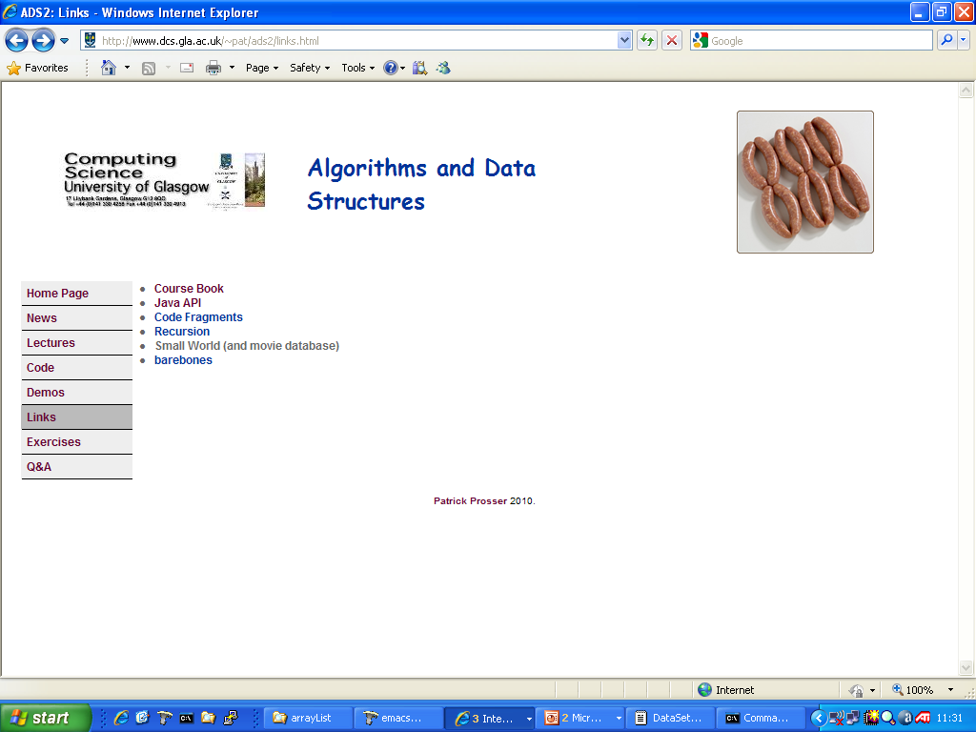

Slide 28
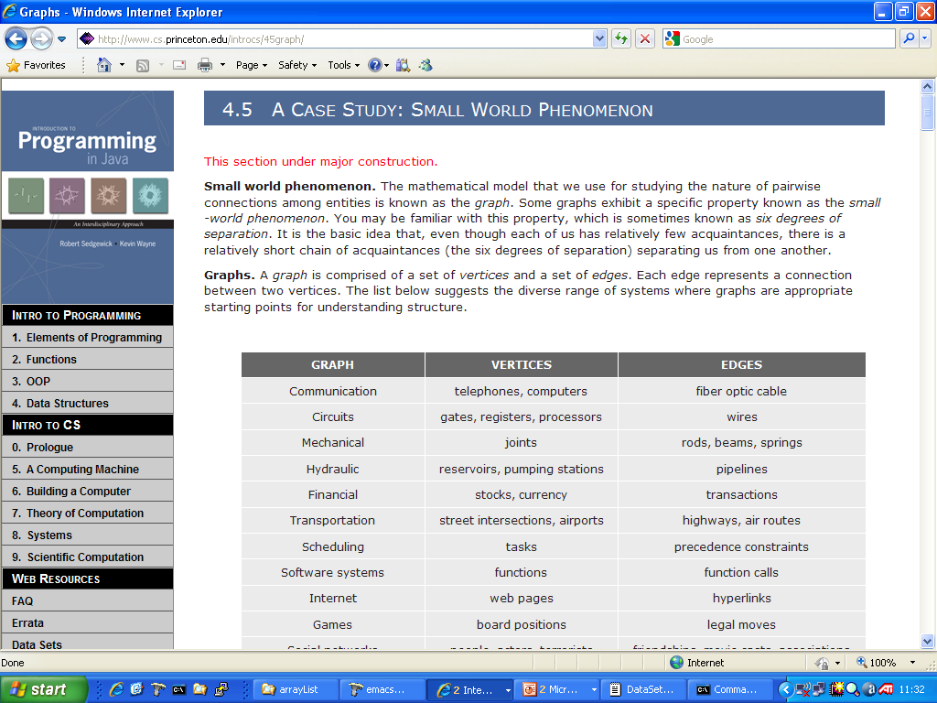

Slide 29
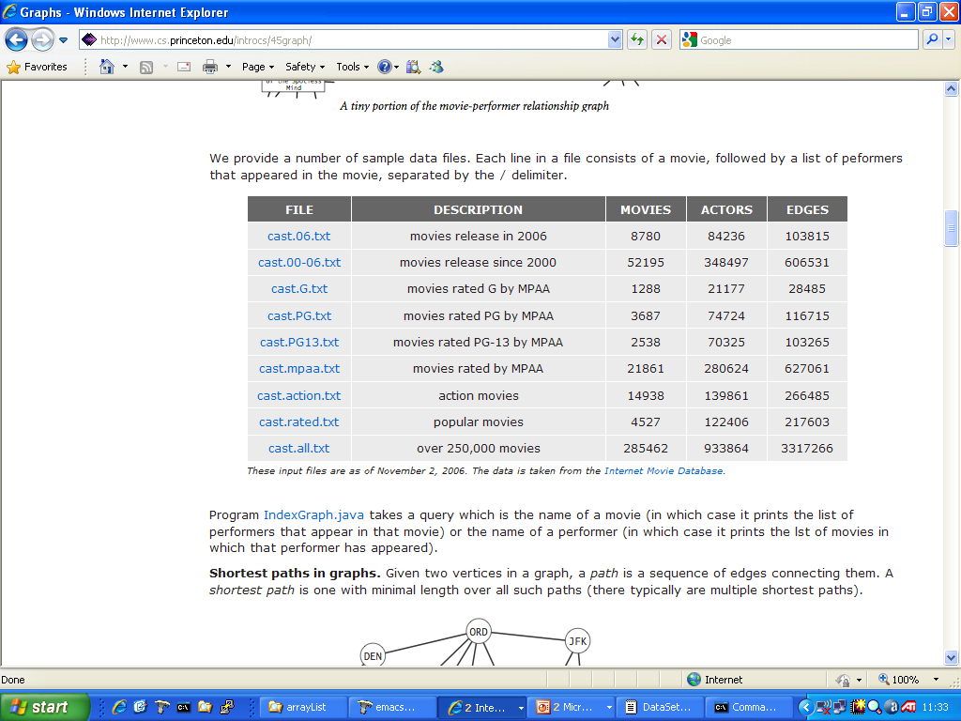

Slide 30
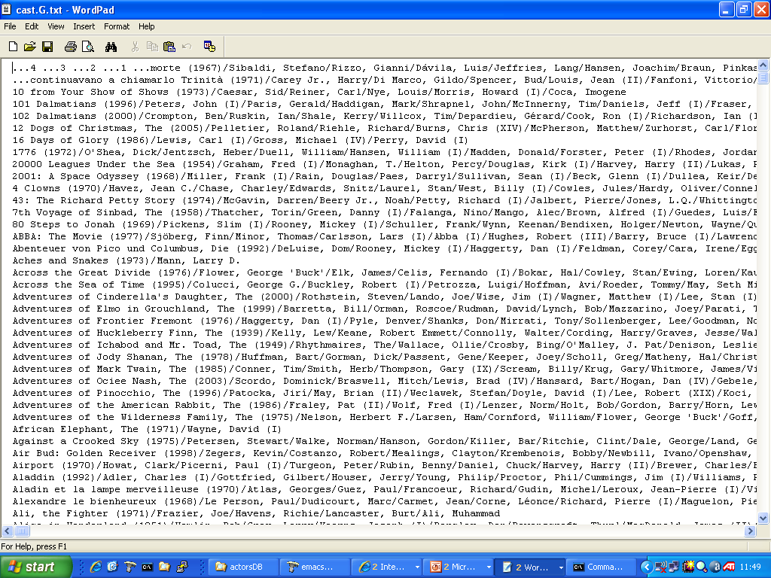

Slide 31
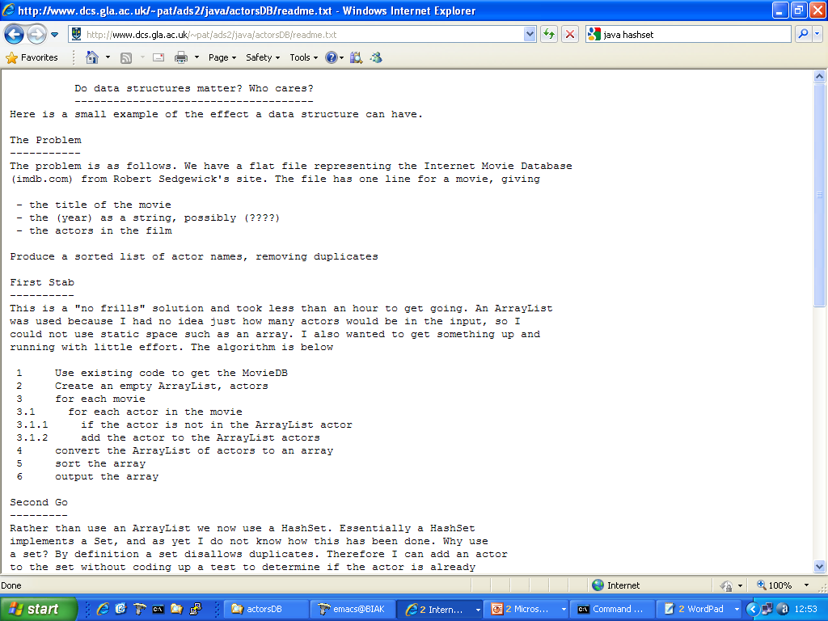

Slide 32
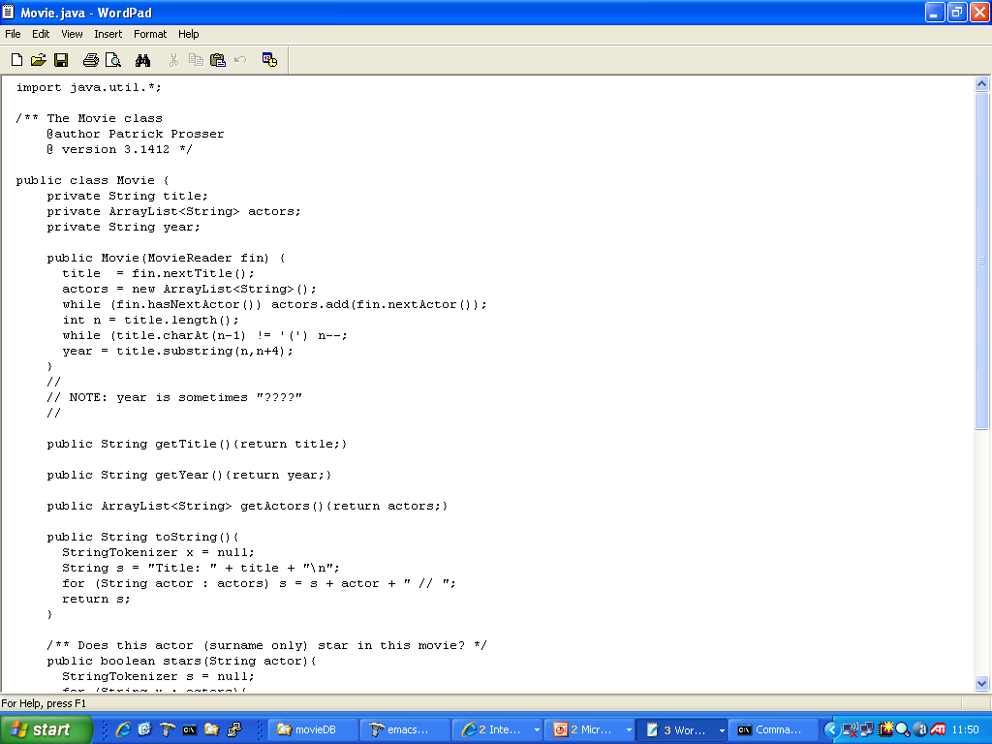
Movie

Slide 33
ArrayList

Slide 34
Constructor … reads from a file

Slide 35
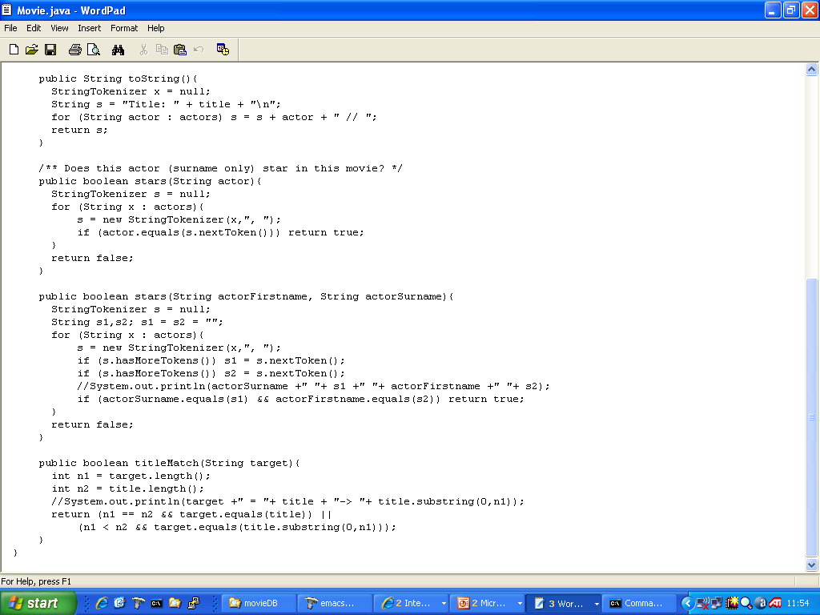

Slide 38
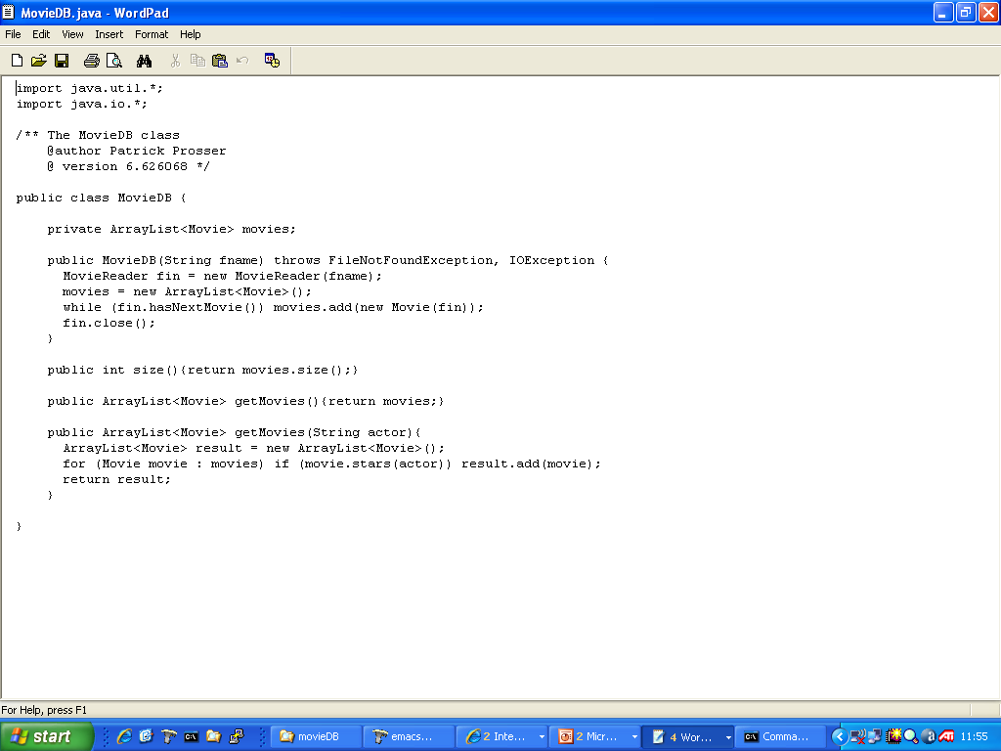
MovieDB

Slide 39
MovieDB

Slide 40
MovieDB

Slide 41
MovieDB

Slide 42
MovieDB

Slide 43
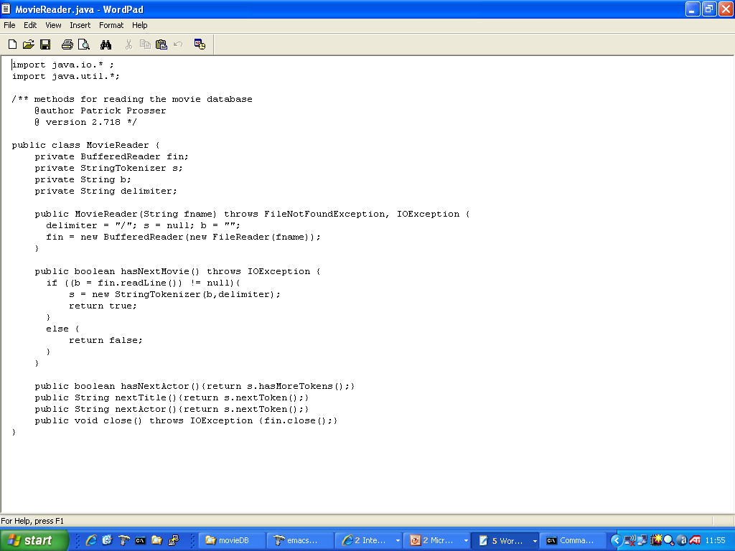
Movie Reader

Slide 44
Problem:
Having read in the MovieDB produce a file of all the actors,
sorted in lex order, duplicates removed.

Slide 45
Problem:
Having read in the MovieDB produce a file of all the actors,
sorted in lex order, duplicates removed.
what do you mean by “lex”
how might we do this?

Slide 46
Using ArrayList as a set

Slide 48
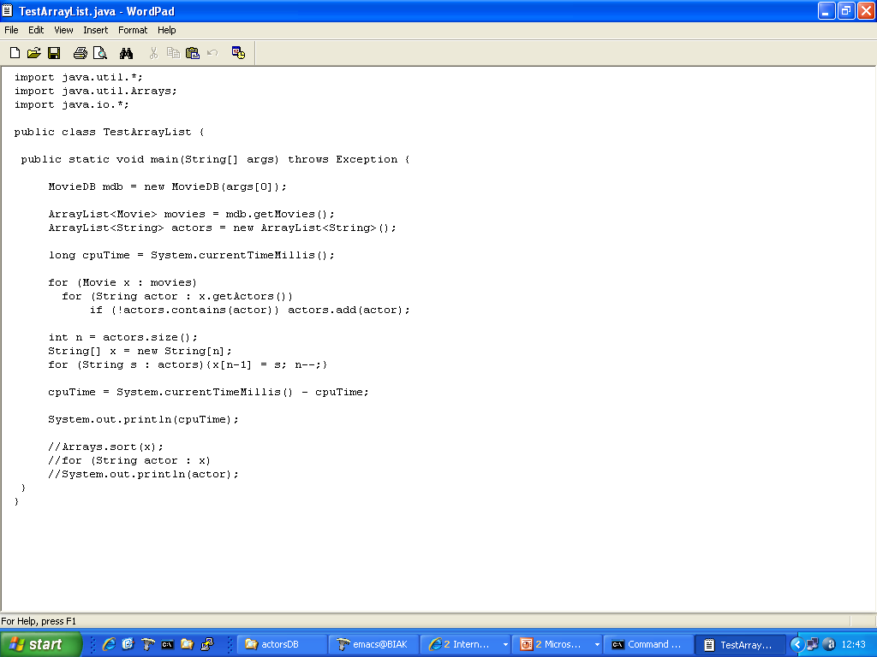
ArrayList Implementation

Slide 49
ArrayList Implementation

Slide 50
ArrayList Implementation
Measure runtime

Slide 51
ArrayList Implementation
Add once only … a set

Slide 52
Using HashSet as a set
… don’t know exactly how it works

Slide 53
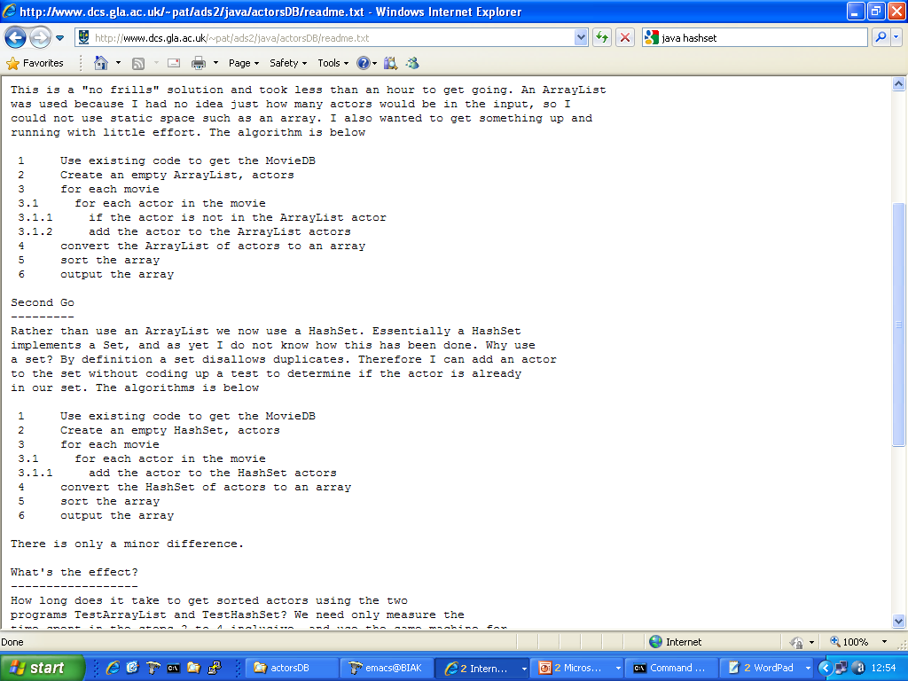

Slide 54
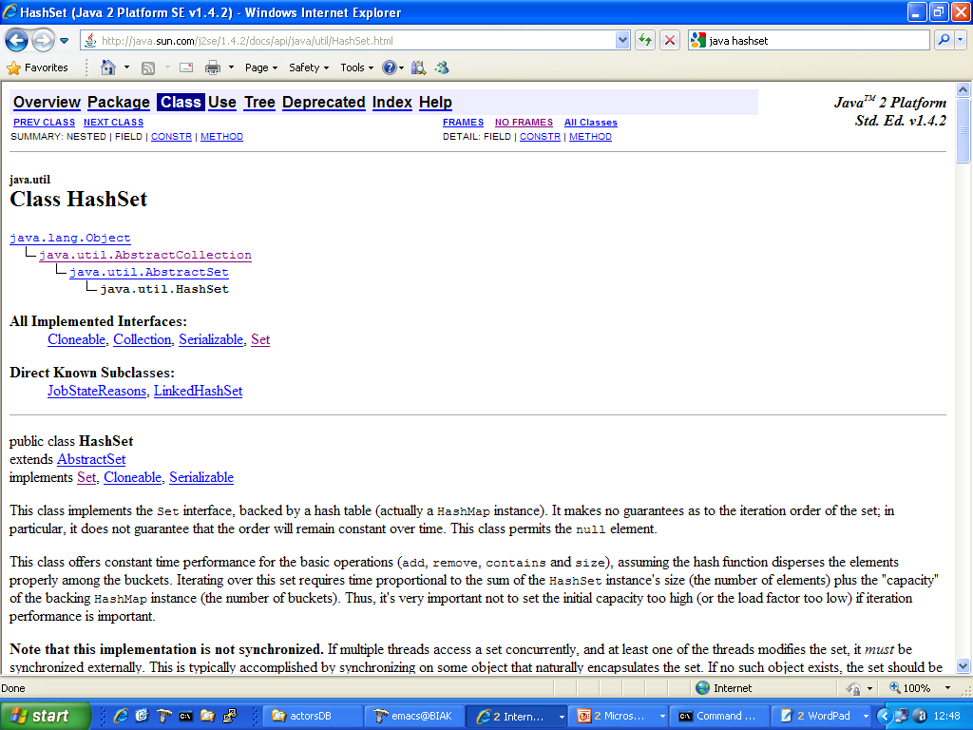

Slide 55
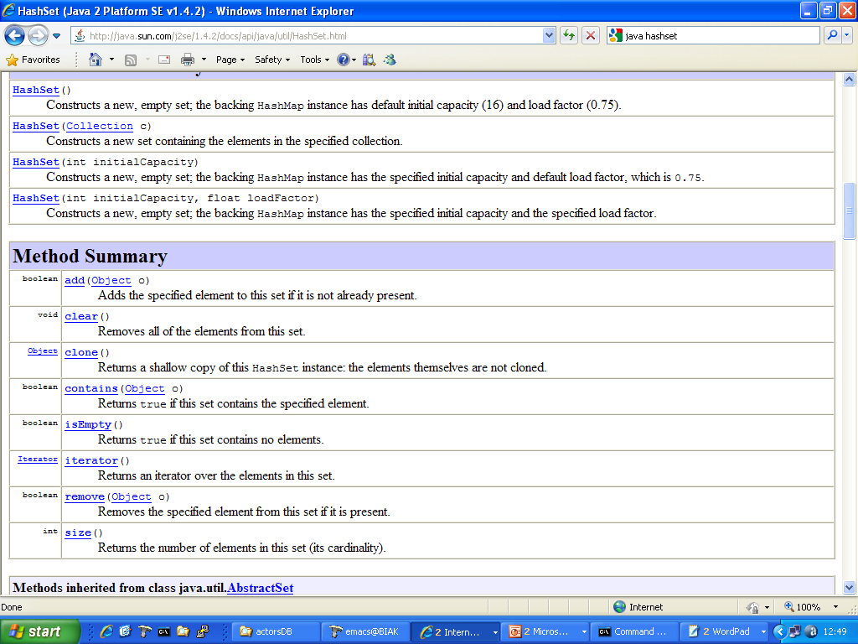

Slide 56
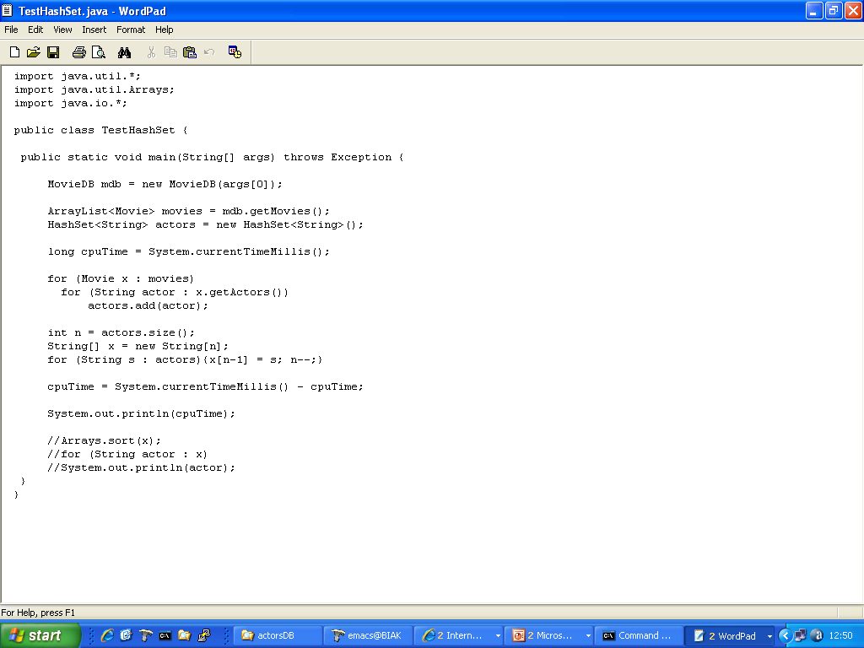

Slide 57
HashSet

Slide 58
Add actor to set. No existence test!

Slide 61
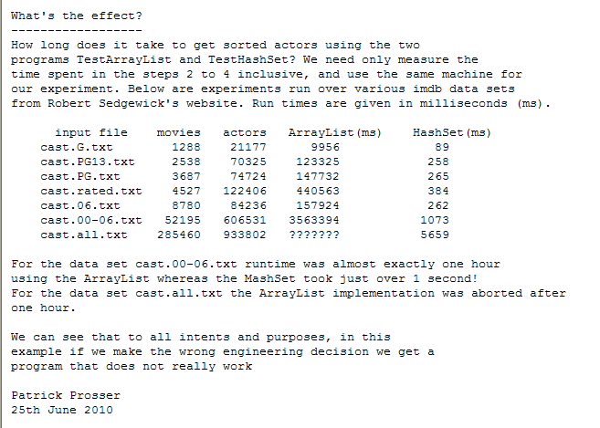

Slide 62
Bigger, faster, cheaper machines
Bigger data sets, greater expectations

Slide 63
I am NOT saying “Do not use ArrayList”.
I am saying “You can make a bad engineering decision with respect to
choice of data structures and that can have a huge effect”.
The same hold true for algorithms and we will explore this later
End of sermon

Slide 64


