Slide 1


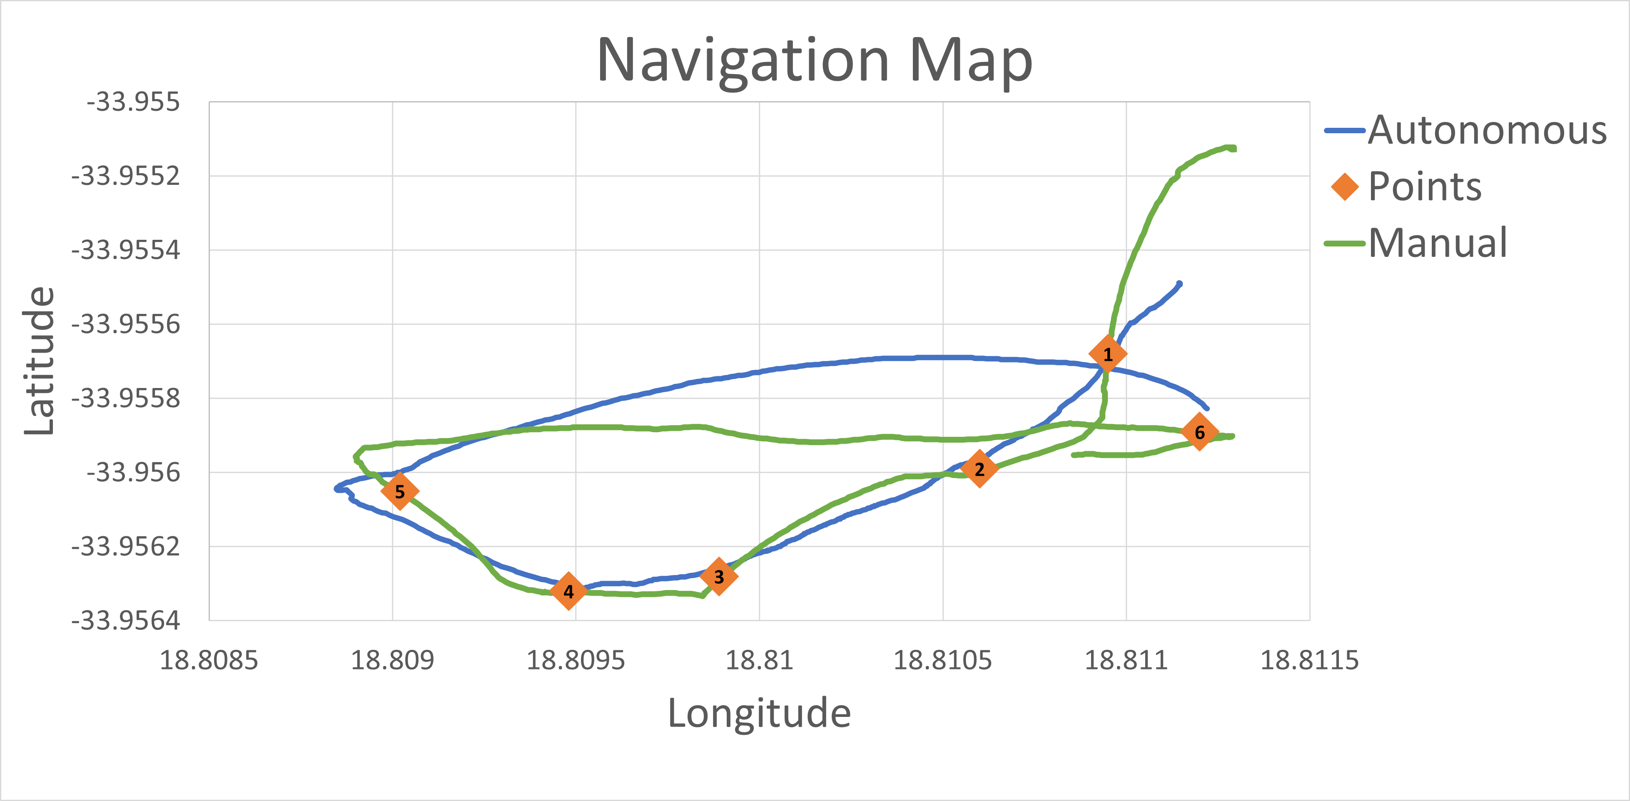
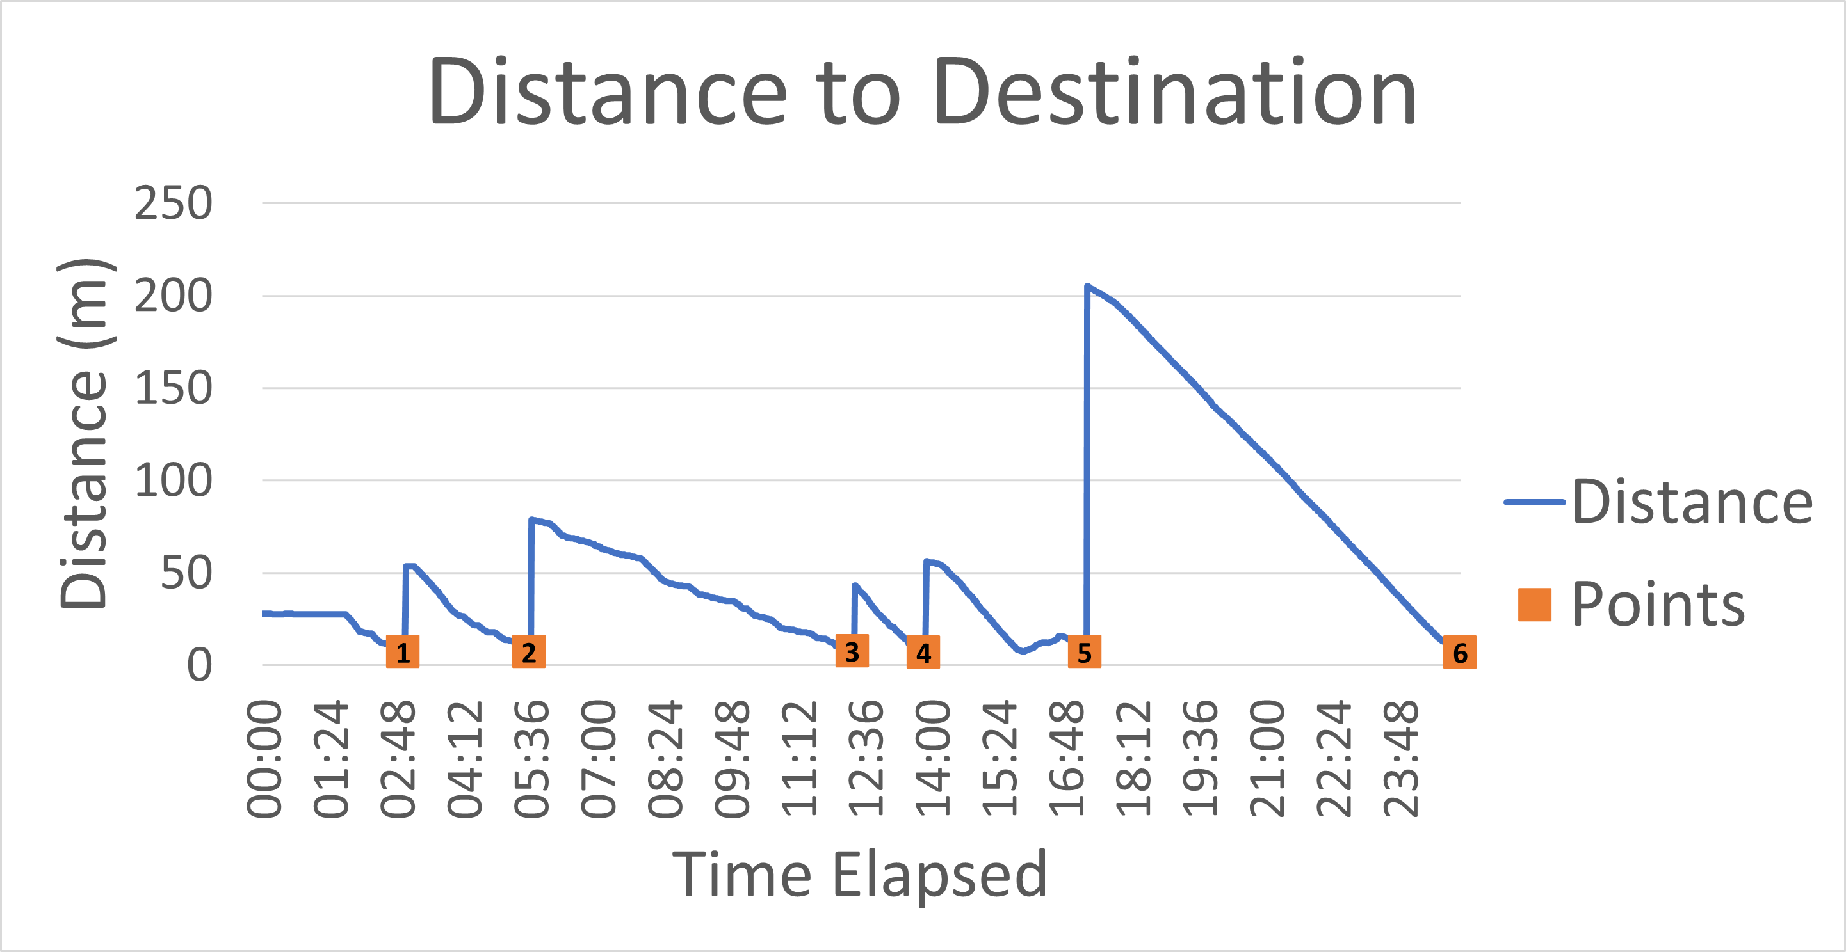
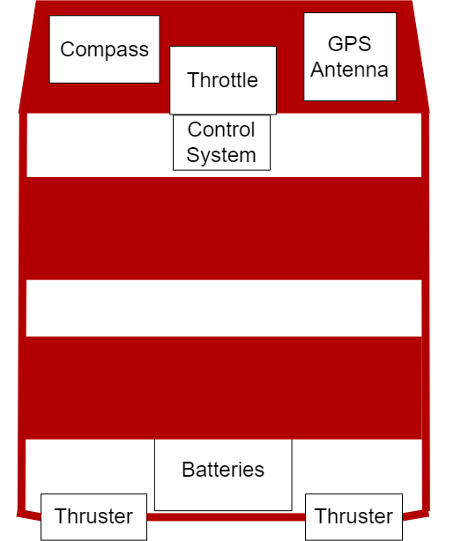
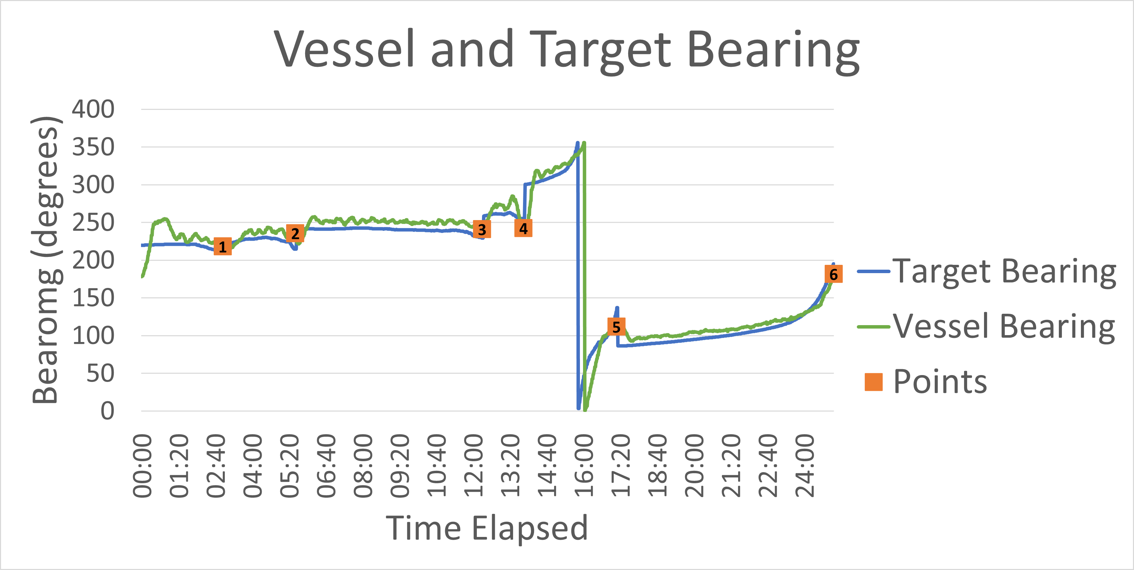
Control System of a USV
Author: Mr LEV Kingwill Supervisor: Prof J Versfeld
Department of Mechanical and Mechatronic Engineering, University of Stellenbosch
Introduction
A USV is an unmanned surface vessel that is typically uses autonomous navigation. A USV can be used to replace manned vessels for naval operations to reduce the costs and carbon footprint of the operations.
Testing
The subsystems of the USV are tested individually before the overall system is tested. The subsystems tested are:
GPS and Compass
Throttle Input
PWM Signal Output
Thruster Control
f
USV distance to target location.
The USV bearing compared to the baring to the target location.
Results
F
Map showing the route of the manual and autonomous navigation. The manual navigation was used to select the points. The autonomous navigation then travelled the same route navigating to each point.
Conclusion
The controls system successfully navigated to each point with minimal error. The final test was conducted under windy conditions and the system countered these to reach the final position.
Further Improvements
Further developments can be done to add obstacle avoidance and a return to home feature. Solar panels can be added to extend the operating range of the USV.
Objectives
The objective of this project was to create a control system that will autonomously control an electric surface vessel. The vessel will receive GPS locations and is required to navigate to these locations.
System Diagram
USV Component Layout

