Slide 1
Project by
Balaji naik
20761A05A3

Slide 2
Restaurant
Mainly this website provides :-
Online delivery
And backend support
Securely designed with login form
Discover the best foods and cooldrinks

Slide 3
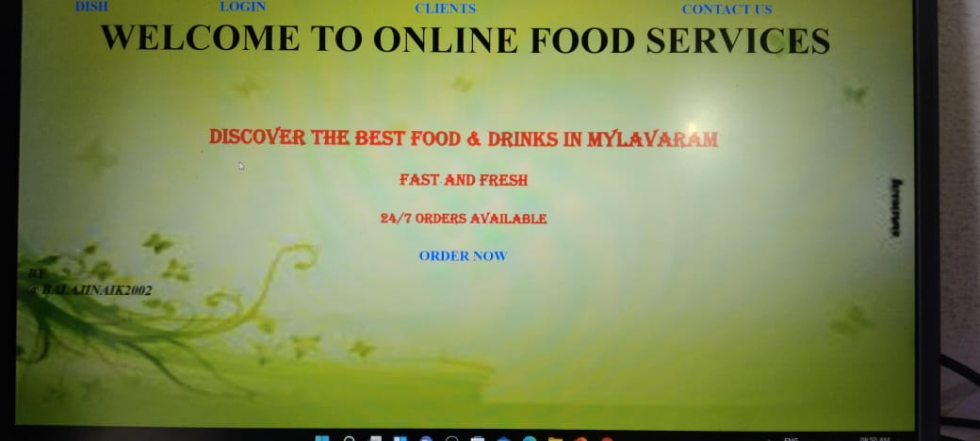
This is the main page of my web site
In this page oredr now button is there by clicking on the button we can redriected to dish page

Slide 4
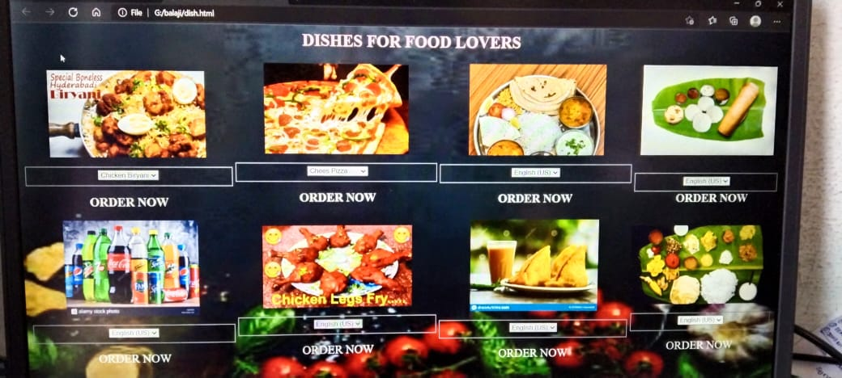

Slide 5
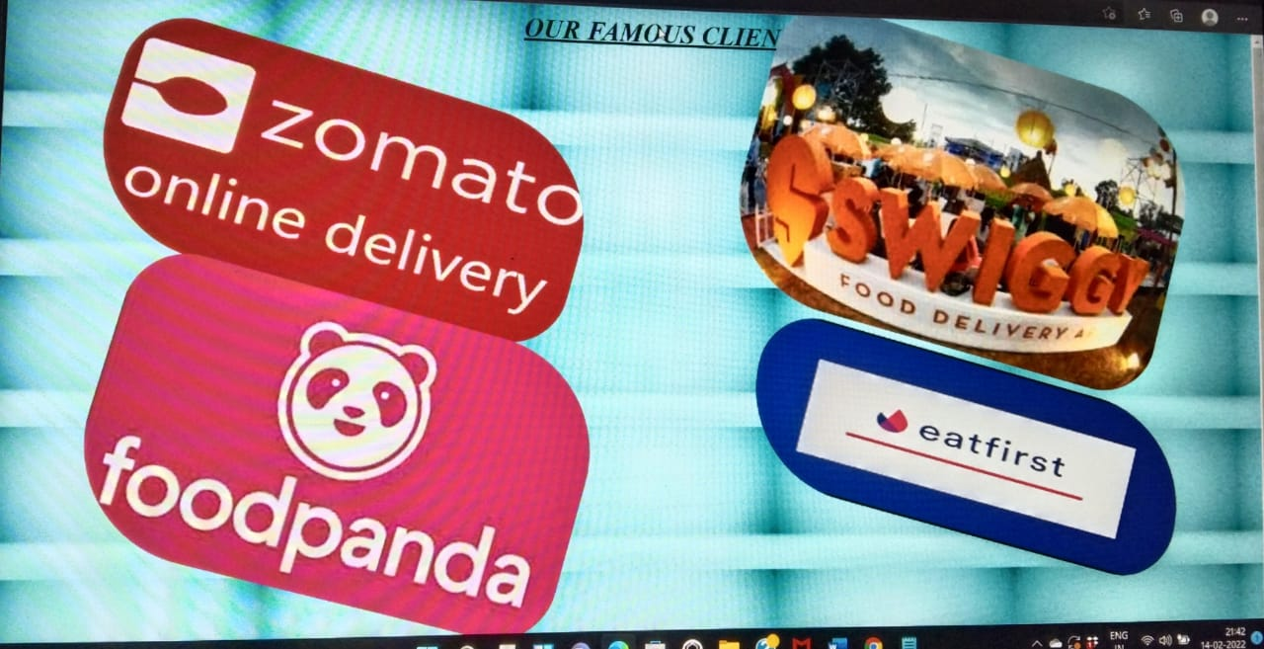

Slide 6
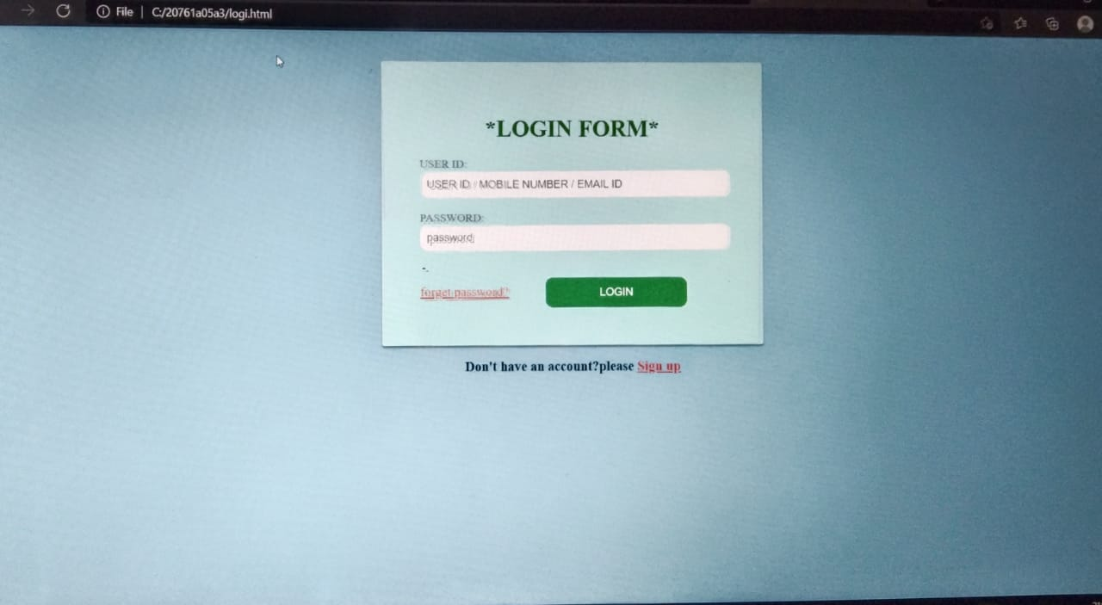
this is the login form:
You can use your email id and
Password you can fill login form
Once fill the login form you can

Slide 7
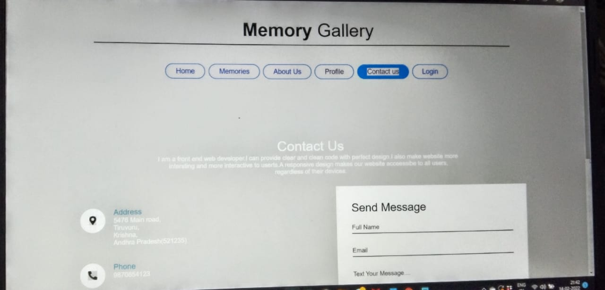

Slide 8
The End
Thank you for visiting

