Slide 1
tourism
…be a traveler…

Slide 2
abstraction
As tourism is one of the fastest growing industries today, thus within the tourism industry events are getting more and more important.
Events can offer various economical and social benefits for destinations, and therefore destination managers can and should employ events effectively in a tourism role..

Slide 3
Introduction
Indian tourism is the rapid growing industry. India is a country which has several unique temples famous for its cultural heritage, various wildlife sanctuaries and it is surrounded by Indian ocean, Himalayas, bay of Bengal and Arabian sea. It’s a multilingual country where people speak different languages. Every foreigner has a dream to visit this fascinating country. It has many tourist attractions like waterfalls, deserts, famous river bodies like ganga, Yamuna, and Indus etc.
India tourism campaign was promoted by many Indian celebrities and its tagline is “Atithi devo bhava” which means honoring the guest as god. This happens only in India. Whenever a guest enters in India, it’s our prime duty to treat them with respect and provide best services. Indians treat their foreign guests with enthusiasm. India tourism is today one of the largest service industry. Its campaign “incredible India” was developed by ministry of tourism. This industry is based on certain standards which are: safai(cleanliness), surakshaa(security), sahyog(cooperation), suchna(information), sanrachna(infrastructure), swagat(welcome), and suvidha(facilitation).

Slide 4
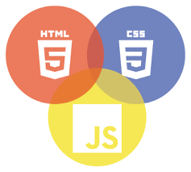

Slide 5
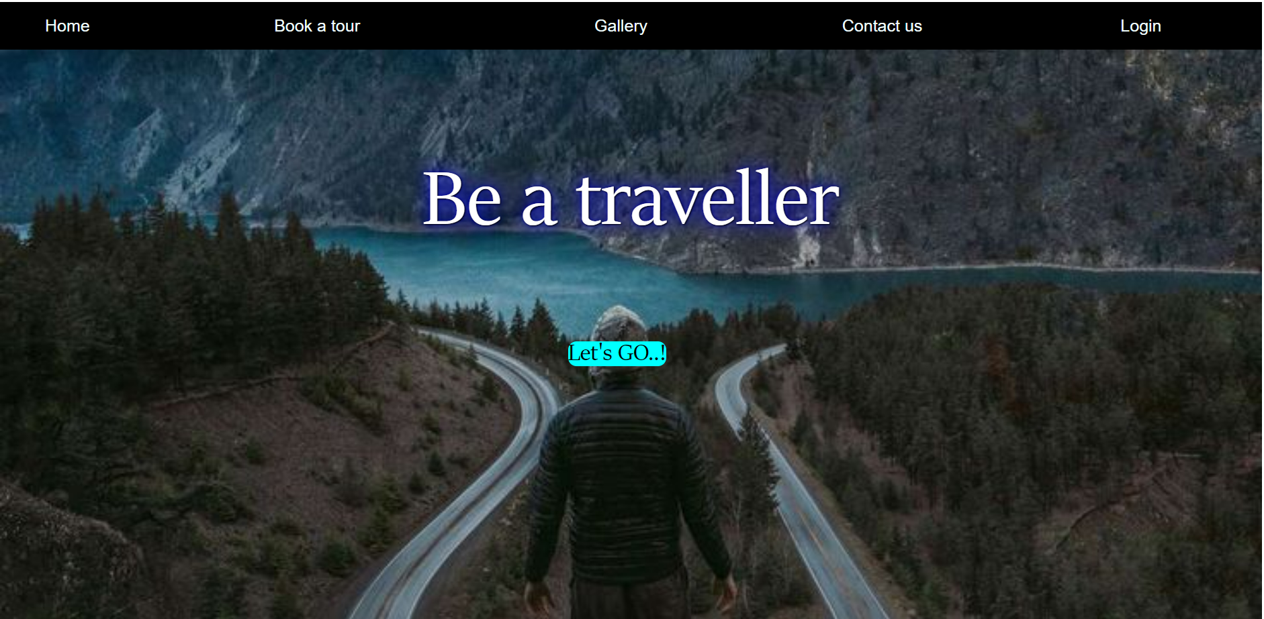

Slide 6
Incoming Developments
Inserting accommodation details in the website itself.
Keeping the travel agencies details
Source for travel information i.e.(Like car, mini van, bus etc.)

Slide 7


