Slide 1
GetGrub
Focused intuition and simplicity
Scales effectively to mobile browsing

Slide 2
Personas – Business Ben
Uses to use the site to find a place to eat out when he is
on business trips
Likes being able to find out which places are closes to
his hotel, which best fit his tastes and which places are
the most highly rated
Could be a one-off or a repeat user

Slide 3
Personas – Regular Ralph
Uses the site often to find places to eat in Glasgow.
Likes to give ratings and reviews
Keeps a list of his favourite places.
Likes to be able use multiple filters on searches such as
rating, proximity, food type, price and opening times.

Slide 4
Personas – One-Off Olivia
Does not want a user profile, just wants to quickly
check out some dining options
Wants to be able to search places by distance, rating
and type of cuisine.
Might want to look at reviews and ratings but is not interested in making any.

Slide 5
Functional Requirements
Enter post code/type of food or both which generates
a list of search results
Filter search results by distance, food type, sit-in/takeaway/, rating and budget
Users should be able to view a restaurant's profile and observe photos, description, ratings and reviews as well as click on external links to the restauran'ts webpage/menu.
Users should be able to create an account, login and logout
Logged in users:
Add ratings and comments for restaurants
Can have a list of favourite restaurants

Slide 6
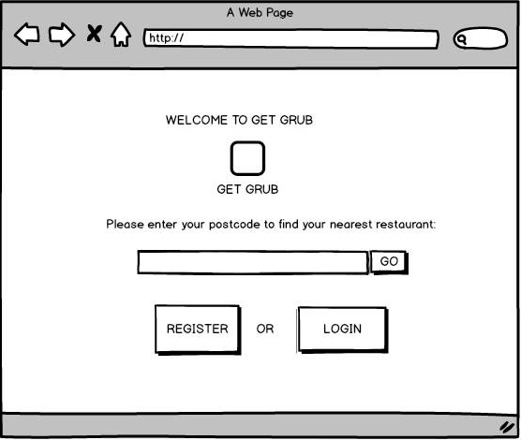
Homepage

Slide 7
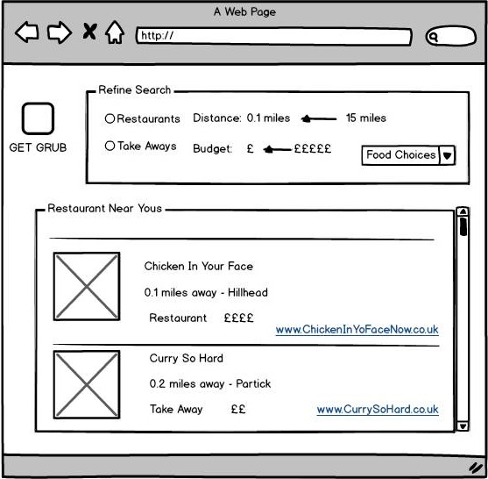
Search Results

Slide 8
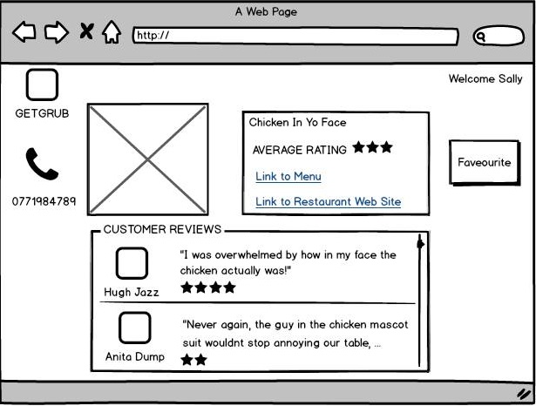
Restaurant Profile

Slide 9
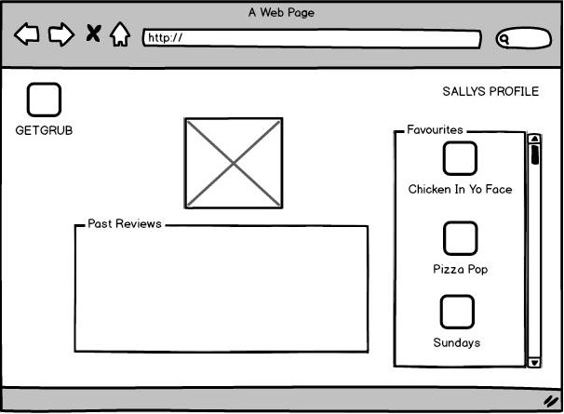
User Profile

Slide 10
