Slide 1
Module 1.3 – Course Introduction
Introduction to Jetson TK1/TX1 and Toolkit

Slide 2
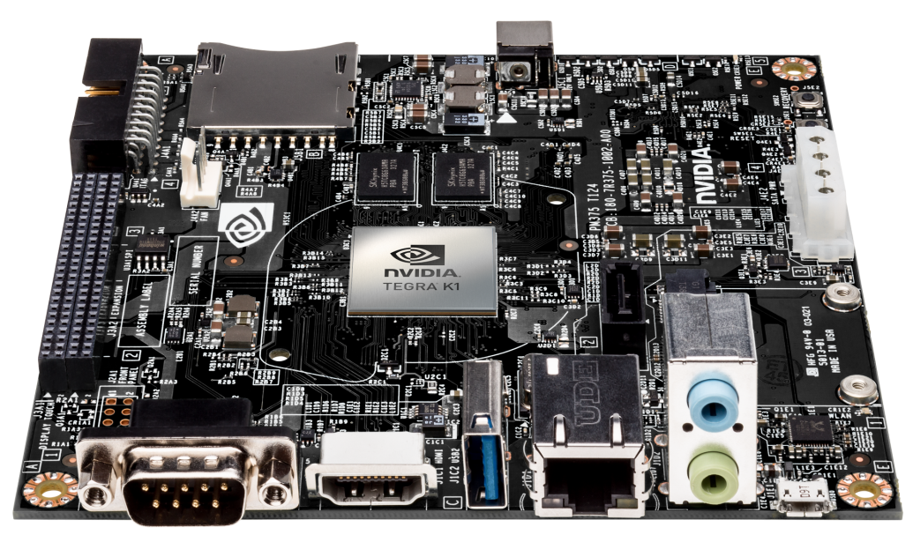
Jetson TK1
The world’s first embedded supercomputer
Tegra K1 Development Kit
Run Ubuntu Linux
CUDA
OpenCV optimized for Tegra
Notes:
The Jetson TK1 is the primary ‘brain’ of Jet and will be the primary computing platform for this robotics course
The board run Ubuntu Linux, so if you are familiar with using Linux, the environment will be very familiar
The board has 2GB of RAM and 16GB of built in flash memory

Slide 3
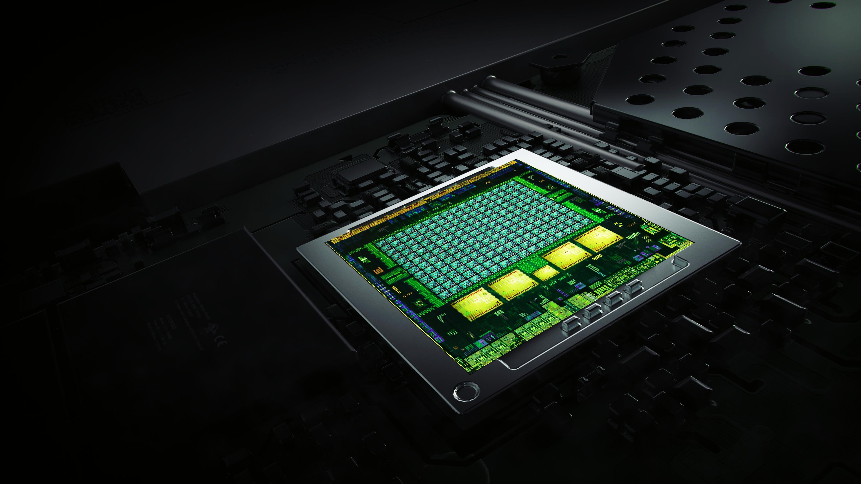
Tegra K1
Impossibly advanced
NVIDIA Kepler Architecture
4-Plus-1 Quad-Core A15
192 NVIDIA CUDA Cores
Over 300 GFLOPS
5 Watts
Notes:
Introduced at CES 2014, Tegra K1, a 192-core super chip, brings the heart of GeForce and the soul of Tesla to mobile.
It’s based on the Kepler architecture, which powers the world’s fastest GPU, GeForce GTX 780 Ti, as well as the Titan supercomputer at Oak Ridge National Labs.
With 192 fully programmable processor cores, Tegra K1 bridges the gap for developers, who can now build next-gen games and apps that will run on any device.

Slide 4
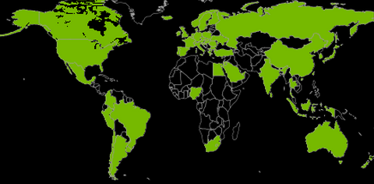
CUDA : World’s Most Pervasive Parallel Programming Platform
Institutions with
CUDA Developers
900+ University Courses
In 62 Countries
8,500+
3,500,000
Toolkit Downloads
638,000,000
GPUs Shipped
Data as of March 2016
Notes:
395M CUDA GPUS: GPUs shipped as of 7/1/2012

Slide 5
Jetson TK1 Block Diagram
JETSON TK1 BLOCK DIAGRAM
USB 2.0 micro B
Tegra K1
SOC
HDMI
USB 3.0
A
SATA
A15
GK20A
192 CUDA Cores
A15
Mini PCIe x1
A15
ALC5639 Audio Codec
Headphone Out
A15
GigE
RTL8111GS PEX - GigE
Arm7
MIC In
ISP
Audio
HD Video
JTAG
SD/MMC
2 GB
DDR3L
16 GB eMMC
Expansion Port (DP/LVDS, Touch SPI, I2C, CSI x1, CSI x4, GPIO 6:0)
AS3722
PMIC
Notes:
This block diagram shows the overall system architecture of the Jetson TK1
The CPU portion of the Tegra K1 consists of 4 ARM A15 CPUs and 1 ARM battery saver CPU core
The GPU consists of 192 CUDA cores
There is a single USB 3.0 port which is connected to the USB hub on Jet (the hub is used to connect to the Arduino Mega and the camera)
The micro USB port is used for flashing the OS during initial configuration
During normal operation, the micro USB port is not used

Slide 6
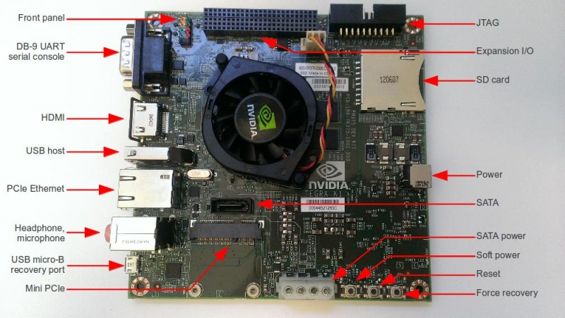
Pinout Diagrams Courtesy of Corneliusz Jarzebski
Notes:
This is a photograph of the TK1 and you can see the USB host port on the left and the micro USB port as well
The soft power button is used to turn on the board and to power down the board, hold down the soft power for 1 second and that will initiate a shutdown
The power jack is on the right side of the board
The Mini-PCIe socket holds the wireless adapter card
A laptop can be connected directly to the TK1 using a crossover ethernet cable
A keyboard and monitor can be connected to the board if necessary, but one the TK1 is configured the system can be run as a headless system

Slide 7
TK1 Development Environment
Code will be developed in C++
Initial configuration of the board is done using a python setup script
docs/setup_jetson.py
Detailed instructions in the lab assignment to build Jet
You can enter code using any standard Unix editor
The files will be saved to the built-in flash
You do not need to add an external memory card
After the system has been configured correctly, relevant source code can be found in the ‘rosjetson’ directory
Notes:
Code that is developed for Jet will be written in C++ and built using the ROS development environment
Initial configuration of the board is done using a python setup script that flashes the operating system and downloads all the relevant packages
You can use any standard Unix editor to type in the code, it is not dependent on any IDE
Once the system has been correctly configured using the installation script, the ROS files can be stored in the ‘rosjetson’ directory

Slide 8
Connecting to the TK1 Remotely
Use ssh to connect to the TK1 for a command line interface
Use VNC to connect with a GUI interface
Notes:
Using ssh, you can remote shell into the TK1 and this will allow remote command line access
Using a VNC client, you can connect to the device and have a graphical display

Slide 9
The GPU Teaching Kit is licensed by NVIDIA and California Polytechnic State University under the Creative Commons Attribution-NonCommercial 4.0 International License.

