Slide 1
Glasgow University TSP
Saturday Scrubs

Slide 2
Algorithms We Used
Simulated Annealing Algorithm
Scrub Algorithm
Genetic Algorithm

Slide 3
Simulated Annealing Algorithm

Slide 4
How it works
Annealing is the process of heating a metal and then allowing it to slowly cool
Has a “temperature” variable which decreases over the runtime and a current path variable
At high temperatures the current path CAN be replace with solutions that are actually worse; this is so that it can jump out of a local optimum.
As the program runs, and temperature decreases, the current path will only be able to be replaced with better (shorter) paths

Slide 5
Genetic Algorithm

Slide 6
How it works
The genetic algorithm uses a sort of “natural selection” to gradually evolve the possible solution until it can find the “best”.
1. Initialise the population, creating a selection of possible solutions.
2. Calculate the fitness of each of the possible solutions.
3. Use the fittest solutions to create new solutions
4. Use mutation to introduce a little bit of randomness into the creation of solutions
5. repeat!!

Slide 7
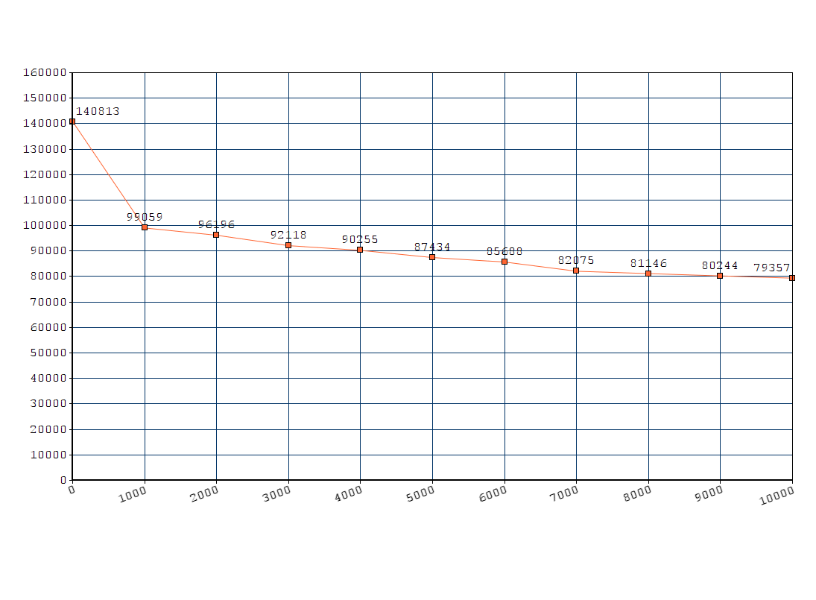

Slide 8
Scrub Algorithm

