Slide 1
Introduction to Computer Visualization
SinGAN: Learning a Generative Model from a Single Natural Image
Marcin Zbigniew Hamerlik 209854
Osman Velat Kabak 248673

Slide 2
SinGAN
Introduction
Single-Image Learning Model
Extension of GAN (Generative Adversarial Nets )
Data Recognition
Multiple Functions:
Image Generation (from noise)
Resolution Upscaling
Editing
Open-source Python Project
Analytical tools

Slide 3
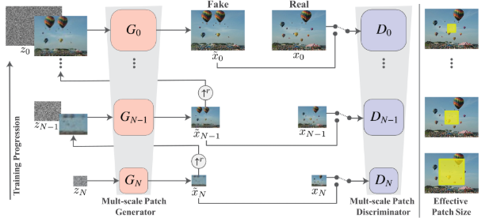
SinGAN
Technology
Multi-Scale Pipeline: Generator -> Discriminator Pair
Process: b.noise + g.image -> conv + g.image -> result.
Sequential pair increase/quality increase
Resolution reduction
Loss functions -> Reconstruction & Adversarial Loss

Slide 4
Experiment
Design
Testing of functions:
Image Generation
Editing
Resolution Upscaling
Real and fake image detection:
Survey
Differentiation detection software
Single Image Frechet Inception Distance (SIFID)

Slide 5
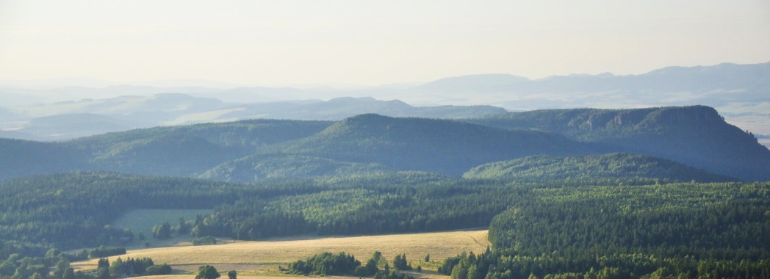


Experiment
Image Generation
Input image
Result (scale=1)
Result (scale=5)

Slide 6
Experiment
Image Generation Believability Results
Scale | Response
 | Real | Generated | Don’t know
Scale = 1 | 73% | 26% | 0%
Scale = 5 | 86% | 7% | 7%
Table 1 Believability of the output image
Scale | SIFID | Survey | SIFID/AMT Correlation
Scale = 1 | 0.02 | Paired Unpaired | -0.22 -0.05
Scale = 5 | 0.01 | Paired Unpaired | -0.19 -0.01
Table 2 SIFID results

Slide 7
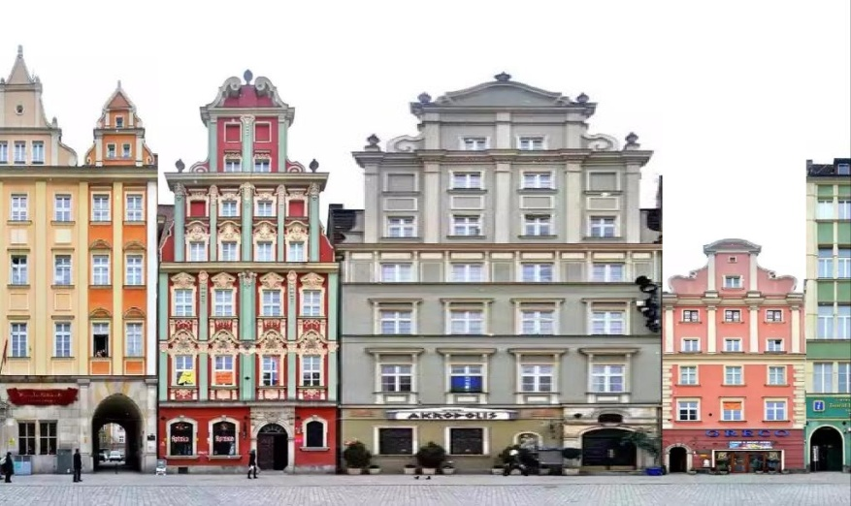
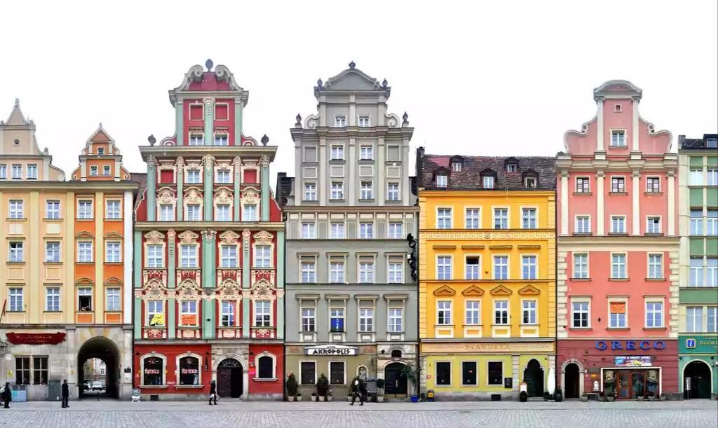

Experiment
Image Editing Input
Naive Edit Image
Input Image
Naive Edit Mask

Slide 8
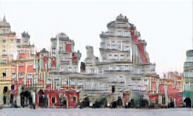
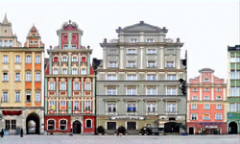

Experiment
Image Editing Output
Output (Scale = 1)
Output (Scale = 8)
Image differencing between the original image and SinGAN scale 8 edit (left) and naive edit(right)

Slide 9

Experiment
Resolution Upscaling
Output (Scale = 8)

Slide 10
Results
Pros
Cons
Requires only one image
Wide array of tools
Built-in recognition
Based on Python
Open-source
Long Training Process (1,3h)
Console-based interface
Requires specific Python Extensions
Resolution loss

Slide 11
Results
Conclusions
Applicable in business sector only
Single-Image Learning as an advantage/disadvantage
Specific application
Useful tools in Computer Visualization
Basis for new technologies

Slide 12
References
[1] Shaham, Tamar Rott et al. “SinGAN: Learning a Generative Model From a Single Natural Image.” 2019 IEEE/CVF International Conference on Computer Vision (ICCV) (2019): 4569-4579.
[2] Esfahani, Shirin Nasr and Shahram Latifi. “Image Generation with GANs-based Techniques: A Survey.” International Journal of Computer Science and Information Technology 11 (2019): 33-50.
[3] Goodfellow, Ian J. et al. “Generative Adversarial Nets.” NIPS (2014).
[4] Hinz, Tobias et al. “Improved Techniques for Training Single-Image GANs.” ArXiv abs/2003.11512 (2020): n. pag.
[5] Mao, Jiayuan et al. “Program-Guided Image Manipulators.” 2019 IEEE/CVF International Conference on Computer Vision (ICCV) (2019): 4029-4038.

Slide 13
Thank you
Questions?

