Slide 1
Lab Procedures
DONE BY
CH.V.K.Harika
(20A31A0528)

Slide 2
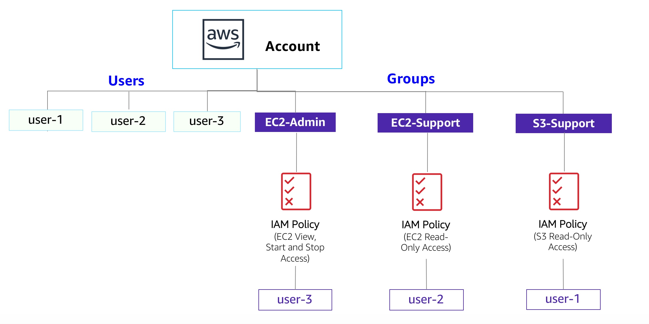
Introduction to AWS IAM
At the top of these instructions, choose Start Lab to launch your lab.
Wait until you see the message "Lab status: ready", then click the X to close the Start Lab panel.
At the top of these instructions, choose AWS
This will open the AWS Management Console in a new browser tab. The system will automatically log you in.
Arrange the AWS Management Console tab so that it displays along side these instructions. Ideally, you will be able to see both browser tabs at the same time, to make it easier to follow the lab steps.
Arrange the AWS Management Console tab so that it displays along side these instructions. Ideally, you will be able to see both browser tabs at the same time, to make it easier to follow the lab steps.
In the navigation pane on the left, choose Users.
The following IAM Users have been created for you:
user-1
user-2
user-3
Choose user-1.
This will bring to a summary page for user-1. The Permissions tab will be displayed.
Notice that user-1 does not have any permissions.
Choose the Groups tab.
user-1 also is not a member of any groups
Choose the Security credentials tab.
user-1 is assigned a Console password

Slide 3
In the navigation pane on the left, choose User groups.
The following groups have already been created for you:
EC2-Admin
EC2-Support
S3-Support
Choose the EC2-Support group.
This will bring you to the summary page for the EC2-Support group.
Choose the Permissions tab.
Choose the plus (+) icon next to the AmazonEC2ReadOnlyAccess policy to view the policy details.
Choose the minus icon (-) to hide the policy details.
In the navigation pane on the left, choose User groups.
Choose the S3-Support group and then choose the Permissions tab.
The S3-Support group has the AmazonS3ReadOnlyAccess policy attached.
Choose the plus (+) icon to view the policy details.
This policy grants permissions to Get and List resources in Amazon S3.
Choose the minus icon (-) to hide the policy details.
In the navigation pane on the left, choose User groups.
Choose the EC2-Admin group and then choose the Permissions tab.
Choose the plus (+) icon to view the policy details.
This policy grants permission to view (Describe) information about Amazon EC2 and also the ability to Start and Stop instances.
Choose the minus icon (-) to hide the policy details.

Slide 4
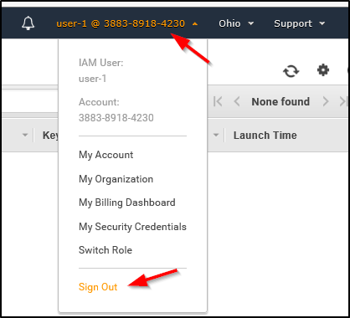
n the left navigation pane, choose User groups.
Choose the S3-Support group.
Choose the Users tab.
In the Users tab, choose Add users.
In the Add Users to S3-Support window, configure the following:
Select user-1.
At the bottom of the screen, choose Add Users.
Using similar steps to the ones above, add user-2 to the EC2-Support group.
user-2 should now be part of the EC2-Support group.
Using similar steps to the ones above, add user-3 to the EC2-Admin group.
user-3 should now be part of the EC2-Admin group.
In the navigation pane on the left, choose User groups.
Each Group should now have a 1 in the Users column for the number of Users in each Group.
If you do not have a 1 beside each group, revisit the above instructions above to ensure that each user is assigned to a User group, as shown in the table in the Business Scenario section.

Slide 5
In the navigation pane on the left, choose Dashboard.
Copy the Sign-in URL for IAM users in this account to a text editor.
Open a private (Incognito) window.
Mozilla Firefox
Choose the menu bars at the top-right of the screen
Select New private window
Google Chrome
Choose the ellipsis at the top-right of the screen
Select New Incognito Window
Microsoft Edge
Choose the ellipsis at the top-right of the screen
Choose New InPrivate window
Microsoft Internet Explorer
Choose the Tools menu option
Choose InPrivate Browsing
Paste the IAM users sign-in link into the address bar of your private browser session and press Enter.
In the Services menu, choose S3.
In the Services menu, choose EC2.
In the left navigation pane, choose Instances.
ign user-1 out of the AWS Management Console by completing the following actions:
At the top of the screen, choose user-1
Choose Sign Out

Slide 6
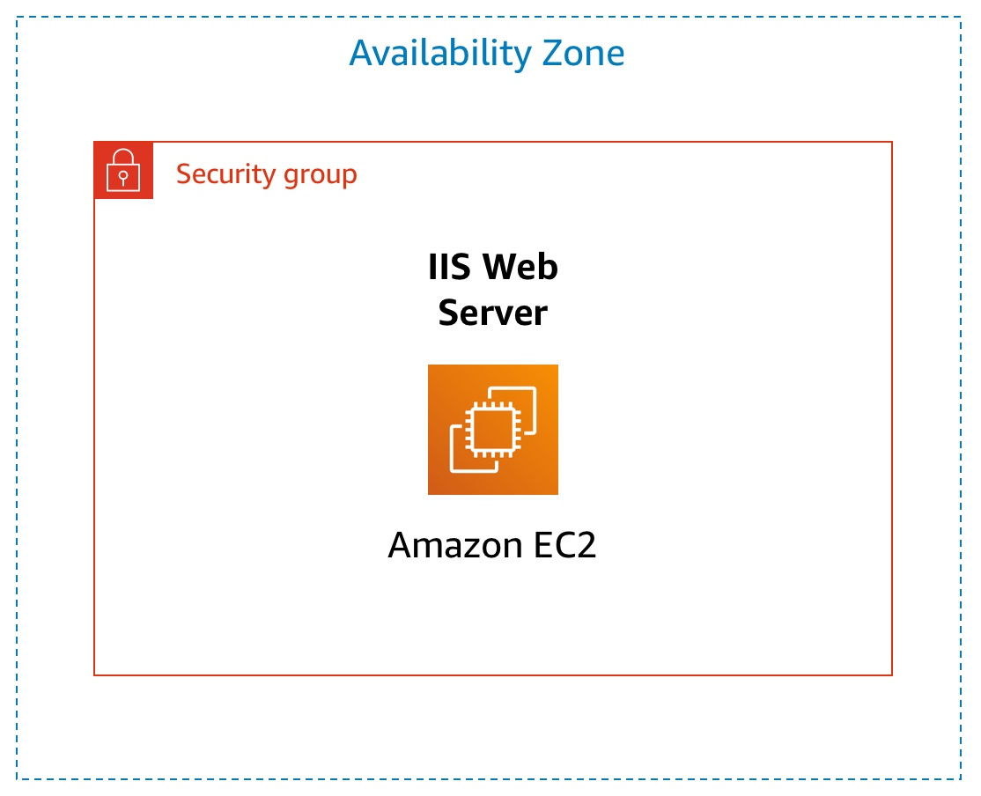
Paste the IAM users sign-in link into your private browser tab's address bar and press Enter.
n the Services menu, choose EC2.
In the navigation pane on the left, choose Instances
In the Instance state menu, choose Stop instance.
In the Stop instance window, choose Stop.
The instance will enter the stopping state and will shutdown.
Close your private browser window.
choose End Lab at the top of this page, and then select Yes to confirm that you want to end the lab.
Introduction to Amazon EC2
At the top of these instructions, choose Start Lab to launch your lab.
A Start Lab panel opens displaying the lab status.
Wait until you see the message "Lab status: ready", then choose the X to close the Start Lab panel.
At the top of these instructions, choose AWS

Slide 7
Arrange the AWS Management Console tab so that it displays along side these instructions. Ideally, you will be able to see both browser tabs at the same time, to make it easier to follow the lab steps.
In the AWS Management Console choose Services, choose Compute and then choose EC2.
Choose the Launch instance menu and select Launch instance.
Give the instance the name Web Server
In the list of available Quick Start AMIs, keep the default Amazon Linux AMI selected.
Also keep the default Amazon Linux 2023 AMI selected.
In the Instance type panel, keep the default t2.micro selected.
For Key pair name - required, choose vockey.
Next to Network settings, choose Edit.
For VPC, select Lab VPC.
Under Firewall (security groups), choose Create security group and configure
In the Configure storage section, keep the default settings.
Expand Advanced details.
For Termination protection, select Enable.
Scroll to the bottom of the page and then copy and paste the code shown below into the User data box:

Slide 8
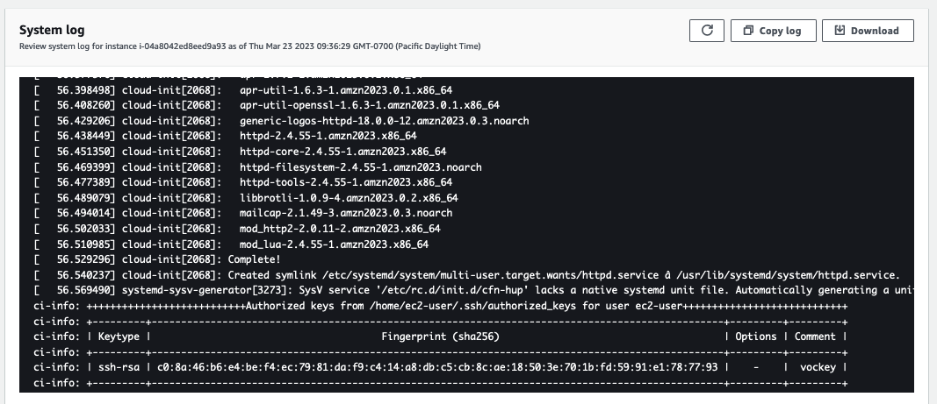
At the bottom of the Summary panel on the right side of the screen choose Launch instance
Choose View all instances
n the Instances list, select Web Server.
Wait for your instance to display the following:
Instance State: Running
Status Checks: 2/2 checks passed
Choose the Status checks tab.
Choose the Monitoring tab.
In the Actions menu towards the top of the console, select Monitor and troubleshoot Get system log.
Scroll through the output and note that the HTTP package was installed from the user data that you added when you created the instance.
Choose Cancel.
Ensure Web Server is still selected. Then, in the Actions menu, select Monitor and troubleshoot Get instance screenshot.
Choose Cancel.

Slide 9
Copy the Public IPv4 address of your instance to your clipboard.
Open a new tab in your web browser, paste the IP address you just copied, then press Enter.
Ensure Web Server is still selected. Choose the Details tab.
Keep the browser tab open, but return to the EC2 Console tab.
In the left navigation pane, choose Security Groups.
Select Web Server security group.
Choose the Inbound rules tab.
Choose Edit inbound rules, select Add rule and then configure:
Type: HTTP
Source: Anywhere-IPv4
Choose Save rules
Return to the web server tab that you previously opened and refresh the page.
On the EC2 Management Console, in the left navigation pane, choose Instances.
Web Server should already be selected.In the Instance State menu, select Stop instance.
Choose Stop
Wait for the Instance state to display: Stopped.
In the Actions menu, select Instance settings Change instance type, then configure:
Instance Type: t2.small
Choose Apply
With the Web Server instance still selected, choose the Storage tab, select the name of the Volume ID, then select the checkbox next to the volume that displays.

Slide 10
Choose Modify
Choose Modify again to confirm and increase the size of the volume.
In left navigation pane, choose Instances.
Select the Web Server instance.
In the Instance state menu, select Start instance.
In the left navigation pane, choose Limits.
From the All limits drop down list, choose Running instances
n left navigation pane, choose Instances.
Select the Web Server instance and in the Instance state menu, select Terminate instance.
Then choose Terminate
In the Actions menu, select Instance settings Change termination protection.
Remove the check next to Enable.
Choose Save
You can now terminate the instance.
Select the Web Server instance again and in the Instance state menu, select Terminate instance.
Choose Terminate
Choose End Lab at the top of this page and then choose Yes to confirm that you want to end the lab
Choose the X in the top right corner to close the panel.

Slide 11
Build your VPC and Launch a Web Server
At the top of these instructions, choose Start Lab to launch your lab.
A Start Lab panel opens displaying the lab status.
Wait until you see the message "Lab status: ready", then choose the X to close the
Start Lab panel
At the top of these instructions, choose AWS
in the search box to the right of Services, search for and choose VPC to open the VPC console
In the top right of the screen, verify that N. Virginia (us-east-1) is the region.
Choose the VPC dashboard link which is also towards the top left of the console.
Next, choose Create VPC
choose VPC and more.
Under Name tag auto-generation, keep Auto-generate selected, however change the value from project to lab.
Keep the IPv4 CIDR block set to 10.0.0.0/16
For Number of Availability Zones, choose 1

Slide 12
For Number of public subnets, keep the 1 setting.
For Number of private subnets, keep the 1 setting.
Expand the Customize subnets CIDR blocks section
Change Public subnet CIDR block in us-east-1a to 10.0.0.0/24
Change Private subnet CIDR block in us-east-1a to 10.0.1.0/24
Set NAT gateways to In 1 AZ.
Set VPC endpoints to None.
Keep both DNS hostnames and DNS resolution enabled.
In the Preview panel on the right, confirm the settings you have configured.
VPC: lab-vpc
Subnets:us-east-1a
Public subnet name: lab-subnet-public1-us-east-1a
Private subnet name: lab-subnet-private1-us-east-1a
Route tables
lab-rtb-public
lab-rtb-private1-us-east-1a
Network connections
lab-igw
lab-nat-public1-us-east-1a

Slide 13
In the left navigation pane, choose Subnets.
First, you will create a second public subnet.
Choose Create subnet then configure:
VPC ID: lab-vpc (select from the menu).
Subnet name: lab-subnet-public2
Availability Zone: Select the second Availability Zone (for example, us-east-1b)
IPv4 CIDR block: 10.0.2.0/24
The subnet will have all IP addresses starting with 10.0.2.x.
Choose Create subnet
The second public subnet was created. You will now create a second private subnet.
Choose Create subnet then configure:
VPC ID: lab-vpc
Subnet name: lab-subnet-private2
Availability Zone: Select the second Availability Zone (for example, us-east-1b)
IPv4 CIDR block: 10.0.3.0/24
The subnet will have all IP addresses starting with 10.0.3.x.
Choose Create subnet
The second private subnet was created.

Slide 14
n the left navigation pane, choose Route tables.
Select the lab-rtb-private1-us-east-1a route table.
In the lower pane, choose the Routes tab.
Leave lab-subnet-private1-us-east-1a selected, but also select lab-subnet-private2.
Choose Save associations
Choose the Subnet associations tab.
In the Explicit subnet associations area, choose Edit sociations
Leave lab-subnet-public1-us-east-1a selected, but also select lab-subnet-public2
Select the lab-rtb-public route table (and deselect any other subnets).
In the lower pane, choose the Routes tab.
Choose the Subnet associations tab.
In the Explicit subnet associations area, choose Edit subnet associations
Leave lab-subnet-public1-us-east-1a selected, but also select lab-subnet-public2.
Choose Save associations
n the left navigation pane, choose Security groups.
Choose Create security group and then configure:
Security group name: Web Security Group
Description: Enable HTTP access

Slide 15
VPC: choose the X to remove the currently selected VPC, then from the drop down list choose lab-vpc
In the Inbound rules pane, choose Add rule
Configure the following settings:
Type: HTTP
Source: Anywhere-IPv4
Description: Permit web requests
Scroll to the bottom of the page and choose Create security group
You will use this security group in the next task when launching an Amazon EC2 instance.
In the search box to the right of Services, search for and choose EC2 to open the EC2 console.
From the Launch instance menu choose Launch instance. At the bottom of the Summary panel on the right side of the screen choose Launch instance
You will see a Success message.
Choose View all instances
Wait until Web Server 1 shows 2/2 checks passed in the Status check column.
Select Web Server 1.
Copy the Public IPv4 DNS value shown in the Details tab at
bottom

Slide 16
Build a Database Server
In the AWS Management Console, on the Services menu, choose VPC.
In the left navigation pane, choose Security Groups.
Choose Create security group and then configure:
Security group name: DB Security Group
Description: Permit access from Web Security Group
VPC: Lab VPC
You will now add a rule to the security group to permit inbound database requests.
In the Inbound rules pane, choose Add rule
The security group currently has no rules. You will add a rule to permit access from the Web Security Group.
Configure the following settings:
Type: MySQL/Aurora (3306)
CIDR, IP, Security Group or Prefix List: Type sg and then select WeSecurityGroup.
Create a DB Subnet Group
On the Services menu, choose RDS.
In the left navigation pane, choose Subnet groups.
Name: DB-Subnet-Group
Description: DB Subnet Group
VPC: Lab VPC
Scroll down to the Add Subnets section.
Expand the list of values under Availability Zones and select the first two zones: us-east-1a and us-east-1b.

Slide 17
Expand the list of values under Subnets and select the subnets associated with the CIDR ranges 10.0.1.0/24 and 10.0.3.0/24.
These subnets should now be shown in the Subnets selected table.
Choose Create
In the left navigation pane, choose Databases.
Choose Create database
If you see Switch to the new database creation flow at the top of the screen, please choose it.
Select MySQL.
Under Settings, configure:
DB instance identifier: lab-db
Master username: main
Master password: lab-password
Confirm password: lab-password
Under DB instance class, configure:
Select Burstable classes (includes t classes).
Select db.t3.micro
Under Storage, configure:
Storage type: General Purpose (SSD)
Allocated storage: 20
Under Connectivity, configure:
Virtual Private Cloud (VPC): Lab VPC
Under Existing VPC security groups, from the dropdown list:
.

Slide 18
Choose DB Security Group.
Deselect default
Choose the RDS link at the top of the page.
Configure the following settings:
Endpoint: Paste the Endpoint you copied to a text editor earlier
Database: lab
Username: main
Password: lab-password
Choose Submit
Scale & Load Balance your Architecture
In the AWS Management Console, on the Services menu, click EC2.
In the left navigation pane, click Instances.
First, you will confirm that the instance is running.
Wait until the Status Checks for Web Server 1 displays 2/2 checks passed. Click refresh to update.
Select Web Server 1.
In the Actions menu, click Image and templates > Create image, then configure:
Image name: WebServerAMI
Image description: Lab AMI for Web Server
Click Create image

Slide 19
In the left navigation pane, choose Target Groups.
Choose Create target group
Choose a target type: Instances
Target group name, enter: LabGroup
Select Lab VPC from the VPC drop-down menu.
Choose Next. The Register targets screen appears.
Review the settings and choose Create target group
In the left navigation pane, click Load Balancers.
At the top of the screen, choose Create Load Balancer.
In the left navigation pane, click Launch Configurations.
Click Create launch configuration
Configure these settings:
Launch configuration name: LabConfig
Amazon Machine Image (AMI) Choose Web Server AMI
Instance type:
Choose Choose instance type
Select t3.micro
Choose Choose
Choose Select an existing security group
Select Web Security Group
Under Key pair configure:
Key pair options: Choose an existing key pair
Existing key pair: vockey

Slide 20
Select I acknowledge...
Click Create launch configuration
You will now create an Auto Scaling group that uses this Launch Configuration.
Select the checkbox for the LabConfig Launch Configuration.
From the Actions menu, choose Create Auto Scaling group
Enter Auto Scaling group name:
Name: Lab Auto Scaling Group
Choose Next
On the Network page configure
Network: Lab VPC
You can ignore the message regarding "No public IP address"
Subnet: Select Private Subnet 1 (10.0.1.0/24) and Private Subnet 2 (10.0.3.0/24)
This will launch EC2 instances in private subnets across both Availability Zones.
Choose Next
In the left navigation pane, click Target Groups (in the Load Balancing section).
Choose LabGroup
Click the Targets tab.
Two Lab Instance targets should be listed for this target group.
Wait until the Status of both instances transitions to healthy. Click Refresh

Slide 21
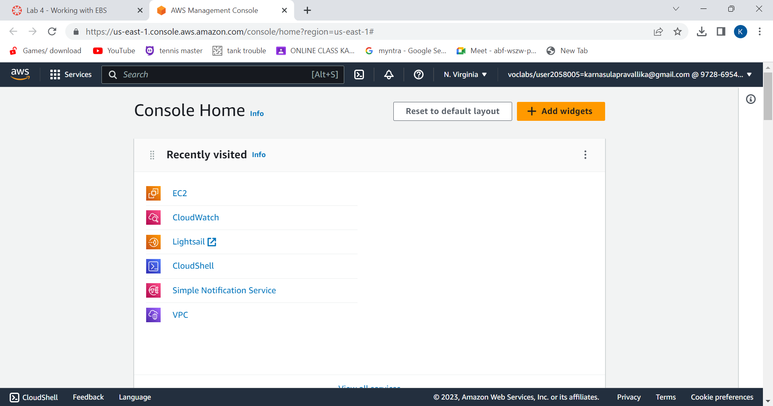
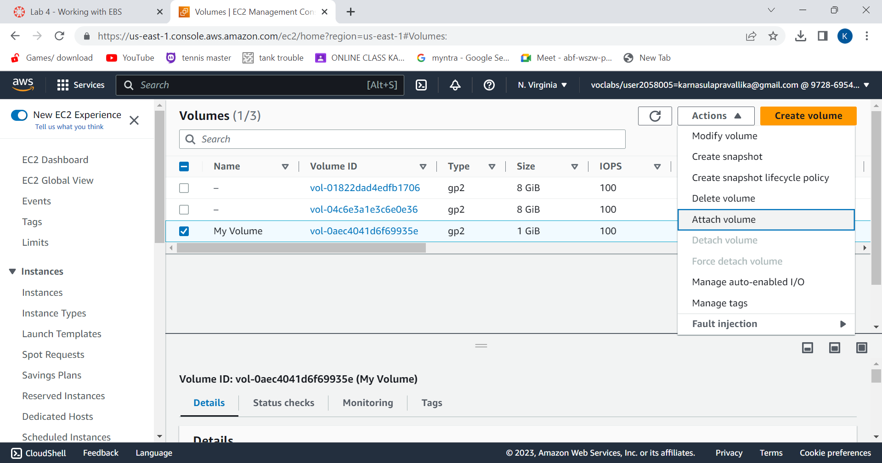
Working with EBS
Create a New EBS Volume
On “Services” menu, click EC2.
choose instances.
Lab has already been launched
choose Volumes. Then choose “Create Volume
Configure the volume settings.
Add tag and choose “create volume”.
Volume is created. Select “My Volume” and in the Actions menu,choose “Attach Volume”.
Choose the Instance field and choose “Attach Volume”.
Then the volume will be in use.
Redirecting to instructions panel, choose Details and click on Show.
Credentials window will open and choose Download PPK button and
save the labuser.ppk file.
Now, You will use PuTTY to SSH to Amazon EC2 instances.
Open putty.exe and configure like below:

Slide 22
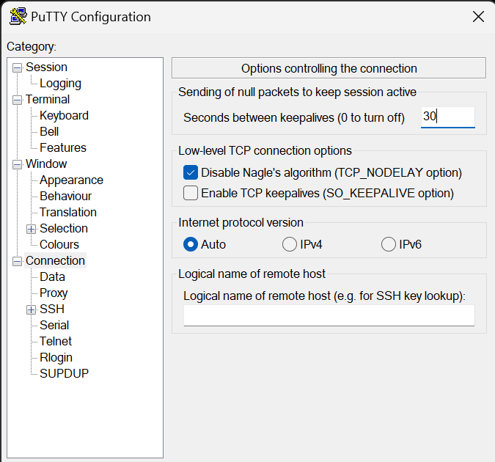
Choose Connection.
Set Seconds between keepalives to 30.
Choose Session
Host Name (or IP address): Paste the Public DNS or IPv4 address of the Lab instance that you noted earlier.
Back in PuTTY, in the Connection list, expand SSH
Choose Auth and expand Credentials
Under Private key file for authentication: Choose Browse
Browse to the labsuser.ppk file that you downloaded, select it, and choose Open
Choose Open again.
To trust and connect to the host, choose Accept.
When prompted login as, enter: ec2-user

Slide 23
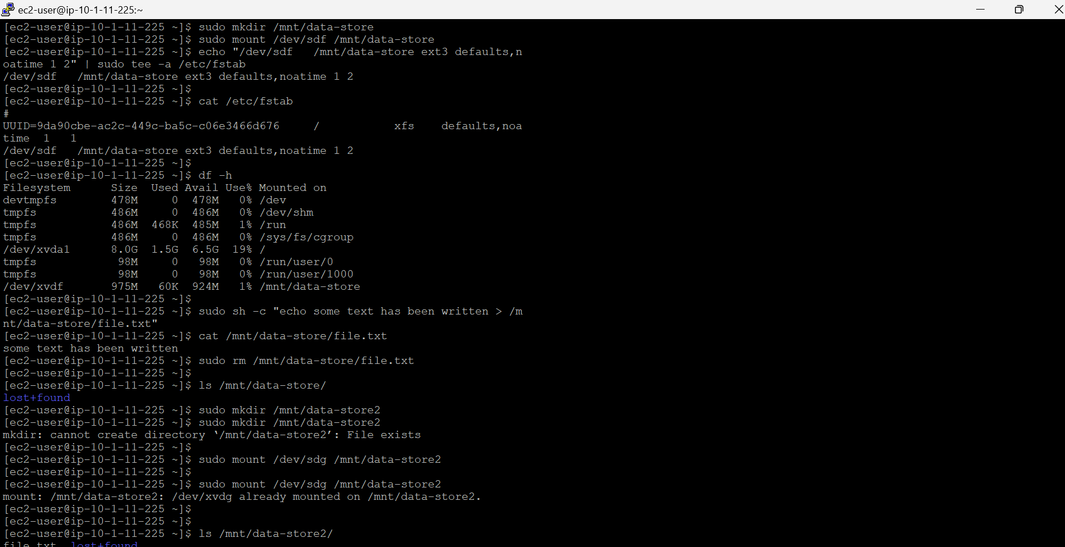
create and configure your file system.
In PuTTY, by executing certain commands, you will
View the storage available on your instance.
Create an ext3 file system on the new volume.
Create a directory for mounting the new storage volume.
Mount the new volume.
View the configuration file to see the setting on the last line.
create a file and add some text to it.
Verify that the text has been written to your volume.
Create an Amazon EBS Snapshot
Attach restored volume to your EC2 instance:
choose volumes and select restored volume.
in the Actions menu, select Attach volume.
Mount the restored volume.
Finally, You should see file.txt.

