Slide 1

Python Programming
Introduction

Slide 2
Agenda
Introduction to Python
Program Development Cycle
Input, Processing, and Output
Variables
Keywords, Identifiers, Basic Data Types
Comments

Slide 3
Agenda
Reading Input from Keyboard
Operators
Type conversions
Expressions
Displaying Output with print Function
Functions, Modules and Packages

Slide 4
Introduction to python
Downloading and Installing python; History of Python; python Features;
Virtual Environments; Execution modes; Python IDEs; GitHub integration

Slide 5

Downloading python
Download latest version (3.9.5) of python from https://www.python.org/downloads/.
Choose the correct operating system to download (browser detects the OS and displays the download button).
Click on the “Download Python 3.9.5”, a pop-up window displayed on the screen.
Click on “Save File”.
The 27MB file named “python-3.9.5-amd64.exe” should start downloading into your standard download folder.

Slide 6
installing python (windows 10)
Double-click the downloaded file python-3.9.5-amd64.exe
A Python 3.9.5 (64-bit) Setup pop-up window appears on the screen
Ensure the following checkboxes at the bottom are checked:
Install launcher for all users (recommended)
Add Python 3.9 to PATH
Highlight and click on the “Install Now (or Upgrade Now)” message.

Slide 7
installing python (windows 10)
Displays “User Account Control pop-up window” asking “Do you want to allow this app to make changes to your device”.
Click “Yes”.
A new Setup pop-up window appears with progress message and a progress bar.
Upon completion, Setup pop-up window appears with a “Setup was successful” message.
Click the close button.

Slide 8
installing python (windows 10)
Python installed into the default folder (C:\Users\<<username>>\AppData\Local\Programs\Python\Python39).
Python39 path is added to PATH variable that facilitates access python command from anywhere.
To verify the installation:
Open command prompt and type “python –version” and hit enter which displays the version 3.9.5.
Open command prompt and hit enter which displays information showing the version and the prompt “>>>”.

Slide 9
History of Python
“Guido Van Rossum” is the founder of python language
Conceived in late 1980s
Implementation started in December 1989
Started at CWI research center at Netherlands.
Version 0.9.0 (February 1991)
Features such as Classes with inheritance, exception handling, functions, core data types (dict, list, str, …) borrowed from modula-3

Slide 10
History of Python
Version 1.0 (January 1994)
Included functional programming features such as lambda, map, filter, reduce functions features from Lisp
Version 1.1 (October 1994), Version 1.2 (April 1995), Version 1.3 (October 1995)
No major feature enhancements; minor bug fixes and security fixes
Version 1.4 (October 1996)
The Keyword arguments feature borrowed from modula-3 (also same as Lisp)
Support for complex numbers, data hiding and name mangling (resolving unique names to programming entities)

Slide 11
History of Python
Version 1.5 (January 1998), Version 1.6 (September 2000)
No major feature enhancements; minor bug fixes and security fixes
Version 2.0 (October 2000)
Functional programming feature List Comprehension borrowed from Haskell
Introduced garbage collection (deallocating memory if its reference count is zero)
minor bug fixes, and with the new GPL-compatible free license

Slide 12
History of Python
Version 2.1 (April 2001)
Changed the language specification to support nested scopes but by default disabled and enabled in next version 2.2
Version 2.2 (December 2001)
Brought the types written in C and types written in Python (classes) into one unified type hierarchy (Pure OOP)
Added generators (iterators) inspired by Icon.
Version 2.3 (June 2003), Version 2.4 (November 2004)
No major feature enhancements; minor bug fixes and security fixes

Slide 13
History of Python
Version 2.5 (September 2006)
Introduced the with statement which encloses a code block within a context manager
Allowing Resource Acquisition Is Initialization (RAII)-like behavior
Replacing a common try/finally idiom
Acquired resources released at the end of the block (lock on a shared resource, opening a file)
Version 2.6 (October 2008)
Developed in parallel with Version 3.0
Introduced "warnings" mode that highlighted the use of features that were removed in Version 3.0

Slide 14
History of Python
Version 2.7 (September 2010)
Developed in parallel with and included features from Version 3.1
On April 20, 2020, Version 2.7.18 released as the final which included fixes for critical bugs and release blockers
Python 2.x versions support multi-paradigms including structured, object-oriented and functional and the same is retained in python 3.x also

Slide 15
History of Python
Version 3.0 (December 2008)
Focused on removing redundant modules and constructs by keeping only the best one
Removed backward-compatibility features, including old-style classes, string exceptions, and implicit relative imports
print is a statement in 2.x and changed to built-in function in 3.x
raw_input() function in 2.x changed to input() function in 3.x
5/4 results 1 in 2.x but 5/4 results in 1.25 in 3.x and for backward compatibility double slash i.e., 5//4 results in 1 in 3.x
Moved the reduce() function from built-in default name space to functools
Unifying the str/Unicode types representing text, introduced immutable bytes type and mutable bytearray type (byte arrays)

Slide 16
History of Python
Version 3.1 (June 2009)
Introduced an ordered dictionary type
Various optimizations to the int type.
A much faster io module
Tile support for Tkinter
A pure Python reference implementation of the import statement
New syntax for nested with statements

Slide 17
History of Python
Version 3.2 (February 2011)
Support for version tagged dynamic libraries
Added new library for concurrent programming
Incorporated improvements to pdb, the Python debugger
The command line argument parsing package optparse replaced by argparse to support positional arguments and much more

Slide 18
History of Python
Version 3.3 (September 2012)
A C implementation of the "decimal" module, with up to 120x speedup for decimal-heavy applications
The import system (__import__) is based on importlib by default
Released python launcher for Windows.
Virtual environment support in core module
Namespace package support
New module ipaddress added

Slide 19
History of Python
Version 3.4 (March 2014)
Added new pathlib module providing object-oriented filesystem paths, standardized enum module and statistics module
Added new C API for implementing custom memory allocators
Added new tracemalloc module for tracing Python memory allocations
Added new hash algorithm for Python strings and binary data
Added new and improved protocol for pickled objects
Added new asyncio module, a new framework for asynchronous I/O

Slide 20
History of Python
Version 3.5 (September 2015)
Improved Python zip application support
"%-formatting" for bytes and bytearray objects added
Introduced new operator @ for matrix multiplication
Made the Windows Python launcher aware of virtual environments
Added new and improved mechanism for loading extension modules

Slide 21
History of Python
Version 3.6 (December 2016)
Introduced formatted string literals (f-strings)
Underscores in numeric literals to separate 1000s (1_000_000_000_000_000 )
Syntax for variable annotations (primes: List[int] = [ ])
Simpler customization of sub class creation (new __init_subclass__ classmethod)
Change Windows filesystem encoding to UTF-8
New dict implementation that reduces memory usage by 20-25%
New secrets module to reliably generate cryptographically strong pseudo-random values suitable for managing secrets

Slide 22
History of Python
Version 3.7 (June 2018)
Postponed evaluation of type annotations
The async and await are now reserved keywords
Added new built-in breakpoint() function introduced to facilitate an easy and consistent way to enter the Python debugger
Added new Time functions with nanosecond resolution
Introduced new dataclass decorator to provide a way to declare data classes

Slide 23
History of Python
Version 3.8 (October 2019)
New syntax := that assigns values to variables as part of a larger expression was introduced
f-strings support = for self-documenting expressions and debugging
New function parameter syntax / to indicate that some function parameters must be specified positionally and cannot be used as keyword arguments, and * to indicate keyword only arguments
Many more improved modules

Slide 24
History of Python
Version 3.9 (October 2020)
Merge (|) and update (|=) operators have been added to the built-in dict class
Added string methods to remove prefixes and suffixes
Introduced flexible function and variable annotations
Added type hinting generics in standard collections
Improved speed of python built-ins (range, tuple, set, frozenset, list, dict)
A new module, graphlib, was added that contains the graphlib.TopologicalSorter class to offer functionality to perform topological sorting of graphs

Slide 25
Python features
Easy to code
Compared to other programming languages like java and C++
One can learn Basic Python syntax in just a few hours (programmer-friendly)
Easy to read
It is a high-level language (English-like)
Dynamic-typing and indentation improves the readability
Expressive
All programs implemented in any PL can be implemented by local transformations
Some programs implemented using python but not in other PLs.
With a myriad of constructs that help us focus on the solution rather than on the syntax

Slide 26
Python features
Free and Open-Source (FOSS/FLOSS)
The binaries for various platforms freely available for download
Source code is available to the public for download, use, alter, and re-distribute
High-level
Programmers don’t need to remember the system architecture
Programmers need not manage memory
Portable
Code on one system (say Windows) and run it on another (Say Linux or Mac)
(one should avoid any system-dependent features to make python portable)

Slide 27
Python features
Interpreted
Source code is executed line by line, and not all at once
It convert one line at a time into bytecode (platform independence), execute the bytecode immediately
This makes it easy to test and debug
Object-Oriented
Python programming language supports classes and objects and hence it is object-oriented
It also supports structured programming and functional programming
Extensible
One can add low-level modules written in C/C++ to python interpreter

Slide 28
Python features
Embeddable
Python code can be embeddable in other programming languages like C++
GUI Programming
Facilitates easy interaction of user with the software
Python offers various libraries for making Graphical user interface for your applications
you can use Tkinter, wxPython or Jpython for easy and fast development of GUI
Large Standard Library
There are libraries for regular expressions, documentation-generation, unit-testing, web browsers, threading, databases, CGI, email, image manipulation, and a lot of other functionality
Python's bulk of the library is very portable and cross-platform compatible on UNIX, Windows, and Macintosh

Slide 29
Python features
Dynamically typed
The type for a value is decided at runtime, not in advance
Facilitates declaring variables without specifying their types
Scalable
Python provides a better structure and support for large programs than shell scripting

Slide 30
Python features
Miscellaneous
Automatic garbage collection
Chain comparisons (1 < 2 < 3 < 4 returns true)
String literals concatenate together (‘Hello’ ‘ World!’ results in ‘Hello World!’)
Else statement not limited to if, but it can be used with try, for and while loops.
Underscore (_) gets the value/result of the last expression
Provides interfaces to all major commercial databases
No braces to delimit the code (readable)
Functions return multiple values
Slicing facilitates easier to extract parts of a string, list and reverse it
Multi variable assignment

Slide 31
Virtual Environments
A cooperatively isolated runtime environment
Solve the problem of different versions of the same module required for different projects
Allows users to install and upgrade Python distribution packages without interfering with other environments
One can activate a virtual environment to use it for the specific project
Create a virtual environment
python3 -m venv tutorial-env
This will create the tutorial-env directory if it doesn’t exist
Create directories inside tutorial-env containing a copy of the Python interpreter, the standard library, and various supporting files

Slide 32
Virtual Environments
Activate the environment
tutorial-env\Scripts\activate.bat
deactivate the environment
tutorial-env\Scripts\deactivate.bat
Adding packages to the virtual environment
python -m pip install [<<packagename>> | <<packagename==version>> | <<packagename@version>>]
Removing packages belonging to the virtual environment
python -m pip uninstall [<<packagename>> | <<packagename==version>> | <<packagename@version>>]

Slide 33
Virtual Environments
Updating packages belonging to the virtual environment
python -m pip install --upgrade [<<packagename>> | <<packagename==version>> | <<packagename@version>>]
Know information about a package installed in the virtual environment
pip show <<packagename>>
Display packages installed in the virtual environment
pip list or pip freeze (output uses the format that pip install expects)
Saving packages in a virtual environment and installing them in another virtual environment
pip freeze > package-list.txt (source)
python -m pip install -r package-list.txt (destination)

Slide 34
Execution Modes
Two mode of running python programs
Interactive or REPL (Read-Evaluate-Print-Loop)
Script

Slide 35
Interactive Execution Mode
The code executes via the Python shell, which comes with Python installation
Open terminal, type python and hit enter displays the python shell (>>>)
Upon hitting enter, python interpreter executes and displays the result

Slide 36
Interactive Execution Mode
It is a quick way of running blocks (extra empty line between statements) or a single line of Python code
Helpful when your script is extremely short and you want immediate results, Faster and Good for beginners who need to understand Python basics
Moving back to previous commands is harder (instead type the command a fresh), tedious to run larger programs

Slide 37
Interactive Execution Mode
The code executes via the Python shell, which comes with Python installation
Open terminal, type python and hit enter displays the python shell (>>>) or IDLE editor installed along with python
Upon hitting enter, python interpreter executes and displays the result

Slide 38
Interactive Execution Mode
It is a quick way of running blocks (extra empty line between statements) or a single line of Python code
Helpful when your script is extremely short and you want immediate results, Faster and Good for beginners who need to understand Python basics
Moving back to previous commands is harder (instead type the command a fresh), tedious to run larger programs

Slide 39
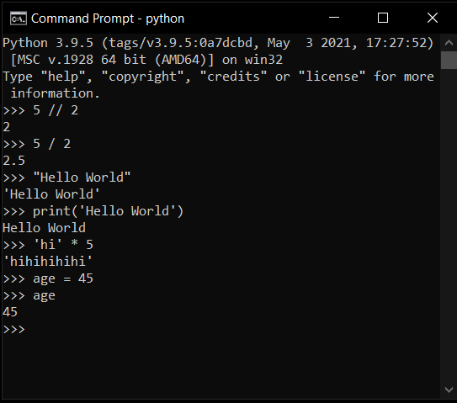
Interactive mode

Slide 40
Script mode
Set of statements written in a file with extension “.py”
Use any text editor for typing the code, including Sublime, Atom, notepad++, etc.
Use the default IDE IDLE which is supplied along with python

Slide 41
Script mode
Easy to run large pieces of code and even spans multiple files
Script editing becomes easier
Good for both beginners and experts
Requires creation and saving the code thus becomes tedious if code is small

Slide 42
Script mode (creating and saving code)
Open IDLE
Select File -> New or press Ctrl + N
Type the code
Select File -> Save or press Ctrl + S
Name it as “test.py” save it on Desktop.

Slide 43
Script mode (executing code)
Click Run -> Run Module or press F5 key
Output displayed on the python prompt
Finally select File -> Exit or Ctrl + X

Slide 44
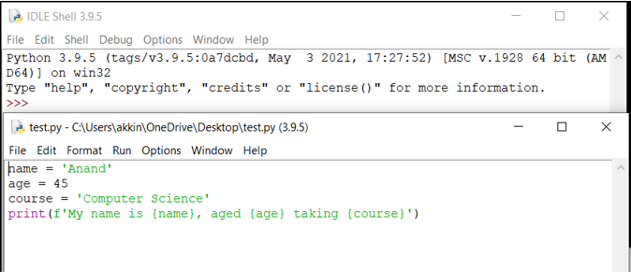
script mode

Slide 45
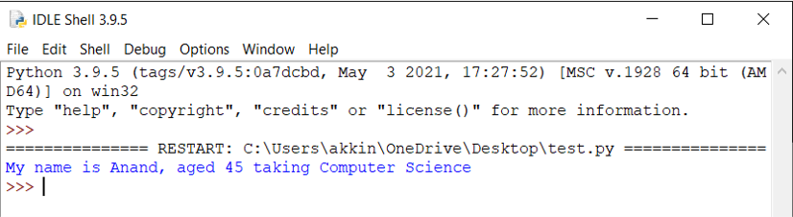
script mode

Slide 46
Integrated development environment (ide)
Syntax highlighting (improves readability)
Autocomplete (making coding significantly faster and simpler)
Takes care of interpreting the Python code, running python scripts, building executables, and debugging the applications
Using the debugging tool that IDE offer, programmers can easily detect errors in their code

Slide 47
Integrated development and learning environment (idLe)
Default supplied and freely available on Mac OS, Windows, and Linux
Suitable for beginner level developers
Assists with Smart indenting, basic text editor features, along with multi-file searching
Interactive interpreter with syntax highlighting, and error and i/o messages
Equipped with a very capable debugger

Slide 48
PyCharm IDE from Jetbrains
Widely used by both basic and professional developers
Facilitates the development of large Python projects
Equipped with smart code navigation, quick and safe code refactoring
Support features like accessing databases directly from the IDE
Available in Free and Commercial editions

Slide 49
Vs code IDE from Microsoft
Open-source, lightweight and comes with powerful features offered only by paid IDEs
Equipped with best smart code navigation, Git integration and code debugging within editor
Provide extensions to add features like code linting, themes and many more
Supports Jupyter notebooks widely used in data analytics and machine learning applications
One IDE supports any programming/scripting language (my preferred choice)

Slide 50
Vs code IDE installation
Download VS code from https://code.visualstudio.com/Download that suits your OS
For Windows, download System installer either 32-bit | 64-bit (selected 64-bit)
Double click on downloaded “VSCodeSetup-x64-1.56.2.exe” file
Follow the onscreen instructions to finish the installation

Slide 51
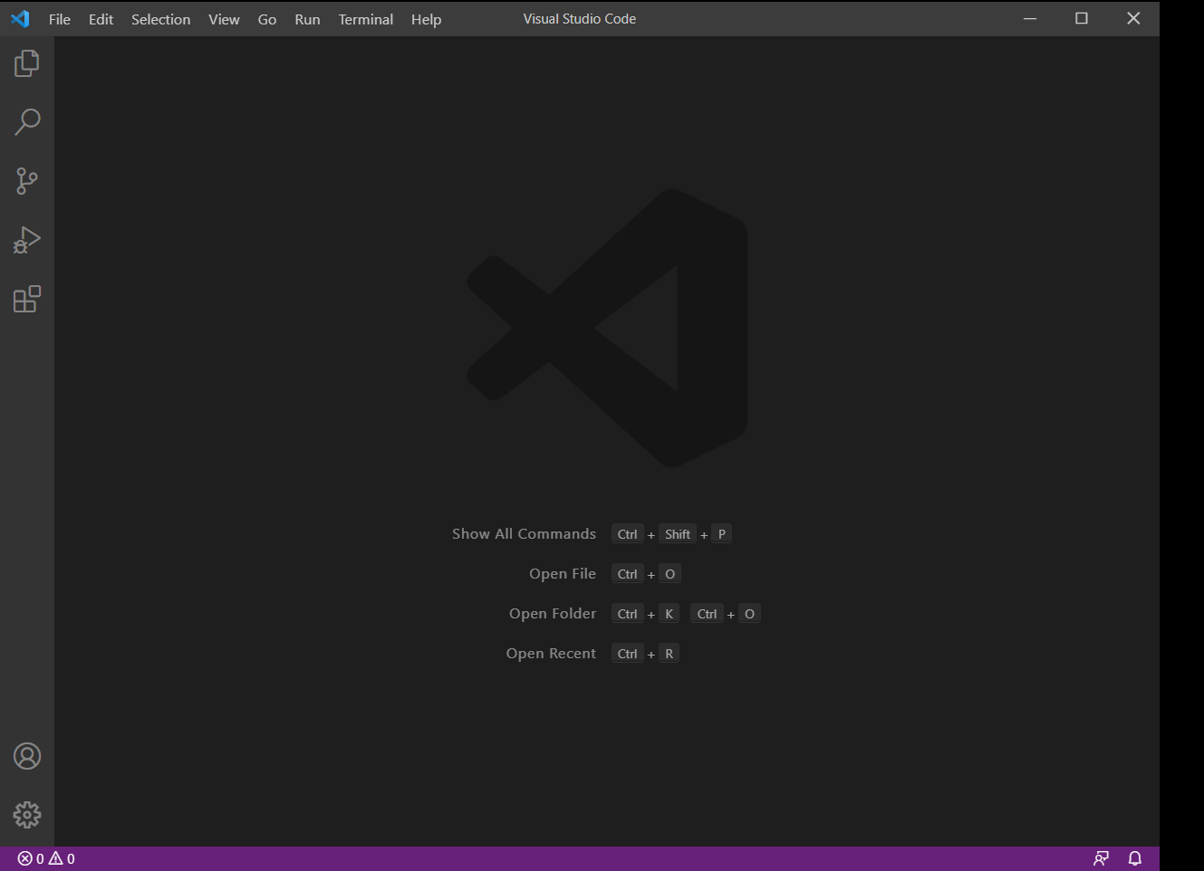
Vs code (cont.)

Slide 52
Vs code IDE extensions
Material icon theme by Philipp Kief (for beautiful icons)
Visual Studio IntelliCode AI-assisted development by Microsoft
Python IntelliSense (Pylance), Linting, Debugging (multi-threaded, remote), Jupyter Notebooks, code formatting, refactoring, unit tests, and more by Microsoft
Jupyter by Microsoft provides Jupyter notebook support, interactive programming and computing that supports Intellisense, debugging and more

Slide 53
Changing virtual environment in Vs code IDE
Open command palette (Ctrl+Shift+P)
Use the Python: Select Interpreter command
Select existing environment or another folder created
You should install Jupyter package into this environment to work with notebooks (saved with .ipynb extension)

Slide 54
GITHUB integration with VS code IDE
Download Git from https://git-scm.com/downloads.
Install the “Git-2.31.1-64-bit.exe” following onscreen instructions
Install GitHub Pull Requests and Issues VS code extension from github
Create a GitHub account by visiting https://github.com.
Remember the user id, the email you registered with, and the repository

Slide 55
Cloning GitHub repository inTO VS code IDE
Close any folders already opened and Select Source Control -> Clone Repository
It will ask you to sign in into GitHub and so and login using your credentials
After successful authentication it will ask you to select a local folder
The selected local folder acts as the local repository and is in sync with remote repository
Select explorer to see the files synced from the remote repository

Slide 56
Sync changes to GitHub repository using VS code IDE
Create a new program or change the existing program
Select source control, then CHANGES folder you can see the changed files
To discard the changes, click on - icon to the right of the filename
To stage the changes, click on click on + icon to the right of the filename

Slide 57
Sync changes to GitHub repository using VS code IDE
The file you created/modified is moved to STAGED CHANGES folder
You should add a message in the text box shown
For the first time you should run the following two commands from the cmd
git config --global user.name “<<username used to login to GitHub>>“
git config --global user.email <<your registered email>>
Click on the tick mark button on top left corner to commit changes to local repository

Slide 58
Sync changes to GitHub repository using VS code IDE
At bottom-left, it shows the branch name you specified when creating a repository
Click on the refresh icon to the right of the branch name to commit the changes to the remote repository
Check your remote GitHub repository; you can see the file you created/the modifications you did on existing file

Slide 59
Program Development Cycle
Problem definition and analysis; Program Design; Implementation (coding); Debugging and Testing;
Documentation; Deployment and Maintenance

Slide 60
Program development cycle (PDC)
Problem definition and analysis
Program Design
Implementation (coding)
Debugging and Testing
Documentation
Deployment and Maintenance
PDC is a sequence of systematic smaller steps to be followed to produce quality software

Slide 61
PDC (Problem Definition and Analysis)
Understand the problem (semantics of the problem statement)
Decide the boundaries (legal inputs) of the problem
State the requirements
For legal inputs what is the expected output
For all other inputs state the error/informative messages to be produced
State the user interaction with the program (expected behavior)
State the process to arrive at the solution
Document the requirements (requirements specification)
The person involved in this phase termed Analyst

Slide 62
PDC (Program design)
Requirement specification prepared in the previous phase is the base document for this phase
Identify sequence of low-level simple basic operations to be performed to realize the process and user interactions
If necessary, group set of statements into functions and group related functions into a modules.
Identify the interaction between modules and functions
Designer is responsible for depicting the logic into combination of algorithms, pseudocodes, flowcharts, data flow diagrams (DFD) and unified modeling diagrams

Slide 63
PDC (coding)
Design document prepared in the previous phase is the base document for this phase
Identify tools available in the chosen programming language to translate the operations specified in the design document. If not implement them on your own
Eliminate syntax and semantical errors in the translated program
Including comments to make others understand the code
Developer is responsible for producing the source code of the problem planned to solve

Slide 64
PDC (testing and debugging)
Source code prepared in the previous phase and the requirements specification in the first phase are the base for this phase
As a tester, Identify different flows of control in the process stated in requirements specification and identify an input that satisfy each of these flows (test cases)
Some test cases may fail due to logical errors in the program
As a debugger, debug your program with the failed test cases to identify the logical errors and fix them
Repeat testing and debugging until all test cases are successful

Slide 65
PDC (documentation)
Design documents prepared in the second phase is the base for this phase
It starts after the previous phase is successfully completed; and deals with
Writing a manual covering overview of the program functionality
Tutorial for beginners explaining major program features
Reference documentation covering all program commands, and thorough description of error messages generated by the program

Slide 66
PDC (Deployment and maintenance)
The program is deployed (installed) at the user’s site. Here also, the program is kept under watch till the user gives acceptance.
After the user acceptance, it was made available to the real users
At this stage, the program not behaving as expected for a special case due to unidentified logical error during development (bug) and needs to be fixed in the next cycle along with any feature enhancements planned.
All the steps once again needs to be undergone to produce the next version (thus it is called a spiral model)

Slide 67
Input, processing and output
IPO Model; Example; Computer support

Slide 68
Input, process, and output (IPO) model
Most basic structure for describing the structure of any process and aptly suited to information processing computer programs
This model divides the work into three categories
Receiving inputs from a user or other source
Doing some processing (computations) on the inputs
Returning outputs (the results) of the computations

Slide 69
Input, process, and output Example
Converting Fahrenheit to Celsius temperature conversion
Input: Fahrenheit temperature
Process: computing the formula
Celsius = (Fahrenheit-32) * 5/9
Output: Celsius temperature

Slide 70
Input, process, and output computer support
To support the IPO model, the computer performs five basic operations
Input: the computer accepts data from the user using any input devices like keyboard, mouse, joystick, sensor connected through a port etc.
Process: computer has three parts
Memory to store values
ALU to perform computations
CU to control the sequence in which instructions executed
Output: the computer produces output onto output devices like monitor, hard disk etc.

Slide 71
Keywords, identifiers, Basic data types
https://github.com/akkinjarapu/python-class/program-1000.ipynb

Slide 72
Python keywords/reserved words
Have specific meaning and purpose and can be used only for that meaning and purpose
Number varies from version to version
List the keywords using help() function
The keyword module facilitates working with keywords programmatically
The kwlist member provides list of all keywords
The iskeyword() member function determines if a string is a keyword or not
Python is case sensitive i.e., differentiates lowercase and uppercase
All keywords are lowercase except True, False and None

Slide 73
Keyword classification based on usage
Used as values (True, False, None)
Used as operators (and, or, not, in, is)
Used for control flow (if, elif, else)
Used for iteration (for, while, break, continue, else)
Used for defining structure i.e., functions and classes, or use context managers (def, class, with, as, pass, lambda)
Used to return values (return, yield)
Used to import modules and packages (import, from, as)
Used to handle exceptions (try, except, finally, raise, assert, else)

Slide 74
Keyword classification based on usage
Used in asynchronous programming (async, await)
Used to handle variables (del, global, nonlocal)
Keywords deprecated (print, exec -> converted to functions in python 3.x)

Slide 75
Identifiers
Names given to entities like classes, functions, variables, etc.
Helps to differentiate one entity from another.
Rules
Must start with a letter or the underscore character.
Cannot start with a number.
Can only contain alpha-numeric characters and underscores (A-z, 0-9, and _ ).
Names are case-sensitive (name, Name, NAME all are different).
The reserved words (keywords) cannot be used for naming identifiers
Can be of any length up to a maximum of 255 characters

Slide 76
Identifiers
Constructing a multi-word identifier
Camel Case: Second and subsequent words are capitalized (percentageOfMarks)
Pascal Case: Identical to Camel Case, except the first word is also capitalized (PercentageOfMarks)
Snake Case: Words expressed in lowercase and separated by underscores (percentage_of_marks)
Python suggests snake case for functions and variables; pascal case for classes

Slide 77
Data types
Numeric (int, float, complex, Decimal, Fraction)
Sequence (str, list, tuple)
Boolean (bool)
Dictionary or Map (dict)
Collections (set, frozenset, range)
Binary (bytes, bytearray, memoryview)

Slide 78
Data types
Standard library includes the numeric types fractions.Fraction, for rationals, and decimal.Decimal, for floating-point numbers with user-definable precision
All sequence types and set are iterables
Data types support operations modify it in place are called mutable and immutable otherwise
The list, dict and set and bytearray are mutable
The str, tuple (immutable list) and bytes are immutable
The frozenset() is a built-in function to create immutable version of set
Use type() function to know which class a variable or a value belongs to
Use isinstance() function is used to check if an object belongs to a particular class

Slide 79
Data types
The sys.getsizeof() method returns the number of bytes allocated to store a value
The number of bytes allocated varies with the value and is also system dependent

Slide 80
Int type
There is no maximum limit for int type, and you can store any number
Conversion functions (bin, oct, hex)
The bit_length() function returns the maximum number of bits required to store the value in binary
The to_bytes() returns a bytes representation in either big-endian or little-endian
The from_bytes() returns int value equivalent to the array of bytes in either big-endian or little-endian format
The as_integer_ratio returns given int as numerator and 1 as the denominator

Slide 81
float type
The float type has a maximum of 15 digits of precision
It has methods to convert to and from hexadecimal representation
Instance method hex() converts float to hex
Class method fromhex() converts hex to float
It has utility methods trunc((), floor() and ceil() from math package to convert from float to int
The round() function used to truncate the precision (decimal digits)
The as_integer_ratio() method returns a pair of integers whose ratio is exactly equal to the original float and with a positive denominator
The is_integer() returns True if the float instance is finite with integral value, and False otherwise

Slide 82
bool type
It supports only two values (True, False)
Built-in objects considered False
The constants False and None
Zero of any numeric value i.e., 0, 0.0, 0j, Decimal(0), Fraction(0, 1)
Empty sequences and collections i.e, '', (), [], {}, set(), range(0)

Slide 83
String data type
https://github.com/akkinjarapu/python-class/program-1001.ipynb

Slide 84
strings
String represented by enclosed with single or double or triple single or triple double quotes
Characters represented as strings of length 1
You can include escape characters also in strings and are interpreted
You prefix string with ‘r’ treats it as a raw string and disables interpretation of escape characters
String is immutable, so any method of a string returns a new string instead of inline modification
Demonstration of important string methods
String slicing to extract substrings
String indexing to extract individual characters

Slide 85
Comments
https://github.com/akkinjarapu/python-class/program-1002.ipynb;

Slide 86
comments
Lines that exist in programs that are ignored by compilers and interpreters
Including comments increase readability and understandability among the programmers
Comment serves as
Notes, explaining what each part of the program is doing (functionality)
Reminder, stating quick pseudocode which is to be implemented later (intent)
Simple way to ignore a piece of code from execution during testing and debugging
Include the comments at the time of writing the program or updating the program (best practice)
Comments in Python begin with a hash mark (#) and continue to the end of the line. (# this is a comment)
Place whitespace character after # for better readability (best practice followed but not a rule)

Slide 87
comments
Comments should be made at the same indent as the code it is commenting.
A function definition with no indent would have a comment with no indent, and each indent level following would have comments that are aligned with the code it is commenting.
single-line comments
begin with a hash mark (#) and whitespace character and continue to the end of the line. (# this is a comment)
Used to explain intent and functionality
Multi-line (block) comments
Each line begins with the hash mark and a single space (sequence of single-line comments)
Used to explain more complicated code that you don’t expect the reader to be familiar with
Inline comments are the comments exists on the same line at the end of the executable statement

Slide 88
comments
String literals not assigned to any variables are also ignored by the interpreter and serve as comments
String literals enclosed in single quotes (single-line comment)
String literals enclosed in double quotes (single-line comment)
String literals enclosed in triple single quotes (multi-line comment)
String literals enclosed in triple double quotes (multi-line comment)
the last two representations are treated as docstrings which we will cover later

Slide 89
variables
https://github.com/akkinjarapu/python-class/program-1003.ipynb;

Slide 90
Variables
Names referring reserved memory locations to store values
No need to declare variables before using them or declare their type (dynamic typing)
Created automatically when you assign some value to it for the first time and assigns a unique id
Value and the type of value can be changed after defining it
We can assign multiple variables with a single value
We can assign different values to different variables in one line
We can assign values to variables already defined inside an expression with (:= assignment)
String assignment and comparison

Slide 91
Reading input from the keyboard and Displaying the output with print function
https://github.com/akkinjarapu/python-class/program-1004.ipynb

Slide 92
Reading input from keyboard
The input() function used to obtain data from user (i.e., keyboard)
Parameters
Only optional parameter is prompt used to display text message to the user
best practice: always specify prompt
Pauses until the user enter a line of text and hit ENTER key
It reads the line of text entered and returns as a string
To change the string type to number, use the appropriate conversion function int() or float() or a better eval()

Slide 93
Displaying output with print()
prints the given objects to the standard output device (screen) or to the text stream file
The parameters
*objects - objects to be printed. * indicates that there may be more than one object
sep - objects are separated by string specified by sep. Default value: single space (‘ ’)
end – the string specified by end is printed at last. Default value: newline (\n)
file - must be an object with write(string) method. If omitted, it defaults to sys.stdout which is the screen
flush - If True, the stream is forcibly flushed. Default value: False
The sep, end, file, flush are keyword parameters and thus supplied as “sep = ‘#’”
It doesn't return any value; returns None

Slide 94
Displaying output with print()
Printing static text
Enclosed in single quotes, double quotes, triple single quotes and triple double quotes
Using keyword arguments end, sep and file to control the behavior of the print function
Printing static text combined with variable values
Formatting using string modulo (%) operator (difficult but efficient)
Formatting using string’s format() method
Formatting using f-strings (formatted strings)
Any object passed to print can be displayed by calling __str__() method, if not __repr__() method on the object

Slide 95
Operators, type conversion
Simple calculations using different operators and type conversion
https://github.com/akkinjarapu/python-class/program-1005.ipynb

Slide 96
Types of operators
Arithmetic Operators
+, -, *, /, //, %, **, unary +, unary -
Relational operators
<, >, <=, >=, ==, !=
Logical Operators
and, or, not
Bit-wise Operators
&, |, ^, ~, <<, >>

Slide 97
Types of operators
Assignment Operators
is, is not
Membership operators
in, not in
=, +=, -=, *=, /=, //=, %=, **=, &=, |=, ^=, ~=, <<=, >>=
Identity operators

Slide 98
Simple Arithmetic calculations
Integer arithmetic
Real arithmetic
String arithmetic
Mixed arithmetic

Slide 99
Type conversions
Convert object data type from one to the other
Two types
Implicit
Explicit (Type Casting)
Implicit Type Conversion
Automatically convert the type by python interpreter (int -> float, int or float -> complex)
Type Casting
Object data type changed by the user using predefined functions (str -> int)
str() function converts int or float data to string type
int() function converts a string or a float value to int type
Float() function converts a string or a int value to float type

Slide 100
Type conversions
ascii() Returns a string containing a printable representation of an object
bin() Converts an integer to a binary string
bool() Converts an argument to a Boolean value
chr() Returns string representation of character given by integer argument
complex() Returns a complex number constructed from arguments
hex() Converts an integer to a hexadecimal string
oct() Converts an integer to an octal string
ord() Returns integer representation of a character
repr() Returns a string containing a printable representation of an object

Slide 101
Expressions
https://github.com/akkinjarapu/python-class/program-1006.ipynb

Slide 102
Expressions
Produces a value upon evaluating them.
Different from statement
Statement is an instruction that a python interpreter can execute but doesn’t display any result (c = a + b)
An expression executed by python interpreter and displays the result (a + b)
Appears normally to the right of an assignment statement and as conditions in control statements
Composed of identifiers (variables and functions), literals and operators
Evaluation result depends on operator precedence and associativity (refer precedence table python docs)
2 + 3 * 4 results in 20 or 14
One can change the order of evaluation by enclosing expressions with parenthesis.
(2 +3) * 4 results in 20

Slide 103
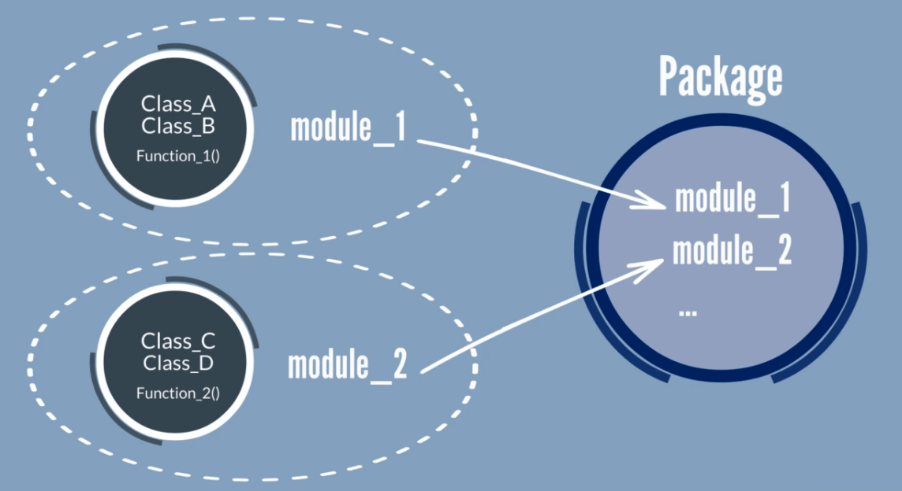
Functions, Modules and packages
https://github.com/akkinjarapu/python-class/program-1007.ipynb

Slide 104
functions
Name given to a block of code pertaining to a particular functionality
Reusable and executed upon calling the function
Accepts multiple values known as parameters
Positional arguments
Keyword arguments
Default arguments
Arbitrary positional arguments (variable length)
Arbitrary keyword arguments (variable length)
Usage of / and * to separate different types of arguments (positional, /, positional-and-keyword, *, only-keyword)
Returns more than one value as a result (using return statement)

Slide 105
functions
Functions classified as
Built-in functions
User-defined functions
Recursive functions
Lambda functions (anonymous one-liner functions used as argument to higher-order functions or loops etc.)
Listing built-in functions (dir function and builtins module)
Demonstrating mathematical built-in functions (default name space)
Abs, divmod, max, min, pow, round, sum functions
Demonstrating built-in functions in math package

Slide 106
functions
Demonstrating user defined functions
With all parameters treated as positional or keyword arguments (default)
Default arguments (should at the end of the parameter list)
With all parameters treated as positional
With all parameters treated as keyword arguments
Some positional and some keyword and others can be treated as either positional or keyword
Demonstrating call-by-value and call-by-reference (default: call-by-reference)
Demonstrating local and global variables
Demonstration of recursive functions
Demonstration of lambda functions

Slide 107
Modules and packages
Creating a module is creation of “module.py” file in some namespace
Define variables inside the module
Define functions inside the module
Define classes inside the module
Creating packages is creation of a folder with the packagename
Create an empty __init__.py file inside the folder
Create sub packages inside the package
Create modules inside the package

Slide 108
Accessing modules/packages
Import all the functions, variables and classes inside a module in default namespace
import <<module-name>>
Import a specific function or a variable or a class inside a module in default namespace
from <<module-name>> import <<function-name | variable-name | class-name>>
Import a module in a namespace (package)
from <<package-name> import <<module-name>>
Import a specific function or a variable or a class inside a module in a namespace (package)
from <<package-name>>.<<module-name>> import <<function-name | variable-name | class-name>>
Import a module in a nested packages
from <<package-name>>.<<sub-package-name>> import <<module-name>>

