Slide 1
QUIZ MAKER
SWECHA PROJECT
TEAM 46
TEAM MEMBERS-
1.SAITEJA
2.GOWTHAM
3.SHIVAGANESH
4.SAI MANOJ
5.SAHITH
6.SRITEJA
7.VIRAT

Slide 2
PROBLEM STATEMENT
With the growing fascination towards web developemnt many people started learning html, css, javacript we have come up with this small quiz which helps users to recall their fundamentals of the topics required for web devleopment. if find it difficult to answers the questions the web page also contains link to amazon store which contains the books related to web development and we also provided link to the link w3 schools were you can have an instant practise on the codes and strengthem your fundamentals

Slide 3
ABOUT THE PROJECT
In this program [Quiz App with Timer], there are three layers or boxes, and these boxes shown one by one on a particular button clicked. At first, on the webpage, there is shown a button labeled as “Start Quiz” and when you clicked on that button, then the info box appears with popup animation.
In this infobox, there are some rules of the quiz and two buttons labeled as “Exit” and “Continue”. When you clicked on the Exit button, the info box will be hidden but when you clicked on the Continue button, then the Quiz Box appears.
In the Quiz Box, there is a header with a title on the left side and a timer box on the right side. This timer starts decrement from 15 to 0 sec and there is also shown a timeline indicator that is sliding from the left to right side according to the timer. If the user selects an option between 15 to 0 sec, the timer will be stopped and all available options will be disabled.

Slide 4
If the user selected option is correct, the selected option color, background color changed to green and there is also shown the tick icon to inform the user that the selected answer is correct. If the user selects an option that is incorrect, the selected option color, background color changed to red and there is shown the cross icon to inform the user that the selected option is incorrect and the correct option will be automatically selected.
If the user doesn’t select an option between 15 to 0 sec, the timer will be stopped once it comes in 0 and the correct option of that question will be selected automatically. After that, there is the next button to show the next question, and there is a total of five questions on this Quiz.
In the end, the result box will be appeared and shown the user score and two buttons [Replay Quiz, Quit Quiz], if the user clicked on the replay quiz button, the quiz will again start with the number 1 question, and the score of the user will be 0 but if the user clicked on the quit quiz button, the current window will be reloaded and the quiz starts from the begin.

Slide 5
TECHNOLOGY USED
In this project we have used
HTML
CSS
JavaScript Software Requirements
Visual Studio Code

Slide 6
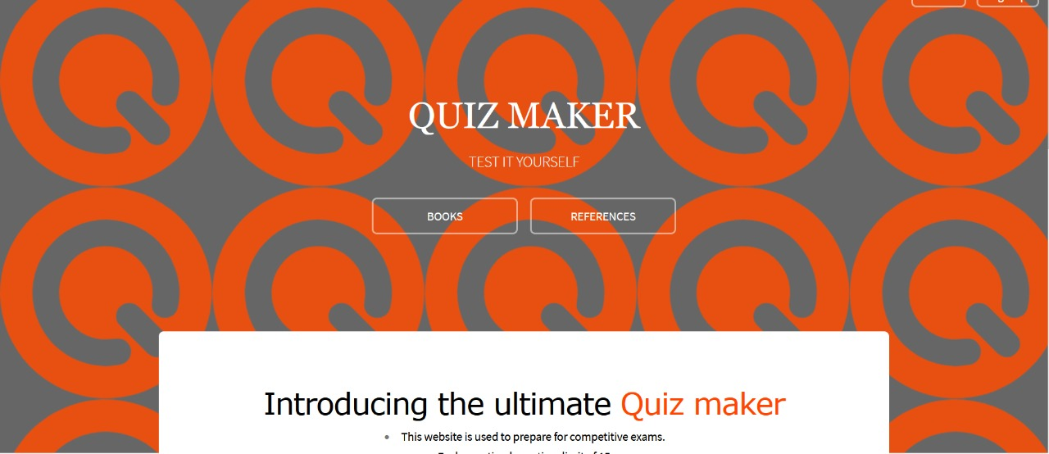
OUTPUT SCREENSHOTS

Slide 7
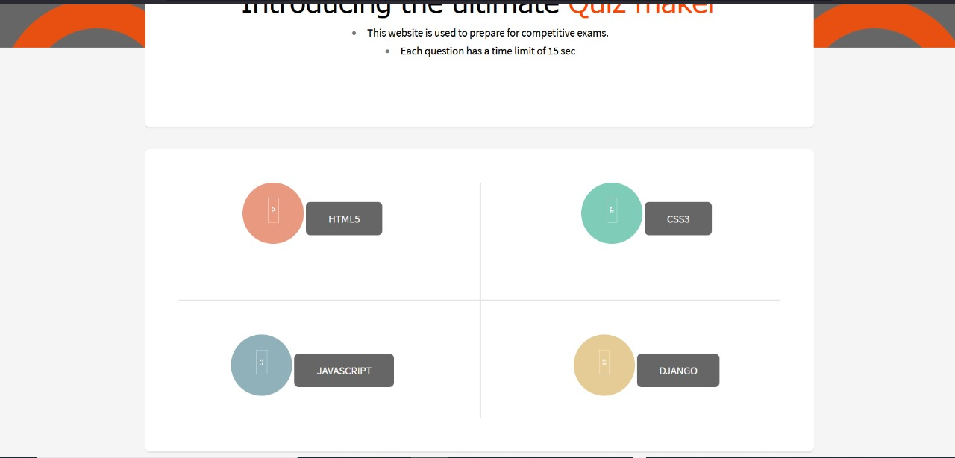


Slide 8
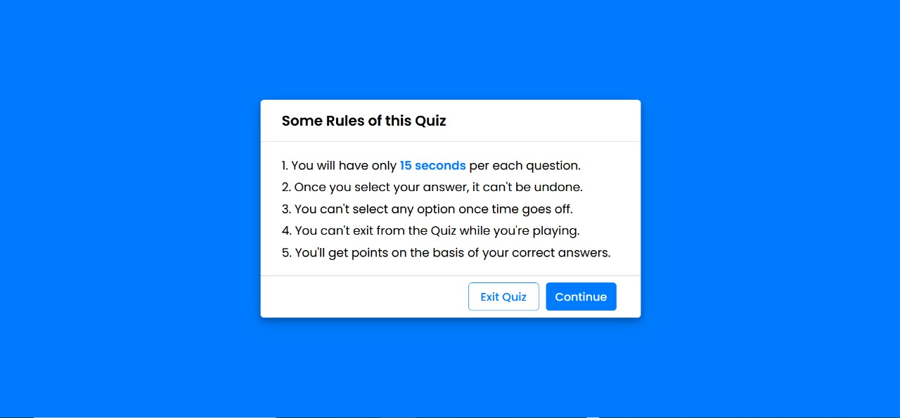
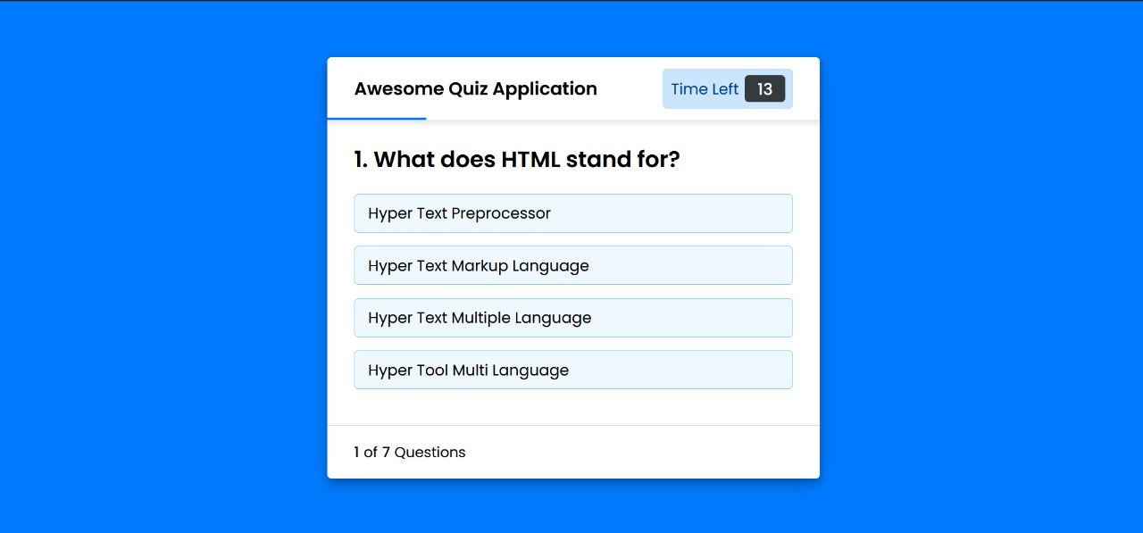

Slide 9
ADVANTAGES
We find various applicati0ns of CSS,JAVASCRIPT, and HTML.
HTML is that it creates the basic skeleton of any website.
CSS stands for cascading style sheet. HTML builds the structure of a website. CSS beautifies the website.
JavaScript is to make the static web pages attractive and interactive.
This project quiz maker helps in finding the talent of the person.

Slide 10
FUTURE SCOPE
When it comes to Web Development, HTML plays very important role since beginning and today without HTML, CSS and javascript, website development would have been little difficult.
These are known as future of web Technology.
JavaScript is extremely popular that it makes interactive web pages. In fact, for some people, front-end development means JavaScript development services.
According to the trends evaluated by W3Techs, JavaScript is the top-notch client-side programming language.

Slide 11
CONCLUSION
Online Quiz is a web application. The key concept is to minimize the amount of paper and convert all forms of documentation to digital form. It can observe that the information required can be obtained with ease and accuracy in the computerized system .The user with minimum knowledge about computer can be able to operate the system easily.

Slide 12
THANK YOU

