Slide 1
Facial Recognition Attendance Using LBPH Algorithm
Submitted in the partial fulfillment for the award of the degree of
BACHELOR OF ENGINEERING
IN
BIG DATA ANALYTICS
Submitted by:
20BCS6140 – GAJULA AJAY
20BCS4467 – P.VINAY KUMAR
Under the Supervision of:
SUPERVISORS NAME :
Ms. Mansi Kajal (E14871)
Department of AIT-CSE
DISCOVER . LEARN . EMPOWER

Slide 2
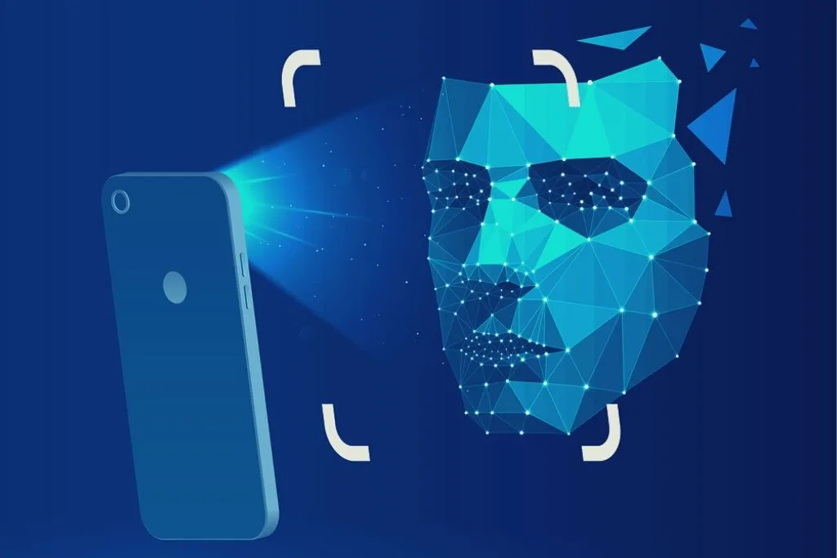
Introduction to Project:
In today's competitive world, teachers face challenges in managing precious class time efficiently.
Faculty members often spend valuable teaching time on completing formal duties like taking daily student attendance manually.
Manual attendance tracking consumes classroom time and makes the process mundane for faculty.
Increasing working hours and less classroom time exacerbate the need for efficient attendance management tools.
Online attendance management systems offer a solution to automate daily attendance processes in schools.
These systems help in maintaining accurate records and generating summarized student attendance reports.

Slide 3
Attendance management system keeps track of daily attendance, working hours, breaks, login, and logout time. It prevents staff's time theft. An attendance management system integrates all attendance devices such as smart cards, biometric, and facial recognition devices in real-time.
Master Soft's Student attendance management software allows schools of all sizes to manage various attendance requirements. This system makes it easy to create daily attendance reports, absentee lists, letters and other documents almost effortlessly. Student attendance system helps teachers to mark online attendance of students during class & reduce manual work. It is used to track student's attendance, absentee record, attendance history & other related documents. Student attendance software allows you to record & manage daily student attendance to speed up the daily attendance process.
Online attendance management system enables school administrators to record, manage & compile daily student attendance data. Along with student attendance, this software also allows teachers to generate 100% accurate student attendance reports.

Slide 4
Problem Formulation:
Attendance Management System is software developed for daily student attendance in schools, colleges and institutes. It facilitates to access the attendance information of a particular student in a particular class. Human brain can automatically and instantly detect and recognize multiple faces. But when it comes to computer, it is very difficult to do all the challenging tasks on the level of human brain. The face recognition is an integral part of biometrics. In biometrics, basic traits of human are matched to the existing data. Facial features are extracted and implemented through algorithms, which are efficient and some modifications are done to improve the existing algorithm models. Computers that detect and recognize faces could be applied to a wide variety of practical applications including criminal identification, security systems, identity verification etc.

Slide 5
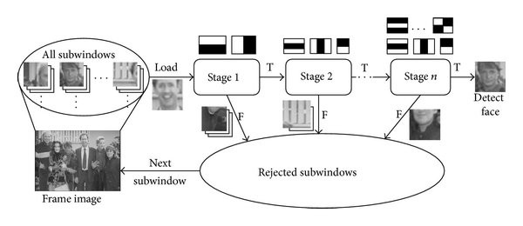
Preliminary Design of the project

Slide 6
Objectives of the work:
The "Attendance Management System" is a piece of software designed to track a student's attendance in college on a daily basis. The staff members in charge of the topics will be responsible for keeping track of the students' attendance. Each member of staff will be given a unique username and password based on the subject they are responsible for. This is where the accurate report based on student attendance is prepared. This approach will also assist in determining a student's attendance eligibility criteria. On a weekly and monthly basis, a report on the student's attendance is generated.
User Friendly: User interface is very easy. Data storing and recovery is fast and secured. In addition, application is provided with graphical representation for easier interpretation and analysis.
Reports are Easily Generated: Various reports, such as student-by-student attendance, day-by-day attendance, class-by-class attendance, month-by-month-by-month-by-month-by-month-by-month Instant access to current and historical reports is possible.

Slide 7
Methodology used:
The proposed system face recognition-based attendance system can be divided into five main modules. The modules and their functions are defined as follows.
a. Image Capture: The high-resolution camera which is used for capturing video is used to take frontal images of the students.
b. Pre-processing: The images are converted from RGB to Grayscale and are scaled down by a factor of 1.2.
c. Face Detection: A proper and efficient face detection algorithm always increases the performance of face recognition systems. Various algorithms are proposed for face detection such as face knowledge-based methods, feature invariant methods, machine learning based methods. In this project, I implemented a system for locating faces in digital images. These are in JPEG format only. Before we continue, we must differentiate between face recognition and face detection. They are not the same, but one depends on the other. In this case face recognition needs face detection for making an identification to “recognize” a face. I will only cover face detection. Face detection uses classifiers, which are algorithms that detects what is either a face (1) or not a face (0) in an image.

Slide 8
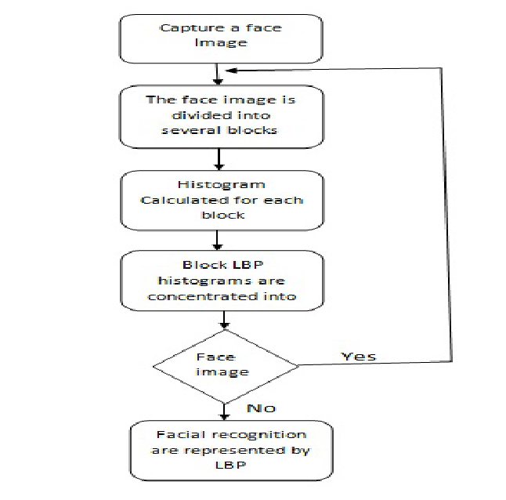
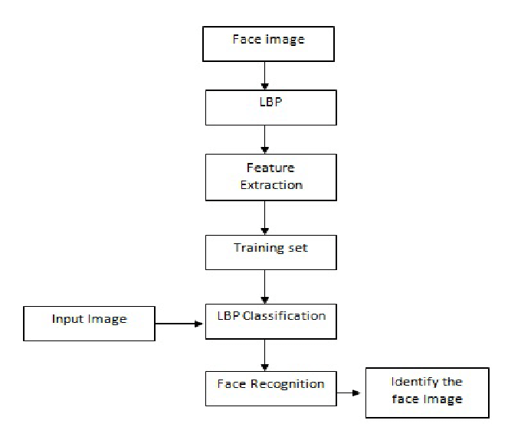

Slide 9
Feature/characteristics Identification
1.Uses LBPH (Local Binary Pattern Histogram) algorithm for face recognization.
2. Score of minimum 100 required to perfectly match a face.
3. Metric : Camera Resolution
4. As prototype, it is fixed to 15 users only but scalable design
5. Requires good lightning condition for better camera capture ability
6. Attendance sheet is .csv file format and can be digitally distributed and maintained.

Slide 10
Constraint Identification
Data Privacy and Ethics
Accuracy vs. False Positives
Extended Training Time
Integration with Existing Systems
Ambient Conditions
Individual Variability

Slide 11
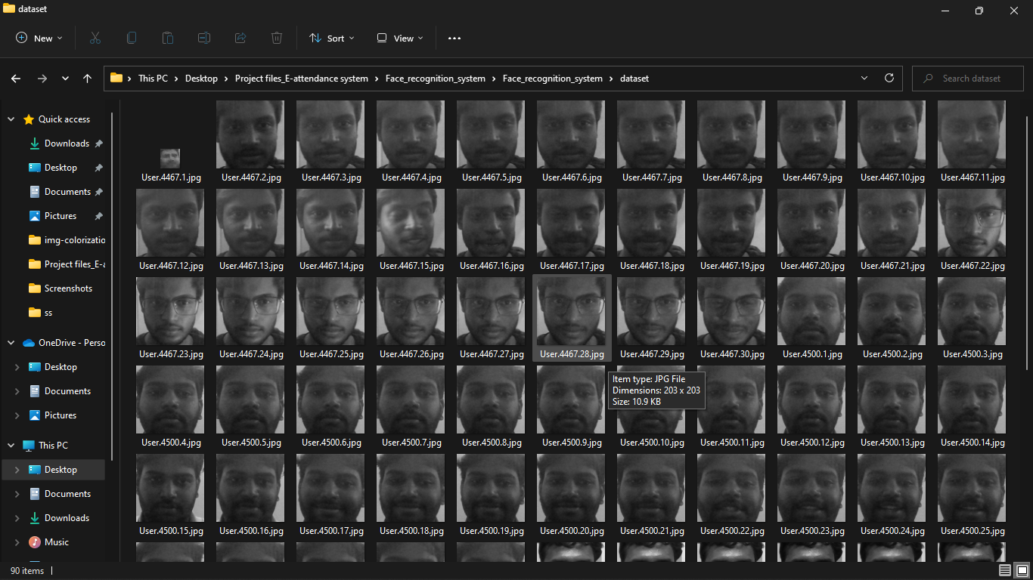
Results and Outputs

Slide 12
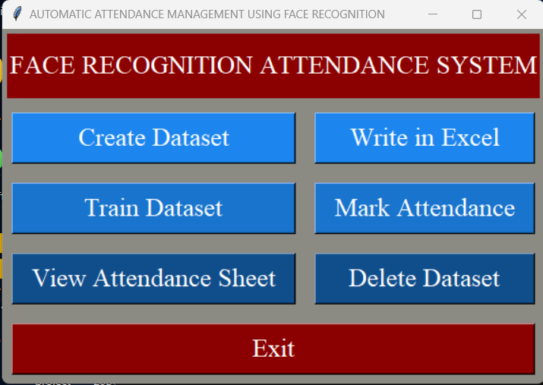

Slide 13
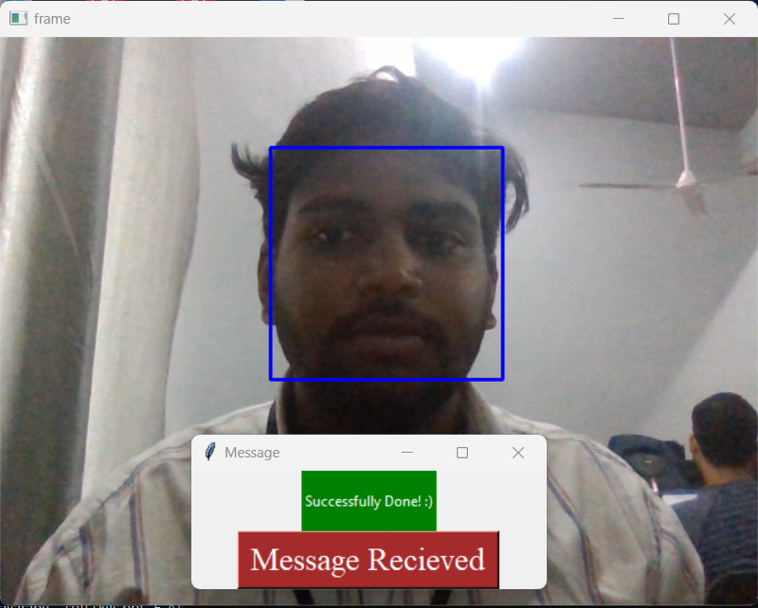

Slide 14
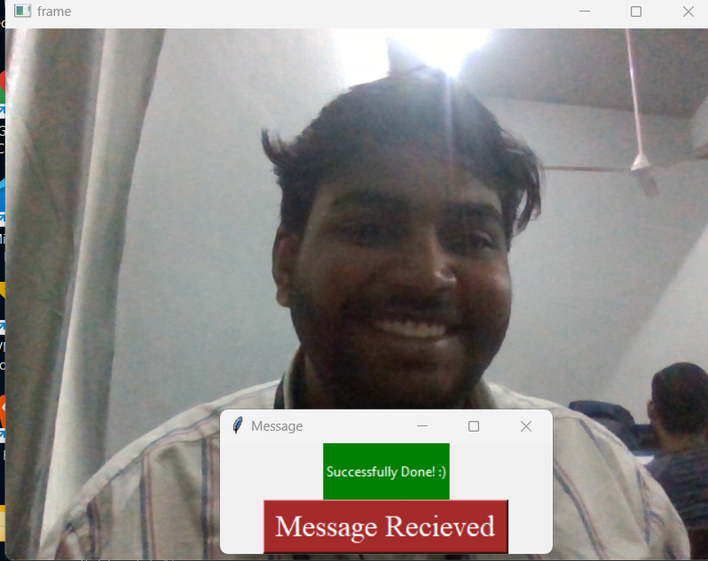

Slide 15
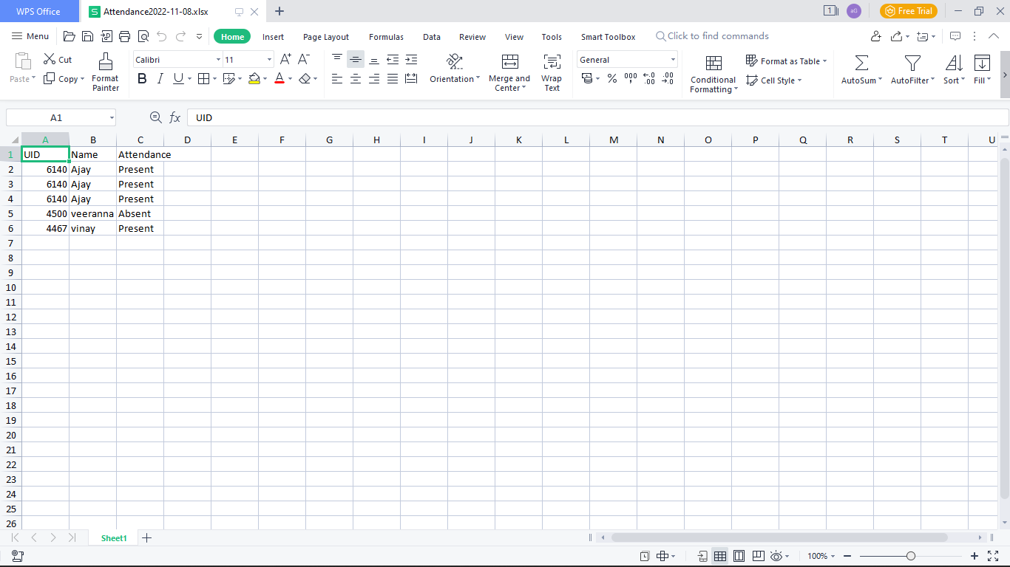

Slide 16
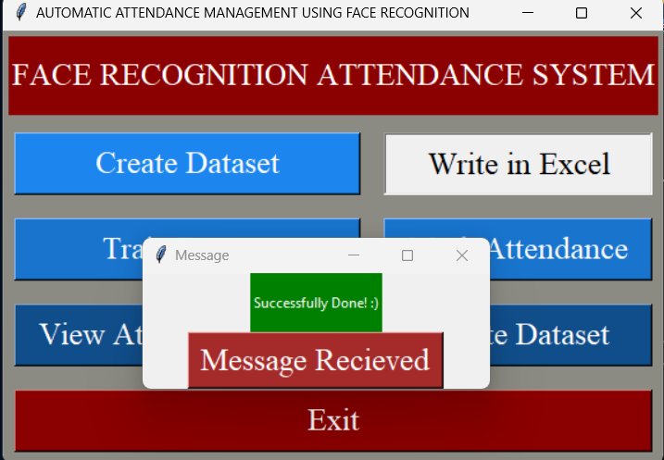

Slide 17
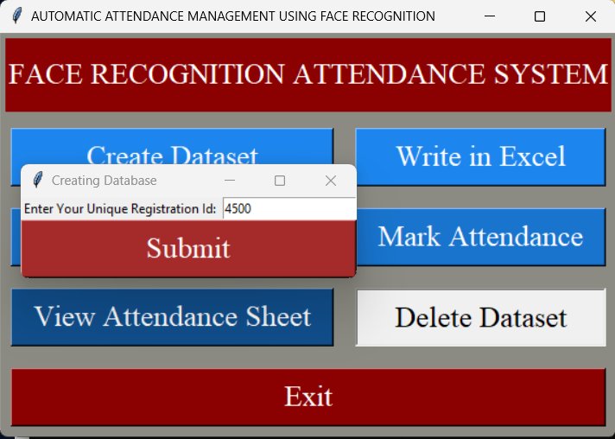

Slide 18
Conclusion
The undertaking has a very widespread scope in future. The assignment can be implemented on intranet in future. Project can be updated in near future as and when requirement for the identical arises, as it is very flexible in terms of expansion. With the proposed software of database Space Manager ready and practical the purchaser is now able to control and therefore run the whole work in a whole lot better, accurate and error free manner. The following are the future scope for the project.
Discontinue of particular student eliminate potential attendance.
Bar code Reader based attendance system.
Attendance administration system maintains music of everyday attendance, working hours, breaks, login, and logout time. It prevents staff's time theft. An attendance management device integrates all attendance gadgets such as clever cards, biometric, and facial recognition devices in real-time

Slide 19
Future Scope
Further research and development can focus on refining the LBPH algorithm to improve its accuracy in facial recognition, especially in challenging conditions such as varying lighting, occlusions, and pose variations.
Future iterations of the E-Attendance system could incorporate real-time monitoring capabilities, allowing for instant identification of individuals and generating alerts for unauthorized access or attendance discrepancies.
Expanding the system to incorporate multiple biometric modalities, such as fingerprint recognition, iris scanning, or voice recognition, could further enhance security and accuracy.
Multi-modal integration can also offer redundancy and improve the system's reliability, especially in cases where facial recognition alone may not be sufficient.
Future versions of the system could prioritize personalization and customization features, allowing institutions to tailor the attendance tracking process according to their specific requirements and preferences.
Customizable interfaces, reporting options, and integration with existing school management systems could enhance user experience and adoption.
Development of mobile applications and cloud-based solutions can offer greater flexibility and accessibility, allowing users to manage attendance data remotely and in real-time.

Slide 20
References
1.https://www.analyticsvidhya.com/blog/2021/07/understanding-face-recognition-using-lbph-algorithm/#:~:text=LBPH%20
2. https://iq.opengenus.org/lbph-algorithm-for-face-recognition/
3. https://iq.opengenus.org/lbph-algorithm-for-face-recognition/
4.https://www.analyticsvidhya.com/blog/2021/07/understanding-face-recognition-using-lbphalgorithm/#:~:text=LBPH%20
5. https://iq.opengenus.org/lbph-algorithm-for-facerecognition/
6. https://iq.opengenus.org/lbph-algorithm-for-facerecognition/
7. https://en.wikipedia.org/wiki/Facial_recognition_system
8. https://docs.opencv.org/3.4/db/d28/tutorial_cascade_cla ssifier.html
9. https://pyimagesearch.com/2021/04/12/opencv-haarcascades/
10. https://www.youtube.com/watch?v=LopYA64KmdE

Slide 21
1.Akbar, Md Sajid, et al. "Face Recognition and RFID Verified Attendance System." 2018 International Conference on Computing, Electronics & Communications Engineering (iCCECE). IEEE, 2018.
2.Okokpujie, Kennedy O., et al. "Design and implementation of a student attendance system using iris biometric recognition." 2017 International Conference on Computational Science and Computational Intelligence (CSCI). IEEE, 2017
3.Rathod, Hemantkumar, et al. "Automated attendance system using machine learning approach." 2017 International Conference on Nascent Technologies in Engineering (ICNTE). IEEE, 2017.
4.Siswanto, Adrian Rhesa Septian, Anto Satriyo Nugroho, and Maulahikmah Galinium. "Implementation of face recognition algorithm for biometrics-based time attendance system." 2014 International Conference on ICT For Smart Society (ICISS). IEEE, 2014
5.Lukas, Samuel, et al. "Student attendance system in classroom using face recognition technique." 2016 International Conference on Information and Communication Technology Convergence (ICTC). IEEE, 2016
6.Salim, Omar Abdul Rhman, Rashidah Funke Olanrewaju, and Wasiu Adebayo Balogun. "Class attendance management system using face recognition." 2018 7th International Conference on Computer and Communication Engineering (ICCCE). IEEE, 2018.

