Slide 1
Project Proposal: Landlord-Off
Chuyi Zhao Xinru Xu Miao Li Qingting Jiang

Slide 2
Proposal
01.
why landlord-off
CONTENTS
02.
methods to use
03.
what we've done
04.
more？

Slide 3
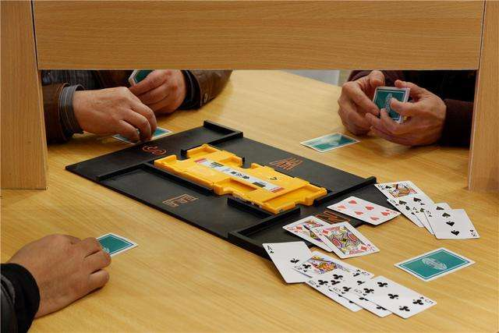
Why Landlord-off?

Slide 4

Why Landlord-off?

Slide 5
Methods we intend to use
random
Game Tree
Reinforcement Learning

Slide 6
What we have done
a random agent

Slide 7
More?
improvement?
GAN

Slide 8
Thanks for Listening!
Q & A

