Slide 1

Retail Store Stock
Inventory Analytics
Jayani Narra (2083) | Nivedha V. (2090) | Nivethaa M. (2091)

Slide 2

OBJECTIVE
Retail store handles stock in large scale on daily basis that makes the monitoring and managing of the inventory more tedious. This brings in the need for a digitized inventory management system that performs retail store stock analytics to achieve less inventory on hand and more stocks on sale with less manual labor. The objective of the proposed work is to handle and manage the bulk stock in retail store in an efficient digitized way involving less labor.

Slide 3

Retail sector handles stock in bulk quantities which brings in the need for a digitized system that can analyze and help managing the inventory effectively. Analytics in this sector has become a mandatory supporting component as the business actions and decisions are taken potently and quickly based on it. Here the proposed work uses SARIMA (Seasonal Autoregressive Integrated Moving Average) statistical analysis model for performing the analysis on the retail store data. Data sets used in this model are as the sales history of the store, inventory and demand history of the store. Unlike other data analytics model, SARIMA has seasonal component ans uses parameters as p(auto-regressive order), d(degree of differencing), q(moving-average order), P(seasonal AR order), D(seasonal differencing) and Q(seasonal MA order) that help in handling seasonal time series data. Also, SARIMA model has smaller MAD (Mean Absolute Deviation) value when compared to widely used Holt Winter’s Exponential Smoothing model which makes it outperform other time series analytics model. Overall, the SARIMA model efficiently performs the retail store stock inventory analytics and calculates the inventory needed to fulfill the customer requirements over a period of time benefiting the retail store with maximum profit.
ABSTRACT

Slide 4

PROJECT SCOPE
The project focuses on implementing an efficient model for maintaining the retail store inventory. Thus the proposed work uses SARIMA time series forecasting model for stock inventory analytics along with NewsVendor formula to calculate parameters as optimal order quantity, reorder point, safety stock and estimated cost to maintain the inventory. Datasets used in modelling are as the demand of the stock over time and inventory level over time.

Slide 5
EXISTING SYSTEM - DISADVANTAGES
Different time series forecasting models are available to forecast the future need based on the previous time series data. Some of these models used in retail sector to forecast inventory are as the LSTM (Long Short-Term memory) model, Simple Exponential Smoothing model, Double Exponential Smoothing model, Holt Winter's Exponential Smoothing model, ARIMA (Autoregressive Integrated Moving Average) model etc. Though these models forecast and predict the future inventory need, the accuracy of the result obtained is not very efficient. This is analyzed by comparing the MAPE, MAR and RMSE error values. Thus an efficient retail store stock inventory analytics model is needed to forecast the optimal inventory needed to fulfill the customer orders.

Slide 6
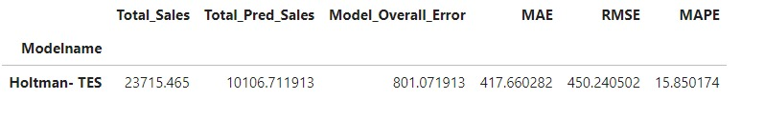
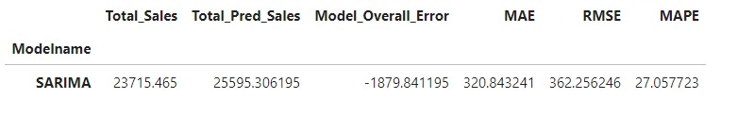
COMPARING THE ERROR RATES

Slide 7
PROPOSED SYSTEM - ADVANTAGES
The proposed solution addresses the problem in managing the retail store inventory using the time series forecasting algorithm. Out of the different models available in this algorithm, SARIMA (Seasonal Autoregressive Integrated Moving Average) model is preferred as it outperforms the others with its ability to forecast future need with past seasonal time series data. SARIMA when compared with the other time series analytics model produces smaller MAD (Mean Absolute Deviation) value. This makes SARIMA model feasible to be used for forecasting. SARIMA has three non-seasonal parameters as p(AR order), d(degree of differencing), q(MA order) and three seasonal parameters as P(seasonal AR order), D(seasonal differencing), Q(seasonal MA order) that are calculated using ACF (Autocorrelation function) and PACF (Partial autocorrelation function). Newsvendor formula is used in the proposed SARIMA model to calculate the optimal order quantity for the inventory. Overall the proposed SARIMA model predicts the optimal inventory needed to fulfill future customer orders over a period of time.

Slide 8
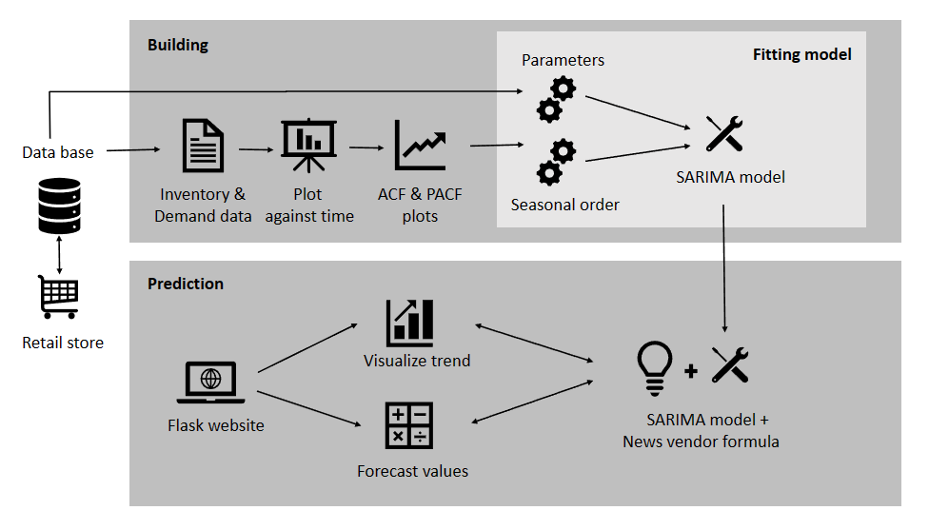
SYSTEM ARCHITECTURE

Slide 9
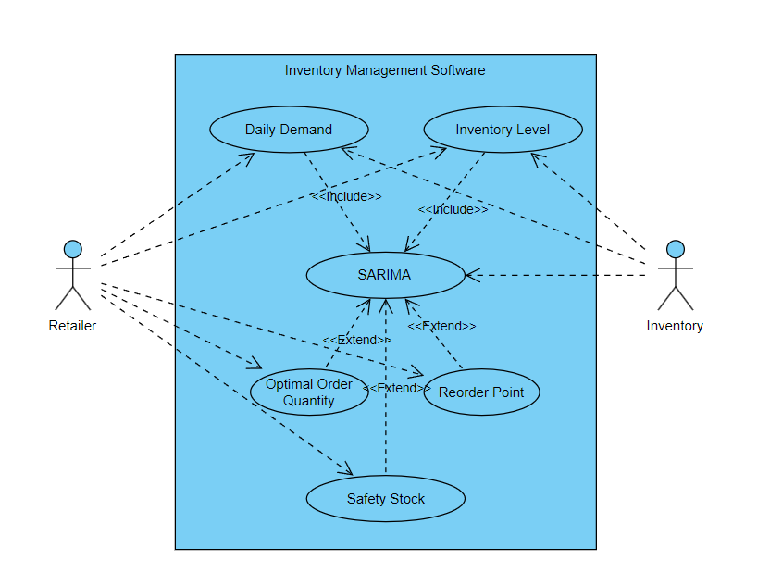
USE CASE DIAGRAM

Slide 10
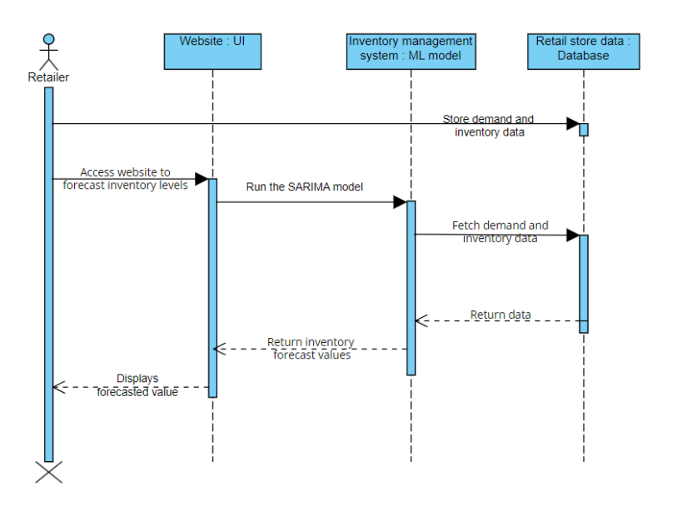
SEQUENCE DIAGRAM

Slide 11
SCREEN SHOTS

Slide 12
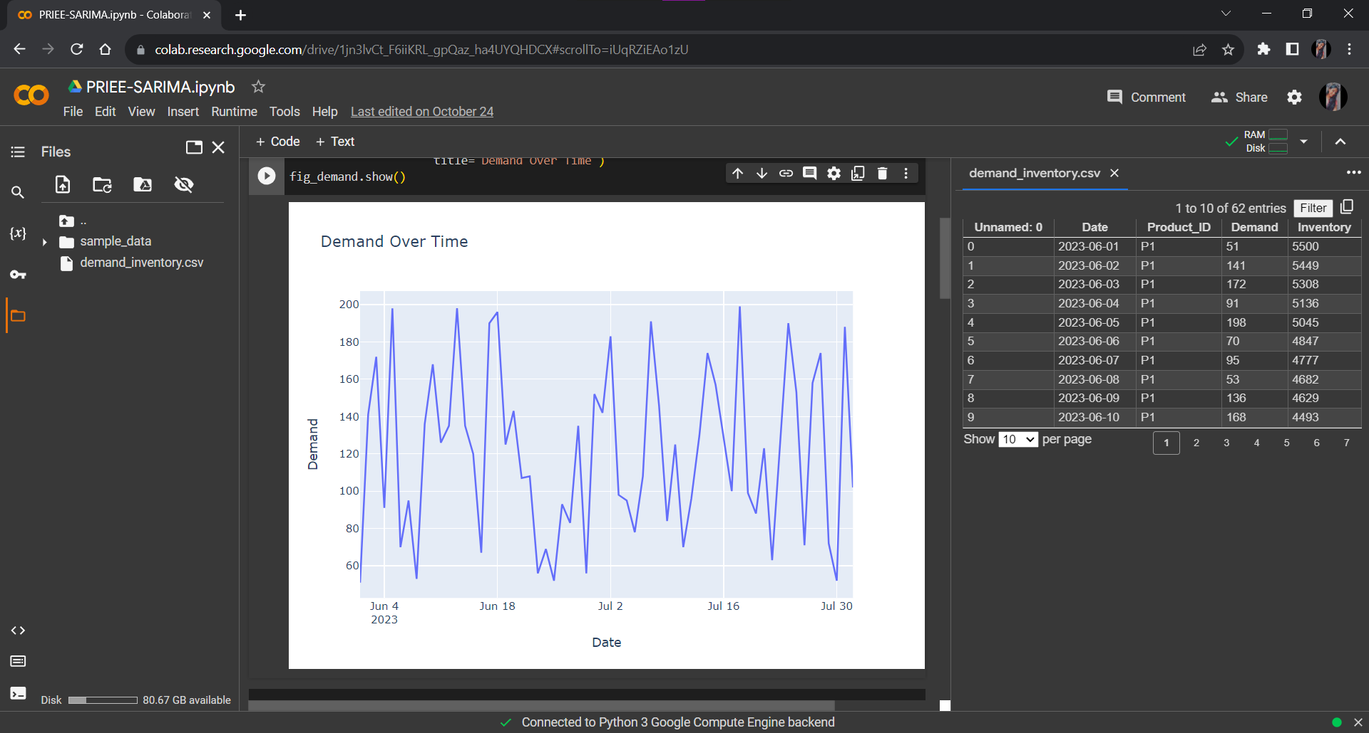
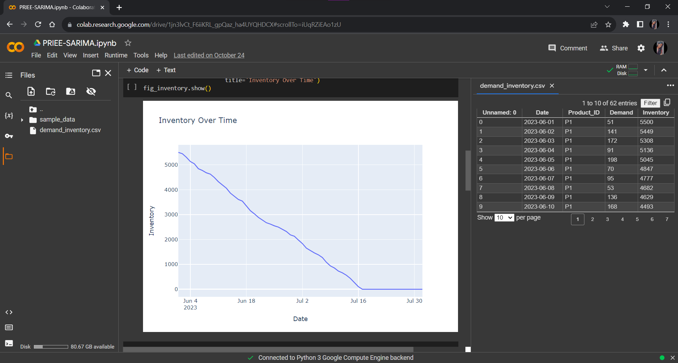
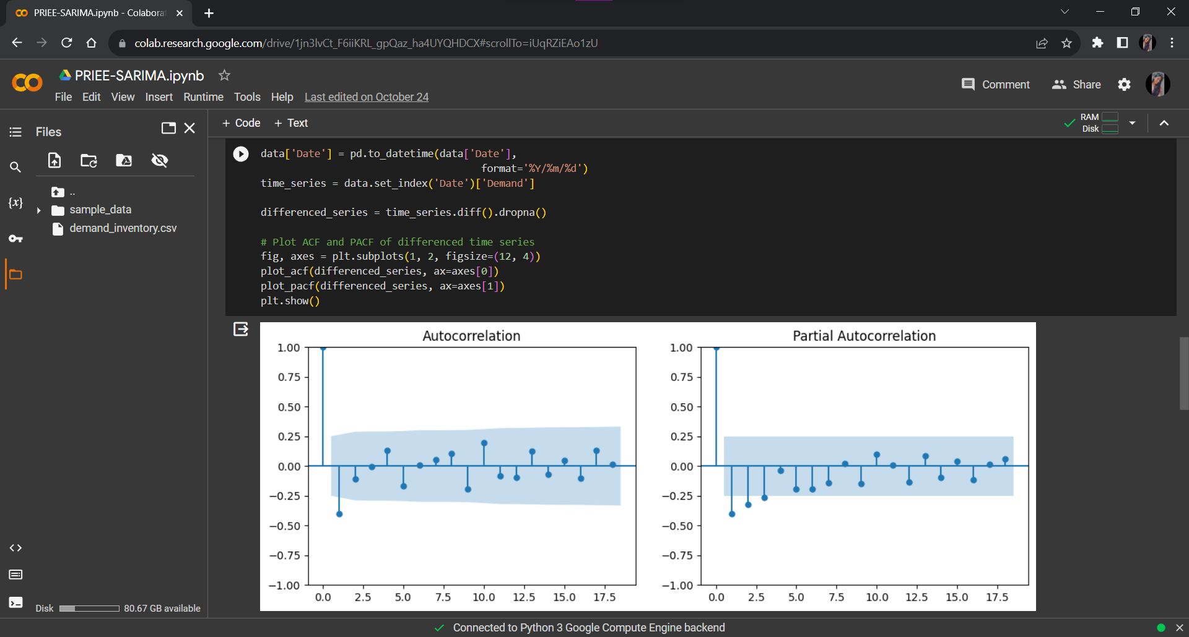

Slide 13
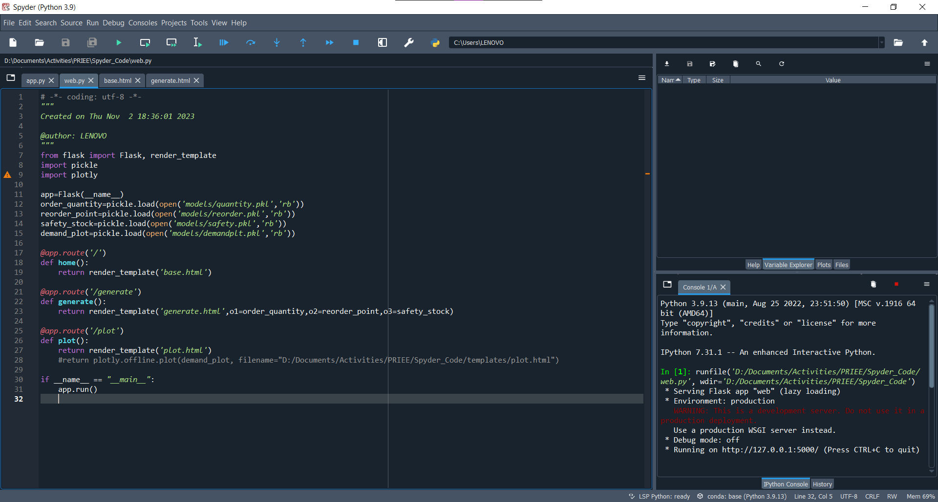
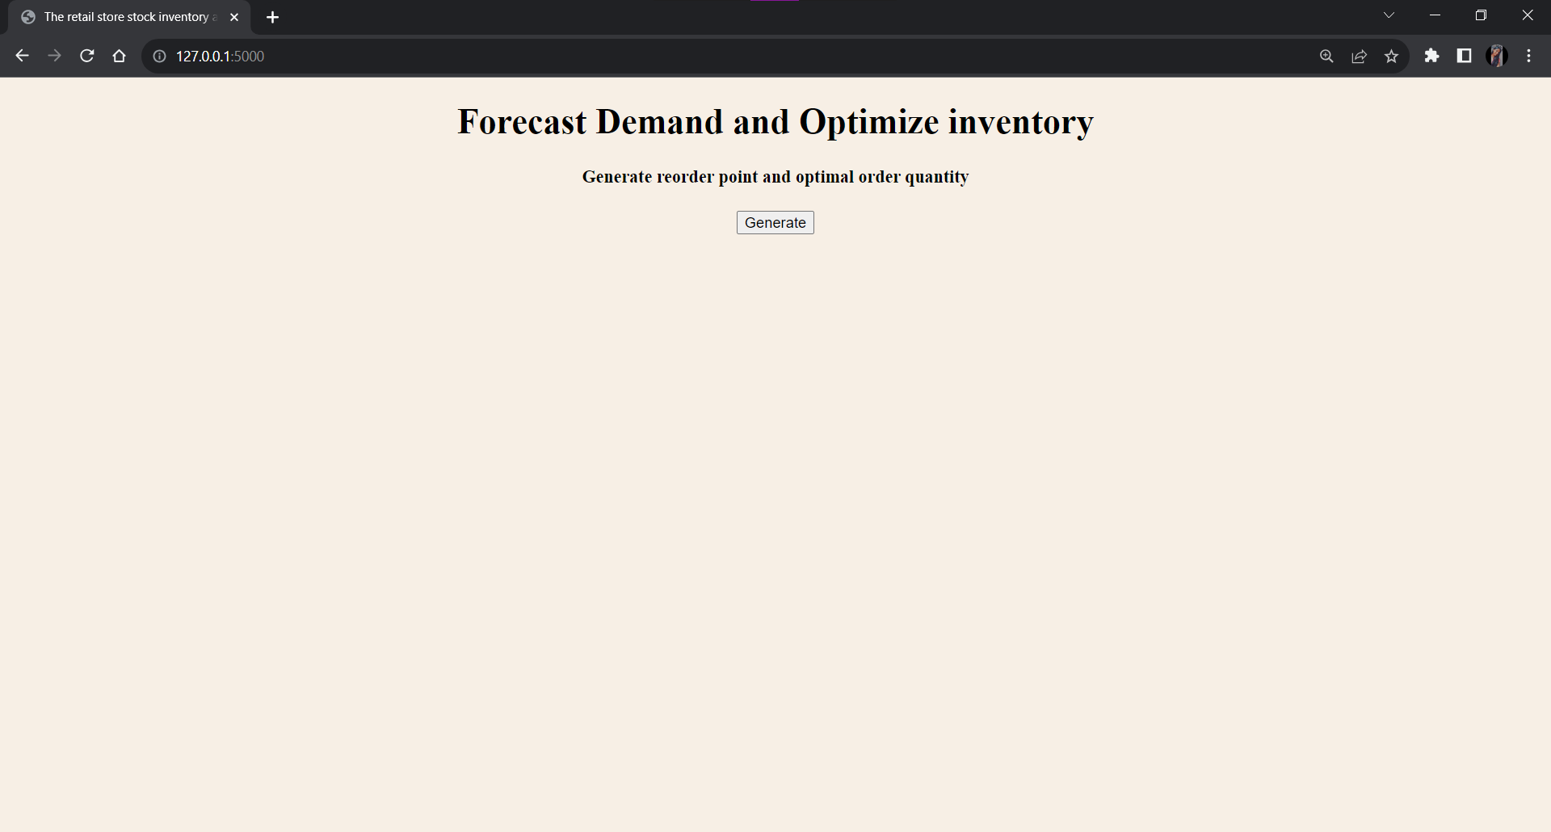
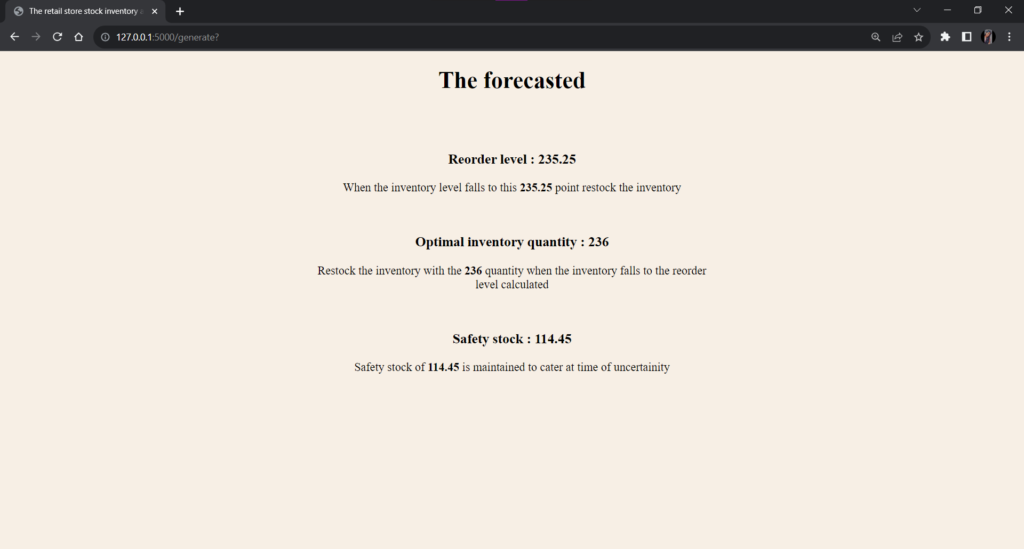

Slide 14

CONCLUSION
Using the time series algorithm and News vendor model the retail store stock inventory analytics is done. Among the different time series algorithms the SARIMA algorithm is used. as it is found to be efficient from other time series algorithms like ARIMA, exponential smoothing, LSTM and other. Thus, the proposed SARIMA model digitized the retail store stock inventory management in an efficient way using the Newsvendor formula to calculate the optimal inventory needed fulfill the customers while benefiting the retailers with maximum profit.

Slide 15
Thank You

