Slide 1
EMPLOYEE BURNOUT ANALYSIS AND PREDICTION

Slide 2

Student details :
Name : Deepika Jonnakuti
SkillsBuild Email ID : deepikajonnkuti@gmail.com
College Name : Vignan's Nirula Institute of Technology and Science for Women
College State: Andhra Pradesh
Internship Domain : Artificial Intelligence
Internship Start Date : 09/06/2023
Internship End Date : 23/07/2023

Slide 3
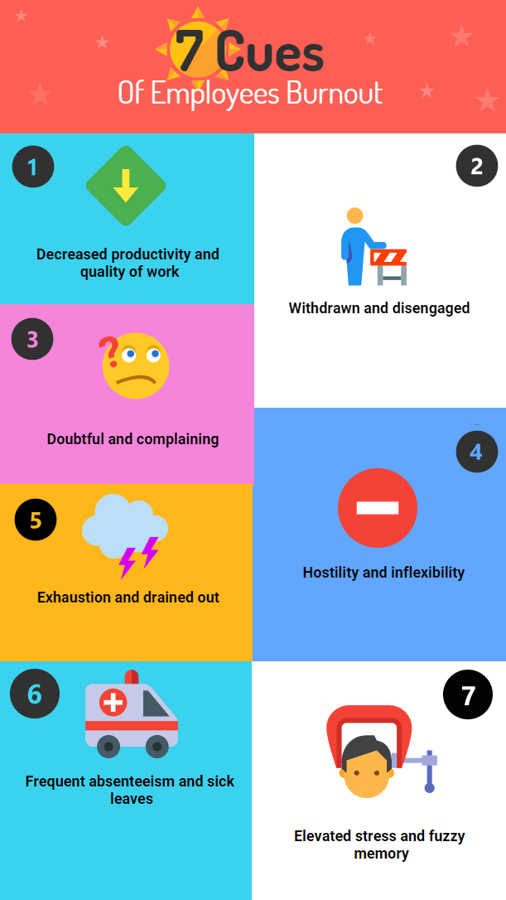
Employee Burnout Analysis :
One of the main factors contributing to employee burnout is a lack of work-life balance. Many workers put in long hours and do not take enough breaks, leading to exhaustion and stress.
Companies lose billions of dollars a year due to the epidemic of employee burnout that is prevalent today. It results in increased absenteeism, personnel turnover, and decreased productivity.

Slide 4
Agenda :
Early detection of these warning signs is essential since employee burnout has an impact on your team's general health as well as your bottom line.
Additionally, it may hinder your capacity to expand your firm swiftly.
Burnout can lead to poorer self-esteem, less involvement and loyalty, and poor customer service.
Chronic fatigue, disengagement, low motivation and poor performance are some telltale signs of Employee burnout that companies need to pay close attention to.
If your best employees suddenly aren’t completing projects, are falling short on goals or have gone quiet, you may be dealing with a staff that’s burned out.

Slide 5
Project Overview :
Introduction
Utilising artificial intelligence and machine learning techniques, the project's goal is to understand employee burnout and take steps to avoid it.
Data Collection
For a better understanding of employee burnout, the project gathers information through surveys, examination of social media postings, examination of emails, and other digital sources.

Slide 6
Uses of Employe Burnout Analysis :
The system creates personalized interventions for employees based on their individual risk factors and needs.
The system can be easily integrated into existing HR platforms, making it easy for businesses to adopt.
Increased ability to keep employees. Employees are more likely to stay with their present employment when they don't feel too worried. Additionally, a company that encourages a low-stress workplace is a desirable choice for potential employees.
Reduced costs to the employer.
The system collects data in real-time, providing managers and employees with up-to-date information about their well-being and productivity.

Slide 7

End Users :
The system's personalized interventions can help employees better manage their workload, improve their work-life balance, and prevent burnout, leading to a happier and more productive workforce
The method may be used by human resources departments to raise employee morale, productivity, and engagement while lowering absenteeism and staff turnover costs.

Slide 8
Solution :
Make managers responsible for addressing burnout.
Make wellbeing part of your culture. Incorporate the five elements of wellbeing into regular conversations and work practices.
Set role expectations and structure jobs to make work more manageable and engaging. Ensure that workload and time pressures are reasonable.
Design ideal environments that are as comfortable and inviting as possible. Employees need spaces for both gathering and getting away from the buzz.
Encourage teamwork and shared accountability. When people work together and support one another, the workload gets lighter and challenges seem smaller.

Slide 9
Value Proposition :
Customized Interventions and Support: Our solution enables organizations to design targeted interventions tailored to the specific needs of individuals and teams. By understanding the unique factors contributing to burnout, organizations can implement personalized support mechanisms, such as counseling, training programs, and work-life balance initiatives.
Early Identification and Prevention: Our solution helps organizations identify individuals and teams at risk of burnout at an early stage. By leveraging predictive models, we can detect patterns and risk factors associated with burnout, enabling proactive measures to prevent its occurrence. This early identification allows for timely interventions and the implementation of preventive strategies, minimizing the negative impact on employees' well-being and productivity.
Data-Driven Decision Making: Our solution relies on data analysis and predictive modeling to provide evidence-based insights. By leveraging historical data, performance metrics, and employee feedback, organizations can make informed decisions regarding workload distribution, resource allocation, and intervention strategies.

Slide 10
Customaisation of the project:
Customize Data Collection:
Adapt the data collection methods to capture relevant information specific to your organization. This may include designing surveys or questionnaires that assess workload, job demands, organizational support, and individual characteristics. Additionally, consider integrating data from existing HR systems, such as performance metrics and absenteeism records, to provide a comprehensive view of employee well-being.
Refine Predictive Models:
Customize the predictive models to align with your organization's data and requirements. Consider variables that may be unique to your context, such as industry-specific factors or cultural aspects. Train and refine the models using historical data specific to your organization to improve their accuracy and applicability.

Slide 11
Modelling :
Modelling methods Used :
Logistic Regressions
Decision Trees
Random Forests
Support Vector Machines
Neural Networks
Time Series Analysis
Using the Artificial Intelligence we were able to analyze the burnout rates of the employees and found the appropriate results in a short period of time . Using AI made the process much more simple and efficient making the cause and prevention easy.
Here are some of the results we acquired from the data given showcasing the burnout rates with respective to the designation, gender, resource allowance and organizational types.

Slide 12
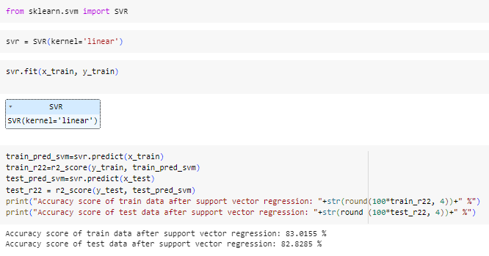

Slide 13

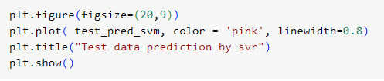
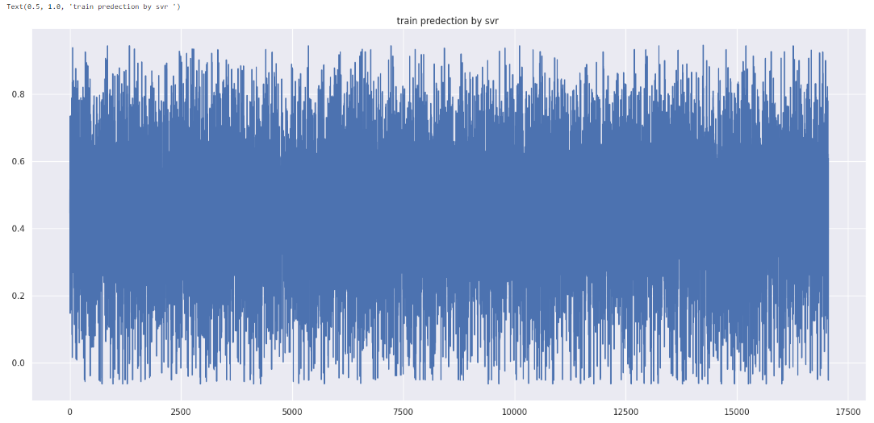
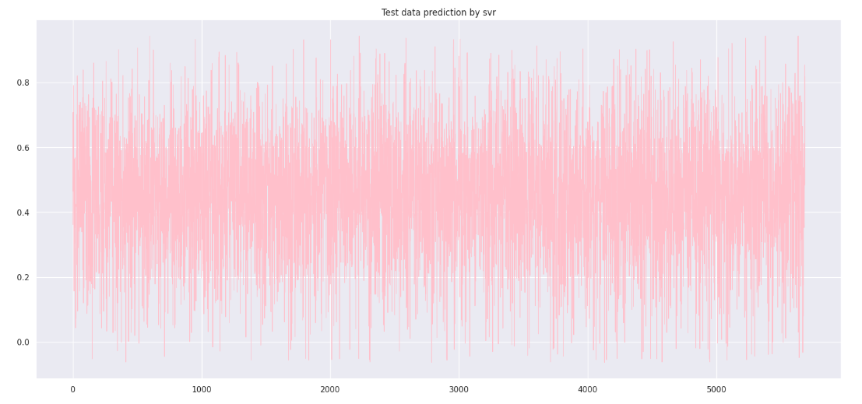

Slide 14
Results :
Through analysis, you may discover the key risk factors and patterns associated with burnout within your organization. This could include workload, job demands, lack of support, or specific organizational characteristics. Understanding these factors can guide the development of targeted
By utilizing predictive models, you can identify employees who are at a higher risk of experiencing burnout. The models can assign probabilities or risk scores to each individual, enabling you to prioritize interventions and support for those who need it the most.
Burnout analysis can shed light on the impact of burnout on organizational outcomes. This may include measuring the correlation between burnout levels and productivity, absenteeism rates, turnover rates, or employee engagement. Such insights can help quantify the costs and consequences of burnout and emphasize the need for intervention.

Slide 15
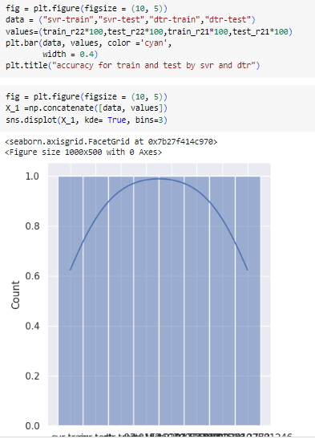

Slide 16
links :
Employee burnout source code
https://drive.google.com/drive/my-drive
https://www.ncbi.nlm.nih.gov/pmc/articles/PMC4911781/#:~:text=The%20three%20key%20dimensions%20of,ineffectiveness%20and%20lack%20of%20accomplishment
https://www.kaggle.com/code/mazharjamdar/employee-burnout/input

