Slide 1
EMPLOYEE BURNOUT ANALYSIS AND PREDICTION

Slide 2
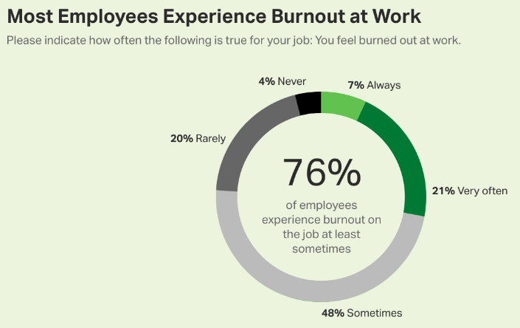
Employee Burnout Analysis :
Companies lose billions of dollars a year due to the epidemic of employee burnout that is prevalent today. It results in increased absenteeism, personnel turnover, and decreased productivity.
Lack of work-life balance is among the major causes of employee burnout. Exhaustion and stress are common side effects of lengthy workdays and insufficient breaks among employees.

Slide 3
Agenda :
Companies need to pay particular attention to some of the warning indicators of employee burnout, which include chronic weariness, disengagement, low motivation, and poor performance.
You may be dealing with a burned-out workforce if your top performers suddenly stop completing projects, don't meet targets, or stop communicating.
Early detection of these warning signs is essential since employee burnout has an impact on your team's general health as well as your bottom line.
Additionally, it may hinder your capacity to expand your firm swiftly.
Burnout can lead to poorer self-esteem, less involvement and loyalty, and poor customer service.

Slide 4
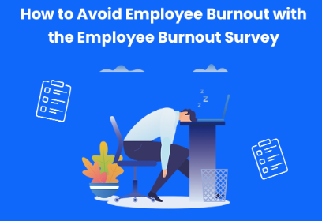
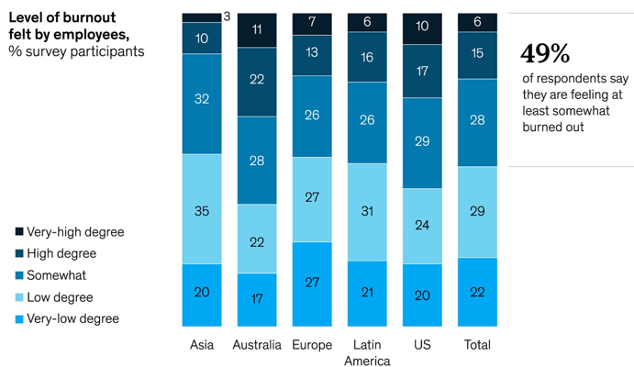
Project Overview :
Introduction :
Data Collection :
Utilising artificial intelligence and machine learning techniques, the project's goal is to understand employee burnout and take steps to avoid it.
For a better understanding of employee burnout, the project gathers information through surveys, examination of social media postings, examination of emails, and other digital sources.

Slide 5
Uses of Employe Burnout Analysis :
Employees' physical and emotional well-being has improved, and there have been fewer absences and sick days taken. One of the main factors influencing employee absenteeism is stress. Employees can need fewer “mental health days" and sick days if they work in a low-stress environment.
Increased ability to keep employees. Employees are more likely to stay with their present employment when they don't feel too worried. Additionally, a company that encourages a low-stress workplace is a desirable choice for potential employees.
Improved work-life balance.
Reduced costs to the employer.
Increased work satisfaction and morale. Healthy workers who experience acceptable amounts of stress are happier and more optimistic. A setting like this at work encourages creativity and productivity.
Reduced costs to the employer.

Slide 6


End Users :
Employees
Human Resources
The system's personalized interventions can help employees better manage their workload, improve their work-life balance, and prevent burnout, leading to a happier and more productive workforce.
The method may be used by human resources departments to raise employee morale, productivity, and engagement while lowering absenteeism and staff turnover costs.

Slide 7
Solution :
Make managers responsible for addressing burnout.
Set role expectations and structure jobs to make work more manageable and engaging. Ensure that workload and time pressures are reasonable.
Encourage teamwork and shared accountability. When people work together and support one another, the workload gets lighter and challenges seem smaller.
Design ideal environments that are as comfortable and inviting as possible. Employees need spaces for both gathering and getting away from the buzz.
Make wellbeing part of your culture. Incorporate the five elements of wellbeing into regular conversations and work practices.

Slide 8
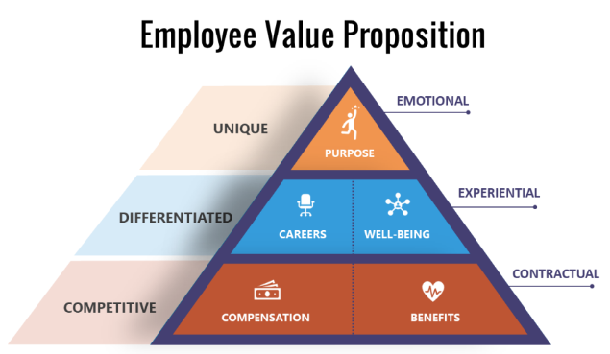
Value Proposition :
Data-Driven Decision Making:
Our solution relies on data analysis and predictive modeling to provide evidence-based insights. By leveraging historical data, performance metrics, and employee feedback, organizations can make informed decisions regarding workload distribution, resource allocation, and intervention strategies.
Customized Interventions and Support:
Our solution enables organizations to design targeted interventions tailored to the specific needs of individuals and teams. By understanding the unique factors contributing to burnout, organizations can implement personalized support mechanisms, such as counseling, training programs, and work-life balance initiatives.

Slide 9
Early Identification and Prevention:
Our solution helps organizations identify individuals and teams at risk of burnout at an early stage. By leveraging predictive models, we can detect patterns and risk factors associated with burnout, enabling proactive measures to prevent its occurrence. This early identification allows for timely interventions and the implementation of preventive strategies, minimizing the negative impact on employees' well-being and productivity.
Improved Organizational Performance:
Addressing employee burnout has a direct impact on overall organizational performance. By preventing burnout and promoting employee well-being, organizations can enhance productivity, reduce absenteeism and turnover rates, and improve employee engagement.

Slide 10
Customaisation of the project :
Tailor the Objectives:
Based on the requirements of your organization, precisely outline the objectives of your employee burnout study and prediction project. Examples include anticipating burnout in high-potential individuals, identifying burnout risk factors in a specific department or team, or evaluating the success of current well-being initiatives.
Refine Predictive Models:
Make the prediction models specific to the information and needs of your organization. Take into account issues that may be particular to your situation, such as those that pertain to your sector or culture. To increase the models' accuracy and applicability, train and enhance them using historical data that is unique to your organization.
Customize Data Collection:
Adjust the data collecting techniques to get pertinent data unique to your organization. Creating surveys or questionnaires to evaluate workload, job demands, organizational support, and individual characteristics may fall under this category. To give a thorough picture of employee wellbeing, also think about combining data from current HR systems, such as performance metrics and absence records.

Slide 11
Modelling :
Modelling methods Used:
Logistic Regressions
Decision trees
Random Forests
Time Series Analysis
Support Vector Machines(SVM)
Neural Networks
Modelling methods vary depending on the data at hand, the nature of the issue, and the precise objectives of your investigation. Before using any modelling approach, it is critical to preprocess the data, manage missing values, and choose the right features. To verify the models' dependability and generalizability, think about analysing their performance using the right metrics and testing them using hypothetical data.
The following data was collected with the use of artificial intelligence utilising Google Collab, employee data sets, and the source code model that was made available to us.
Here are some of the results we acquired from the data given showcasing the burnout rates with respective to the designation, gender, resource allowance and organizational types.

Slide 12
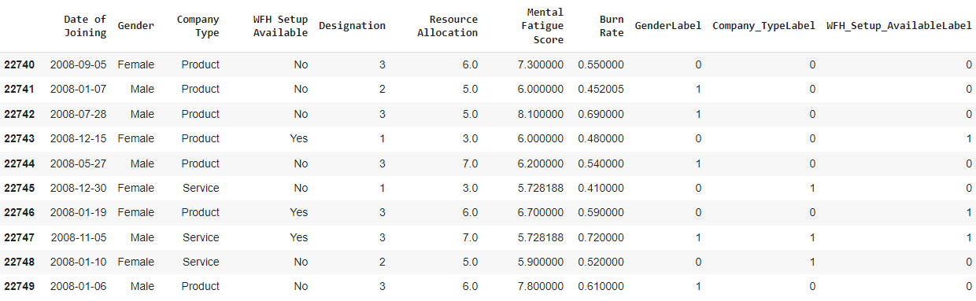
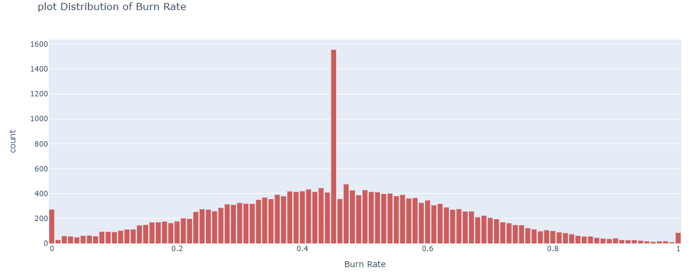

Slide 13
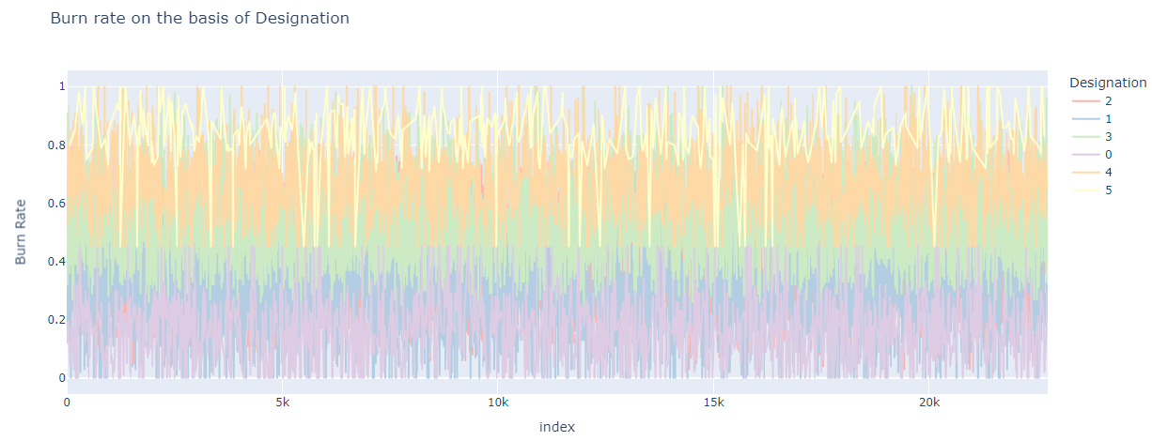
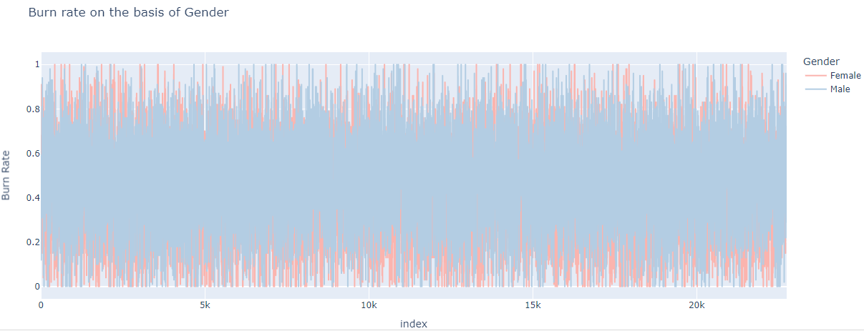

Slide 14
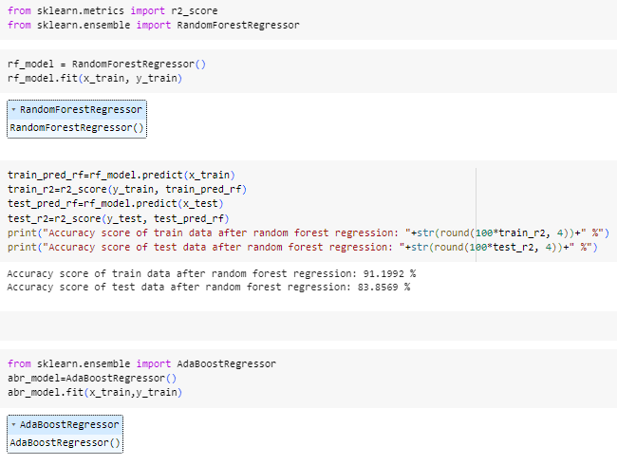

Slide 15
Results :
The findings of analyses and forecasts of employee burnout can offer important insights on the incidence of burnout within an organization, the causes of it, and the identification of those who are at risk. Here are some possible outcomes that you may get:
Identification of High-Risk Individuals :- Employers who are more likely to burn out can be identified by using predictive models. The models may give each person a probability or risk score, allowing you to focus interventions and assistance on those who need it the most.
Risk Factors and Patterns :- Through analysis, you may identify the main risk factors and trends related to burnout in your company. This could refer to the volume of work, the demands of the position, a lack of assistance, or certain organizational traits. Understanding these elements can help in the creation of specialised preventative plans and treatments.
Insights into Organizational Impact :- Analysis of burnout can provide insight into how it affects organizational outcomes. This might involve tracking the relationship between employee engagement, absenteeism, or burnout levels and productivity. Such information can highlight the need for intervention and assist quantify the costs and effects of burnout.

Slide 16
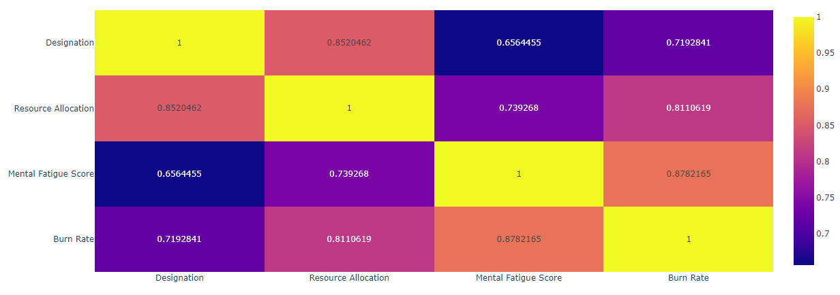
Here is an overall graph of the burnout rate respective to different factors .

