Slide 1

Basic Details of the Team and Problem Statement
Ministry/Organization Name/Student Innovation: All India Council for Technical Education (AICTE)
PS Code : DR702
Problem Statement Title : AI based Chatbot to answer FAQs
Team Name :
Team Leader Name : Medam Sai Pranathi
Institute Code :
Institute Name : PSG College of Technology
Theme Name :

Slide 2
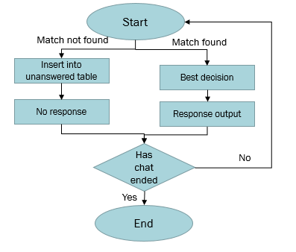
Idea/Approach Details
Describe your idea/Solution/Prototype here:
AI based Chatbot creates answers to queries based on FAQs.
It includes categorization of queries.
Fast, accurate and reliable responses are delivered instantaneously.
Describe your Technology stack here:
Flutter
Dart
Python (prototype)
SQL (prototype)

Slide 3
Idea/Approach Details
Describe your Use Cases here
Describe your Dependencies / Show stopper here
FAQ’s include information regarding :
Announcements
Internships
Universities
Schemes
Education
Opportunities
and other features provided by AICTE.
This chatbot offers a set of categories with predefined queries.
The user can also provide their own/custom query to seek solution.
UI is simple and easy to cope up.

Slide 4
Team Member Details
Team Leader Name: Medam Sai Pranathi
Branch (Btech/Mtech/PhD etc): MSc (integrated) Stream (ECE, CSE etc): Software Systems Year (I,II,III,IV): ll
Team Member 1 Name: Sai Dinesh B
Branch (Btech/Mtech/PhD etc):MSc (integrated) Stream (ECE, CSE etc): Software Systems Year (I,II,III,IV): ll
Team Member 2 Name: Abishek A
Branch (Btech/Mtech/PhD etc): MSc (integrated) Stream (ECE, CSE etc): Software Systems Year (I,II,III,IV): ll
Team Member 3 Name: Karthik K M
Branch (Btech/Mtech/PhD etc): MSc (integrated) Stream (ECE, CSE etc): Software Systems Year (I,II,III,IV): ll
Team Member 4 Name: Raghavan M
Branch (Btech/Mtech/PhD etc): MSc (integrated) Stream (ECE, CSE etc): Software Systems Year (I,II,III,IV): ll
Team Member 5 Name: Vijay Krishna D
Branch (Btech/Mtech/PhD etc): MSc (integrated) Stream (ECE, CSE etc): Software Systems Year (I,II,III,IV): ll
Team Mentor 1 Name: Type Your Name Here
Category (Academic/Industry): Expertise (AI/ML/Blockchain etc): Domain Experience (in years):
Team Mentor 2 Name: Type Your Name Here
Category (Academic/Industry): Expertise (AI/ML/Blockchain etc): Domain Experience (in years):

Slide 5
Important Pointers
Please ensure below pointers are met while
Kindly keep the maximum slides limit to 4 pages
All the topics should be utilized for description of your idea
Try to avoid paragraphs and post your idea in points
Keep your explanation precisely and easy to understand
Idea should be unique and novel. If it has a business potential more weightage will be given.
Apart from this PPT abstract of your idea will be asked separately while submitting
You need to save the file in PDF and upload the same on portal. No PPT, Word Doc or any other format will be supported
You can delete this slide (Important Pointers) when you upload the details of your idea on SIH portal.

