Slide 1
LINUX MINI PROJECT
Linux System Health
& Predictive Monitoring
Bash and Linux commands in WSL
01 / 10
Notes:
Good morning, ma'am. My name is Bollini Chandana Sai. My project is Linux System Health and Predictive Monitoring. I run it in the WSL terminal using Bash and standard Linux commands. It reads resource counters, saves a history, estimates usage for the next minute and shows warnings. A generated HTML page provides the frontend. I will explain the working, the commands and the actual verification results.
Evidence: Linux_System_Health_Report.docx, Bash project verification on 25 October 2026. Actual readings and browser snapshot come from a controlled Ubuntu 24.04.3 Linux container, not the student WSL laptop. The HTML dashboard is generated locally without a runtime web server. Known-input prediction checks are explicitly labeled test fixtures.

Slide 2
Project purpose and working
Purpose
Working
Monitor CPU, memory, disk
and network activity.
Keep readings and flag high usage.
1
Read Linux counters
2
Save observations as CSV
3
Calculate trends with awk
4
Generate the HTML dashboard
Sampling: 5 seconds Forecast horizon: 60 seconds
02 / 10
Notes:
This project makes Linux resource usage easier to observe. The Bash loop reads the system counters, awk calculates percentages, and the program saves observations as CSV. The latest twenty readings are used to estimate the next minute of resource usage. The generated dashboard shows measured history, forecasts and warnings. The normal collection delay is five seconds. The browser reloads the local HTML file every five seconds. The Linux environment is running through WSL on Windows.
Evidence: Linux_System_Health_Report.docx, Bash project verification on 25 October 2026. Actual readings and browser snapshot come from a controlled Ubuntu 24.04.3 Linux container, not the student WSL laptop. The HTML dashboard is generated locally without a runtime web server. Known-input prediction checks are explicitly labeled test fixtures.

Slide 3
Commands to start in WSL
cd /mnt/c/Users/bezaw/Downloads/
Linux_System_Health_Project
Type the folder path above as one continuous command.
Command | Meaning
ls | Check the project files
explorer.exe . | Open the folder in Windows
bash linux_health.sh | Start the Bash collector
Open health-data/dashboard.html in Chrome or Edge.
Keep the WSL terminal running. Press Ctrl+C to stop.
03 / 10
Notes:
After extracting the ZIP into Downloads, I open WSL and enter the project folder shown on the slide. The command cd changes the working directory. ls lists the files so I can check that the Bash script, awk file and HTML template are together. explorer.exe followed by a dot opens that folder in Windows File Explorer. I then run bash linux_health.sh and keep the terminal open. After the first sample, I open health-data and double-click dashboard.html in Chrome or Edge. Ctrl+C stops monitoring.
Evidence: Linux_System_Health_Report.docx, Bash project verification on 25 October 2026. Actual readings and browser snapshot come from a controlled Ubuntu 24.04.3 Linux container, not the student WSL laptop. The HTML dashboard is generated locally without a runtime web server. Known-input prediction checks are explicitly labeled test fixtures.

Slide 4
Linux monitoring commands
Command | What it provides
whoami | Current Linux user
cat /proc/stat | Cumulative CPU counters
free -m | Memory figures in MiB
df -P / | Root filesystem usage
cat /proc/net/dev | Network byte counters
sleep 5 | Delay between readings
awk extracts fields and calculates percentages, rates and trends.
04 / 10
Notes:
whoami shows the current Linux account. cat on /proc/stat shows cumulative CPU counters. free dash m provides memory information in mebibytes. The project calculates its memory percentage using MemTotal and MemAvailable from /proc/meminfo. df dash P slash reports the root filesystem in a predictable format. cat on /proc/net/dev shows network interface counters. awk reads the needed fields, and sleep five waits between readings. These commands expose the Linux resource information used by the script.
Evidence: Linux_System_Health_Report.docx, Bash project verification on 25 October 2026. Actual readings and browser snapshot come from a controlled Ubuntu 24.04.3 Linux container, not the student WSL laptop. The HTML dashboard is generated locally without a runtime web server. Known-input prediction checks are explicitly labeled test fixtures.

Slide 5
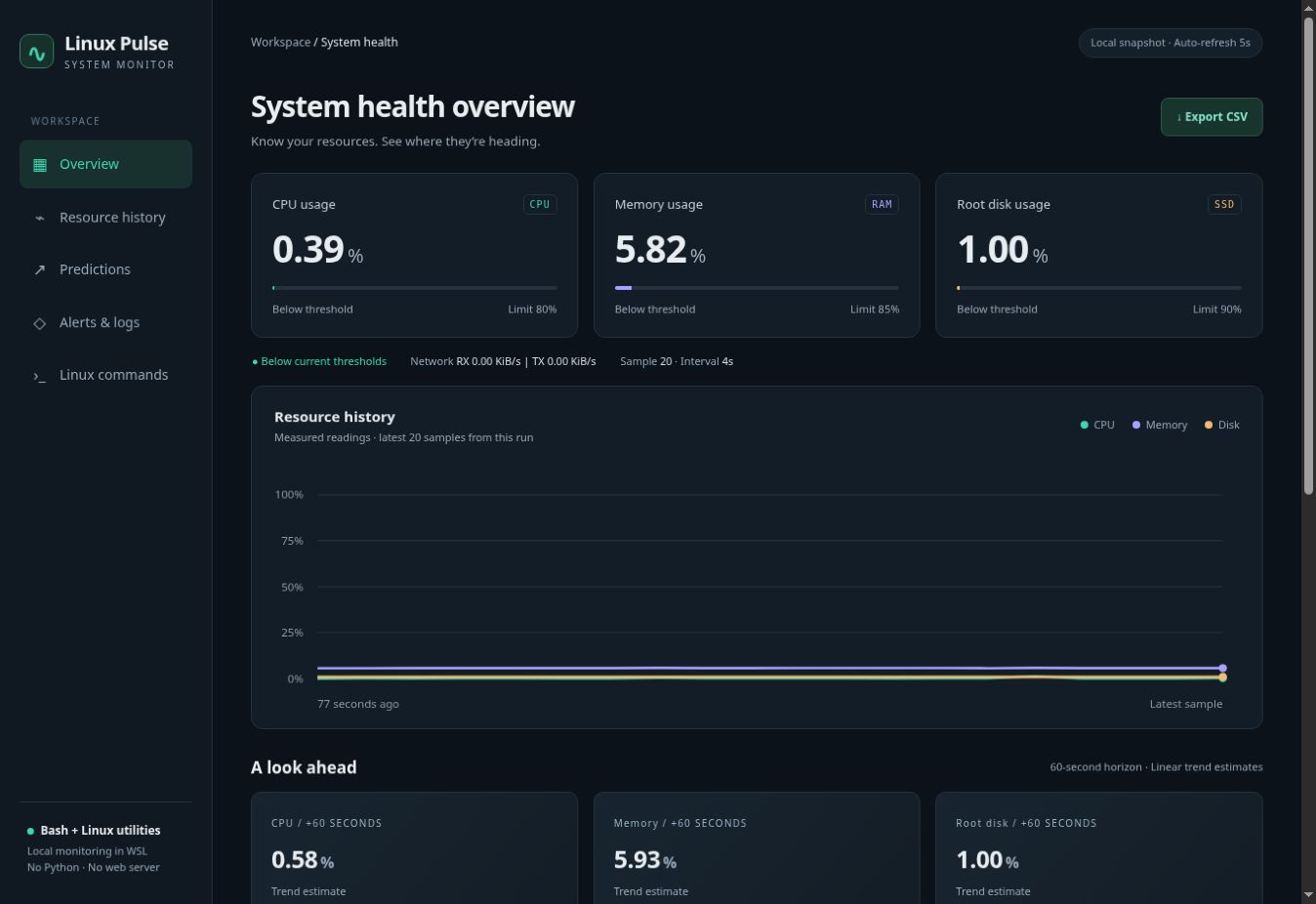
Frontend dashboard
Actual generated dashboard from the report run. Open the local HTML file.
05 / 10
Notes:
This is an actual browser view of the HTML generated from the report's Linux run. The top cards show CPU, memory and root disk percentages. The chart shows recent measured history. Prediction cards estimate the next sixty seconds. Lower sections show active warnings, recent readings and commands to explain during the demonstration. Bash regenerates the page and the browser reloads it. The application itself does not need a web server or internet connection. On my laptop, the readings describe Linux inside WSL rather than every Windows process.
Evidence: Linux_System_Health_Report.docx, Bash project verification on 25 October 2026. Actual readings and browser snapshot come from a controlled Ubuntu 24.04.3 Linux container, not the student WSL laptop. The HTML dashboard is generated locally without a runtime web server. Known-input prediction checks are explicitly labeled test fixtures.

Slide 6
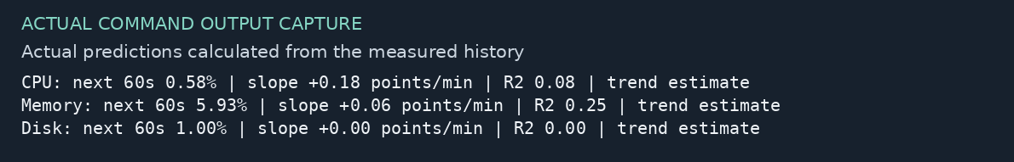
Predictive monitoring with awk
Fit a line to the latest 20 measured samples.
Require at least 60 seconds of history.
Estimate CPU, memory and disk usage 60 seconds ahead.
Actual estimates from 20 readings over 77 seconds; future accuracy is not established.
06 / 10
Notes:
The prediction uses a straight-line model called linear regression. Time is the input and resource percentage is the output. awk fits the line to the latest twenty observations and extends it sixty seconds beyond the latest sample. The history needs twenty samples spanning at least sixty seconds. With the normal five-second interval, I allow about one hundred seconds for the first forecast. R-squared measures how well the line fits past data. A weak fit or a sudden workload change can make the future estimate unreliable. The image shows calculations from twenty actual readings.
Evidence: Linux_System_Health_Report.docx, Bash project verification on 25 October 2026. Actual readings and browser snapshot come from a controlled Ubuntu 24.04.3 Linux container, not the student WSL laptop. The HTML dashboard is generated locally without a runtime web server. Known-input prediction checks are explicitly labeled test fixtures.

Slide 7
Warnings and a safe demonstration
Limits: CPU 80% Memory 85% Disk 90%
Current warning
Measured usage reaches its limit.
Predicted warning
Rising estimate reaches the limit; R² ≥ 0.5.
Controlled demonstration command
bash linux_health.sh --cpu-threshold 0
--data-dir demo-data
Type on one line. Open demo-data/dashboard.html. A 0% limit is a deliberate test.
07 / 10
Notes:
The normal limits are eighty percent for CPU, eighty-five for memory and ninety for disk. A current warning means the measured value has reached its limit. A predicted warning requires current usage below the limit, a rising trend, R-squared of at least zero point five and an estimate that reaches the limit. For a safe demonstration, I stop normal monitoring and use a zero CPU limit with a separate output directory. The reading remains real, but the threshold deliberately triggers the warning. I open demo-data/dashboard.html for that run. This is not a real overload.
Evidence: Linux_System_Health_Report.docx, Bash project verification on 25 October 2026. Actual readings and browser snapshot come from a controlled Ubuntu 24.04.3 Linux container, not the student WSL laptop. The HTML dashboard is generated locally without a runtime web server. Known-input prediction checks are explicitly labeled test fixtures.

Slide 8
Stored readings and log commands
Command | Purpose
tail -n 5 health-data/metrics.csv | Read recent observations
tail -n 10 health-data/alerts.log | Read recorded warnings
bash linux_health.sh --help | View program options
CSV: epoch, CPU, memory and disk percentages
Export CSV links to the saved metrics.csv file.
alerts.log is created when a warning occurs. --data-dir selects a different output folder.
08 / 10
Notes:
The project creates a health-data folder for a normal run. metrics.csv contains epoch time, CPU percentage, memory percentage and disk percentage. The network rates are displayed but are not CSV columns in this version. tail dash n five displays the last five CSV lines. The alerts log is created on the first warning and can be inspected with tail. The help option lists the interval, sample count, thresholds and data-directory settings. The Export CSV link points to the same saved CSV file. Large log files would need a future rotation policy.
Evidence: Linux_System_Health_Report.docx, Bash project verification on 25 October 2026. Actual readings and browser snapshot come from a controlled Ubuntu 24.04.3 Linux container, not the student WSL laptop. The HTML dashboard is generated locally without a runtime web server. Known-input prediction checks are explicitly labeled test fixtures.

Slide 9
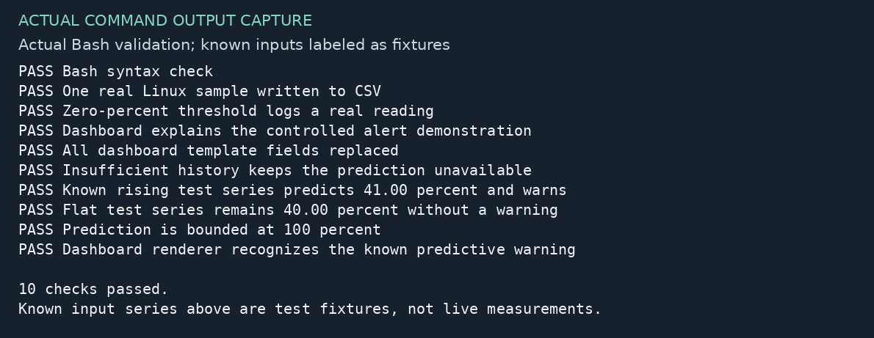
Validation and actual results
bash VERIFY_PROJECT.sh
10 checks passed · 20 live samples in the report
Known-input arithmetic tests are labeled fixtures; measured readings are recorded separately.
09 / 10
Notes:
The bundle includes VERIFY_PROJECT.sh. Running it with Bash performs ten checks, including syntax, a real Linux sample, CSV writing, alert logging and template substitution. Known input series separately check the regression and warning calculation. The screenshot is the actual validation transcript from the report run. Those known-input values are test fixtures and are not live resource observations. Separately, the report records twenty real samples over seventy-seven seconds, a browser-rendered dashboard and a byte-identical CSV backup. This verifies specific behavior rather than long-term accuracy.
Evidence: Linux_System_Health_Report.docx, Bash project verification on 25 October 2026. Actual readings and browser snapshot come from a controlled Ubuntu 24.04.3 Linux container, not the student WSL laptop. The HTML dashboard is generated locally without a runtime web server. Known-input prediction checks are explicitly labeled test fixtures.

Slide 10
Conclusion and future scope
What the project demonstrates
Linux resource monitoring, CSV history and a local dashboard.
Short-term trend estimates and configurable warnings.
Limitation
Workload changes can reduce forecast accuracy.
Future scope
Notifications, log rotation and scheduled startup.
Thank you
10 / 10
Notes:
The project demonstrates Linux resource monitoring using Bash and standard commands. It saves a CSV history, generates the frontend and shows current and qualified predicted warnings. I learned to inspect /proc, use awk for calculations, control a sampling loop, handle output files and compare backups. The prediction is a recent-trend estimate and can be wrong when the workload changes. Future improvements could add notifications, log rotation, per-process monitoring and scheduled startup. Thank you, ma'am. I can now demonstrate the project or explain the commands.
Evidence: Linux_System_Health_Report.docx, Bash project verification on 25 October 2026. Actual readings and browser snapshot come from a controlled Ubuntu 24.04.3 Linux container, not the student WSL laptop. The HTML dashboard is generated locally without a runtime web server. Known-input prediction checks are explicitly labeled test fixtures.

