Slide 1

ArIES Presents
Computer Vision Workshop
Gesture Based Mouse Control
(Implemented using Open Cv)
What is Computer Vision?
Computer vision is a field of study that helps computers to understand the content of the digital images such as photographs and videos.
What is OpenCV?
OpenCV is a Python image and video processing open source library, which is used for computer vision in Artificial intelligence, Machine Learning, face recognition, etc.
When it integrated with various libraries, such as NumPy, python is capable of processing the OpenCV array structure for analysis. To Identify image pattern and its various features we use vector space and perform mathematical operations on these features.

Slide 2
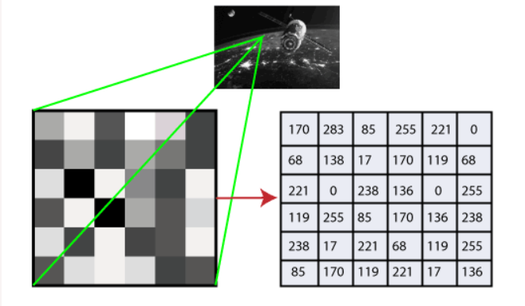
How does computer recognize the image?
Human eyes provide lots of information based on what they see. Machines are facilitated with seeing everything, convert the vision into numbers and store in the memory. Here the question arises how computer convert images into numbers.
So the answer is that the pixel value is used to convert images into numbers. A pixel is the smallest unit of a digital image or graphics that can be displayed and represented on a digital display
The picture intensity at the particular location is represented by the numbers. In the above image, we have shown the pixel values for a grayscale image consist of only one value, the intensity of the black color at that location.
For a coloured image, the combination of red, green and blue colour(RGB) together makes a new color. The computer retrieves that value from each pixel and puts the results in an array to be interpreted.

Slide 3
PROJECT FLOW
Video Capture
(Taking live video feed from system’s camera).
Masking
(Filtering out colours
Red/blue/yellow from the environment )
Colour calibration
(Setting colour ranges for the colour to be segmented out)
Centroid calculation
(Calculation centroid of the detected region)
Choose Action
(choosing action based on the hand gesture)
Execute Action

Slide 4
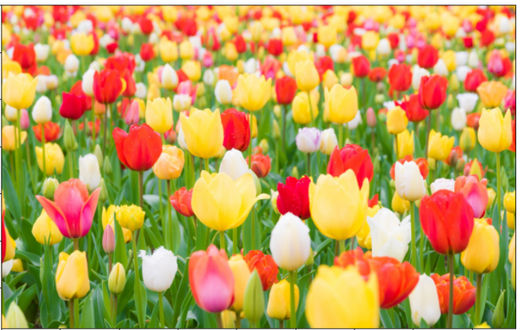
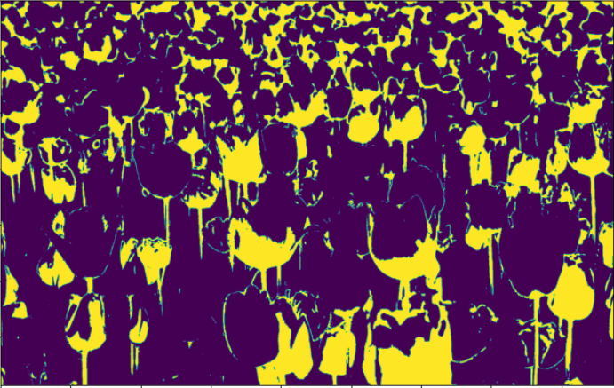
MASKING

Slide 5


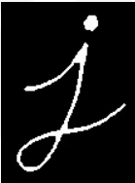
Erosion and Dilation
Original image
Dilation
Erosion

Slide 6
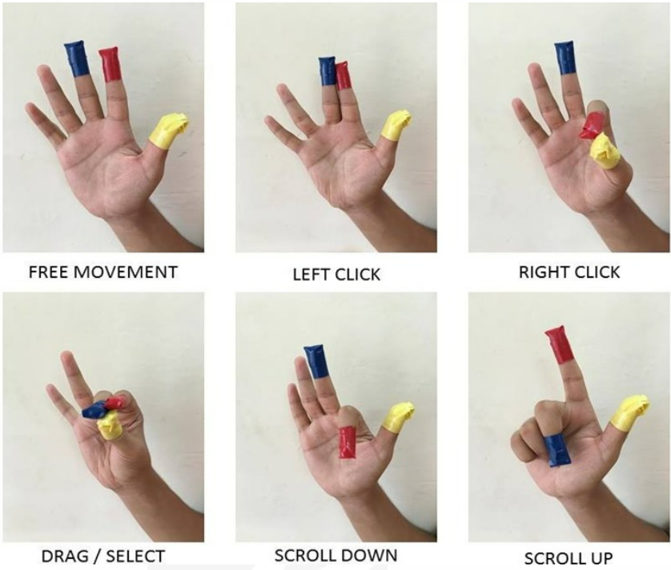
Hand Gesture Guide

