Slide 1
NEXTHIHE IT SOLUTIONS
Python based GUI Calculator
This calculator is developed by using python programming language and the tkinter Gui toolkit. It provides users with an intitutive interface to perform essential mathematical computations.
Taniya Tyagi

Slide 2
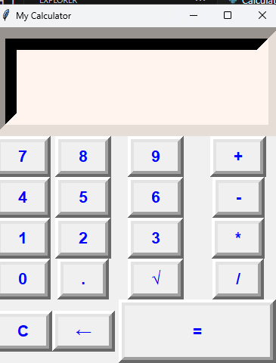
A snapshot of functionality
Designed to perform calculations easily .
A well organised panel of buttons for numbers, operators, and functions.
Keyboard support to perform operations.
A clear display to show the entered expression and calculation results.

Slide 3
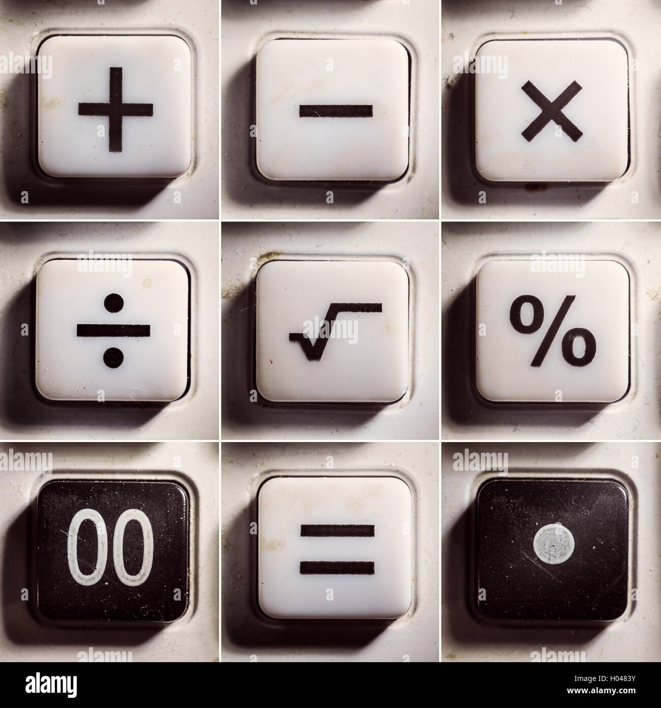
Core Operations
1.Addition- Add two or more numbers.
2.Subtraction- subtract one number from another number.
3.Multiplication- Multiply two or more numbers.
4. Division- Divide one number by another.

Slide 4
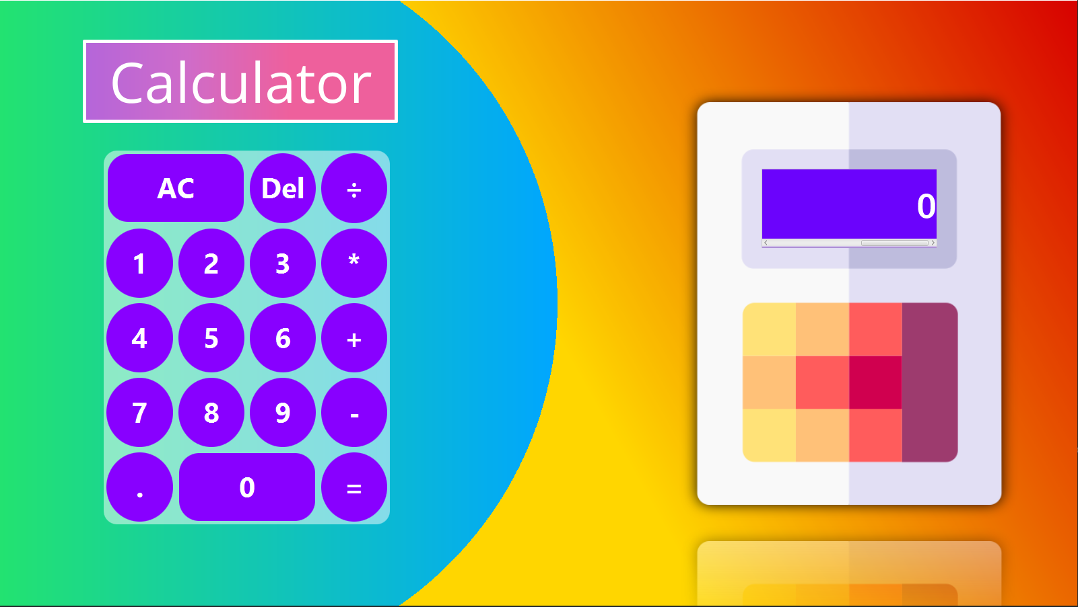
Project goals
The goal of this project is to create a functional and user friendly calculator using Python’s Tkinter library for the graphical user interface(GUI), and Handle mathematical functions efficiently.

Slide 5
Software Used
Visual studio code: commonly referred as VS code is an integrated development environment developed by Microsoft for windows, Linux, macOS, and Web Browsers. Provides a fast and efficient editing experience with features like syntax highlighting, bracket-matching, auto-indentation, and code completion (IntelliSense).
Includes integrated tools for debugging, semantic code understanding and navigation, and code refactoring.
Python: Python is a high –level ,general purpose programming language. It is designed to emphasize code readability with the use of significant indentation

Slide 6
References used
Goggle
GitHub
YouTube etc.

Slide 7


