Slide 1
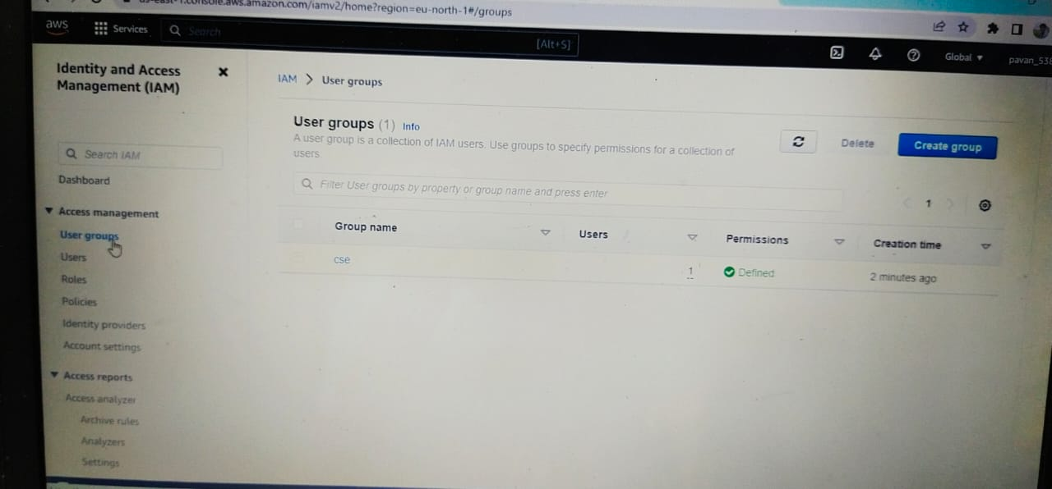
Creating IAM User
Steps
Click on Add User
Enter name and tick on “Provide user access to the AWS Management console”.
Tick on “I Want to create an IAM user and put custom password . Press Next.”
Tick on add user to group and create group.
Attach policies in the group and press NEXT.
Finally, Create User.

Slide 2
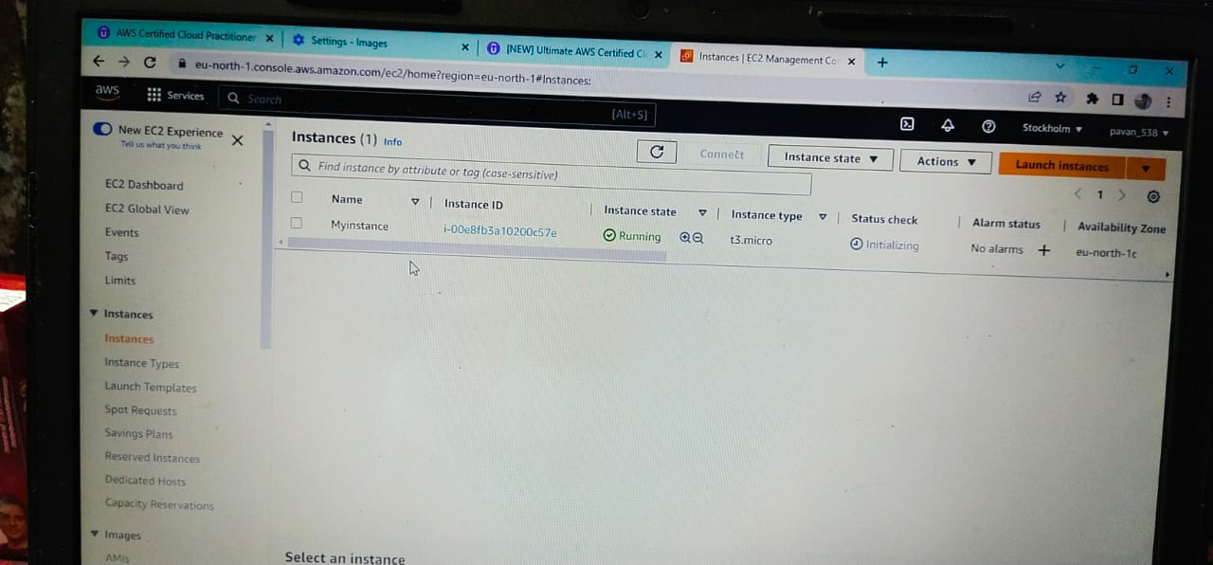
Creating Instance
Select launch Instance.
Enter name and choose Amazon Linux O.S and choose t3.micro Instance Type.
Now, Select the key Pair.
Select Existing security group.
Fially Launch Instance.

Slide 3
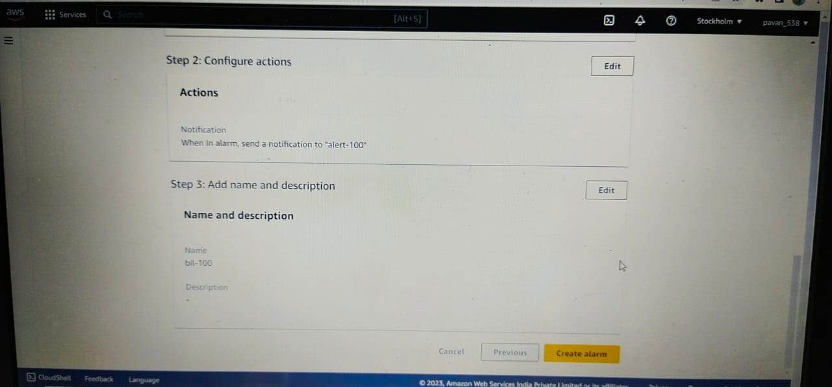
Cloud Watch
Select Create Alarm and choose select metric.
Change USD into Rupees then keep the threshold value.
Select create new topic and Enter Name.
Give email endpoint that will receive notification then press create topic . Press Next.
Enter name of Alarm.
Finally, Preview and press create Alarm.

Slide 4
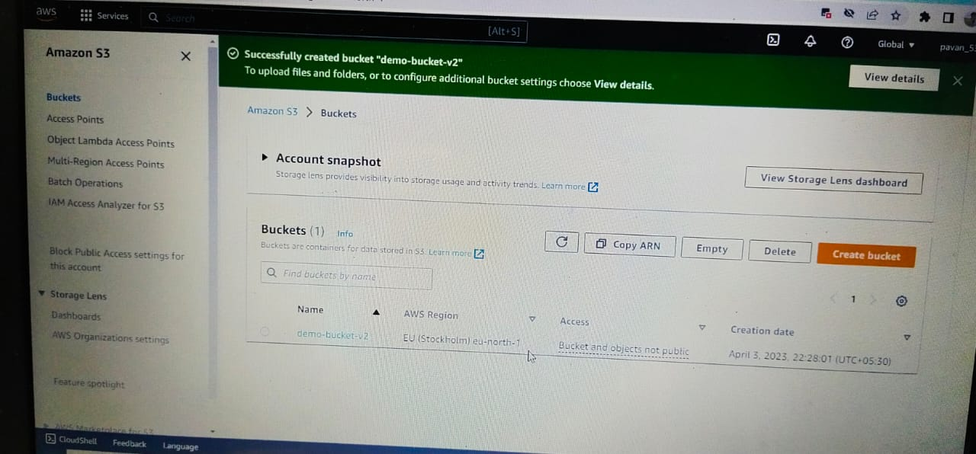
Creating S3 bucket
Select create bucket.
Enter name and choose region.
Press create bucket.
Push “objects” into buckets.
Press Add files and drag the file.
Finally, Create a Bucket with object.

Slide 5
Thank you

