Slide 1
PRACTICAL IMPLEMENTAtiON
OF AWS SERVICES
B. Sri Durga Bhavani
20A31A05D2

Slide 2
CONTENTS
AWS Command Line Interface (CLI)
Elastic Cloud Compute (EC2)
Virtual Private Cloud (VPC)
Elastic Load Balancer (ELB)
Identity and Access Management (IAM)
Relational Database System (RDS)
Elastic Block Service (EBS)
Simple Storage Service (S3)
Cloud Watch
AWS Lambda

Slide 3
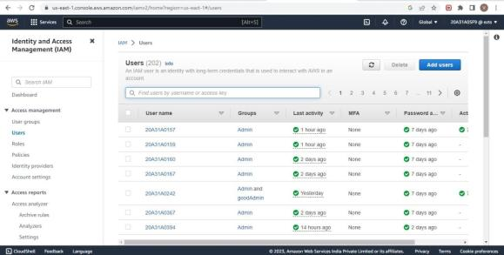
AWS COMMAND LINE INTERFACE
STEP 1 - Download and install AWS CLI and complete the installation steps
STEP 2 - Login to AWS Management Console and search for IAM.
STEP 3 - In the navigation pane ,select Users
Lab - Configuring AWS CLI

Slide 4
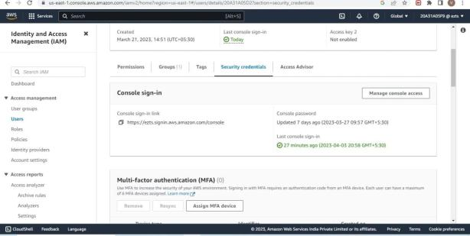
STEP 4 - In the users select the name of the user whose access keys you want to create.
STEP 5 - Click on Security Credentials tab.

Slide 5
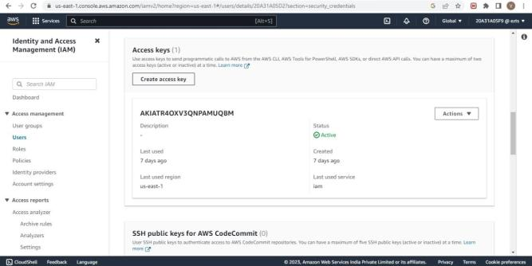
STEP 6 - In the access Keys section , choose Create access key -> Command Line Interface -> Create Access Key

Slide 6
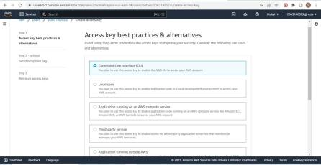
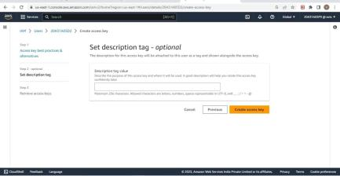
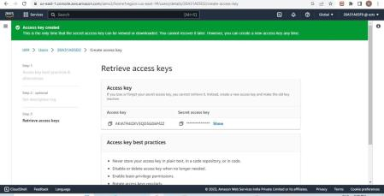

Slide 7
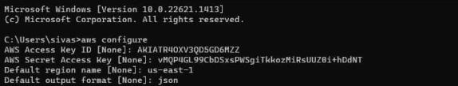
STEP 7 - Now you can use this access key to configure CLI
STEP 8 - Open Command Line Interface and run the following command
>aws configure
After entering this command AWS CLI prompts us with four pieces of information
1. Access Key ID: (enter your ID)
2.Secret Access Key: ( enter your key)
3.AWS Region: (enter the desired region )
4.Output Format: (enter the desired output)
Finally we get Javascript Object Notation of all the users as output.

Slide 8
ELASTIC CLOUD COMPUTE ( EC2)
Lab - Creating an EC2 Instance
Step-1: Go to AWS services, click EC2, and then select ‘launch instances’.
Step-2: Name the instance, select an AMI(LINUX, WINDOWS server), select a key pair, and click launch instance.
Step-3: For Linux-select the PPK key and for Windows server-select the PEM key.
Step-4: If a key pair is not available create a new key.
Step-5: For Linux-click connect to instance you will be redirected to the CLI (or) open the putty file configure it to not timeout, and configure the putty session. This will redirect you to the CLI.
For Windows server-click connect→RDP client→ get password→ upload private key→ decrypt password. Open the RDP file and enter the password. This will redirect you to the Windows server. Now terminate instances.

Slide 9
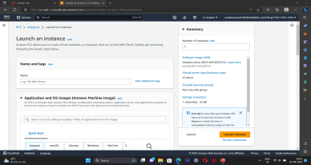
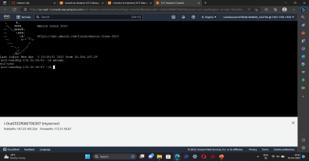
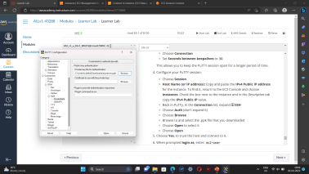
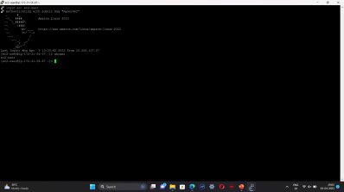

Slide 10
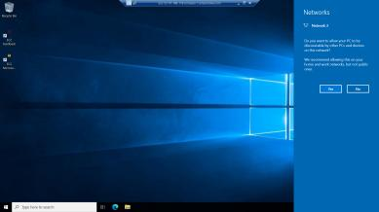
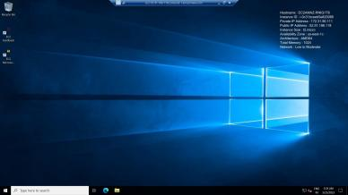
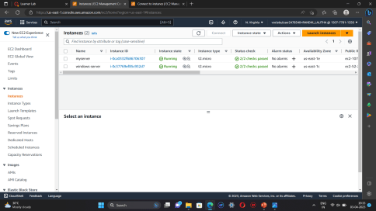

Slide 11
VIRTUAL PRIVATE CLOUD (VPC)
Lab – Building a VPC and Launching a Web server
Step 1: First start the lab, when the lab status gets ready, it redirects to the AWS management console.
Step 2: Go to AWS services, search, and choose VPC to open the VPC console.
Step 3: Verify that your regions remain in the N-Virginia(us-east-1). Choose to create VPC in the VPC dashboard
Step 4: Choose VPC and more, in name tag auto-generation, keep auto-generate select and change it to a lab.
Step 5: Keep the IPv4 CIDR block to 10.10.0.0.0/16 and next for a number of availability zones select 1, number of public subnets select 1 , number of private subnets select 1
Step 6: Now customize subnets CIDR blocks, change public subnet(us-east-1a) to 10.10.0.0/24, and change private subnet (us-east-1a) to 10.0.1.0/24

Slide 12
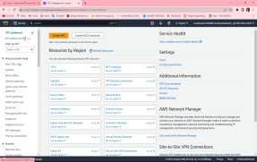
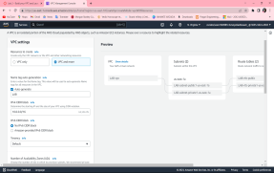
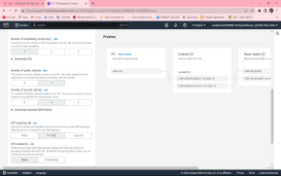
Step 7: Set the NAT gateways to 1AZ and set VPC endpoints to none and keep both DNS hostnames and DNS resolutions enabled
Step 8: Check on the preview panel on the right side whether they match with the given regions or not

Slide 13
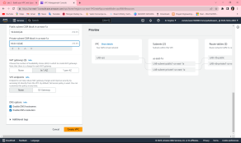
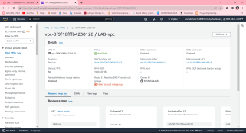
CREATING ADDITIONAL SUBNETS :
Step 1: Choose subnets in the left panel, choose to CREATE SUBNET
Step 2: in this, choose VPC ID: LAB-vpc and choose subnet name to lab-subnet-public2, choose availability sone to us-east-1b and choose IPv4 block to 10.0.2.0/24
Step 3: choose to create a subnet and again create the same subnet with lab-subnet-private2, change the IPv4 block to 10.0.2.0/24, and then create a subnet
Step 4: Choose the routing table in the left panel, select lab-rtb-private1-us-east-1a, in the lower panel, choose routes note destination, choose the subnet association tab, in the explicit subnet associations panel choose EDIT SUBNET ASSOCIATIONS

Slide 14
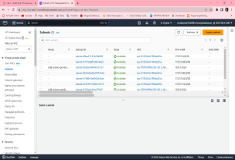
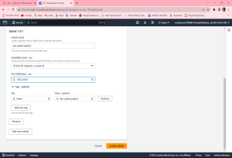
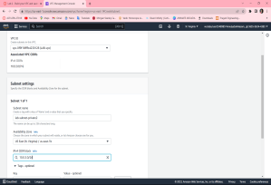
Step 5 : Leave lab-subnet-private1-us-east-1a and also select lab-subnet-private2
Step 6: Choose SAVE ASSOCIATIONS
Step 7: Select lab-rtb-public route table and deselect any other subnet
Step 8: In the lower panel, again repeat from step 4 but here we select lab-subnet-public2 also
Step 9: Choose SAVE ASSOCIATIONS

Slide 15
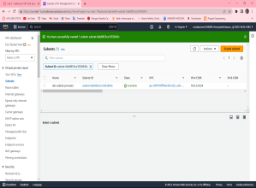
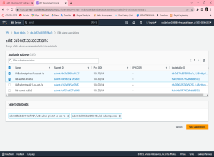
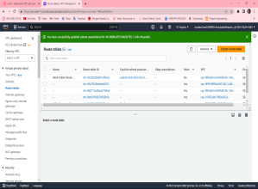

Slide 16
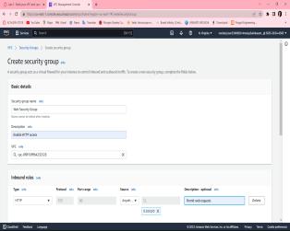
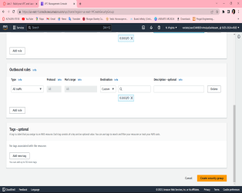
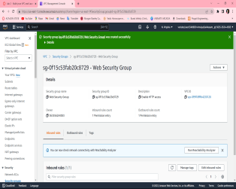
CREATING A VPC SECURITY GROUP
Step 1: Choose to create a security group and in this choose the security group name to a web security group, have a description as enable HTTP access and choose vpc to lab-vpc
Step 2: In inbound rules choose to add rule and then in this chosen type to HTTP, source to Anywhere ipv4 and description to permit web requests

Slide 17
LAUNCH A WEB SERVER INSTANCE
Step 1 : Choose EC2 to open EC2 console , from instances click launch instance and give name as web server 1
Step 2 : Keep Amazon Linux selelct and select amazon linux 2023 AMI , Choose t2.micro
Step 3 : Choose key pair name to vockey , in network settings choose edit select network to lab-vpc ,subnet to lab-subnet-public2 and auton assign to enable
Step 4 : Under firewall choose select existing security group , for common security groups select web security group
Step 5 : Expand the advanced details panel , scroll down upto the user data box appear .
#!/bin/bash
# Install Apache Web Server and PHP
sudo dnf install -y httpd wget php mariadb105-server
# Download Lab files get https://aws-tc-largeobjects.s3.us-west-2.amazonaws.com/CUR-TF-100-ACCLFO-2-9026/2-lab2-vpc/s3/lab-app.zip
unzip lab-app.zip -d /var/www/html/
# Turn on web server
chkconfig httpd on
service httpd start

Slide 18
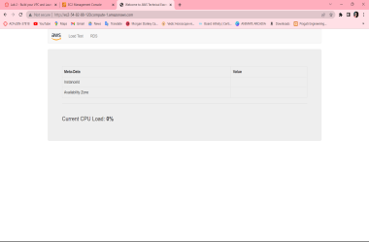
Step 6: At the bottom SUMMARY panel choose launch instance ,click on view instances
Step 7 : Wait until web server 1 shows 2/2 checks passed
Step 8 : Copy the public ipv4 dns value present in details tab
Step 9 : Open a new browser , copy the public dns
Step 10 : Finally we see a web page displaying the AWS logo and instances meta-data values
Finally, a web page opens displaying the AWS logo and instances of metadata values

Slide 19
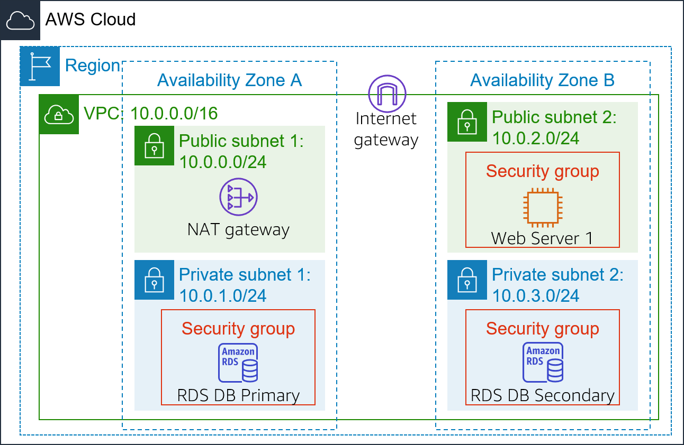
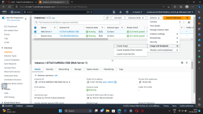
ELASTIC LOAD BALANCER (ELB)
Elastic Load Balancing automatically distributes incoming application traffic across multiple Amazon EC2 instances.
In this lab, We are provided with the given infrastructure.
Procedure:
Task1: Creating an AMI for Auto Scaling
Click start lab then click on AWS.
You will navigate to AWS management console. Click on services and select EC2.
Click instances. Make sure that Status Checks for Web Server 1 displays 2/2 checks.
Select Web Server 1 and in actions click images and templates > create image. Name the image and give the description.
Click create image.

Slide 20
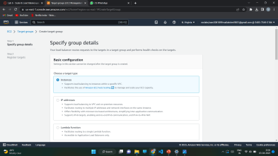
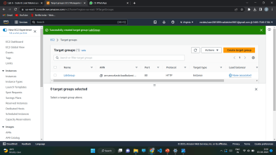
Task 2: Creating a load balancer
Choose Target Groups and then click on create target group.
Select target type as instances. Name the target group. Select Lab VPC under VPC that is we are creating load balancer in Lab VPC .
Choose next and then click on create target group.
From the left navigation pane , select Load Balancers. Click create load balancer.
To create a application balancer, click create under Application Load Balancer and Name it.
In Networking mapping, select Lab VPC and specify the subnets that the load balancer should use.
In security groups, select only Web Security Group and deselect all other than it .
For the Listener HTTP:80 row, set the Default action to forward to LabGroup.

Slide 21
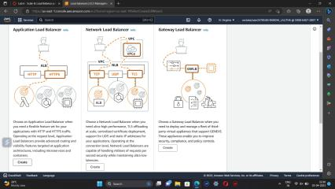
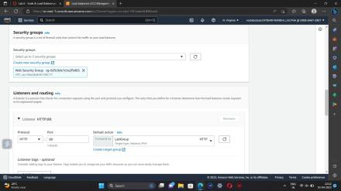
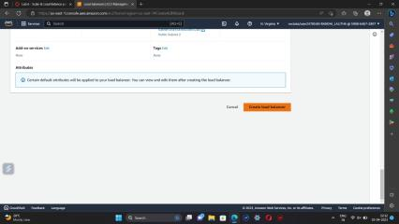
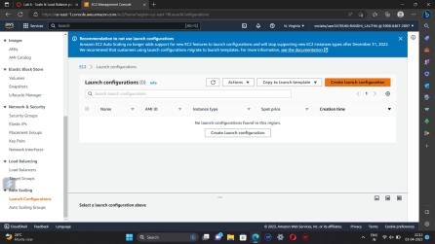

Slide 22
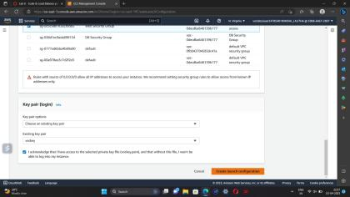
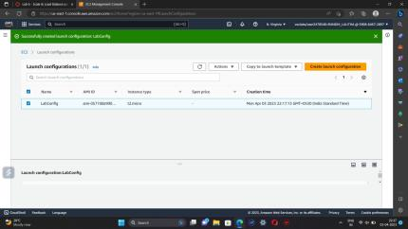
Click create load balancer.
Task 3: Create a Launch Configuration and an Auto Scaling Group
In Launch Configurations, click create launch configuration.
Name the configuration and for AMI choose web server AMI that you created in task 1.
Select the instance type.
Under Additional Configuration, for monitoring select Enable EC2 instance detailed monitoring within CloudWatch.
Under security groups , choose an existing security group Web Security Group.
Under key pair, choose an existing key pair vockey. Check I acknowledge…
Click Create launch configuration.
For created launch configuration, select create auto scaling group from actions.
Name it and select Lab VPC under VPC, select the private subnets.
Select an existing load balancer which was created earlier.

Slide 23
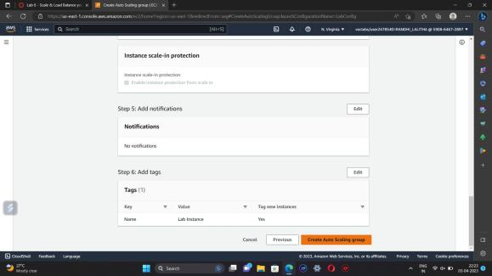
Specify the values under Group size.
Under Scaling policies, choose Target tracking scaling policy and name the policy. Specify metric type and target value. Then add a tag and click create auto scaling group.

Slide 24
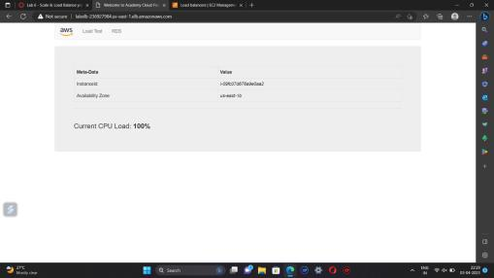
Task 4: Verify that Load Balancing is Working
click Instances.You should see two new instances named Lab Instance. These were launched by Auto Scaling.
In the labgroup target group, two Lab Instance targets should be listed for this target group.Wait until the Status of both instances transitions to healthy.
Now copy the DNS name of the created laod balancer making sure to omit "(A Record)".and paste it in a new browser
The application should appear in your browser. This indicates that the Load Balancer received the request, sent it to one of the EC2 instances, then passed back the result.

Slide 25
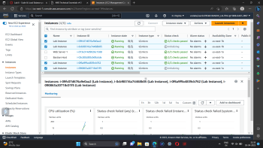
Task 5: Test Auto Scaling
On the Services menu, click CloudWatch.In the left navigation pane, choose All alarms.Two alarms will be displayed. These were created automatically by the Auto Scaling group.
From services select EC2 and choose Auto Scaling Groups and select Lab Auto Scaling Group which you created.
choose the Automatic Scaling tab. Select LabScalingPolicy and from actions change the target value to 50.click update.
To go cloudwatch and click all alarms and verify.
Click the OK alarm, which has AlarmHigh in its name.Return to the browser tab with the web application.
Click Load Test beside the AWS logo.This will cause the application to generate high loads.
You should see the AlarmHigh chart indicating an increasing CPU percentage. Once it crosses the 60% line for more than 3 minutes, it will trigger Auto Scaling to add additional instances.
In EC2 instances , you notice that more than two instances labeled Lab Instance should now be running.
Finally terminate the Web Server 1.

Slide 26
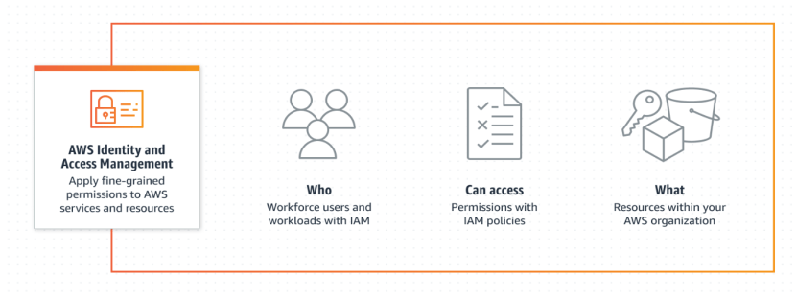
IDENTITY AND ACCESS MANAGEMENT
AWS Identity and Access Management (IAM) is a web service that enables Amazon Web Services (AWS) customers to manage users and user permissions in AWS. With IAM, you can centrally manage users, security credentials such as access keys, and permissions that control which AWS resources users can access.

Slide 27
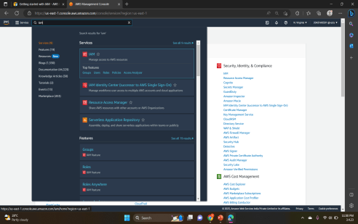
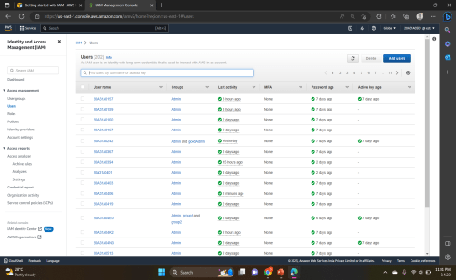
Steps to create IAM User and User Groups
On the Console Home page, select the
IAM service.
2.In the navigation pane, select Users and
then select Add users.

Slide 28
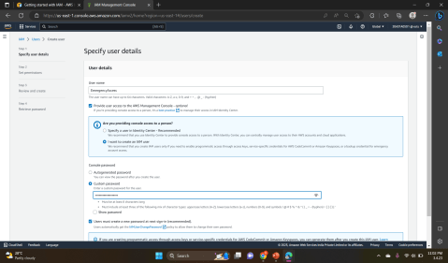
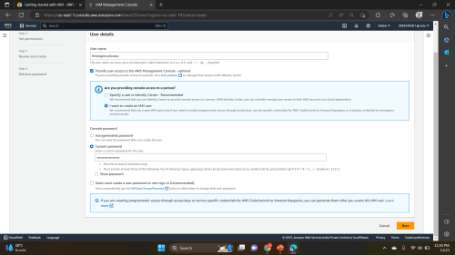
3.For Username, enter EmergencyAccess and ,Select the check box next to Provide user access to the AWS Management Console– optional and then choose I want to create an IAM user.
4.Under Console password, select Custom Password and create your own password.
5. Clear the check box next to User must create a new password at next sign-in (recommended). Then click on Next.

Slide 29
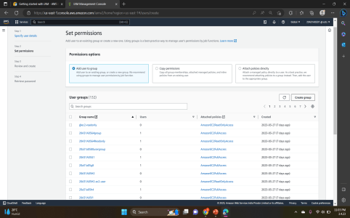
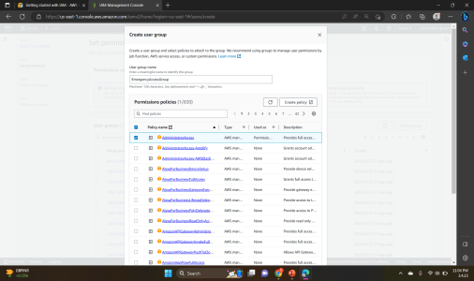
6. On the Set permissions page, under Permissions options, select Add user to group. Then, under User groups, select Create group.
7. On the Create user group page, in User group name, enter EmergencyAccessGroup. Then, under Permissions policies, select AdministratorAccess.

Slide 30
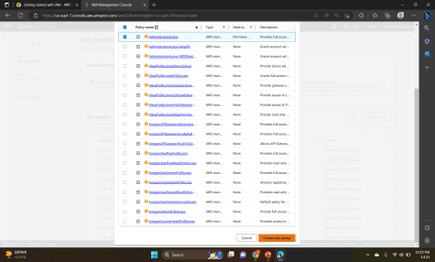

8. Select Create user group to return to the Set permissions page.
9. Select Next to proceed to the Review and create page.

Slide 31

10.On the Review and create page, review the list of user group memberships to be added to the new user. When you are ready to proceed, select Create user.
11. On the Retrieve password page, select Download .csv file to save a .csv file with the user credential information (Connection URL, user name, and password).
12. Save this file to use if you need to sign-in to IAM and do not have access to your federated identity provider.

Slide 32


13. If you want to add permissions to the user group, then go to User groups and click on the respective User group.
14. Go to Permissions → Add permissions→ Attach policies

Slide 33


15. Add the permission policy and the policy is attached to the User group.

Slide 34


AWS RDS
Step 1: Create a Security Group for the RDS DB Instance.
aws management console → vpc → security groups → choose create security group → add inbound rule → create security group.

Slide 35


Step 2 : Create a DB Subnet Group.
Rds → subnet groups → choose create DB subnet group → add subnets → create DB subnet group.

Slide 36


Step 3: In the left navigation pane, choose Databases → choose create database → MYSQL

Slide 37


Step 4: In Availability and durability ,choose Multi –AZ DB instance then configure settings , DB instance class, Storage, connectivity, choose existing vpc security group and setup additional configuration.

Slide 38

Step 5: Wait until Info changes to Modifying or Available.
Scroll down to the Connectivity & security section and copy the Endpoint field.

Slide 39


Step 6 : Interact with Your Database.
On Details , copy the WebServer IP address. Open a new web browser tab, paste the WebServer IP address and press Enter.
The web application will be displayed, showing information about the EC2 instance.

Slide 40

Step 7 : Choose the RDS link at the top of the page and configure the settings.

Slide 41

Step 8: After a few seconds the application will display an Address Book.
The Address Book application is using the RDS database to store information.

Slide 42
ELASTIC BLOCK SERVICE ( EBS )
Open Management Console, on the services menu open Ec2
In the left navigation pane choose instances and create a instance with a name
Next, In the left navigation pane choose Volumes
Click on Create Volume
Select volume type, size(Gib),Availability Zone and in Add tag section add key and value names.
Then click on create volume
Click on volumes on left navigation pane select the created volume and attach a previously created instance to it.
Then, go to “Details” drop down, choose “show”
Download the ppk file
Download putty
Open putty set the fields (such as Host name, public key, private key) as per the requirement.
The putty shell will open , then login into it and run the commands.
The commands looks like:
df –h
sudo mkfs –t ext3/dev/sdf etc.,
14. Create a EBS snapshot by giving the necessary fields.
15. Create a volume using snapshot.
16. Attach the volume to the created EC2 instance

Slide 43





Slide 44





Slide 45





Slide 46
AWS S3 (SIMPLE STORAGE SERVICE)
TASKS FOR CONFIGURING S3:
1.Log into the AWS Management Console.
2.Create an S3 bucket.
3.Upload an object to S3 Bucket.
4.Access the object on the browser.
5.Change S3 object permissions.
6.Setup the bucket policy and permission and test the object accessibility.
Step 1: Click on create group.
Step 2:Set up the bucket name. S3 bucket name are globally unique, choose a name which is available. Leave other settings as default and click on create group.
Step 3:Click on your bucket name.
Step 4: Click Upload.

Slide 47
Step 5: Click on Add Files , and choose a file from your computer.
Step 6: After choosing your file, click on Next.
Step 7: Click on Upload.
Step 8:Now you have a private S3 bucket with a private object uploaded, which means you cannot visit it through Internet.
Step 9:Now you have a private S3 bucket with a private object uploaded, which means you cannot visit it through Internet.
CHANGE BUCKET PERMISSIONS:
Step 10:Go back to your bcket and click on Permissions.
Step 11:Click on Everyone under the Public access, and click on Read object on the right of pop-up window. Then click on Save.
Step 12 :Now its state switches to Read Object - Yes
Step 13:Click on Overview, and click on your Object URL again .
Step 14:Notice the URL on your browser

Slide 48




Step 1
Step 2
Step 2
Step 3

Slide 49




Step 5
Step 4
Step 6
Step 7

Slide 50




Step 8
Step 9
Step 10
Step 11

Slide 51



Step 12
Step 13
Step 14

Slide 52

AWS CLOUDWATCH
PROCEDURE
1.Go to AWS Services,Click on CloudWatch and then in the Dashboard go to Alarms section and select Billings.

Slide 53

2.Then Click on CREATE ALARM.
3.Then follow the steps.
In the first step it will ask us to Specify metric and conditions.Click on Select Metric.
Change the Currency to Rupee.
In the Conditions section choose the EstimatedCharges like Greater/GreaterEqual/Lowerequal/Lower and also define the threshold value.
4.Click on Next.

Slide 54



5.Now for Cofigure Actions choose Create new topic.Give a name to the topic and enter your email to receive a notification.Click on Create Topic,then Next.

Slide 55



6.Give a name to your Alarm and Click on next.
7.You will get a AWS Notification-Subscription Confirmation mail to the email which you have provided.Click on Confirm Subscription.Then it will open a window showing Subscription Confirmed.

Slide 56

8.Preview the details you have entered .
9.Click on Create alarm.This will Create your Alarm.

Slide 57
AWS LAMBDA
1)Choose Create function.
2)In the Create function screen, configure these settings:
>Choose Author from scratch
>Function name: myStopinator
>Runtime: Python 3.8
>Choose Change default execution role
>Execution role: Use an existing role
>Existing role: From the dropdown list, choose myStopinatorRole
3)Choose Create function.
4) Choose Add trigger.
5)Choose the Select a trigger dropdown menu, and select EventBridge (CloudWatch Events).
6)For the rule, choose Create a new rule and configure the settings and click add.

Slide 58
Below the Function overview pane, choose Code, and then choose lambda_function.py to display and edit the Lambda function code.
In the Code source pane, delete the existing code. Copy the following code, and paste it in the box:
import boto3
region = '<REPLACE_WITH_REGION>'
instances = ['<REPLACE_WITH_INSTANCE_ID>']
ec2 = boto3.client('ec2', region_name=region)
def lambda_handler(event, context):
ec2.stop_instances(InstanceIds=instances)
print('stopped your instances: ' + str(instances))
9)Replace the <REPLACE_WITH_REGION> placeholder with the actual Region that you are using. To do this:
10)Choose on the region on the top right corner and use the region code. For example, the region code for US East (N. Virginia) is us-east-1.
11)Verify that an EC2 instance named instance1 is running in your account, and copy the instance1 instance ID.
12)Return to the AWS Lambda console browser tab, and replace <REPLACE_WITH_INSTANCE_ID> with the actual instance ID that you just copied.
13)Choose the File menu and Save the changes. Then, in the top-right corner of the Code source box, choose Deploy.

Slide 59



