Slide 1
Analysis and Forecasting
Oman Oil Prices
Using Statistical Models & Machine Learning Techniques
Student: Abdullah Ahmed Aldhahli (ID: 129190)
Supervisor: Dr. Brahim Benaid
Institution: Sultan Qaboos University | Spring 2026

Slide 2
Introduction
Why Oil Prices Matter
Our Approach
Oil is the backbone of Oman's economy — it funds public services, infrastructure & development
Oil prices are highly volatile — driven by global demand, political events
price swings directly affect government budgeting
Forecasting oil prices accurately is essential for economic stability
📊 Descriptive Statistics & EDA
📈 Multiple Linear Regression
🔁 Time Series Model
🤖 ML (SVR)
🔗 Hybrid SVR-ARIMA Model
Oil contributes over 70% of Oman's government revenue. When prices fall, the whole economy feels it — so we need good forecasting tools.

Slide 3
Research Problem & Aim of Study
Research Problem
Oil price forecasting in Oman is challenging because traditional models often fail to capture the complex, non-linear dynamics of the market. This limits accurate economic planning and policy decisions.
Main Objective
To compare traditional statistical models (ARIMA) with machine learning techniques (SVR) for forecasting Oman oil prices, and identify the best performing approach.
Specific Objectives
Analyze historical oil prices, exports & production (2016–2022)
Apply & evaluate Multiple Linear Regression model
Apply & evaluate Time Series models
Apply & evaluate Machine Learning models

Slide 4
Research Questions
Q1
What are the important factors that influence oil price fluctuations in Oman?
Q2
How accurate are traditional statistical methods like ARIMA in forecasting Oman's oil prices?
Q3
Can machine learning techniques (SVR) improve forecasting accuracy over ARIMA?
Q4
Which approach — statistical or machine learning — gives the most reliable predictions?
These four questions guided our entire analysis — each chapter answers one of them.

Slide 5
Database
84
7
2016–2022
4
Monthly Observations
Variables
Time Period
Missing Values
Variable | Description | Range
prices | Oil price (USD per barrel) | $23.65 – $112.93
exports | Oil exports (Millions USD) | $19,870 – $30,969M
productions | Daily production (barrels/day) | 26,374 – 33,944 bpd
USD_to_OMR | Exchange rate | 0.3837 – 0.3853
date | Monthly date (2016–01 to 2022–12) | 84 months
dataset covers 7 years of monthly data. Prices ranged from a low of $23 (COVID crash) to a high of $113 (2022 recovery). Four values were missing and handled by imputation.

Slide 6
Data Preparation
Create Date Variable
01
Combined year + month columns into a proper monthly date column (YYYY-MM-DD). Sorted data for accurate time series analysis.
Check Missing Values
02
Found 4 missing values: prices missing for Oct 2021, exports missing for Jan 2019 & Aug 2019, productions missing for Jun 2017.
Imputation
03
Replaced missing values with the average for that month across all years. This preserves seasonal patterns without distorting the dataset.

Slide 7
Exploratory Data Analysis (EDA)
Key Statistics
Min Price
Median
Mean
Max Price
$23.65
$61.10
$59.99
$112.93
Prices dipped sharply in 2020 due to COVID-19 and recovered strongly in 2022. The distribution shows most prices cluster between $50–$75.

Slide 8
EDA — Correlation Analysis
 | Prices | Exports | Productions | USD_OMR
Prices | 1.00 | 0.04 | 0.59 | -0.07
Exports | 0.04 | 1.00 | 0.42 | 0.06
Productions | 0.59 | 0.42 | 1.00 | 0.04
USD_OMR | -0.07 | 0.06 | 0.04 | 1.00
Key Findings
Prices ↔ Production: moderate positive (0.59) — higher production links to higher prices
Prices ↔ Exports: very weak (0.04) — exports don't directly drive price
Exports ↔ Production: moderate (0.42) — more production → more exports
Exchange rate shows no meaningful correlation with any variable
Strong positive (≥ 0.5)
Moderate (0.2–0.5)
Weak (< 0.2)
Negative
The strongest link is between production and price (0.59). This tells us production is a better predictor than exports — which guides our regression model.

Slide 9
One-Way ANOVA
What is One-Way ANOVA?
Hypotheses
Tests whether the mean oil price differs significantly across multiple groups (e.g. years or months)
Compares variation between groups vs. variation within groups
If F-statistic is large and p-value < 0.05 → prices differ significantly between groups
H₀ : Mean oil prices are equal across all years
H₁ : At least one year has a significantly different mean price
Result & Interpretation
p-value < 0.05 → Reject H₀
Oil prices differ significantly across years — confirming that year has a strong impact on price levels (e.g. COVID-19 in 2020, recovery in 2022).
ANOVA confirms what we see visually — oil prices in 2020 were significantly lower than other years, and 2022 was significantly higher.

Slide 10
Multiple Linear Regression
Model: Price = β₀ + β₁(Production) + β₂(Exports) + ε
Variable | Estimate | p-value | Significance
Intercept | -1.213e+02 | 0.000188 | ✔ Significant
Production | +0.008038 | 1.65e-10 | ✔ Significant
Exports | -0.002331 | 0.008832 | ✔ Significant
39.87%
1.127e-09
36.22%
R-Squared (Full Data)
F-test p-value
R² after Log Transform
Production has a significant POSITIVE effect on price. Exports have a significant NEGATIVE effect. Together they explain ~40% of price variation.

Slide 11
Hypothesis Testing — Regression by Period
Period | Production (p-val) | Exports (p-val) | F-test (p-val) | R²
Full Data | 1.65e-10 ✔ | 0.0088 ✔ | 1.13e-09 ✔ | 39.87%
2016 | 0.0076 ✔ | 0.0079 ✔ | 0.0029 ✔ | 72.65%
2017–2018 | 0.044 ✔ | 0.121 ✗ | 0.044 ✔ | 25.81%
2019–2021 | 0.0009 ✔ | 0.502 ✗ | 0.003 ✔ | 29.83%
2022 | 0.0074 ✔ | 0.433 ✗ | 0.023 ✔ | 56.84%
Key Takeaways
Production is consistently significant (p < 0.05) in ALL periods — it's the most reliable predictor
Exports are only significant in 2016 — in later years they lose explanatory power
The 2016 model has the highest R² (72.65%) — strongest fit; 2022 model is second best (56.84%)

Slide 12
Confidence Intervals (95%) — Summary
Period | Production CI | Includes Zero? | Exports CI | Includes Zero?
Full Data | [0.00585, 0.01022] | No ✔ Significant | [-0.00406, -0.00060] | No ✔ Significant
2016 | [0.00204, 0.00999] | No ✔ Significant | [-0.00422, -0.00085] | No ✔ Significant
2017–2018 | [-0.00117, 0.00769] | Yes ✗ Not Significant | [-0.00485, 0.00061] | Yes ✗ Not Significant
2019–2021 | [0.00215, 0.00752] | No ✔ Significant | [-0.00238, 0.00119] | Yes ✗ Not Significant
2022 | [0.00248, 0.01201] | No ✔ Significant | [-0.00770, 0.00360] | Yes ✗ Not Significant
What a Confidence Interval Tells Us
If the 95% CI does NOT include zero → the variable has a statistically significant effect on price
Production's CI excludes zero in most periods → confirms its consistent significance
Exports' CI includes zero in 2017–2022 → confirms it is not a reliable predictor in recent years

Slide 13
Time Series Analysis
Key Observations
2016–2019: Gradual upward trend with mild fluctuations
Early 2020: Sharp COVID-19 crash
2021–2022: Strong recovery, peaking at ~$113
No clear seasonal pattern → non-seasonal models are appropriate
Series is NON-STATIONARY → differencing required
Time Series Components
📈 Trend
🔄 Seasonality
〰 Cyclic Pattern
🎲 Random Noise

Slide 14
Stationarity — ACF & PACF Analysis
❌ Slow decay = Non-Stationary
✅ Values within bounds = Stationary
PACF Analysis
PACF after differencing shows NO significant spikes → No strong autoregressive (AR) pattern
This suggests the model is likely a simple MA model → leads us to ARIMA(0,1,1)
Box-Pierce Diagnostic Test: p-value = 0.783 → Residuals are random (white noise) ✅ The model is valid.

Slide 15
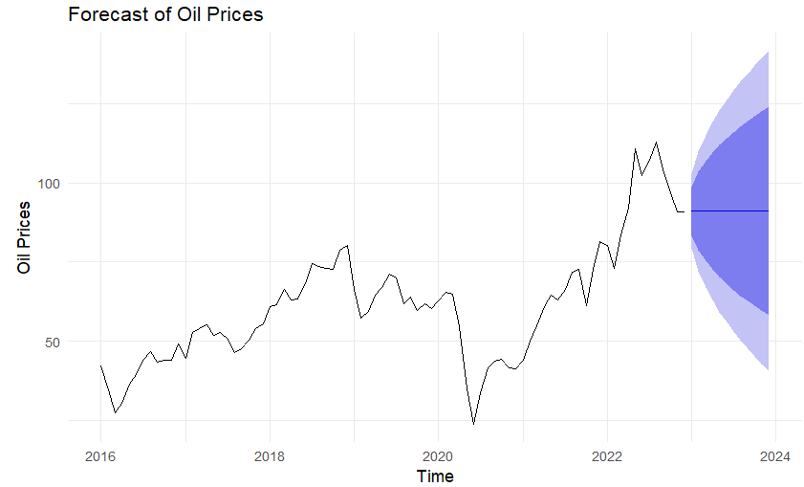
ARIMA Models — Results & Forecasting
ARIMA(0,1,1) — Full Data
RMSE
31
MAE
4.547
Box-Pierce p-value
0.783 ✅
📈 Forecast Insight:
ARIMA(0,1,1) forecasts oil prices stabilizing near $91/barrel (Jan 2023). Confidence intervals widen over time — Jan 2023: $79–$103, Oct 2023: $45–$137. Short-term forecasts are more reliable.

Slide 16
Support Vector Regression (SVR)
How SVR Works
Optimal Parameters Selected
Machine learning model for predicting continuous values
Uses a kernel function to find complex non-linear patterns
Key parameters: Cost (C) controls penalty for errors; Epsilon (ε) allows a tolerance margin
Cost (C)
50
Epsilon (ε)
0.25
SVR Alone — Performance Results
RMSE
MAE
Verdict
37.02
27.11
❌ Poor
Very high error
Predictions off by ~$27
Not suitable alone
💡 SVR alone fails because it doesn't model the time-dependent trend in oil prices. However, it becomes powerful when combined with ARIMA to capture residual non-linear patterns.

Slide 17
Hybrid SVR-ARIMA Model — Best Results
Fit ARIMA
Extract Residuals
1
2
Apply ARIMA to capture the linear trend in oil prices
Compute the errors (residuals) left over from ARIMA
Train SVR on Residuals
Combine Forecasts
3
4
Use SVR to learn the non-linear patterns in residuals
Final prediction = ARIMA forecast + SVR correction
🏆 Winner
SVR-ARIMA
RMSE = 8.28
vs. ARIMA 31.26
vs. SVR 37.02

Slide 18
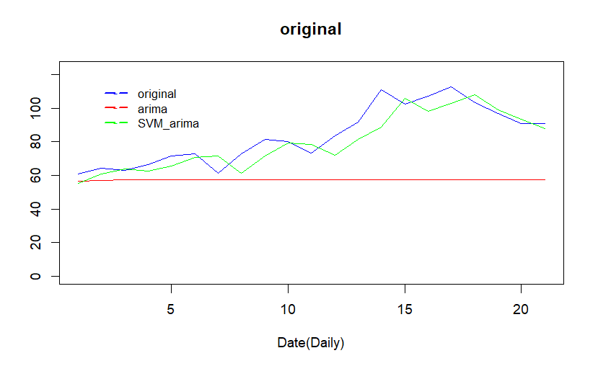
plot compares the original oil prices with ARIMA and SVR-ARIMA forecasts

Slide 19
Conclusions & Recommendations
📌 Production Drives Prices
📉 ARIMA Works — But Moderately
Production is the most consistent and significant predictor of oil prices across all periods studied.
ARIMA(0,1,1) provides acceptable forecasts (RMSE =31) but is limited to linear patterns in the data.
🤖 SVR Alone is Insufficient
🏆 Hybrid Model is Best
SVR alone produces very high errors (RMSE=37) and is not suitable for standalone oil price forecasting.
SVR-ARIMA achieves the lowest RMSE (8.28) — combining statistical and ML power gives the best accuracy.
💡 Recommendation:
Future work should test deep learning models and include additional variables like global demand, geopolitical events to improve forecasting accuracy.

