Slide 1
Introduction to AI

Slide 2
History of AI
Turing Test Developed (1950)
Arthur Samuel Writes 1st Game Playing Program (1962)
ALVINN created by Pomerleau at CMU (1989)
Deep Blue vs Garry Kasparov
(1997)
Rise of Personal Assistants
(2010s)
A Brief History of AI
Notes:
ALVINN – Autonomous Land Vehicle in a

Slide 3
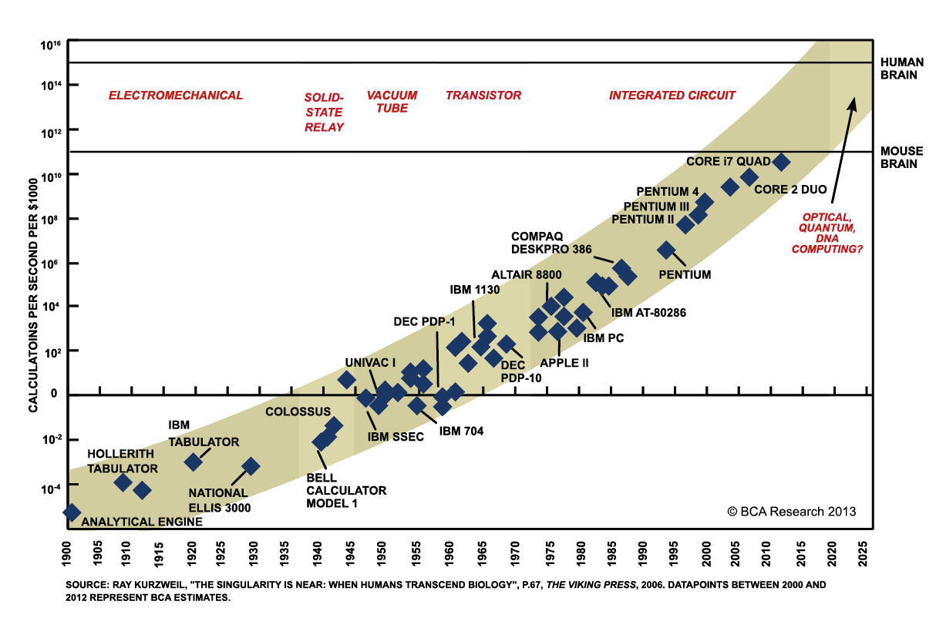
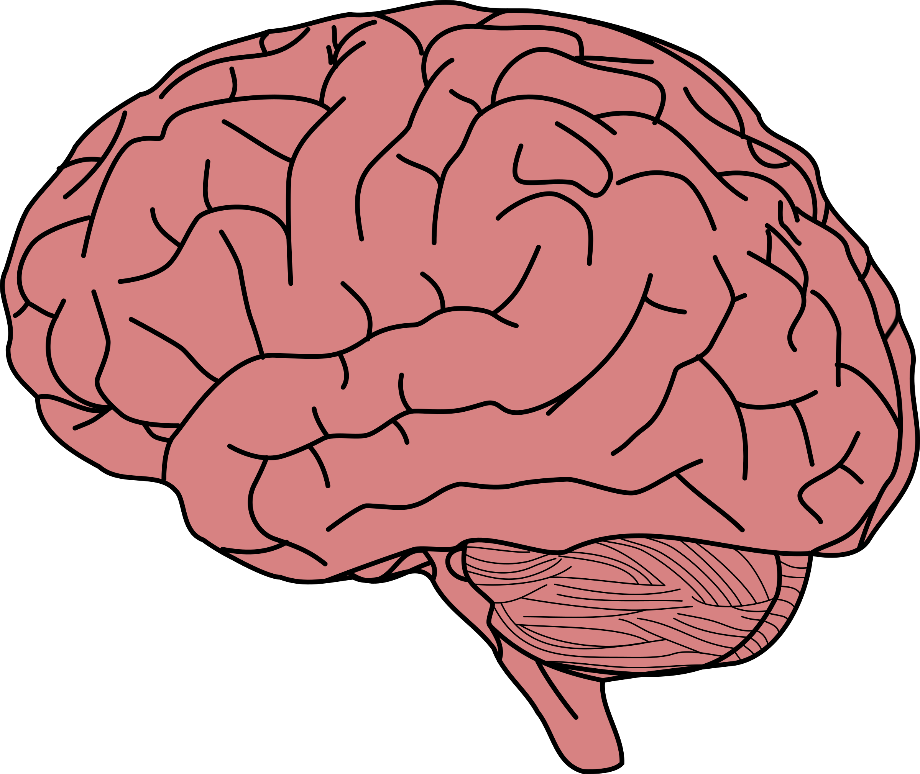
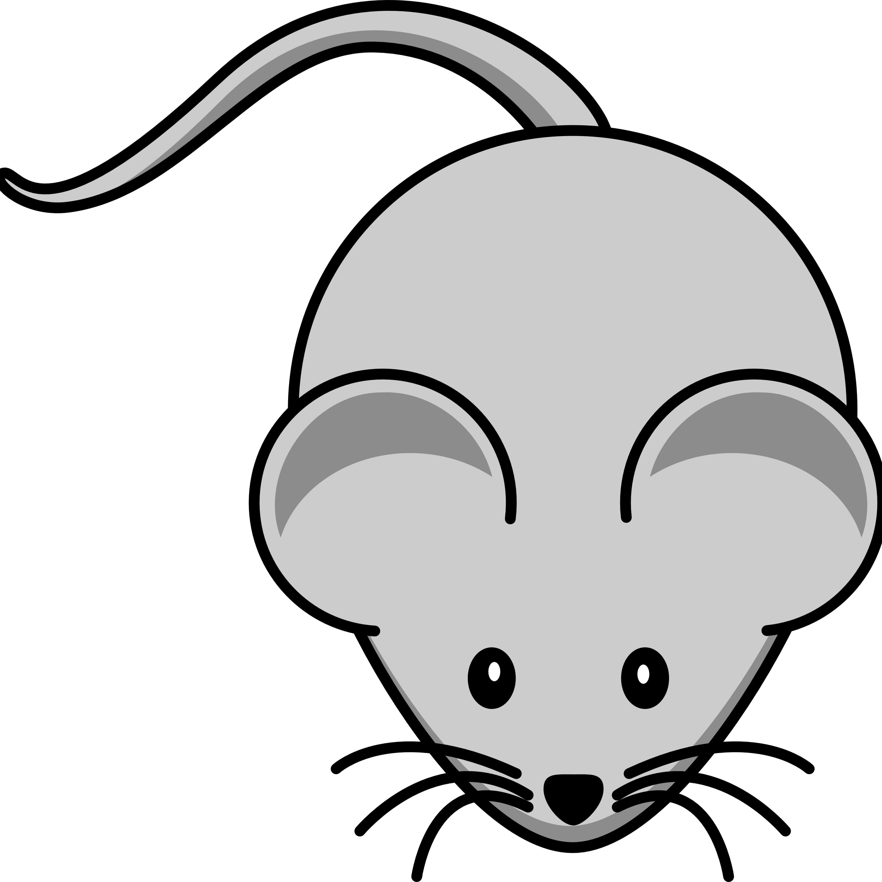
Moore’s Law
Notes:
Moore's Law along with specific chips like Google's TPU for deep learning allows for us to reach capacity of human brain.

Slide 4
Breaking Down AI
AI
Machine Learning
Predictive Analytics
Robotics
Speech
Vision
Machine Vision
Image Recognition
Text to Speech
Speech to Text
Deep Learning

Slide 5
“Field of study that gives computers the ability to learn without being explicitly programmed”
- Arthur Samuel 1959

Slide 6
How We Do ML
Gather Dataset
Process your Dataset
Build your ML Model
Test Model
Analyze Results

Slide 7



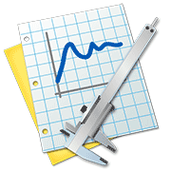
Gathering Data
How to Get Datasets
Publicly Available Datasets
Gathering Your Own Data
Notes:
Data can be anything like images

Slide 8
Preprocessing Data
Importing Dataset
Missing Data
Categorical Data
Splitting Dataset into training/test set
Future Scaling
Create Template
Data Preprocessing sucks!
But you can’t do Machine Learning without it!

Slide 9
There are a Lot of Models!
Regression
Linear
Support Vector
Polynomial
Decision Tree
Classification
Logistic
K-NN
SVM
Naive Bayes
Clustering
K-means
Hierarchical
RL
UCB
Thomson Sampling

Slide 10
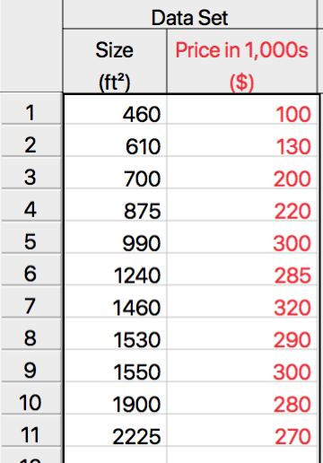
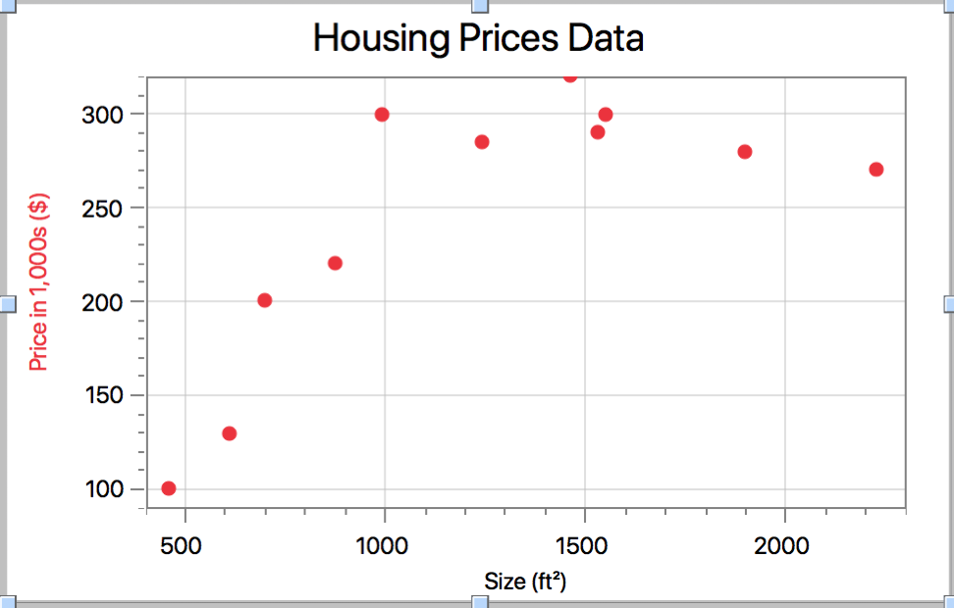
Supervised Learning (Building models)

Slide 11
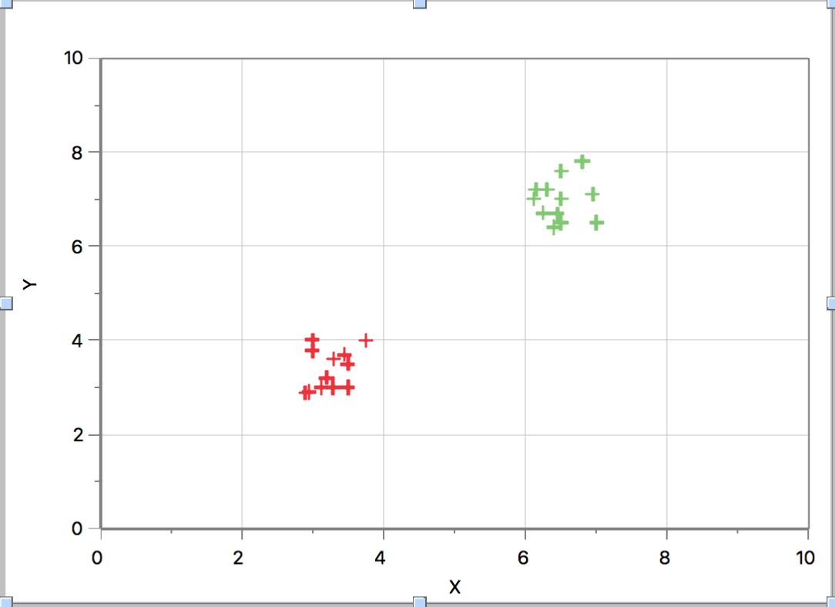
Unsupervised Learning (Building models)

Slide 12
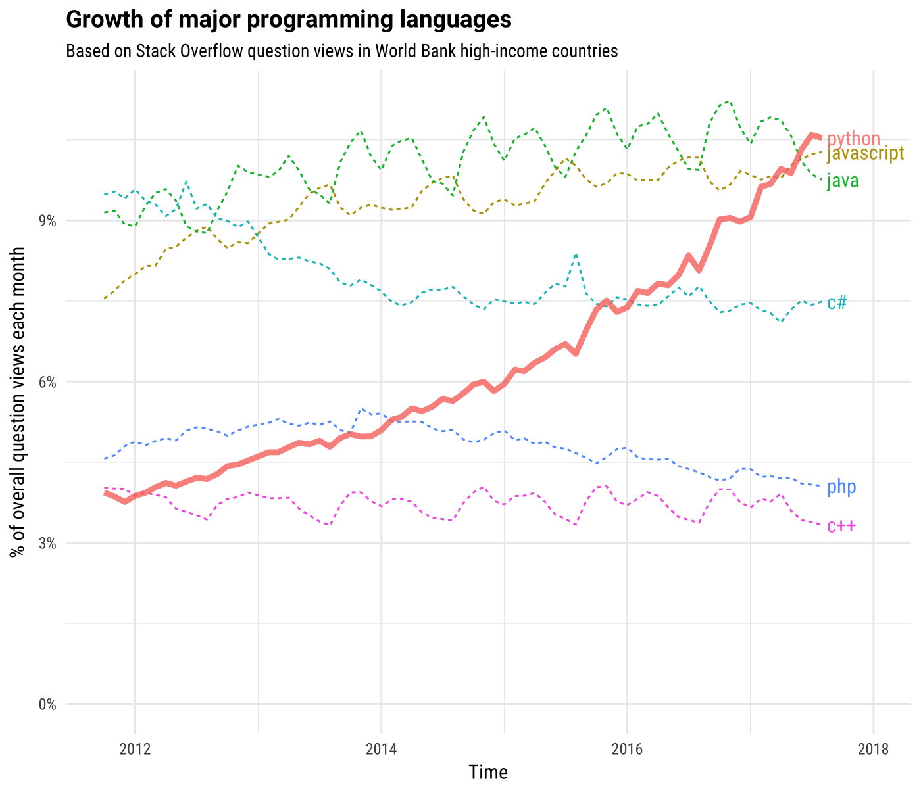
Why Python?
Easy
Easy to learn and read
Libraries
Lots of libraries for ML
Scikit-learn, Pandas, Matplotlib to name a few

Slide 13
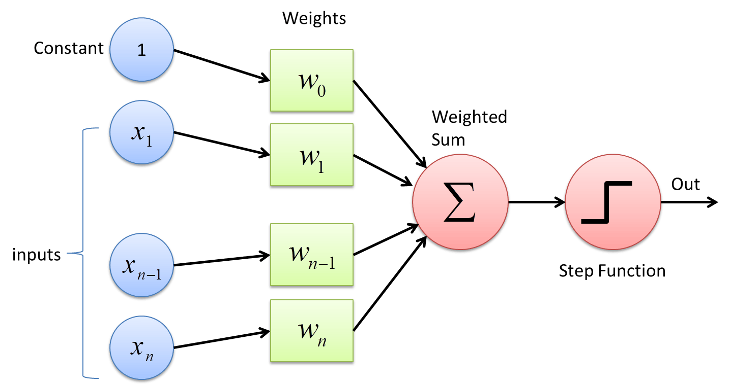
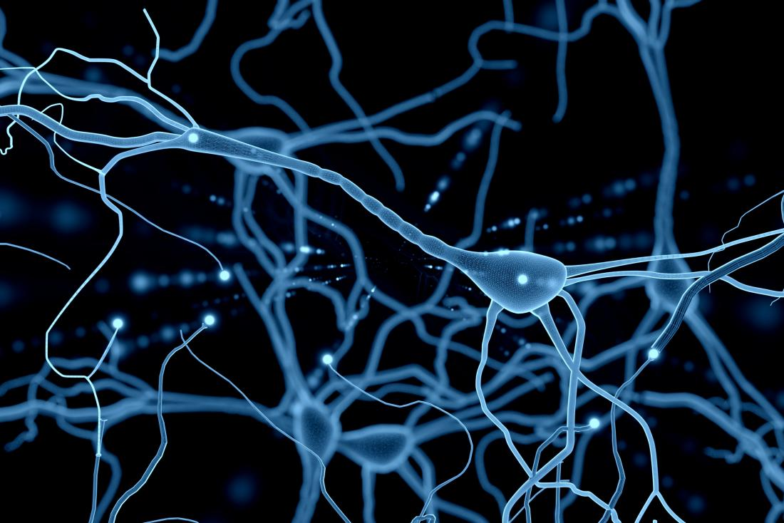
Brief Intro to Deep Learning

Slide 14
Structure Of The Lectures
Python for ML
Machine Learning
Deep Learning

Slide 15
Thanks!
Any questions?
Harker AI Club 2018

