Slide 1
Introduction to AI Harker AI Club 9/26/18

Slide 2
History of AI
Turing Test Developed (1950)
Arthur Samuel Writes 1st Game Playing Program (1962)
ALVINN created by Pomerleau at CMU (1989)
Deep Blue vs Garry Kasparov
(1997)
Rise of Personal Assistants
(2010s)
A Brief History of AI
Notes:
Ideas of AI created long before 1950
For simplicity I start with turing test
Turing Test – Test of a machine’s ability to exhibit humanlike behavior
RL for checkers – Arthur Samuel (Professor – Stanford)
Dean Pomerleau (ALVINN – Autonomous Land Vehicle in a Neural network)
IBM Deep Blue

Slide 3
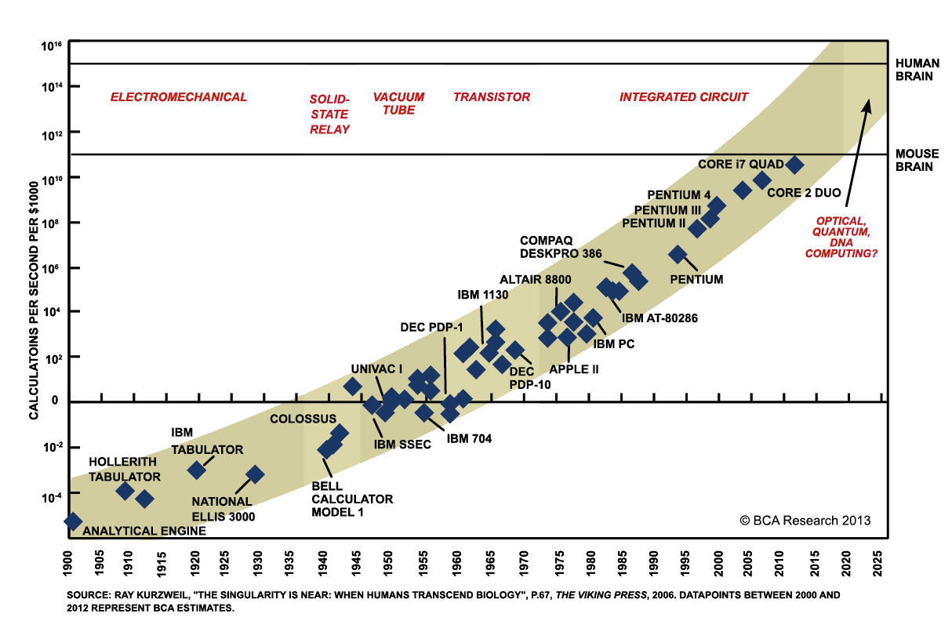
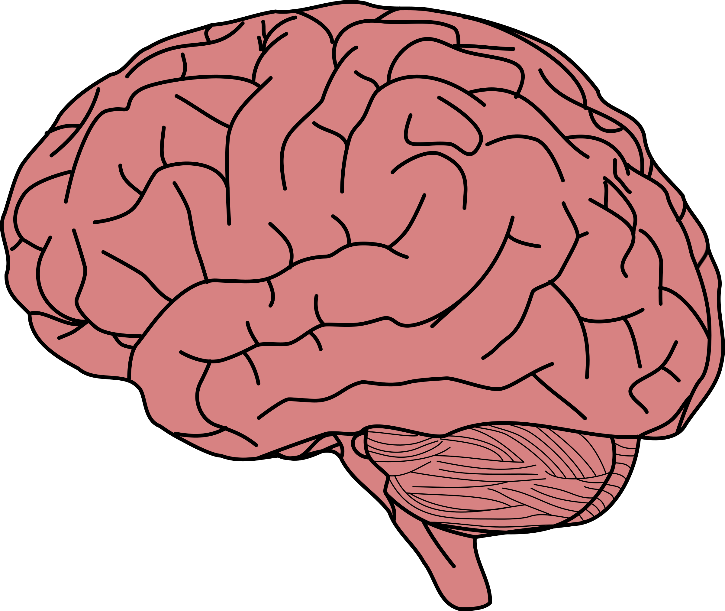

Moore’s Law
Notes:
Neural Networks invented in latter half of 1900s, this is why they are popular today.

Slide 4
Breaking Down AI
AI
Machine Learning
Predictive Analytics
Robotics
Speech
Vision
Machine Vision
Image Recognition
Text to Speech
Speech to Text
Deep Learning

Slide 5
“Field of study that gives computers the ability to learn without being explicitly programmed”
- Arthur Samuel 1959

Slide 6
How We Do ML
Gather Dataset
Process your Dataset
Build your ML Model
Test Model
Analyze Results
Notes:
A lot like the scientific method, except a machine is doing the expirement, not you

Slide 7



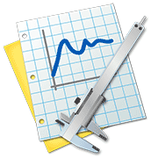
Gathering Data
How to Get Datasets
Publicly Available Datasets
Gathering Your Own Data

Slide 8
Preprocessing Data
Importing Dataset
Missing Data
Categorical Data
Splitting Dataset into training/test set
Future Scaling
Create Template
Data Preprocessing sucks!
But you can’t do Machine Learning without it!
Notes:
Dealing with missing data, OMMITING data from the actual dataset if it is not necessary
Splitting dataset into training / testing set

Slide 9
There are a Lot of Models!
Regression
Linear
Support Vector
Polynomial
Decision Tree
Classification
Logistic
K-NN
SVM
Naive Bayes
Clustering
K-means
Hierarchical
RL
UCB
Thomson Sampling

Slide 10
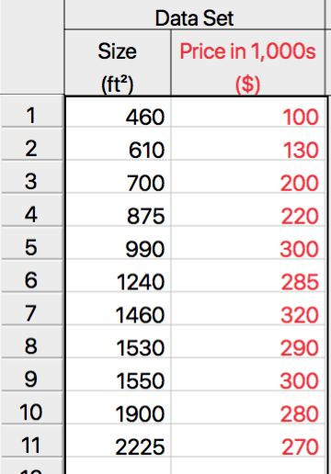
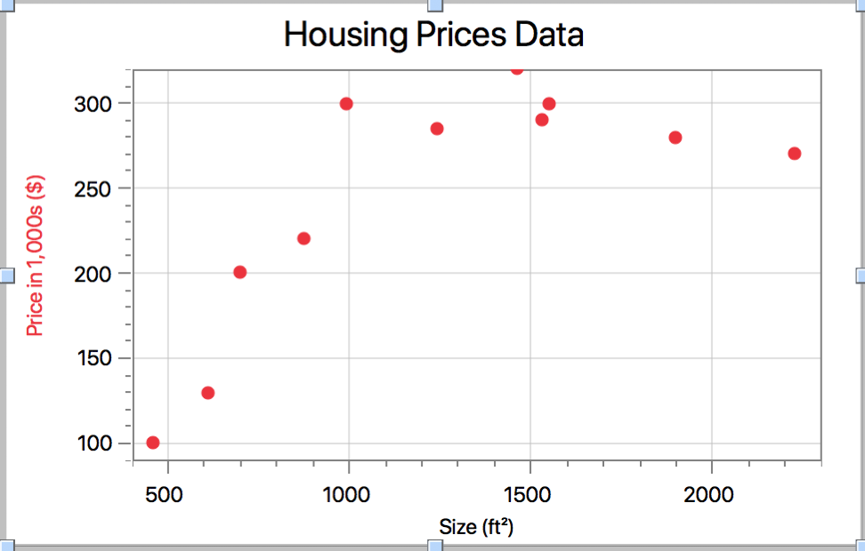
Supervised Learning (Building models)

Slide 11
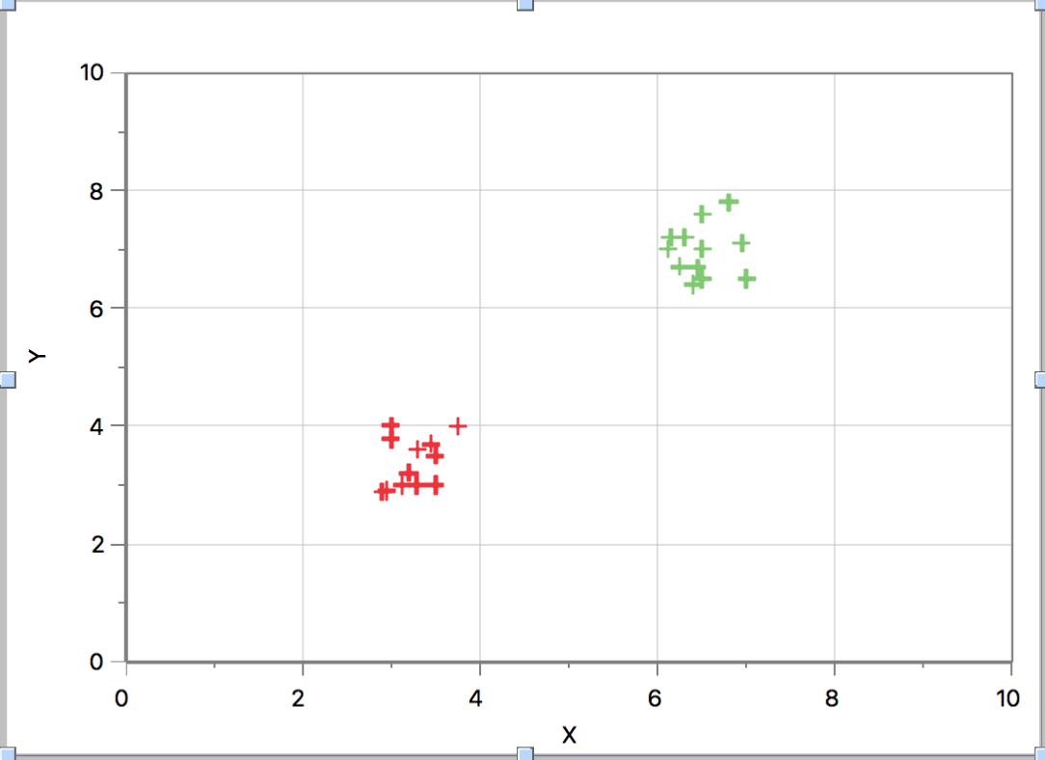
Unsupervised Learning (Building models)
Notes:
Unsupervised learning means no labels, no test set or (answers)
2 different data clusters represented on a XY plane
Clustering divides them up and uses the circles to draw a line.
The model then uses that line to differentiate between two different things

Slide 12
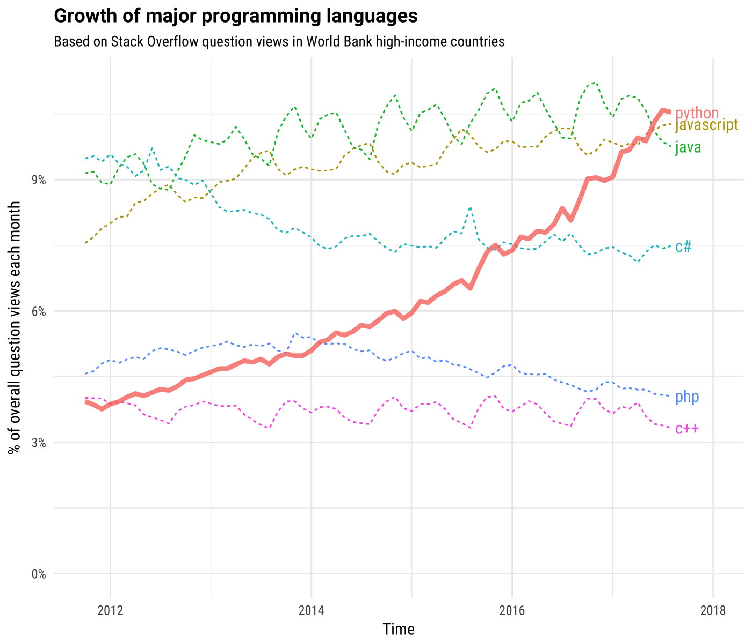
Why Python?
Easy
Easy to learn and read
Libraries
Lots of libraries for ML
Scikit-learn, Pandas, Matplotlib to name a few

Slide 13
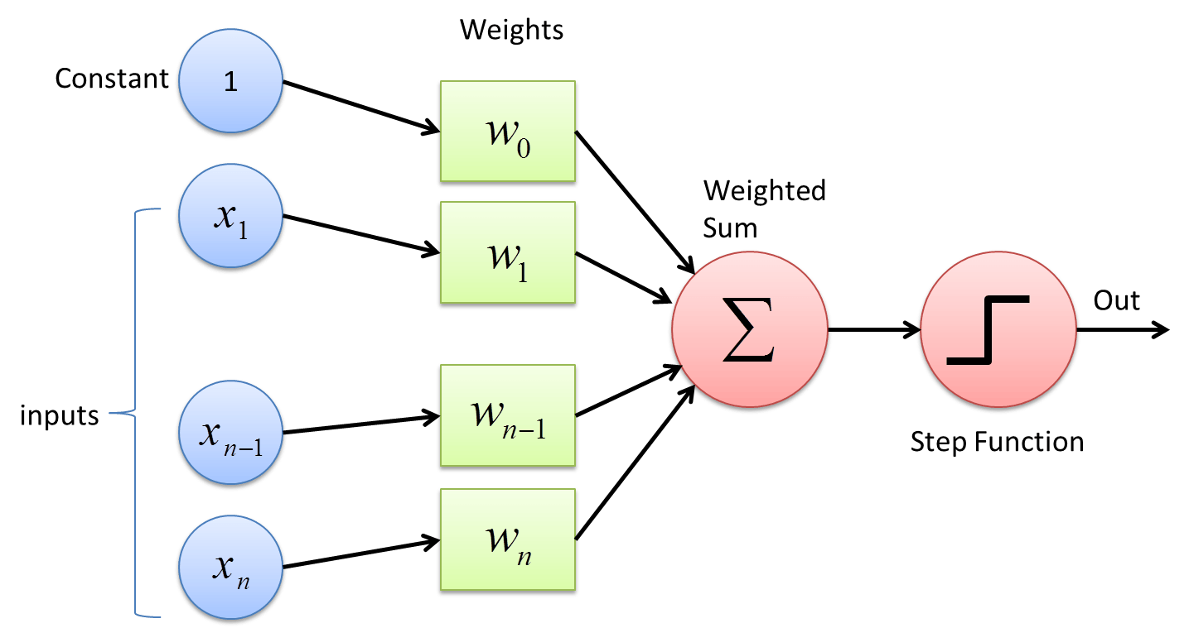
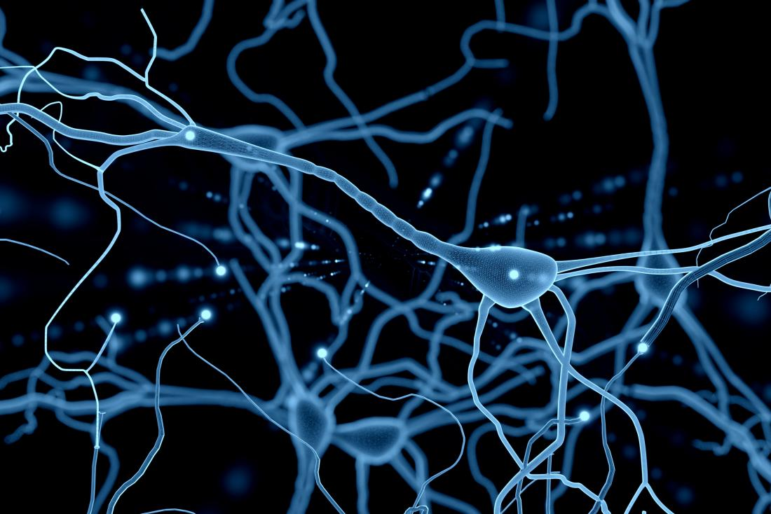
Brief Intro to Deep Learning
Notes:
Deep Learning is based on neurons in the brain
Its how we transmit signals from different parts of our brain.
Frank Rosenblatt first modeled the neurons in our brain with the first neural network. Called the Perceptron.
As the power of computers increased, as seen in moore’s law, the power of different neural networks increased.
Made up of inputs, hidden layers, and an output.
Inputs can be anything like images or numerical values.

Slide 14
Overview of Our Upcoming Lectures
Python for ML
Machine Learning
Deep Learning
Notes:
If time, before I end I want to mention that the applications of ai are widespread
Autonomous vehicles
Robots
Video Recognition (ex: referreing sports games)
General Purpose decision making

Slide 15
Thanks!
Any questions?

