Slide 1


Slide 2


Slide 3
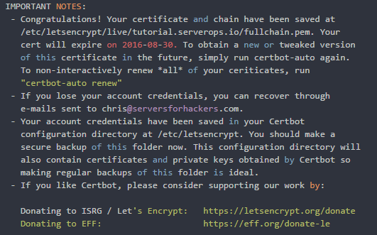
export DOMAINS=“example.com, www.example.com"
export DIR=/var/www/demo
cd /opt/letsencrypt
./letsencrypt-auto certonly -a webroot --webroot-path=$DIR -d $DOMAINS

Slide 4
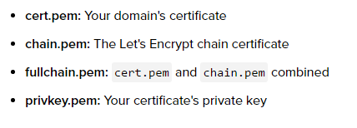
ls -lah /etc/letsencrypt/live/example.com

Slide 5
server {
listen 80 default_server;
listen 443 ssl default_server;
ssl_certificate /etc/letsencrypt/live/example.com/fullchain.pem;
ssl_certificate_key /etc/letsencrypt/live/example.com/privkey.pem;
/opt/letsencrypt/letsencrypt-auto renew
crontab entry
30 2 * * 1 /opt/letsencrypt/letsencrypt-auto renew >> /var/log/le-renew.log

