Slide 1

Larry cai <larry.caiyu@gmail.com>

Slide 2
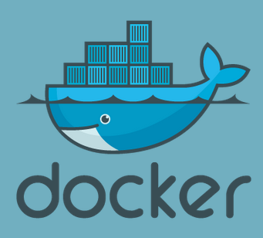
Agenda
Introduction
Exercise 1: First docker container
Exercise 2: Add package and create own docker image
Exercise 3: Understand layer
Exercise 4: Expose the service
Exercise 5: Dockerfile to build
Exercise 6: Publish your image in docker.io index registry
Reference
Online for ex1/ex2: https://www.docker.io/gettingstarted/
Online for ex5: https://www.docker.io/learn/dockerfile/
Learn docker in 90 minutes

Slide 3
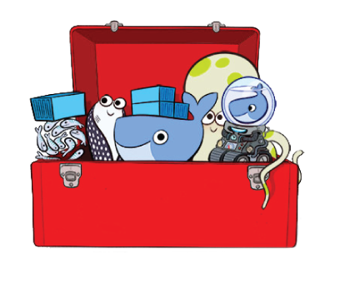

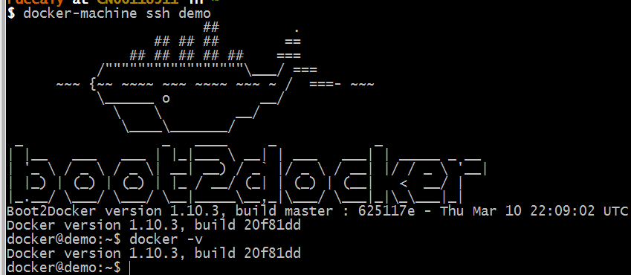
Environment Preparation
Docker toolbox (127M)
  Contains latest docker already, fast
  Container persistence via disk automount on /var/lib/docker
Create docker host in virtualbox
  Quickstart to get default
  Or `docker-machine`
  docker-machine create --driver virtualbox default
Verify the installation
  docker-machine ssh default
  $ docker -v
  User/Passwd: docker/tcuser
https://www.docker.com/products/docker-toolbox
Learn docker in 90 minutes

Slide 4
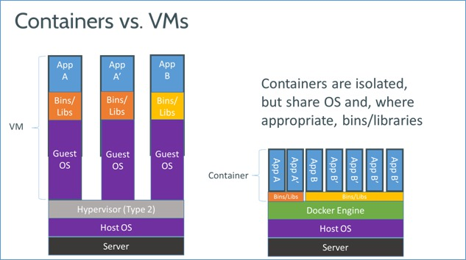
Introduction
Docker is an open-source engine that automates the deployment of any application as a lightweight, portable, self-sufficient container that will run virtually anywhere.
Based on LXC (Linux Container), easy to use.
Similar to VM as end-user with different features
Learn docker in 90 minutes

Slide 5
Exercise 1: First docker container
Download from central place for ubuntu
Execute command inside container
Interactive with container
$ docker search ubuntu # from lots of release
$ docker pull ubuntu:latest # may take minutes
Pulling repository ubuntu
ad892dd21d60: Pulling dependent layers
511136ea3c5a: Pulling fs layer
$ docker images # list local images
REPOSITORY TAG IMAGE ID CREATED VIRTUAL SIZE
ubuntu latest ad892dd21d60 6 days ago 275.5 MB
$ docker run ubuntu echo “Hello World”
$ docker run -i -t ubuntu bash
Learn docker in 90 minutes

Slide 6
`docker` - the command line tool
Some common commands:
  $ docker search # search hub.docker.com for an image
  $ docker pull # download image
  $ docker images # list all existing local images
  $ docker run # initiates a container from an image
  $ docker ps # list running containers
  $ docker build # build images from Dockerfile
$ docker start/stop/kill # commands
$ docker rm/rmi to remove a container or image
http://superuser.com/questions/756999/whats-the-difference-between-docker-stop-and-docker-kill
Learn docker in 90 minutes

Slide 7
Exercise 2: Add own package and image
Try to install apache2 inside
  $ docker run -i -t ubuntu /bin/bash
  # sed -i 's/us.archive.ubuntu.com/mirrors.163.com/' /etc/apt/sources.list
  # apt-get update && apt-get install –y apache2
  # exit
$ docker ps –l # -l means –latest
CONTAINER ID IMAGE COMMAND CREATED STATUS
c4bd63cc87f1 ubuntu:latest bash 2 minutes ago Exited 2 sec
$ docker commit <container id> apache2
66db661d9ad8681b082bb62b21b6ef5f2ddb4799e3df5dbd8fb23aed16616b1d
Check and run it again to see the apache is there
$ docker images
REPOSITORY TAG IMAGE ID CREATED VIRTUAL SIZE
apache2 latest 66db661d9ad8 28 seconds ago 298.5 MB
ubuntu latest ad892dd21d60 6 days ago 275.5 MB
$ docker run –i –t apache2 bash # check apache
Slow connection, then use mirror ubuntu
Learn docker in 90 minutes

Slide 8
Docker image & layer
Docker images are saved in layered !!
  Differed binary for apache2 image
$ docker run --rm -v /var/run/docker.sock:/var/run/docker.sock nate/dockviz images -t
…
└─511136ea3c5a Virtual Size: 0 B
└─e465fff03bce Virtual Size: 192.5 MB
└─23f361102fae Virtual Size: 192.7 MB
└─9db365ecbcbb Virtual Size: 192.7 MB
└─ad892dd21d60 Virtual Size: 275.5 MB Tags: ubuntu:latest
└─66db661d9ad8 Virtual Size: 298.5 MB Tags: apache2:latest
http://docs.docker.io/terms/layer/
Learn docker in 90 minutes

Slide 9
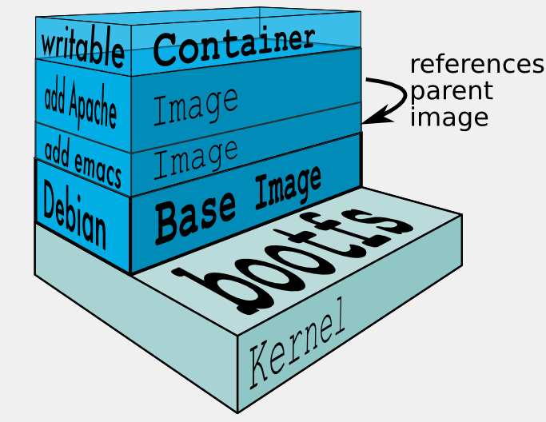
Docker image & layer
When Docker mounts the rootfs, it starts read-only, it takes advantage of a union mount (aufs) to add a read-write file system over the read-only file system.
There may be multiple read-only file systems stacked on top of each other. We think of each one of these file systems as a layer.
http://docs.docker.io/terms/layer/
Learn docker in 90 minutes

Slide 10
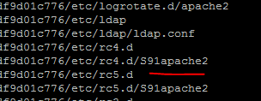
Exercise 3: Understand the layer
Data are stored under /var/lib/docker (root permission)
  aufs is used in boot2docker, could be others like devicemapper/btrfs …
$ ls –al /var/lib/docker
$ ls -1 /var/lib/docker/aufs/diff/
..
66db661d9ad8681b082bb62b21b6ef5f2ddb4799e3df5dbd8fb23aed16616b1d/
9db365ecbcbbb20e063eac70842c53e27fcad0e213f9d4ddb78152339cedd3b1/
See what is diff inside /var/lib/docker/aufs/diff/<image id> !!
$ find /var/lib/docker/aufs/diff/66* | grep apache2
On MacOS, type command below
to docker server
boot2docker ssh
See more http://blog.thoward37.me/articles/where-are-docker-images-stored/
Learn docker in 90 minutes

Slide 11
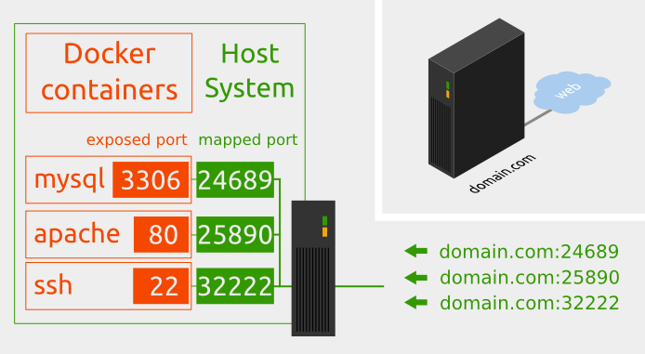
Docker service
Network in container is not visible outside (using NAT)
The service is exposed by Port !!
Run –p host:guest # assign port to host
    $ docker run –p 25890:80 –i –t apache2 bash
    # apache2ctl start
source from : http://pierre-jean.baraud.fr/blog/2014/06/02/host-docker-containers/
Learn docker in 90 minutes

Slide 12
Docker service
Interactive mode vs. Daemon (Detach) mode
(docker run)
  -d : run in daemon mode
  -i : run in interactive mode
  (CTRL-P-Q to quit from shell to enter daemon mode, exit will stop the container)
  $ docker attach <container ID> : connect to existing container
Other parameters for docker run
--name : define container name
Enter into existing docker container (since 1.3 version)
$ docker exec -it <container ID> bash
Learn docker in 90 minutes

Slide 13
Exercise 4: Expose the service
Export the port to host as 25890 and start the service manually
$ docker run -p 25890:80 –i -t apache2 bash
root@35ac981a49e5:/# service apache2 start
$ docker ps # in another shell
CONTAINER ID IMAGE …. STATUS PORTS NAMES
e020aa2c02a5 apache2:latest ….. Up 14 seconds 0.0.0.0:25890->80/tcp web
$ curl http://localhost:25890 # or use 192.168.59.13 to replace localhost
Come into the container again to check
$ docker exec –it e020aa2c02a5 bash
Run contain in daemon mode
$ docker run –p 25891:80 –d –t apache2 apache2ctl –D FOREGROUND
Learn docker in 90 minutes

Slide 14

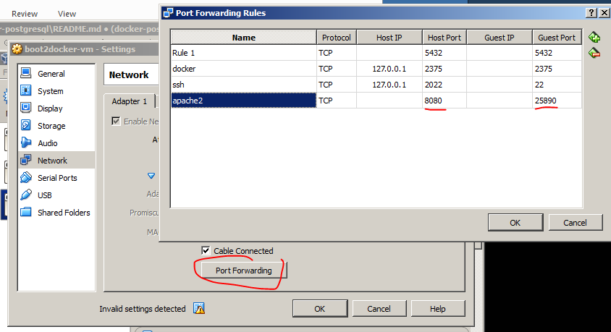
Port forward to Windows
Use boot2docker VM IP to access
$ boot2docker ip
  http://192.168.59.104:25890
Use Virtualbox (may cause network issues, not recommend)
  25890 is visible in VM
  8080 is visible in Host (Windows)
  http://localhost:8080
Learn docker in 90 minutes

Slide 15
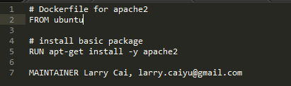
Dockerfile
Dockerfile instructs on how to build the image automatically
Dockerfile Syntax (INSTRUCTION arguments)
  FROM – defines base image
  RUN - executes arbitrary command
  ENV – sets environment
  EXPOSE – expose a port
  ADD – add local file
  CMD – default command to execute
  MAINTAINER – author information
Used by docker build
Learn docker in 90 minutes

Slide 16

Exercise 5: Dockerfile apache2/wget
Write the Dockerfile
$ vi /tmp/Dockerfile
$ cd /tmp
$ docker build –t wget .
$ docker run --rm -v /var/run/docker.sock:/var/run/docker.sock nate/dockviz images -t
Start the wget image and verify !!
Learn docker in 90 minutes

Slide 17
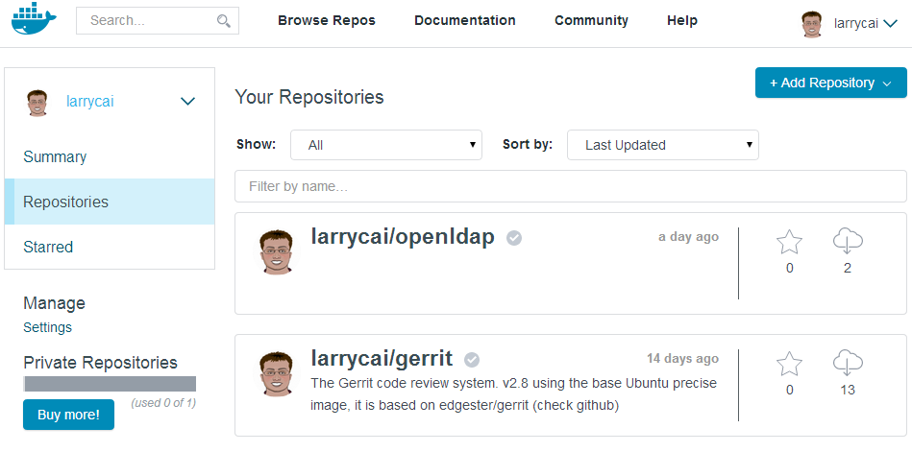
Share images in docker repository
Docker is also a tool for sharing. A repository is a shareable collection of tagged images that together create the file systems for containers.
Public repo. <username>/<repo_name>
Trusted image
$ docker search/pull/login/push
http://docs.docker.com/docker-hub/repos/
Learn docker in 90 minutes

Slide 18
(Bonus) Exercise 6: Share your image
Register in https://hub.docker.com/
Connect it with your github and build
Learn docker in 90 minutes

Slide 19
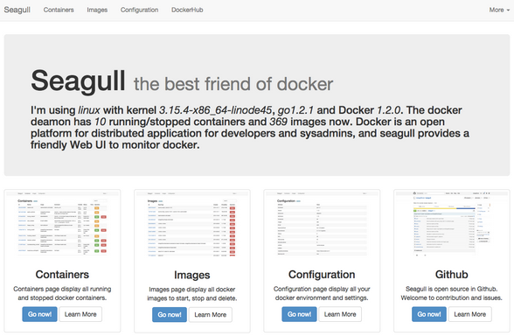
Bonus: more for docker
Try run https://github.com/tobegit3hub/seagull to check your local images/containers
Run container in daemon
Several docker container as a complete service
Share disk between containers
Share disks with host
Network …
See next CodingWithMe for “Build Service With Docker”
http://www.slideshare.net/larrycai/build-service-withdockerin90mins
Learn docker in 90 minutes

Slide 20
Summary
This is getting started training slides, door is open to you.
Benefit and use case will be added with your growing competence
Docker grows very fast, follow it.
Docker vs. openstack ? Friends/Competition …
Learn docker in 90 minutes

Slide 21
Reference
https://www.docker.io
http://prezi.com/d2vm7h0mmze5/containerize-it/
Blog:
http://blog.thoward37.me/articles/where-are-docker-images-stored/
http://stackoverflow.com/questions/17252356/run-a-service-automatically-in-a-docker-container
Cool service
  http://drone.io http://travis-ci.org open source CI system
  https://quay.io another register service
  http://www.tutum.co/ PaaS, AWS+Heroku
  http://ustack.com coreos image provider
  http://docker.cn http://dockerpool.com/ sChinese docker service
Learn docker in 90 minutes

Slide 22
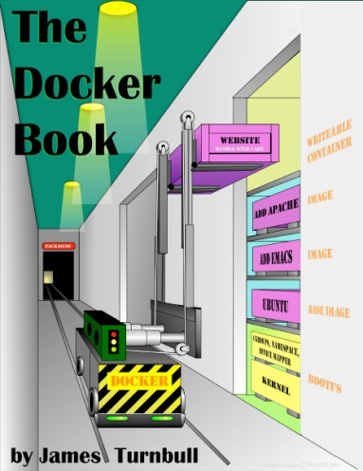
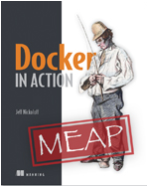
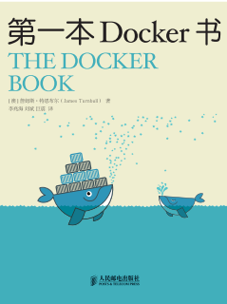
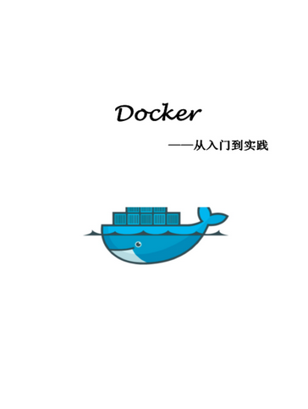
Books
http://www.dockerbook.com/ The Docker Book
http://www.manning.com/nickoloff/ Docker in Action
http://yeasy.gitbooks.io/docker_practice/ Docker 从入门到实践
Learn docker in 90 minutes

Slide 23

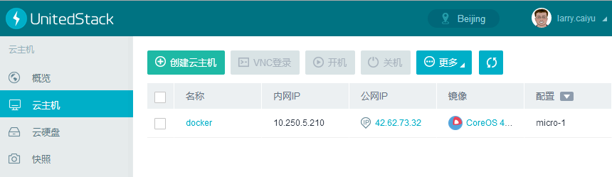
Or Ustack online environment
Register in https://www.ustack.com/cloudservice/public-cloud/
Select CoreOs VirtualMachine with key pair
Arrange Public IP for it to access
$ ssh -i id_rsa core@42.64.x.x
Reference: https://www.ustack.com/blog/running-coreos-on-uos/ (Chinese)
Learn docker in 90 minutes

Slide 24
ChangeLog
2016/03/23: docker toolbox
2014/12/31: docker exec instead of attach, MacOS, Add books
Learn docker in 90 minutes

