Slide 1
Skin Cancer Image Classification
Amir Zaman (1191514), Chigozie Ofodike (0942247),
Ayan Desai (1143073)

Slide 2
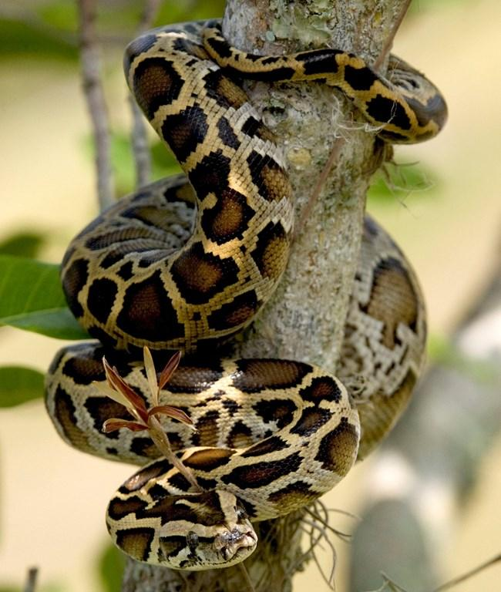
Introduction
Skin cancer bad
Expedite diagnosis
Quicker access to care
Catch it early survival good
Learn/apply python AI programming
Real world application = deeper understanding of mechanisms

Slide 3
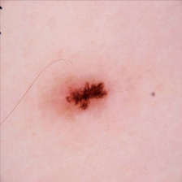
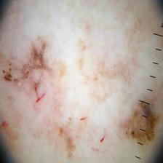
Dataset
Images of surface level skin splotches.
Classified into malignant and benign for skin cancer.
Fig 1. Benign image example from dataset
Fig 1. Malignant image example from dataset

Slide 4
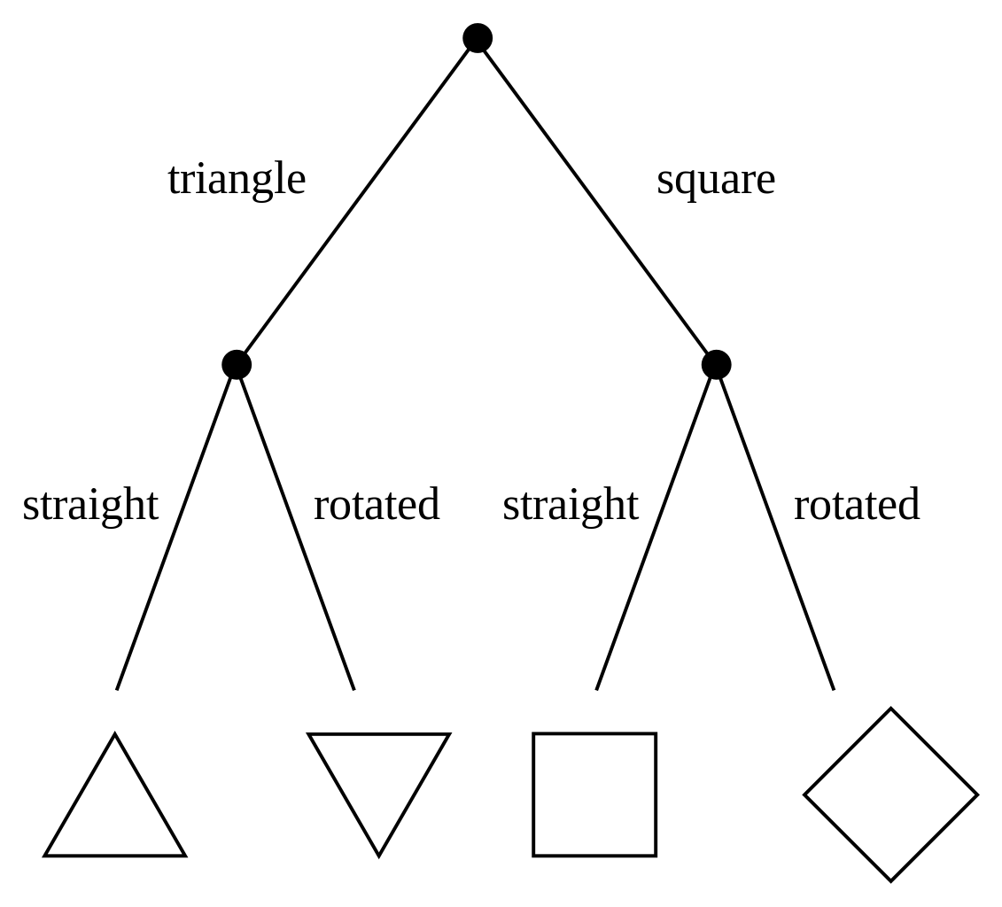
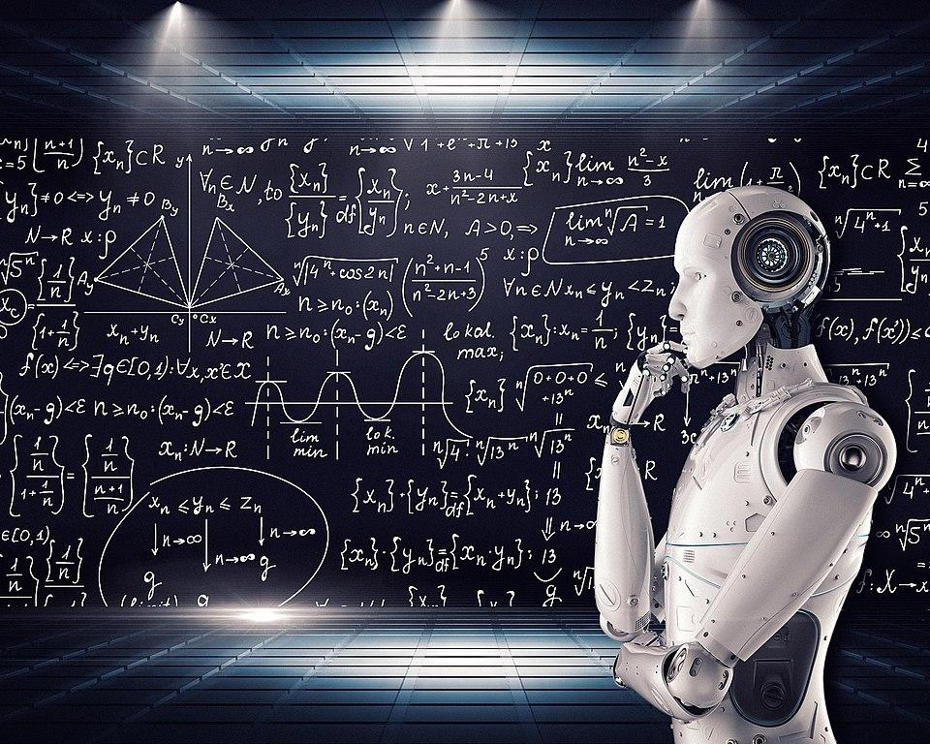
Methods
2 Models
Decision Tree
Deep Learning
Resnet-50
Pre-trained
Evaluation
Confusion matrix
Precision
Recall
Data Uncertainty
Entropy

Slide 5
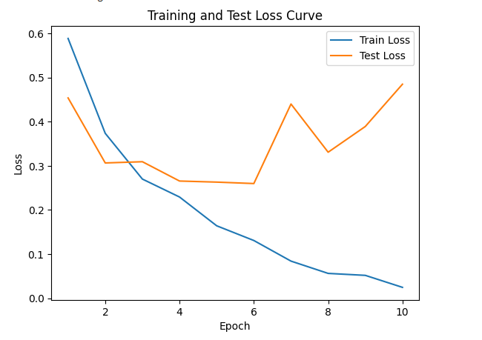
Results
Decision tree results:
Confusion Matrix:
[[271 70]
[ 88 231]]
Precision: 0.7674418604651163
Recall: 0.7241379310344828
Entropy: 0.9944220705380191
Deep learning results:
Confusion Matrix:
[[305 14]
[ 75 266]]
Precision: 0.95
Recall: 0.7800586510263929
Average entropy: 0.1231112971547104
Fig 3. training curve for deep learning model

Slide 6
Conclusions
Decision Tree
Not terrible precision and recall
High entropy, inconsistent predictions
Many features -> high entropy
Deep Learning
Decent precision
Low recall, many missed positive readings
Low entropy, higher certainty in predictions
Overall
Generally poor performance

Slide 7
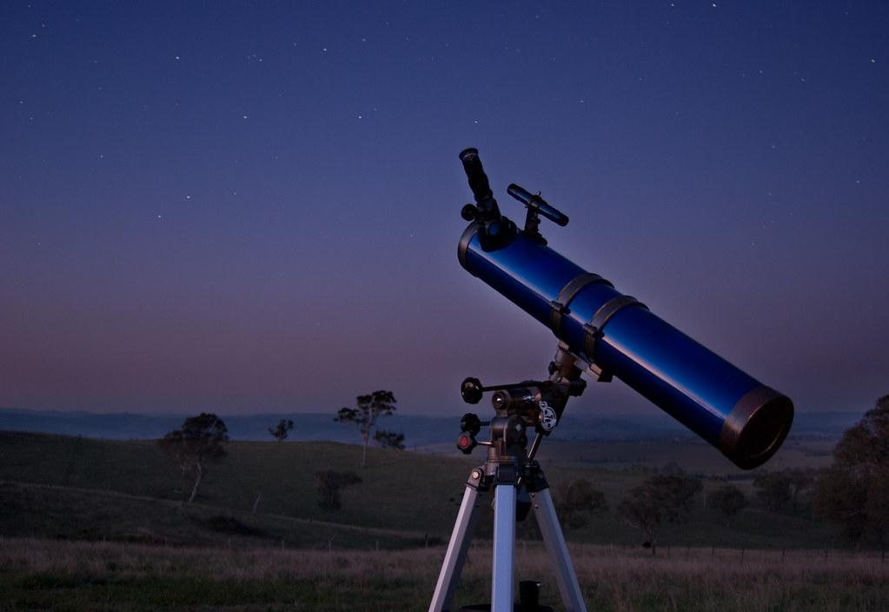
Future Outlook
Limited by google collab resources
Limited GPU RAM
Reloading notebook in new environment slow
Network issues
Solution: Set up home environment or use paid cloud service
Using just decision tree is low performing
Random forest
Ensemble techniques
Try other models and do more levels of uncertainty measure

