Slide 1
NAME = PATEL DEV PATEL PRINCE ROLL = 20IT085,20IT106
SUB = SOFTWARE GROUP PROJECT.
DATE = 16/9/2021.

Slide 2
DEFINATION:- This app will help you to record your all your property that you inheritance to your family and etc.
PROJECT = PROPERTY GUIDER.

Slide 3


Advantages
Personal benefits.
= Less stress.
= More Freedom.
maintain the value and property.
Lower maintenance.

Slide 4
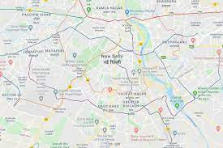
.MORE ACCURACY. 1. WITH GOOGLE MAPS :=

Slide 5

.FOR RENT AND SELL.
= We give one more benefit to sell or give for rent.
= collecting rent .

Slide 6
REGISTRATION CRITERIA.
Aadhar Card.
Number Verification.
Photos of Property.
All information about Property.

Slide 7
.THANK YOU.

