Slide 1
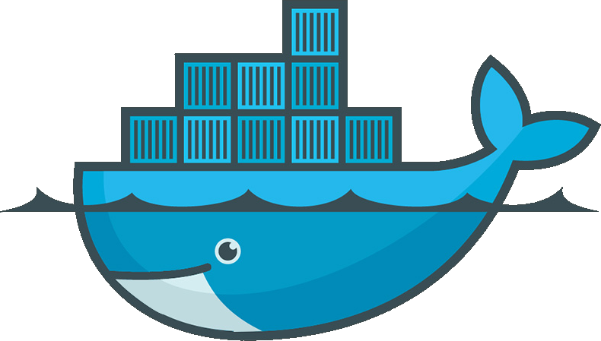
Docker – Containerizing Apps

Slide 2
Summary
What are containers ?
  From shipping logistics to virtualization
Problems docker solves:
  “It works on my machine”
  Keeping your versions and sanity in check
  Acheiving interplanetary scale
How docker is used locally
How docker is used in production
Demo

Slide 3
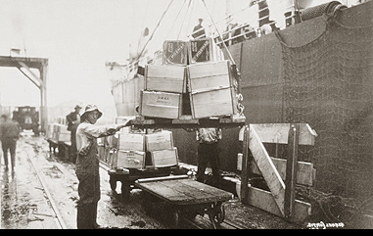
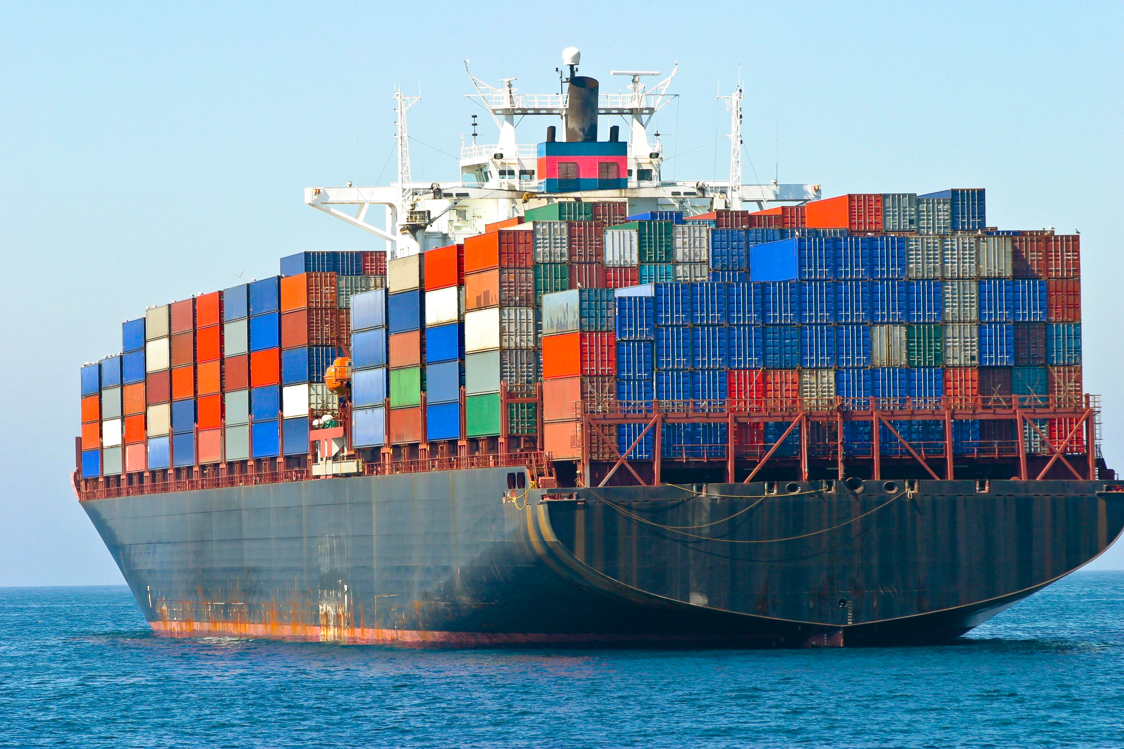
What are containers?

Slide 4
Container Virtualization
Power of OSS
  Originiate from Linux Containers (LXC 2005)
  Docker released open source in 2012
  Docker released Docker Enterprise in 2015
  Today 3,300 contibutors, 43,000 stars on repo
Layered like an onion
Distributable

Slide 5
Problem 1: “It works on my machine”
Programs like web servers, databases, programming languages setup differently in other environments
  Location of files
  Different configs by default
Any changes that make the environments slightly different could cause unexpected affects from system to system.
  Modified a config file for 1 project?
  Making all systems in an org being exactly that same is difficult.

Slide 6
Problem 2: Keeping your versions and sanity check
Python 2.6 vs 3, PHP 5 vs 7, Go 1.8 vs 1.11, Mysql 5 vs Mysql 5.6...
  Code built in 1 version might not be backward compatible
  Managing several installs of a language is not easy
  Constantly have to change system to use whatever version you’re developing with
  Some tools not even available for your system?

Slide 7
Problem 3: Achieving interplanetary scale
Distributing entire systems with a single image file
  Minimal setup
  Minimal startup
  Transportable
Deploying apps across data centers is now possible
  Docker handles networking, dependency installs, restarts
Writing autoscaling infastructure is made possible with docker
  Kubernetes orchestration

Slide 8
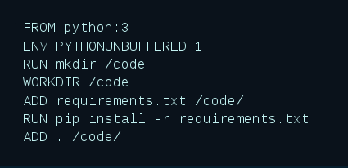
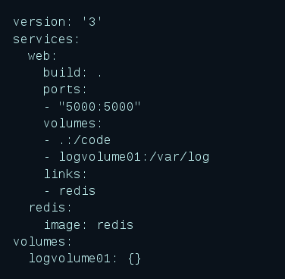
How is it used locally?
Dockerfile
Docker Compose

Slide 9
How is it used in production?
Kubernetes
  Uses docker images created from dockerfiles
  Just run the video...
  How does Kubernetes just “spin up” new instances ? Where does it get these resources from ?
    Cloud controller managers act as the glue that allows Kubernetes to interact providers with different capabilities, features, and APIs while maintaining relatively generic constructs internally. This allows Kubernetes to update its state information according to information gathered from the cloud provider, adjust cloud resources as changes are needed in the system, and create and use additional cloud services to satisfy the work requirements submitted to the cluster.

Slide 10
Demo time
Pull repo
  Oh no, we don’t have Go or Redis installed... how do we run or test?
Create docker-compose file
Build image
Run container
Run tests inside container

Slide 11
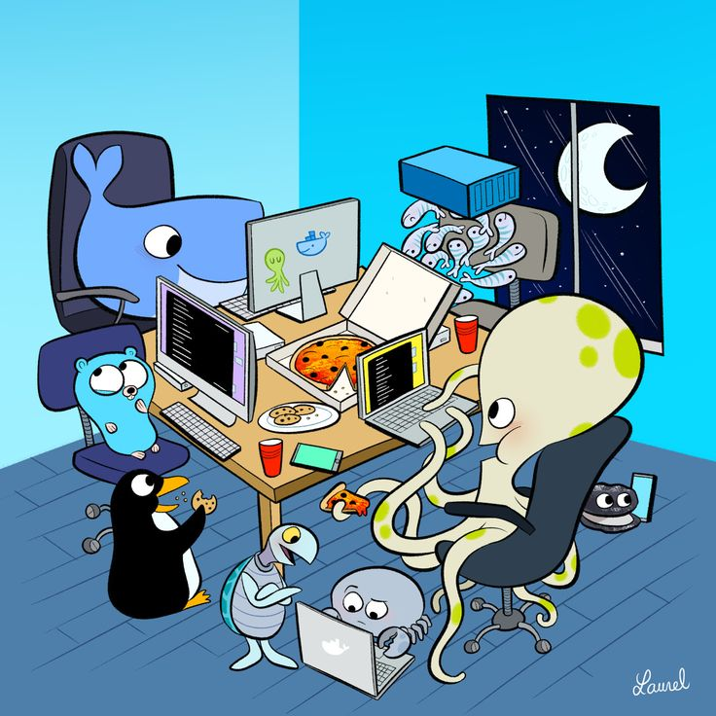
Done

