Slide 1

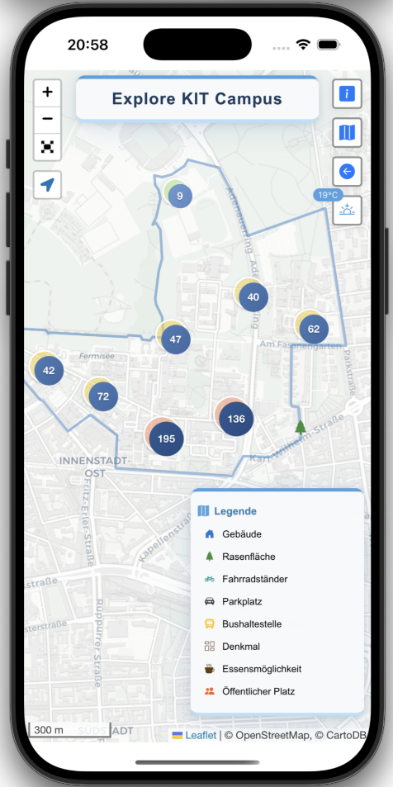
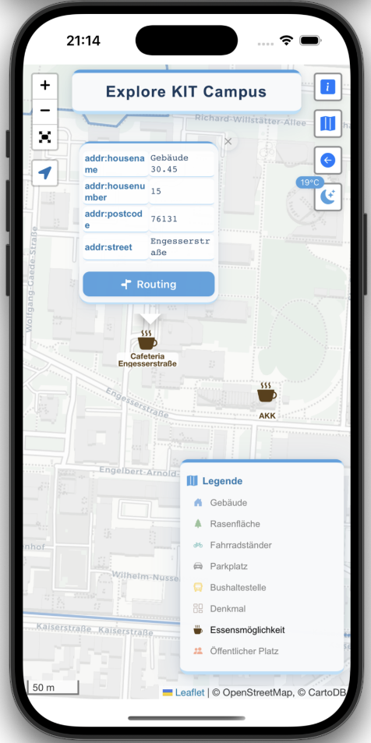
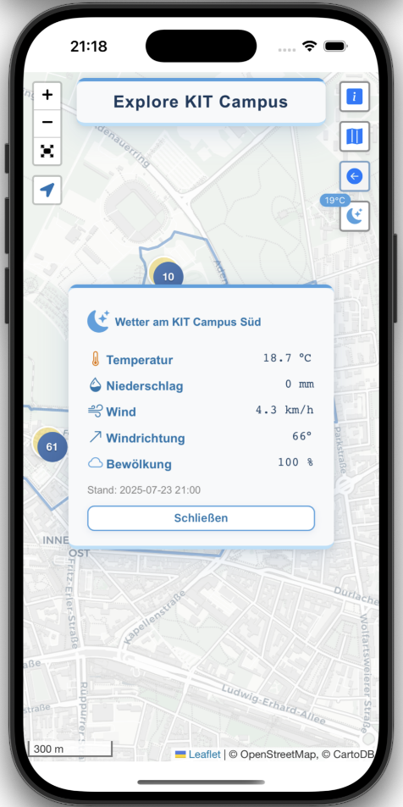
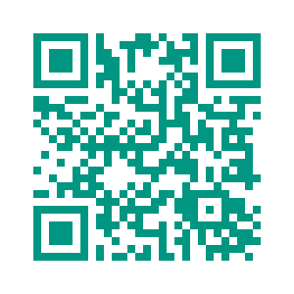
Explore KIT Campus
Discover, Navigate, Enjoy.
What is it?
Are you new to KIT or would you like to learn more about the campus? Then you're exactly right here! Our mobile web application Explore KIT Campus allows you to get an overview of the campus. Whether it's dining options, buildings, monuments, or parking, find out more about them in our app and use the routing function to get to your destination.
Features
Interactive Campus Map
Find all key places: buildings, parks, dining halls, and more.
Detailed Information
Need specific information about a room, café, or building? Check the detailed information box.
Routing
Want to go somewhere? Plan your route across campus.
Weather
Planning an outdoor learning session? Check the current weather with the integrated weather panel.
Try it now!
Available as browser preview. https://20korvin01.github.io/www/
Why use the app?
Orientation for first-year students
Packed with information for visitors and guests
Optimize routes on campus for students, staff and researchers
For You to explore KIT!
Korvin Brecht – Jasmin Jährling – Elisabeth Kral – Merlin Pillich
Mobile GIS – Summer Semester 2025 – Dr.-Ing. Paul Vincent Kuper

Slide 2
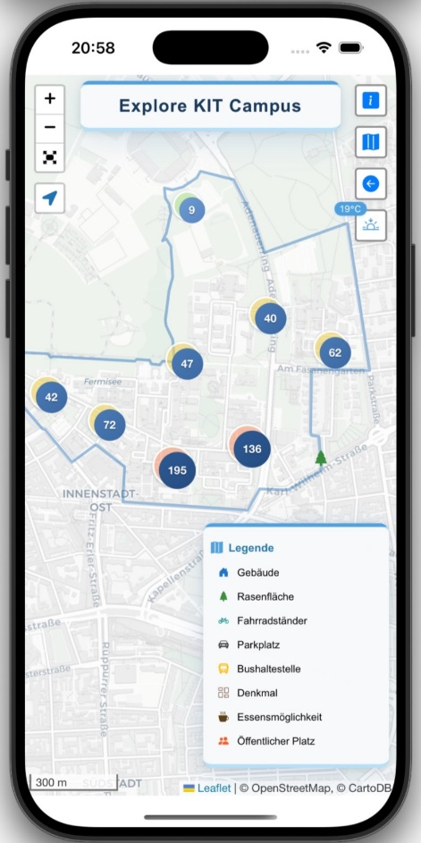
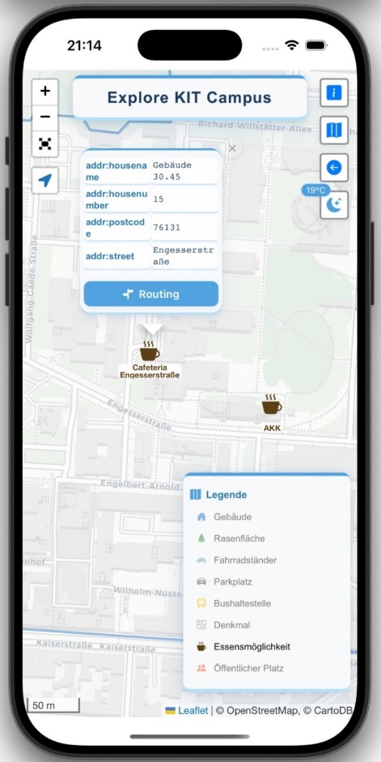
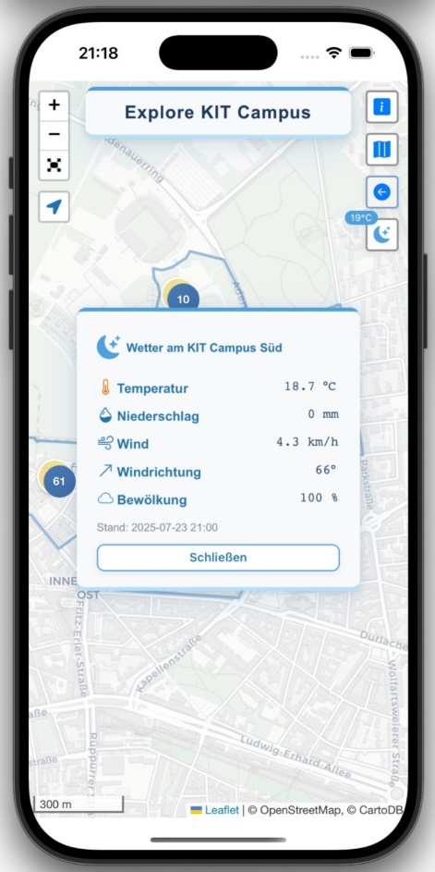
Explore KIT Campus
Discover, Navigate, Enjoy.
What is it?
Are you new to KIT or would you like to learn more about the campus? Then you're exactly right here! Our mobile web application Explore KIT Campus allows you to get an overview of the campus. Whether it's dining options, buildings, monuments, or parking, find out more about them in our app and use the routing function to get to your destination.
Features
Interactive Campus Map
Find all key places: buildings, parks, dining halls, and more.
Detailed Information
Need specific information about a room, café, or building? Check the detailed information box.
Routing
Want to go somewhere? Plan your route across campus.
Weather
Planning an outdoor learning session? Check the current weather with the integrated weather panel.
Try it now!
Available as browser preview. https://20korvin01.github.io/www/
Why use the app?
Orientation for first-year students
Packed with information for visitors and guests
Optimize routes on campus for students, staff and researchers
For You to explore KIT!
Korvin Brecht – Jasmin Jährling – Elisabeth Kral – Merlin Pillich
Mobile GIS – Summer Semester 2025 – Dr.-Ing. Paul Vincent Kuper

Slide 3
Explore KIT Campus
Discover, Navigate, Enjoy.
What is it?
Are you new to KIT or would you like to learn more about the campus? Then you're exactly right here! Our mobile web application Explore KIT Campus allows you to get an overview of the campus. Whether it's dining options, buildings, monuments, or parking, find out more about them in our app and use the routing function to get to your destination.
Features
Interactive Campus Map
Find all key places: buildings, parks, dining halls, and more.
Detailed Information
Need specific information about a room, café, or building? Check the detailed information box.
Routing
Want to go somewhere? Plan your route across campus.
Weather
Planning an outdoor learning session? Check the current weather with the integrated weather panel.
Try it now!
Available as browser preview. https://20korvin01.github.io/www/
Why use the app?
Orientation for first-year students
Packed with information for visitors and guests
Optimize routes on campus for students, staff and researchers
For You to explore KIT!
Korvin Brecht – Jasmin Jährling – Elisabeth Kral – Merlin Pillich
Mobile GIS – Summer Semester 2025 – Dr.-Ing. Paul Vincent Kuper

Slide 4
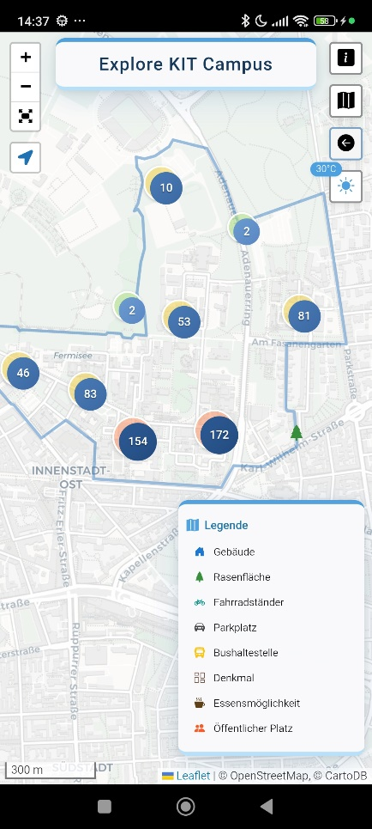
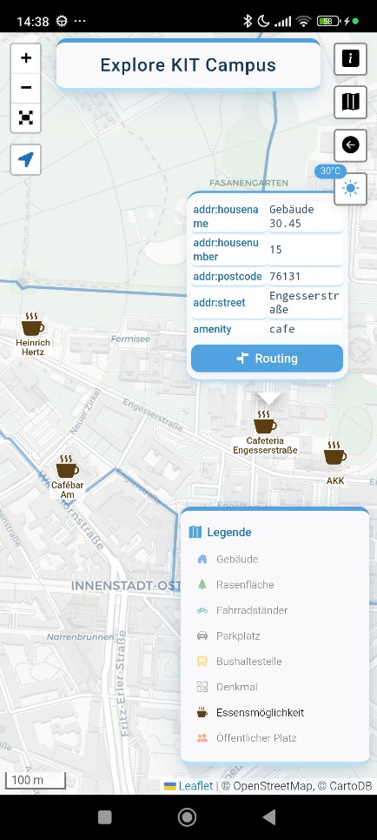
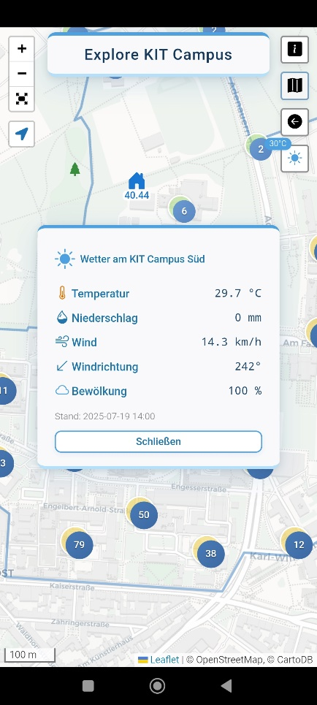
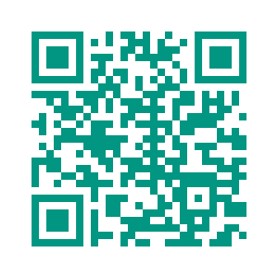
Explore KIT Campus
Discover, Navigate, Enjoy.
What is it?
Are you new to KIT or would you like to learn more about the campus? Then you're exactly right here! Our mobile web application Explore KIT Campus allows you to get an overview of the campus. Whether it's dining options, buildings, monuments, or parking, find out more about them in our app and use the routing function to get to your destination.
Features
Interactive Campus Map
Find all key places – buildings, parks, dining halls, and more.
Detailed Information
Need specific information about a room, café, or building? Check the detailed information box.
Routing
Want to go somewhere? Plan your route across campus.
Weather
Planning an outdoor learning session? Check the current weather with the integrated weather panel.
Try it now!
https://github.com/20korvin01/www/
Why use the app?
Orientation for first-year students
Packed with information for visitors and guests
Optimize routes on campus for students, staff and researchers
Anyone curious about KIT!
Korvin Brecht – Jasmin Jährling – Elisabeth Kral – Merlin Pillich
Mobile GIS – Summer Semester 2025 – Dr.-Ing. Paul Vincent Kuper

Slide 5
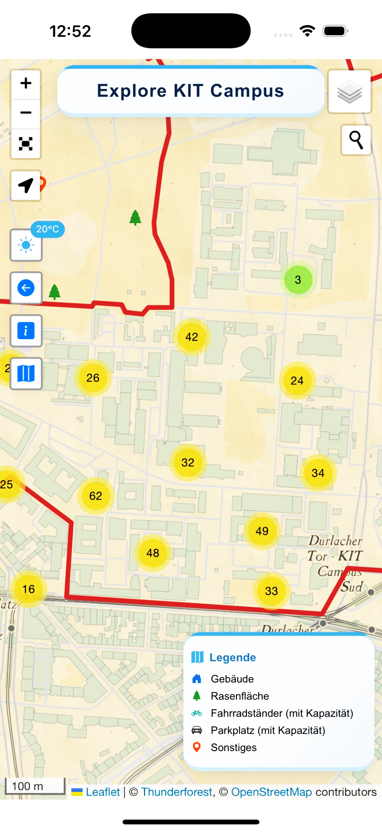

Mobile GIS Summer Semester 2025
Fancy Appname
Korvin Brecht, Jasmin Jährling, Elisabeth Kral, Merlin Pillich
Are you new to KIT or would you like to learn more about the campus? Then you're exactly right here! Our mobile web application "Name" allows you to get an overview of the campus. Whether it's dining options, buildings, monuments, or parking, find out more about them in our app and use the routing function to get to your destination.
Korvin Brecht
uinmb@student.kit.edu
Jasmin Jährling
uwlpz@student.kit.edu
Elisabeth Kral
uoeut@student.kit.edu
Merlin Pillich !!!!!!!!!!@student.kit.edu
Dr.-Ing. Paul Kuper
kuper@kit.edu
Geodätisches Institut

