Slide 1
KIT Campus App
Korvin Brecht, Jasmin Jährling, Elisabeth Kral, Merlin Pillich
Mobile GIS and LBS 2025 - Dr.-Ing. Paul Vincent Kuper

Slide 2
Overview
App idea
General information
Database
App features
Summary

Slide 3
App idea
Create an App to…
explore the KIT Campus
easily find places to eat
know where buildings of interest are
learn more about monuments, memorials, squares, …

Slide 4
General information
Development of a hybrid web application for mobile devices
Used Software (Open Source):
App development: Apache Cordova
Styling: Leaflet
Weather data: Open-Meteo
Files: JavaScript, GeoJSON, CSS

Slide 5
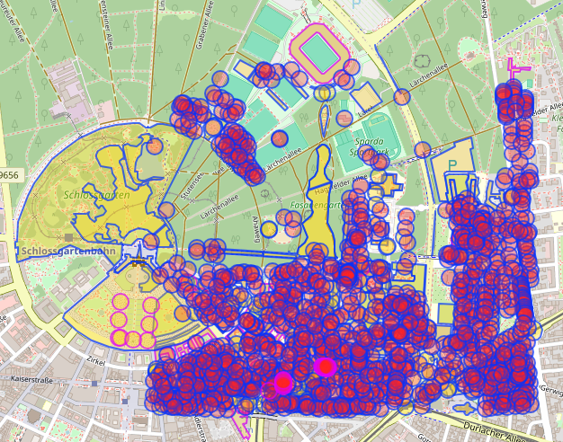
Database
Querying individual information in Overpass about…
Buildings (university, office, …)
Parking places for cars & bicycles
Parks and grassy areas
Public transport stops
Monuments/memorials
Squares
Restaurants, bars, cafes, …

Slide 6
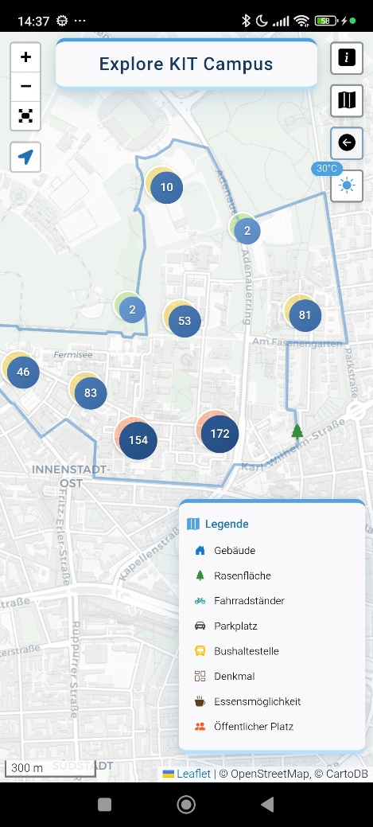
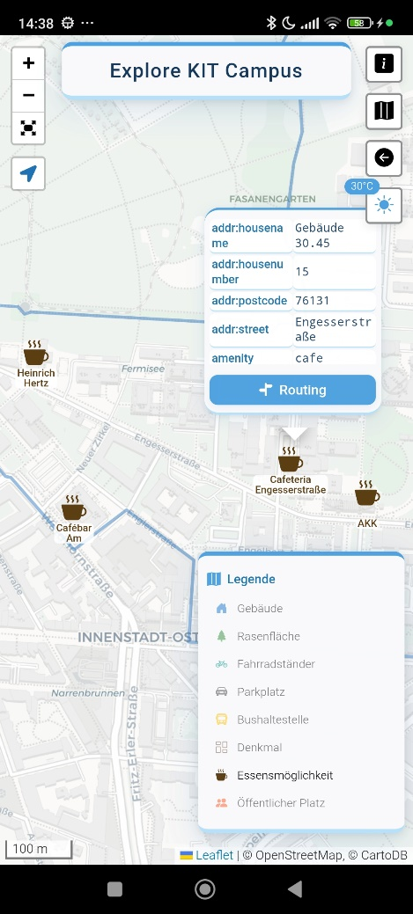
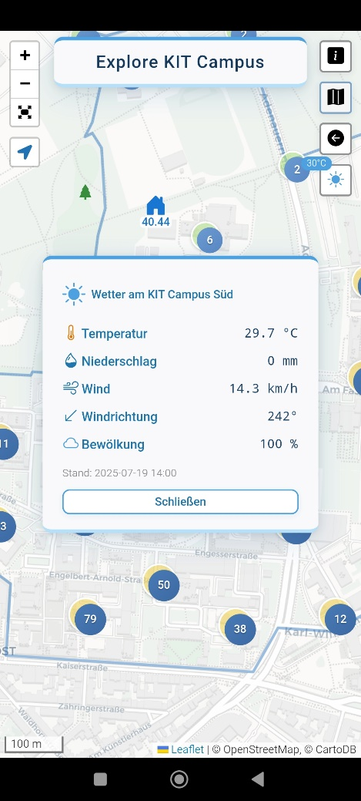
App features
Visualization of map tiles using OSM/Leaflet
Zoom in & out
Information about current position
Legend, filter by category
Information about points of interest at KIT campus
Routing to POI at the KIT campus
Button to get back to campus
Weather API

Slide 7
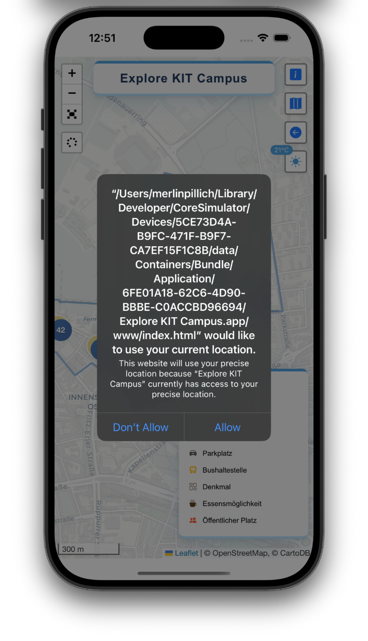
Difficulties
Cross-Origin Resource Sharing (CORS) Settings on WFS-Server
Fetching Files in JavaScript on iOS
Getting the Geolocation on iOS
UI experience when requesting location access inside a WebView on iOS

Slide 8

Summary
Hybrid web app for exploring the KIT campus
Easy search & navigation for buildings, monuments & dining options
Real-time information on weather
Interactive map with filtering, zoom, and routing features
Integration of open data sources
Developed with Apache Cordova and Leaflet
Cross-platform usability (iOS, Android, web browsers)
Check the browser preview: https://20korvin01.github.io/www/

Slide 9
References
Cordova: https://cordova.apache.org/docs/en/12.x-2025.01/guide/overview/index.html
Android Studio: https://developer.android.com/studio?hl=de
Mapbox: https://www.mapbox.com/
Leaflet: https://leafletjs.com/
OpenStreetMap: https://www.openstreetmap.org/
Overpass Turbo: https://overpass-turbo.eu/
Open-Meteo: https://open-meteo.com/

Slide 10

Mobile GIS and LBS – KIT Campus App
Korvin Brecht; Jasmin Jährling; Elisabeth Kral; Merlin Pillich
Mobile GIS & LBS 2025 - Dr.-Ing. Paul Vincent Kuper
KIT – Die Forschungsuniversität der Helmholtz-Gemeinschaft

Slide 11
Gliederung
App idea
General Information
Database
App Features
Summary
KIT – Die Forschungsuniversität der Helmholtz-Gemeinschaft

Slide 12

1. App idea
Create an App to…
explore the KIT Campus
easily find places to eat
know where buildings of interest are
learn more about monuments, memorials, squares, …

Slide 13
2. General Information
Development of a hybrid web application for mobile devices
Used Software (Open Source): Apache Cordova
Files: JavaScript, GeoJSON, CSS

Slide 14
3. Database
Querying individual information in Overpass
about…
buildings (university, office, …)
parking places for cars & bicycles
parks and grassy areas
public transport stops
monuments/memorials
Squares
restaurants, bars, cafes, …

Slide 15
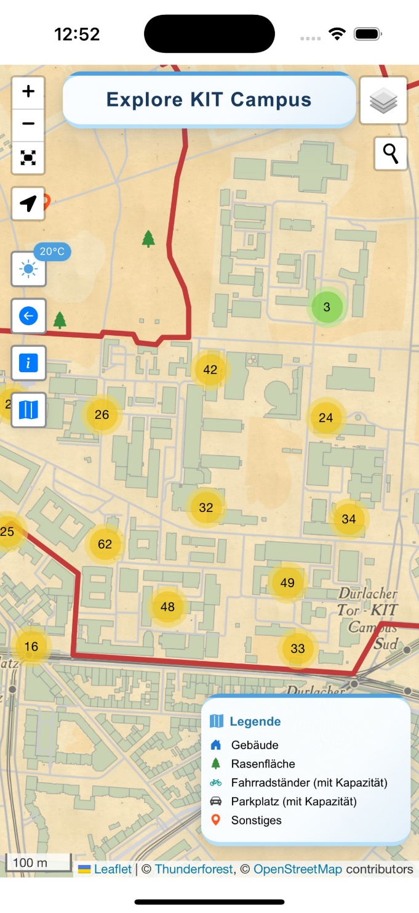
4. App Features
Visualization of map tiles - OSM/Leaflet
Zoom in & out
Feature to always go back to the campus
Use of the location sensor
Weather API
Information about points of interest at the KIT campus
Routing to specific places at the KIT campus

Slide 16
5. Summary
mip

Slide 17
References

