Slide 1



BVRIT HYDERABAD
College of Engineering for Women
GOOGLE PLAY STORE APP RATING
Team No: 4
Team Members:
V.Sushma-20WH1A1207
A.Divya sri-20WH1A1280
V.Srujana-20WH1A12B2
T.Sujatha-21WH5A1208
E.Abhinaya-21WH5A1210
G.Sai Harshitha-20951A1282

Slide 2
TABLE OF CONTENTS
Problem statement Python Packages Algorithm
output and Graphs Comparison table

Slide 3
Problem Statement
Google play store apps are downloaded based on the ratings by users.Hence the rating is very important feature for any app on the play store.Lets try to predict the rating based on several
parameters using the data collected from Google

Slide 4
Python Packages
numpy pandas seaborn
matplotlib pyplot warnings standard scalar train test split
confusion matrix
metrics
Randomized search cv sk learn
Logistic regression
Random Forest Classiﬁer Listed Color map Decision Tree Classiﬁer Accuracy Score

Slide 5
Algorithms
Logistic Regression Linear Regression Random Forest Decision Tree

Slide 6
Logistic Regression
Logistic Regression is a popular supervised learning algorithm used for classiﬁcation tasks.
It is commonly used to predict the probability of an outcome based on input variables.
Output is a binary variable, which takes only two values, 0 and 1.
Applications-spam detection, medical diagnosis, and credit risk analysis.
Accuracy of Logistic regression is 0.75

Slide 7
Linear Regression
Linear Regression is a popular supervised learning algorithm used for regression tasks.
It is commonly used to predict a continuous output variable based on input variables.
Output is a linear function of the input variables.
The algorithm works by ﬁnding the best-ﬁt line that describes the relationship between the input and output variables.
Accuracy of linear regression is 0.068

Slide 8
Random Forest
Random Forest is a popular ensemble learning algorithm used in supervised learning tasks such as classiﬁcation and regression.
It is a combination of decision trees.
The output of the random forest is the average or majority vote of the predictions made by the individual trees.
Advantages of using random forest include high accuracy, robustness to noise and outliers, and the ability to handle large datasets.
Accuracy of random forest is 0.88

Slide 9
Decision Tree
Decision tree is a popular supervised learning algorithm used for both classiﬁcation and regression tasks.
It is a tree-like model that uses a set of rules to make predictions.
In decision tree, The leaf nodes represent the ﬁnal output, which can be a class label or a continuous value.
It is widely used in various ﬁelds such as ﬁnance, healthcare, and marketing.
Accuracy of decision tree is 0.85

Slide 10
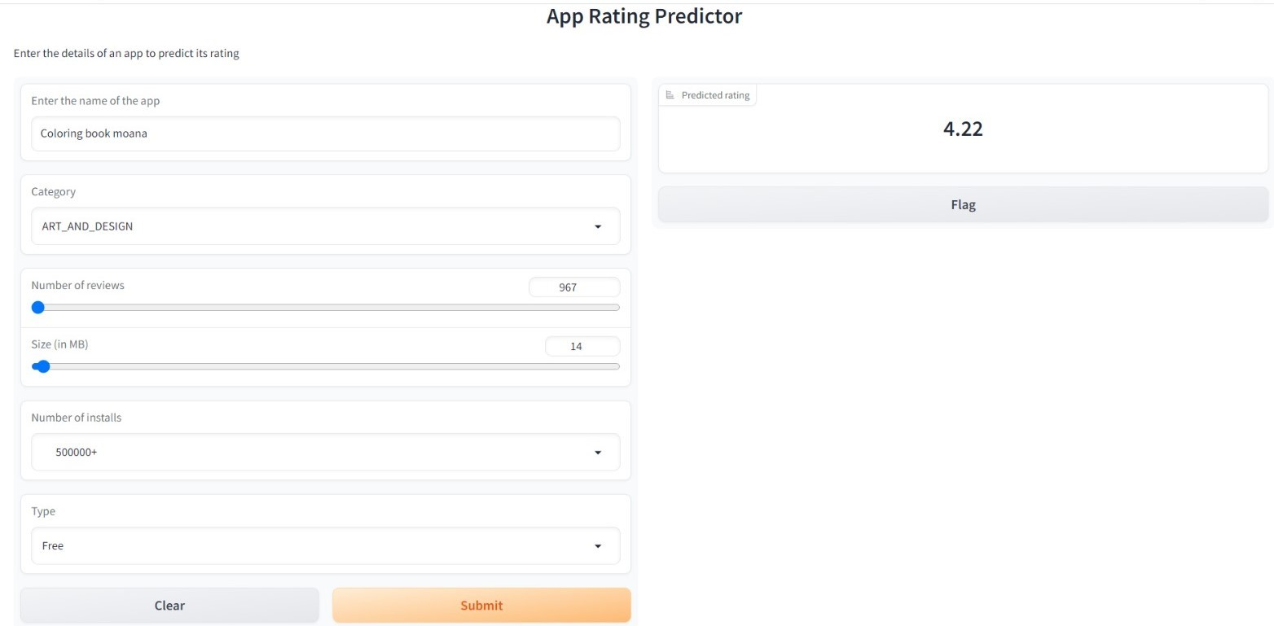
Output and Graph
Figure:Deployment using gradio

Slide 11
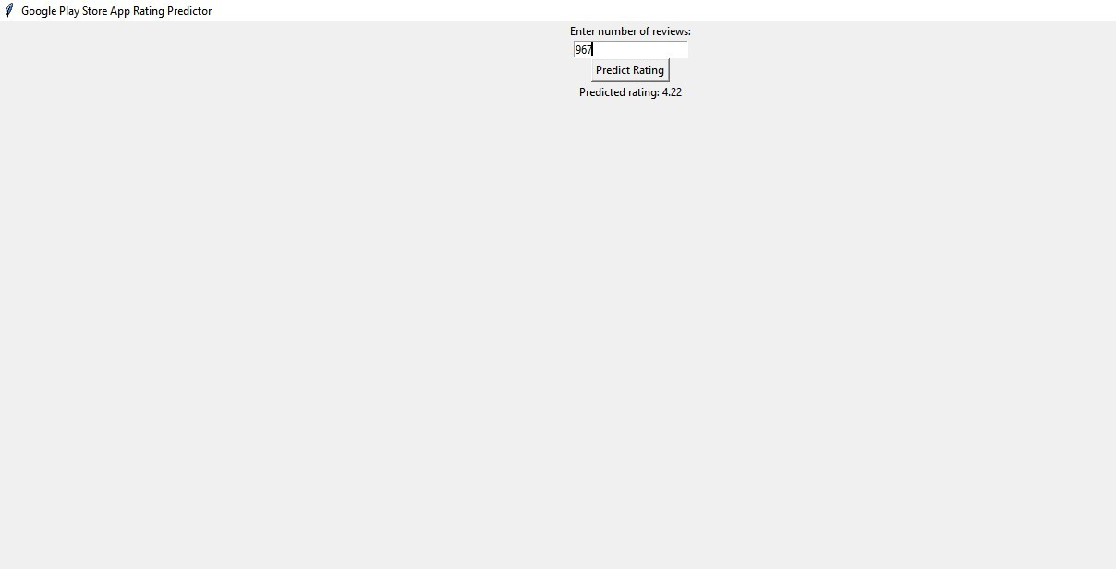
Output and Graph
Figure:GUI(tkinter)

Slide 12
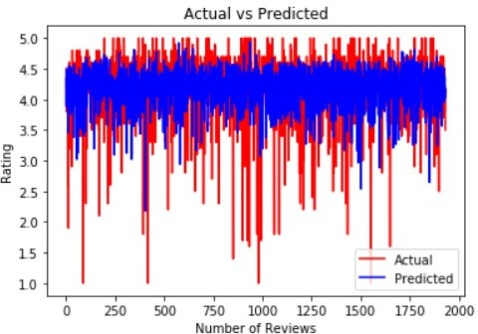
Output and Graph
Figure:Actual vs Predicted
Department of Information Technology
12

Slide 13
Comparison Table
 | Algorithm | accuracy(in percentage)
1 | Logistic Regression | 75
2 | Linear Regression | 6.8
3 | Random Forest | 88
4 | Decision Tree | 85
Department of Information Technology
13

Slide 14
THANK YOU
Department of Information Technology
14

