Slide 1
Gsheet based Automated Webpage
Vishal Gandluri
210010017

Slide 2
Presentation Flow
Website - Database
Gsheet as a Database
Pros(Data collection-Easy extra way gforms) & Cons(Data presentation -Privacy issue)
Problem & Solution
Conclusion

Slide 3
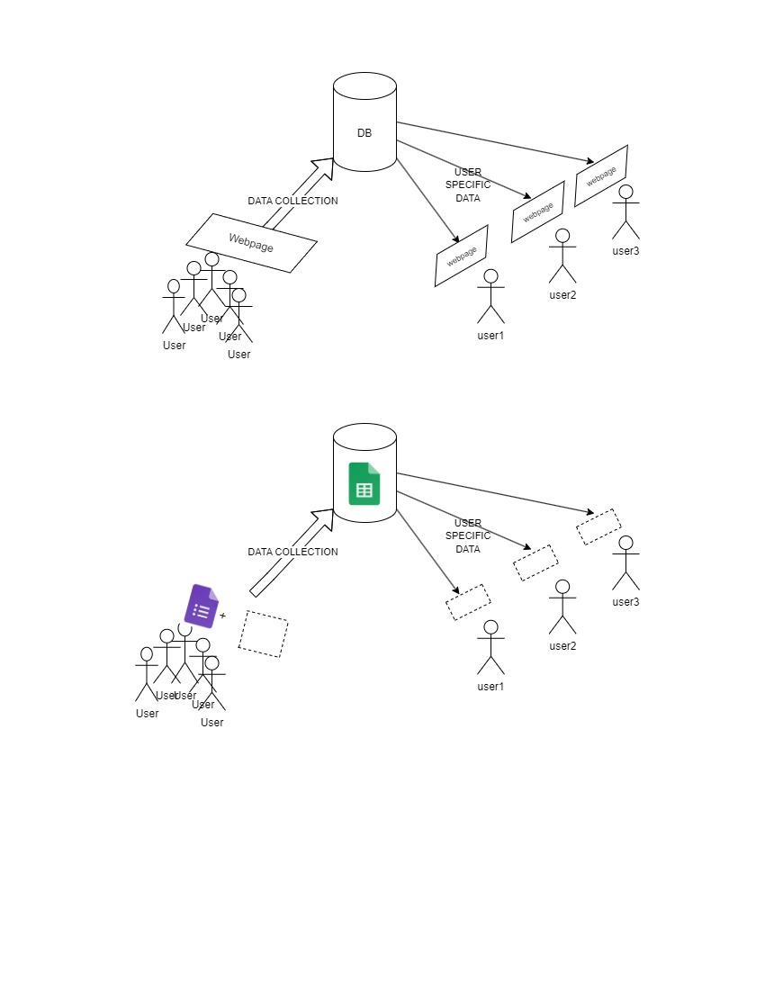
Traditional Databases

Slide 4
What If Gsheet a Database?

Slide 5
Google Apps Script
Very less resources to learn but best fits with ecosystem
User friendly for deploying

Slide 6
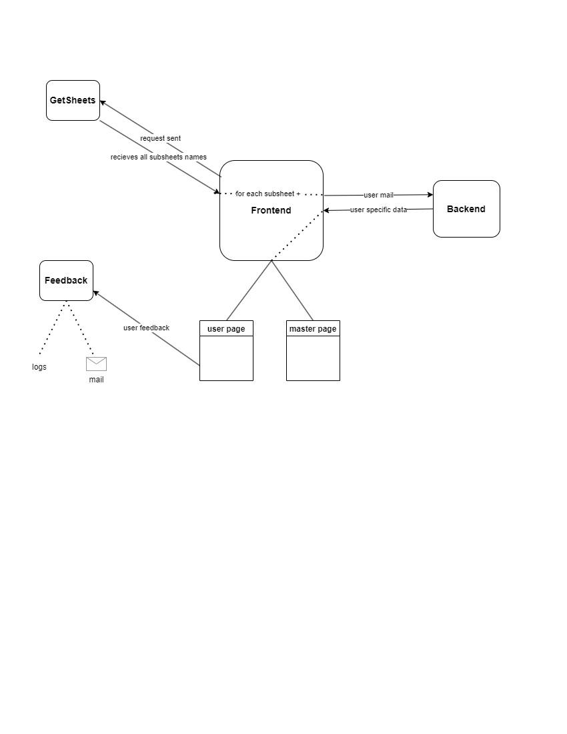
High Level Design 1

Slide 7
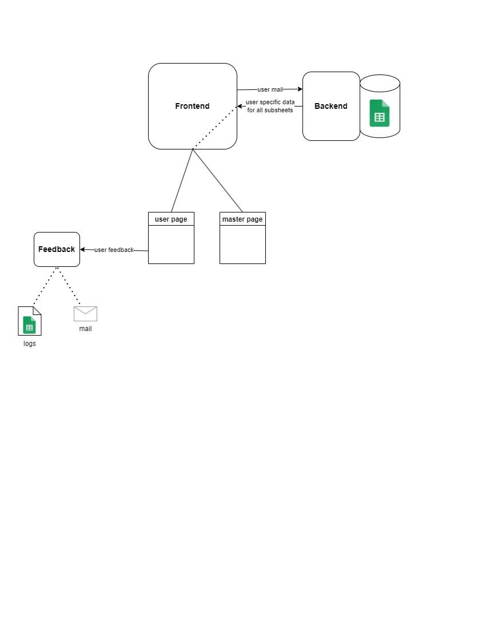
Optimized High Level Design

Slide 8
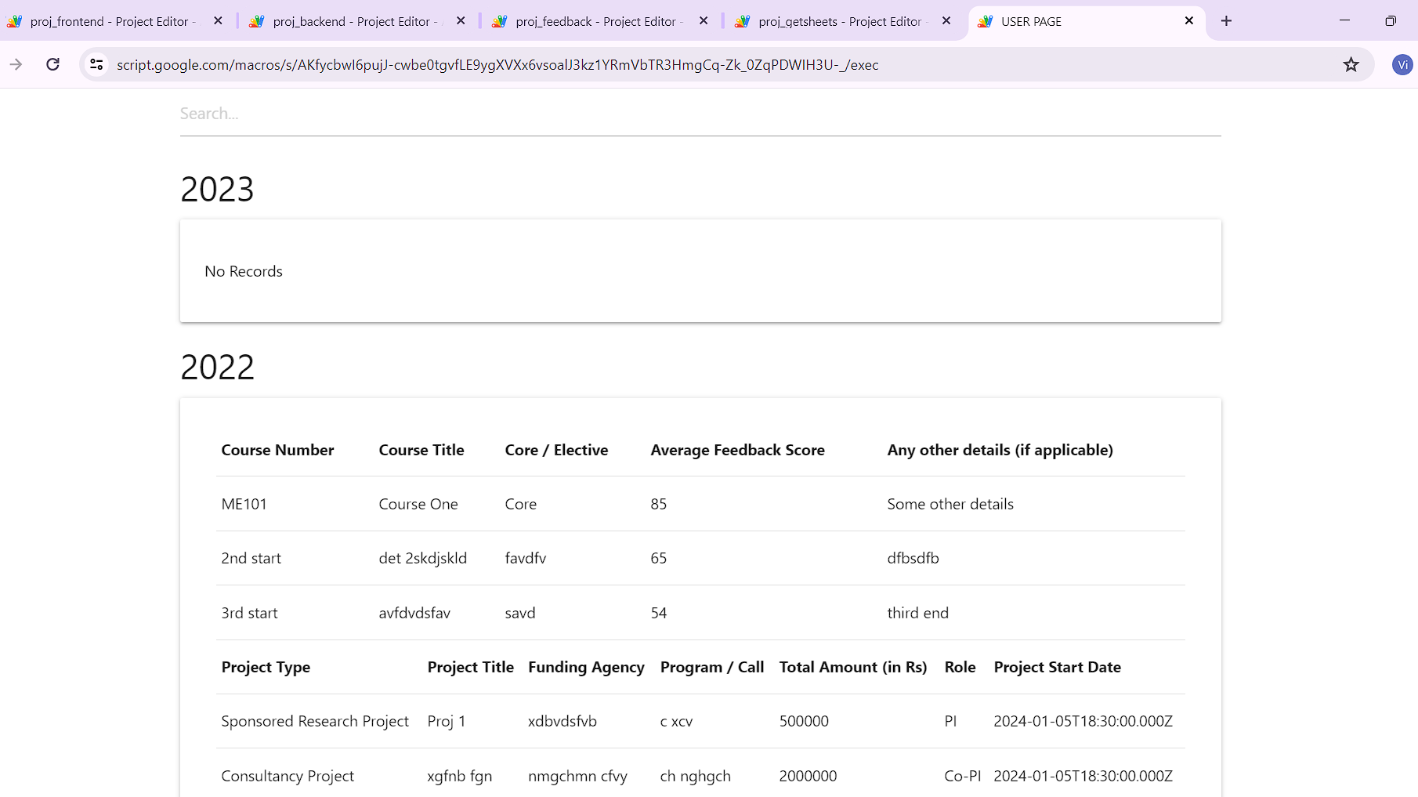
Output - userpage

Slide 9
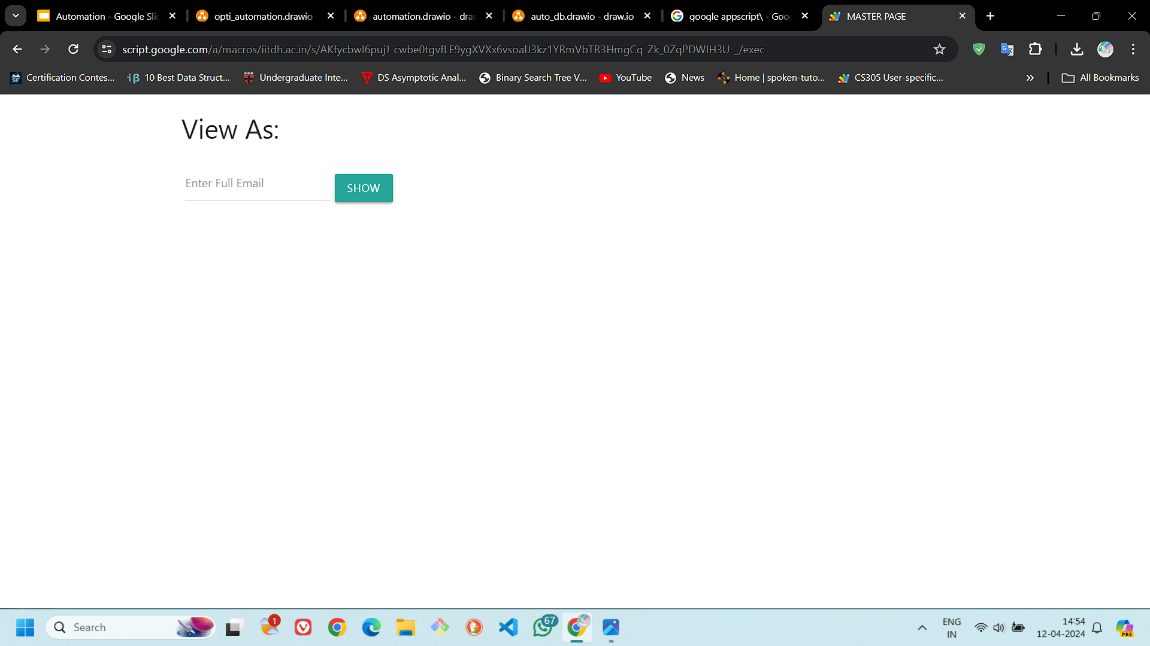
Output - masterpage

Slide 10
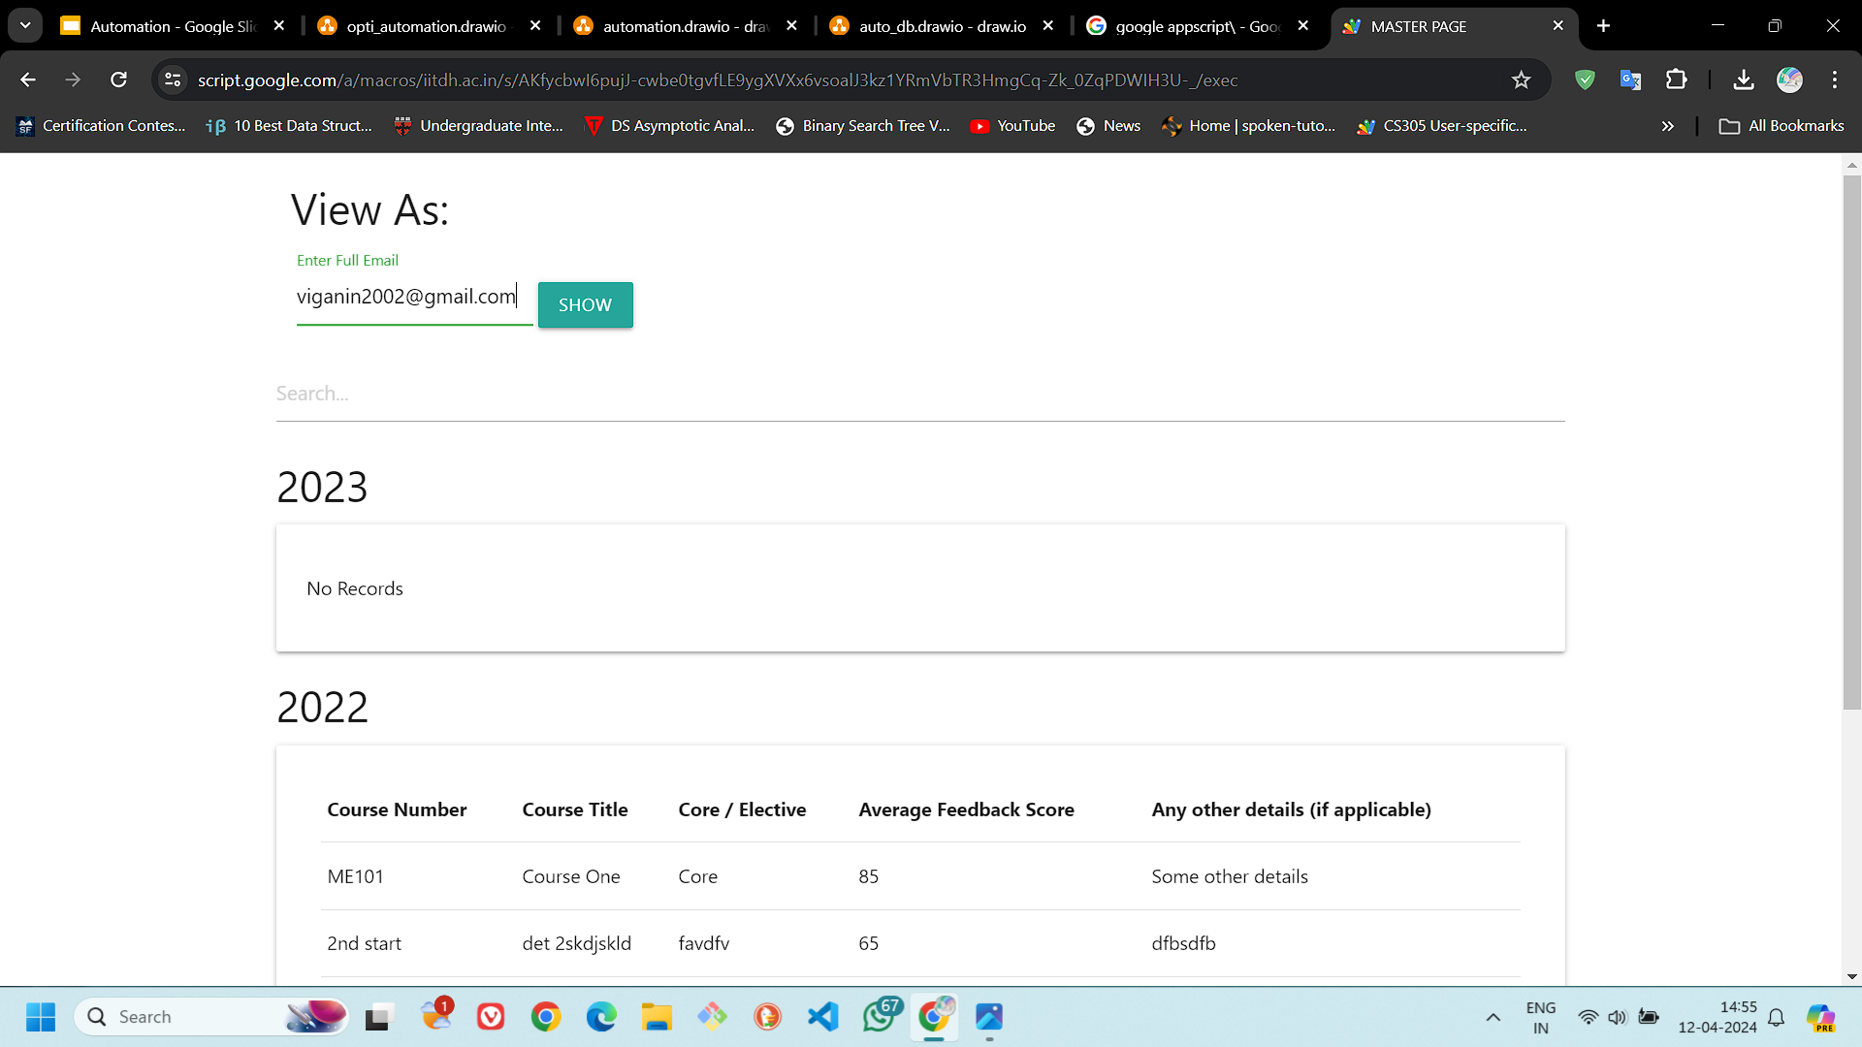
Output - masterpage

Slide 11
Conclusion and future direction
All the Foundation & Structure is done in a modular way
Just modify the scripts in a way you want to see the output, especially if you want to change the look of the table, just change the “function generateTable(sheetData)” in userpage.html & masterpage.html

