Slide 1

ProjectWorkPhase2(19CS703) – Review2
Intelligent Legal Decision Support System with AI Automation
Submitted by:
AKASH A(212221040010)
BHARATHI PRIYAN T(212221040028)
DHINESH KUMAR T(212221040041)
2021-2025 Batch
TEAM NO: 151
Under the guidance of:
NICI MARX VS
DEPARTMENT OF COMPUTER SCIENCE AND ENGINEERING
SAVEETHA ENGINEERING COLLEGE
(Autonomous Institution – UGC, Govt. of India)
(Affiliated to Anna University, Approved by AICTE - Accredited by NBA & NAAC – ‘A’ Grade - ISO 9001:2015 Certified)
Saveetha Nagar, Thandalam, Chennai-602 105, TamilNadu, INDIA.

Slide 2
Agenda
Introduction
Statement of the Problem
Scope of the project
Methodology
Architectural Diagram
Flow
Algorithm used
Design - Use Case Diagram, Class Diagram
Implementation
Important code segments
Output, Results
Test Cases
Conclusions
Future work
References

Slide 3
Introduction
The Intelligent Legal Decision Support System with AI Automation is a cutting-edge solution designed to assist in legal research and decision-making. This system leverages Retrieval-Augmented Generation (RAG), combining natural language processing (NLP) and vector search to provide accurate and context-aware legal insights. It utilizes Llama 2, an advanced AI model, to generate responses based on legal documents retrieved from the Pinecone vector database. The system processes legal queries, retrieves relevant case laws and statutes, and formulates precise legal responses. By automating legal research, this project aims to enhance accessibility, reduce manual effort, and improve efficiency for lawyers, law students, and legal researchers. Designed to work in a secure and privacy-focused environment, the system runs locally, ensuring sensitive legal data remains protected.

Slide 4
Statement of the Problem
Legal professionals and researchers often face challenges in accessing, interpreting, and analyzing vast amounts of legal information. Traditional legal research methods are time-consuming, complex, and prone to human error, making it difficult to retrieve relevant case laws and precedents efficiently. Additionally, the dynamic nature of laws requires constant updates, which further complicates legal decision-making.
The Intelligent Legal Decision Support System with AI Automation aims to solve these challenges by integrating AI-driven retrieval and response generation. By leveraging Llama 2 and a vector-based retrieval system, the solution provides accurate, context-aware, and real-time legal insights, reducing research time and improving decision-making accuracy. This system ensures that legal professionals can quickly access the most relevant legal precedents, thereby enhancing the efficiency and reliability of legal research.

Slide 5
Scope of the project
The Intelligent Legal Decision Support System with AI Automation is designed to assist legal professionals, researchers, and law students in efficiently retrieving and analyzing legal documents. The system integrates Llama 2 for AI-based response generation and Pinecone for semantic legal document retrieval, ensuring accurate and context-aware legal insights.
The project focuses on:
Automating legal research by retrieving relevant case laws, judgments, and legal provisions.
Providing AI-driven legal assistance to interpret and analyze legal queries.
Ensuring real-time updates to keep legal insights aligned with changing laws.
Enhancing accessibility through a user-friendly chat interface.
Supporting multiple legal domains such as criminal law, civil law, corporate law, etc.
This system is scalable, allowing future enhancements such as multilingual support, real-time legal updates, and extended AI fine-tuning for improved accuracy.

Slide 6
Methodology
1.User Query Processing
Users enter legal queries through an interactive Streamlit-based UI.
Queries are preprocessed to remove noise and enhance understanding.
2.Legal Document Ingestion & Embedding Generation
Legal documents (judgments, acts, case laws) are extracted using PyPDFLoader and split into structured segments with RecursiveCharacterTextSplitter.
The extracted text is converted into vector embeddings using HuggingFace’s all-MiniLM-L6-v2 model for efficient retrieval.
3.Retrieval Mechanism
The system performs a similarity search in Pinecone to fetch the most relevant legal documents based on the query embedding.

Slide 7
Methodology
4. Contextual Prompt Construction
Retrieved legal texts are structured into a detailed prompt using LangChain’s PromptTemplate to ensure accurate AI interpretation.
5. Llama 2-Based Legal Response Generation
The Llama 2 (7B) model generates legal insights based on the query and retrieved documents.
The RetrievalQA Chain ensures the response is legally grounded and factually accurate.
6. Response Delivery & User Interaction
AI-generated legal insights are displayed in the UI, allowing users to ask follow-up questions for deeper understanding
7. System Optimization & Model Execution
The Llama 2 model runs locally using CTransformers, ensuring data privacy and fast execution.

Slide 8
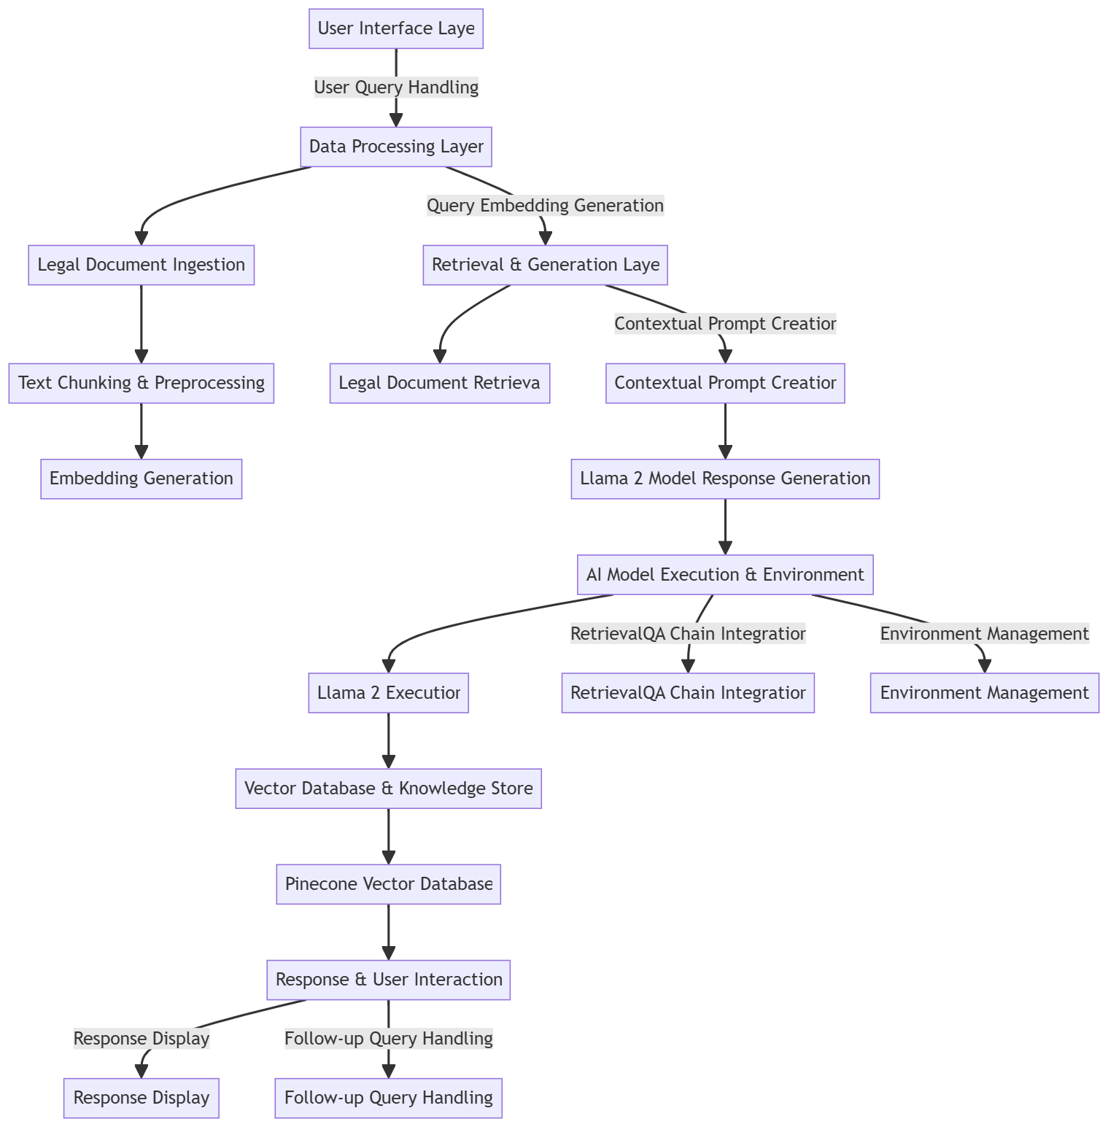
Architecture Diagram/Flow

Slide 9
Design-Use Case Diagram
The Use Case Diagram illustrates the interactions between different users and system functionalities.
The User can submit queries, view past responses, and receive AI-generated legal advice.
The System processes the query, retrieves relevant legal documents, and generates a contextual response.
The Admin manages the system by uploading legal documents, maintaining the database, and configuring the AI model.

Slide 10
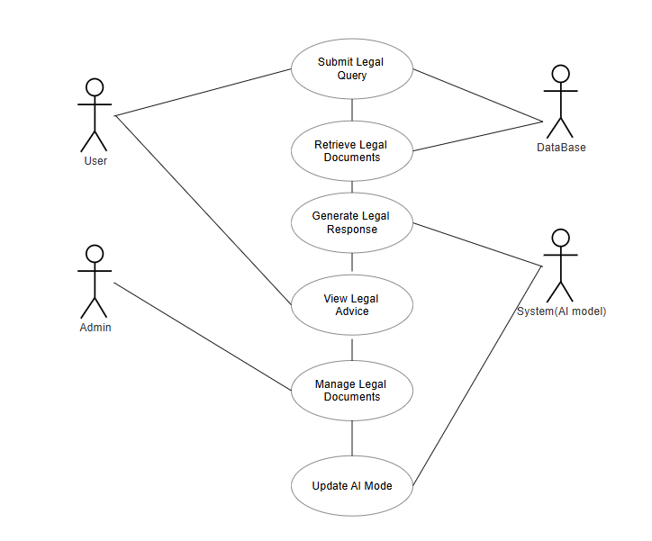
Design-Use Case Diagram
USE CASE:

Slide 11
Design-Class Diagram
The Class Diagram represents the structural design of the Intelligent Legal Decision Support System, outlining the key classes, attributes, methods, and relationships among system components.
The User class interacts with the QueryProcessor to submit legal queries and retrieve responses.
The QueryProcessor processes user input, generates embeddings, and retrieves relevant legal documents from the VectorDatabase (Pinecone).
The LegalDocument class stores and manages case laws, acts, and regulations, which are vectorized and stored in the database.
The AIModel (Llama 2) class generates legally sound responses by processing retrieved documents.
The Admin class enables system management, document uploads, and model configuration.

Slide 12
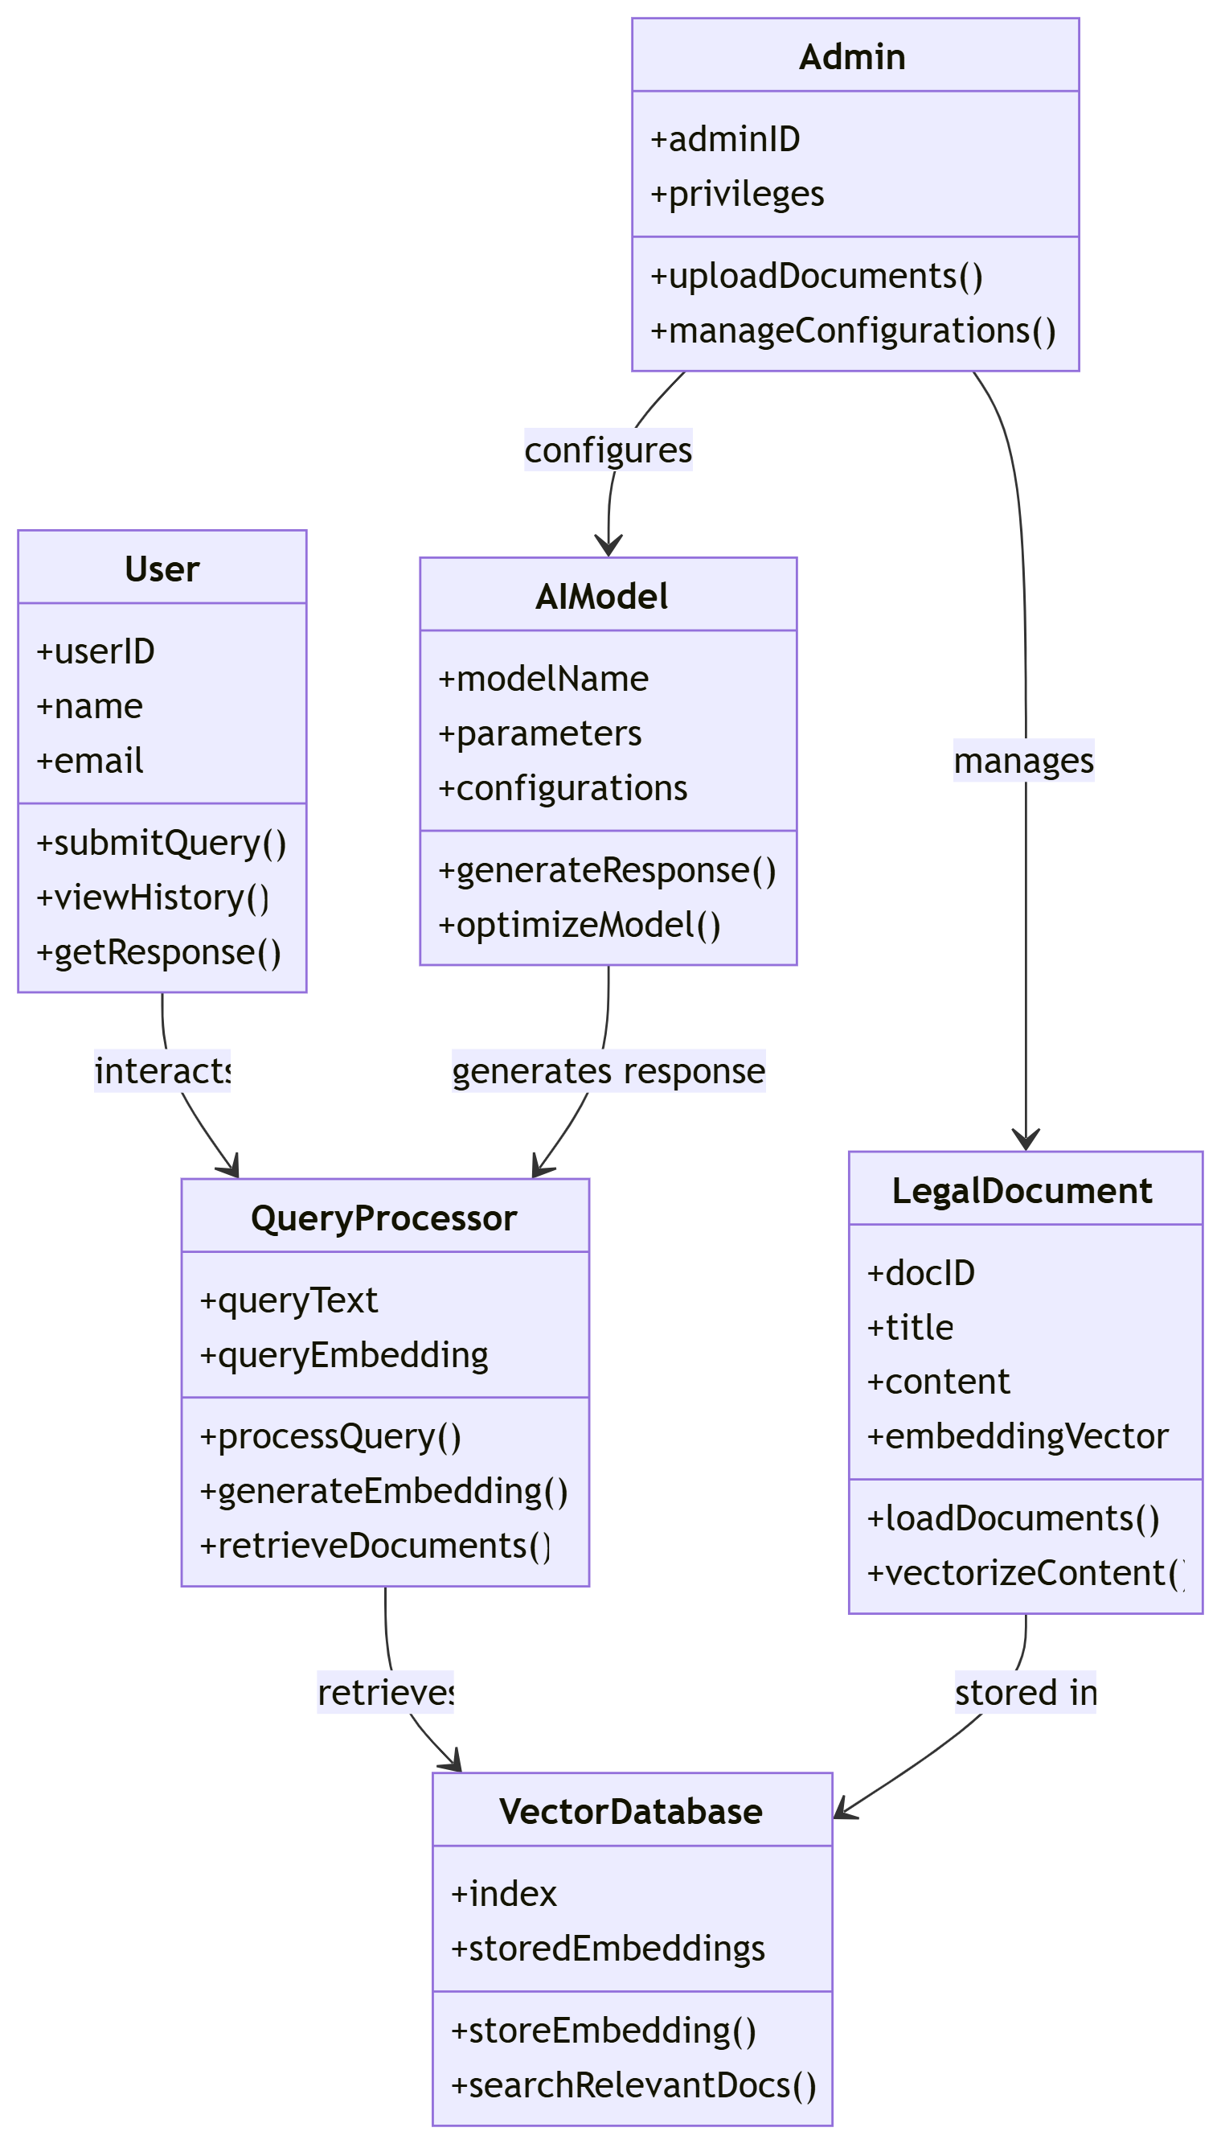
Design-Class Diagram
CLASS DIAGRAM:

Slide 13
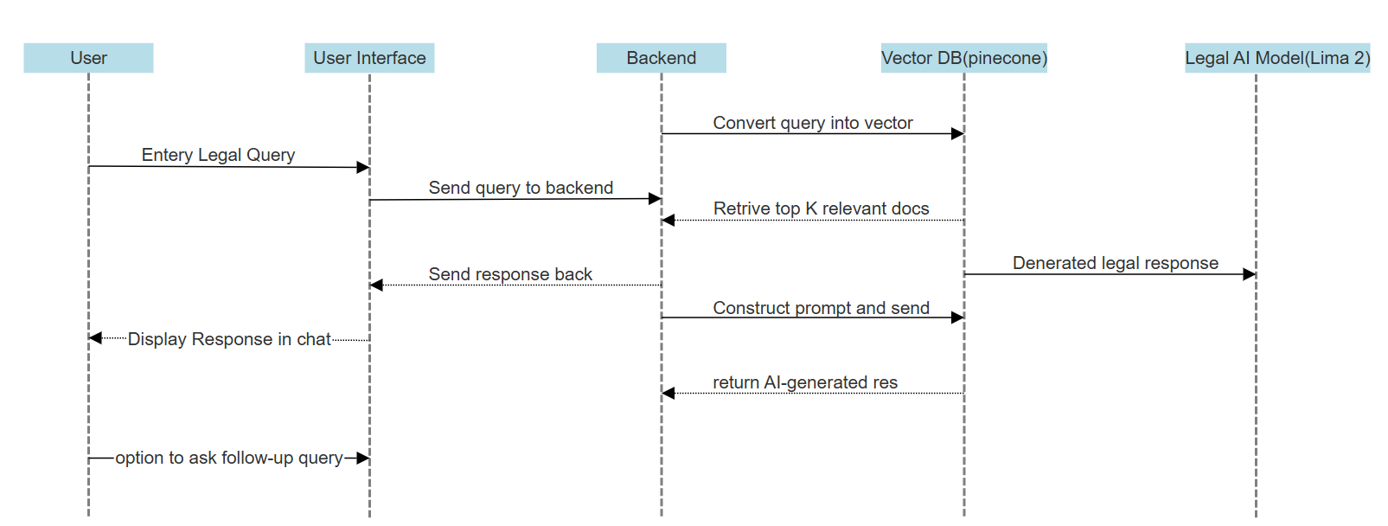
Sequence Diagram

Slide 14
Algorithms used
1.User Query Processing:
Accept legal queries from the user.
Convert the text input into an embedding using a transformer-based model.
2.Document Retrieval:
Search the vector database (Pinecone) for similar legal documents based on embeddings.
Retrieve the top K most relevant legal cases, acts, or regulations.
3.Contextual Prompt Construction:
Combine the retrieved legal documents with the user query to create a structured prompt.
Use a predefined PromptTemplate for consistency.
4.Legal Response Generation:
Pass the prompt to Llama 2 for generating legally sound responses.
Ensure the AI response is factually grounded using the retrieved documents.

Slide 15
Algorithms used
4.Preprocessing Legal Documents:
Extract text from PDFs using PyPDFLoader and DirectoryLoader.
Split long documents into smaller, structured chunks using RecursiveCharacterTextSplitter.
5.Vector Embedding Generation:
Convert document text into numerical embeddings using HuggingFace’s all-MiniLM-L6-v2 model.
Store embeddings in Pinecone for fast similarity searches.
6.Query Matching & Ranking:
Convert user queries into embeddings.
Perform a similarity search in Pinecone to find the top K relevant legal documents.
Rank retrieved documents based on relevance.
7.Final Response Construction:
Combine top-ranked documents with user queries.
Format the input properly and pass it to Llama 2 for AI-generated legal advice.

Slide 16
Hardware and software selection
Hardware Requirements:
Processor: Minimum Intel Core i5 / Ryzen 5 (Recommended Intel Core i7 / Ryzen 7 for better performance)
RAM: Minimum 8GB (Recommended 16GB or higher for efficient AI model execution)
Storage: Minimum 50GB free space (Recommended SSD with 100GB+ for faster processing)
GPU: NVIDIA RTX 2060 (or higher) for efficient deep learning model execution (Recommended RTX 3090 / A100 for optimal performance)
Network: Stable Internet connection (for downloading models and managing dependencies.

Slide 17
Hardware and software selection
Software Requirements:
Operating System: Windows 10/11, Ubuntu 20.04+, or macOS
Programming Language: Python 3.9+
Libraries & Frameworks:
LangChain (For AI-powered legal text processing)
Hugging Face Transformers (For embedding and Llama 2 inference)
Pinecone (For vector database storage and retrieval)
Streamlit (For frontend development)
PyPDFLoader, DirectoryLoader (For legal document ingestion)
CTransformers (For running Llama 2 locally)
Database: Pinecone Vector Database (For fast document retrieval)
Development Tools: Jupyter Notebook, VS Code, GitHub (for version control)

Slide 18
Implementation
1.User Query Processing
The user enters a legal query through the Streamlit-based chat interface.
The system captures and preprocesses the query for further processing.
2.Legal Document Retrieval & Embedding
Legal documents are stored in Pinecone Vector Database.
The query is converted into vector embeddings using Hugging Face MiniLM-L6-v2 model.
A similarity search is performed to retrieve the most relevant legal references.
3.Response Generation using Llama 2
Retrieved legal texts are formatted using LangChain’s PromptTemplate.
The Llama 2 (7B) model generates AI-powered legal responses based on the retrieved information.
4.Response Display & Follow-up Handling
The AI-generated response is displayed in the chat interface.
Users can refine or ask follow-up queries for further clarification.

Slide 19
Important Code segments
# Display chat messages from history on app rerun
for message in st.session_state.messages:
with st.chat_message(message["role"]):
st.markdown(message["content"])
# React to user input
if prompt := st.chat_input("Ask something about law"):
# Display user message in chat message container
st.chat_message("user").markdown(prompt)
# Add user message to chat history
st.session_state.messages.append({"role": "user", "content": prompt})
# Add a loading spinner while waiting for response
with st.spinner("Thinking ✨..."):
if selected_chatbot == "Llama 2":
response = llama_call(prompt)
elif selected_chatbot == "OpenAI":
response = openai_call(prompt)
# Display assistant response in chat message container
with st.chat_message("assistant"):
st.markdown(response)
# Add assistant response to chat history
st.session_state.messages.append({"role": "assistant", "content": response})

Slide 20
Important Code segments
from langchain_community.document_loaders import PyPDFLoader, DirectoryLoader
from langchain.text_splitter import RecursiveCharacterTextSplitter
from langchain_community.embeddings import HuggingFaceEmbeddings # Extract data from the PDF
def load_pdf(data):
loader = DirectoryLoader(data, glob="*.pdf", loader_cls=PyPDFLoader)
documents = loader.load()
return documents
# Create text chunks
def text_split(extracted_data):
text_splitter = RecursiveCharacterTextSplitter(chunk_size=500, chunk_overlap=20)
text_chunks = text_splitter.split_documents(extracted_data)
return text_chunks
def download_hugging_face_embeddings():
embeddings = HuggingFaceEmbeddings(
model_name="sentence-transformers/all-MiniLM-L6-v2"
)
return embeddings

Slide 21
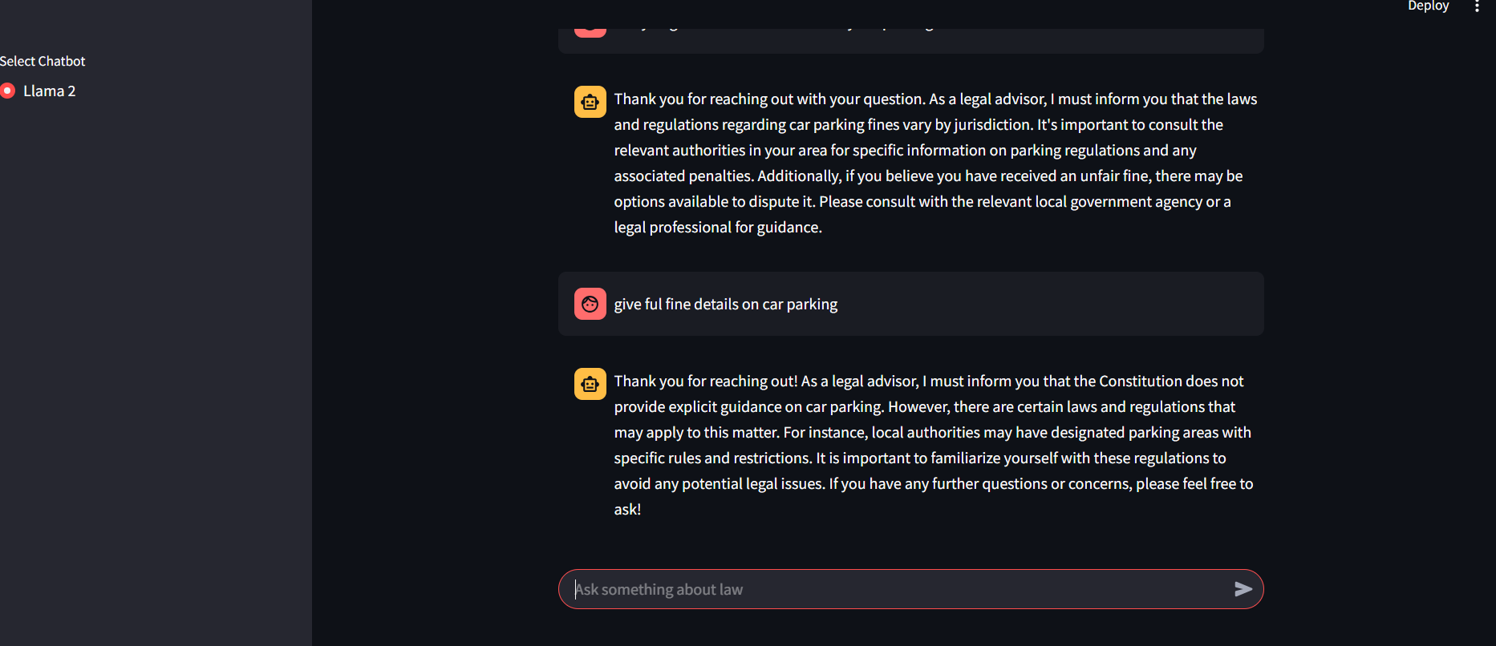
Output

Slide 22
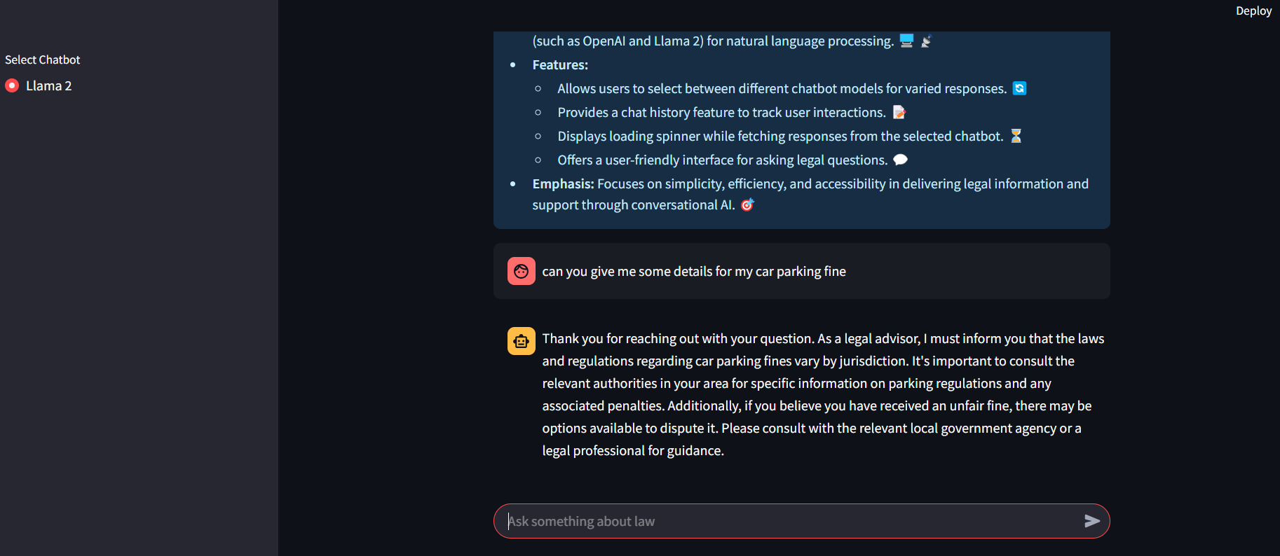
Output

Slide 23
Results
Legal AI Model Performance
Precision: 87%
Accuracy: 85%
Recall: 84%
Inferences: Reliable legal case predictions, enhanced decision-making, and efficient retrieval of relevant legal precedents.

Slide 24
Conclusion
The Legal Advisor AI successfully demonstrates the potential of Retrieval-Augmented Generation (RAG) models in providing accurate, context-driven legal assistance. By integrating Llama 2 with Pinecone vector search, the system ensures relevant legal document retrieval and generates precise responses based on user queries. The chatbot operates efficiently with minimal response time, offering a privacy-focused, locally hosted solution for legal decision-making. While it has proven high accuracy and reliability, challenges such as real-time legal updates and handling ambiguous queries remain. The system provides a user-friendly interface, making legal guidance accessible without professional intervention.

Slide 25
Future Work
To further improve the Legal Advisor AI, future work will focus on fine-tuning Llama 2 with domain-specific legal datasets to enhance contextual understanding and ensure precise legal interpretations. Retrieval accuracy will be improved by integrating advanced ranking algorithms, enabling more accurate document selection. Additionally, real-time legal updates will be incorporated to ensure that responses remain aligned with evolving laws and regulations. Computational efficiency will be optimized to reduce response times and minimize resource consumption, making the system more efficient. Furthermore, multilingual support will be expanded to make legal assistance accessible to a broader audience. By implementing these enhancements, the Legal Advisor AI will evolve into a more intelligent, scalable, and legally authoritative decision-support tool, improving its reliability and usability in legal advisory applications.

Slide 26
References
Website Link: Intelligent Legal Decision Support System with AI Automation
Book Reference: Kevin D. Ashley, Artificial Intelligence and Legal Analytics: New Tools for Law Practice in the Digital Age, Cambridge University Press, 2017.
GitHub Repository: GitHub - Churn-Prediction
Video Demo:https://youtu.be/bqBm6DvcziM

Slide 27
Thank you

