Slide 1

ProjectWork1(19CS702) – Review 1
Security Posture Evaluation and Threat Intelligence Analysis using Python
Submitted by:
Akash A (212221040010)
Bharathi priyan T (212221040028)
Dhinesh Kumar T (212221040041)
2021-2025 Batch
TEAM NO:137
Under the guidance of:
Thilagavathy S
Associate Professor,
Department of CSE
DEPARTMENT OF COMPUTER SCIENCE AND ENGINEERING
SAVEETHA ENGINEERING COLLEGE
(Autonomous Institution – UGC, Govt. of India)
(Affiliated to Anna University, Approved by AICTE - Accredited by NBA & NAAC – ‘A’ Grade - ISO 9001:2015 Certified)
Saveetha Nagar, Thandalam, Chennai-602 105, TamilNadu, INDIA.

Slide 2
Agenda
Introduction
Statement of the Problem
Scope of the project
Methodology
Architectural Diagram
Flow
Algorithm used
Design - Use Case Diagram, Class Diagram
Implementation
Important code segments
Output, Results
Conclusions
Future work
References

Slide 3
Introduction
In today’s digital landscape, the safeguarding of sensitive information is of utmost importance as individuals and organizations face an ever-increasing array of cyber threats. With the rise of sophisticated hacking techniques, traditional security measures often prove inadequate in preventing unauthorized access and data breaches. These incidents can have severe repercussions, including financial loss and damage to reputation, highlighting the urgent need for enhanced security protocols.
This project aims to address these challenges by developing a comprehensive solution for detecting and analyzing suspicious files and processes on computer systems. By employing advanced behavioral analysis and anomaly detection techniques, the solution will identify potential data transmissions to unauthorized entities. Ultimately, this initiative seeks to empower users and organizations to better protect their sensitive information and strengthen their defenses against the evolving landscape of cyber threats.

Slide 4
Statement of the Problem
The growing complexity and sophistication of cyber threats pose a significant risk to sensitive information, making unauthorized access and data breaches increasingly common. Traditional security measures often fail to adequately monitor and analyze system behavior, leaving organizations vulnerable to data theft and loss. This problem necessitates the development of advanced solutions capable of detecting and analyzing suspicious files and processes that may indicate unauthorized data transmissions, ensuring robust protection against evolving cyber threats.
Real-Time Threat Detection: Employing advanced machine learning algorithms to monitor system behavior and identify suspicious files and processes as they emerge.
Automated Alerts: Automatically generating notifications for cybersecurity teams when potential threats are detected, providing critical information such as threat type and affected system components.
Integration and Precision: Ensuring high accuracy in threat identification while seamlessly integrating with existing cybersecurity frameworks to enhance overall system security.

Slide 5
Scope of the project
This project is designed to work on Windows systems, utilizing Windows-specific libraries such as psutil and WMI for gathering and analyzing process and network data. It focuses on monitoring active processes and network connections to detect suspicious activities, without extending to full system-wide monitoring. The use of Python allows flexibility and seamless integration with external APIs and libraries to enhance functionality.
The project integrates with external threat intelligence services like VirusTotal and AbuseIPDB to verify the reputation of suspicious IP addresses, aiding in the detection and assessment of potential threats. However, the analysis is limited to network and process activities, and does not cover broader system monitoring tasks beyond these parameters

Slide 6
Methodology
Module 1: Identify and Monitor Running Processes on a System
Module 2: Capture Network Details Associated with These Processes
Module 3: Analyze the Collected Data to Detect Suspicious Activities
Module 4: Verify Suspicious IP Addresses Against VirusTotal and AbuseIPDB
Module 5: Provide a Comprehensive Report of the Findings to the User
Module 6: Final Output

Slide 7
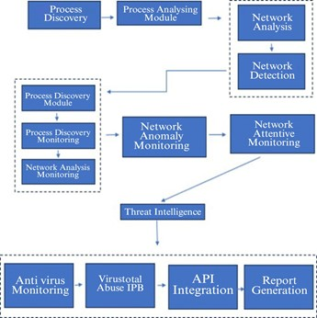
Architecture Diagram/Flow

Slide 8
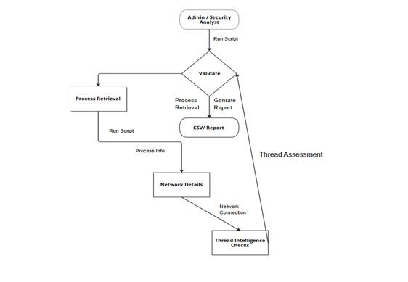
Design-Class Diagram

Slide 9
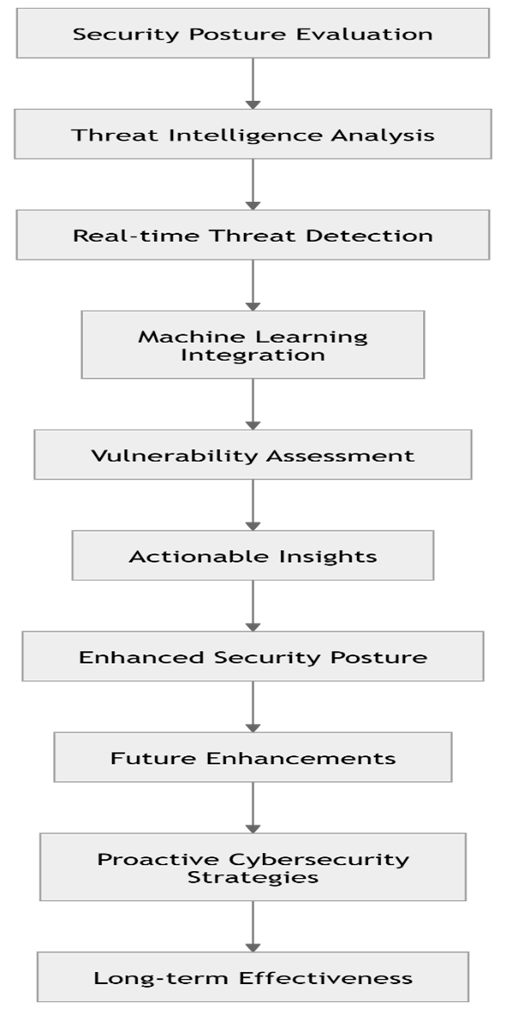
Design-Class Diagram

Slide 10
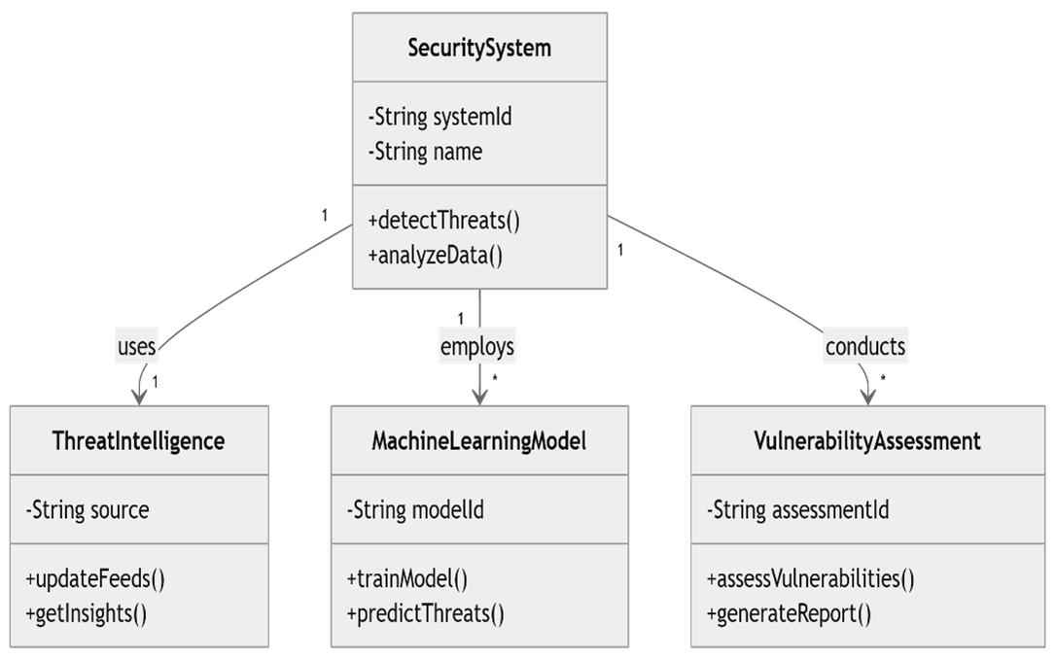
Sequence Diagram

Slide 11
Hardware and software selection
HARDWARE ENVIRONMENT
Processor : Pentium Dual Core 2.00GH
Hard disk : 120 GB
RAM : 2GB (minimum)
Keyboard : 110 keys enhanced
SOFTWARE ENVIRONMENT
Operating system : Windows7 (with service pack 1), 8, 8.1 ,10 and 11
Language : Python
TECHNOLOGIES USED
IDE - Visual Studio
Framework - React
AbuseIPDB

Slide 12
Implementation
set up the environment for the Security Posture Evaluation and Threat Intelligence Analysis system, begin by ensuring that Python is installed on your system. The necessary libraries for this project can be installed using the following command: pip install psutil requests wmi pandas. The psutil library provides an interface for retrieving information on system utilization such as CPU, memory, disks, network, and processes. The requests library enables interaction with external APIs like VirusTotal and AbuseIPDB, which are critical for threat intelligence queries. The wmi library allows querying of system and process information specifically on Windows platforms. Pandas is used for data manipulation and analysis, making it useful for handling large datasets or generating reports, particularly as the project
Additionally, you will need to obtain API keys for external services to fully utilize the threat intelligence features. For VirusTotal, register on their website to receive an API key, which is necessary to check if files or IP addresses are flagged as malicious. Similarly, for AbuseIPDB, registering on their website provides an API key to query whether an IP address has been reported for abusive behavior. These API keys are essential for integrating external threat intelligence feeds into the system and enabling real-time threat detection.

Slide 13
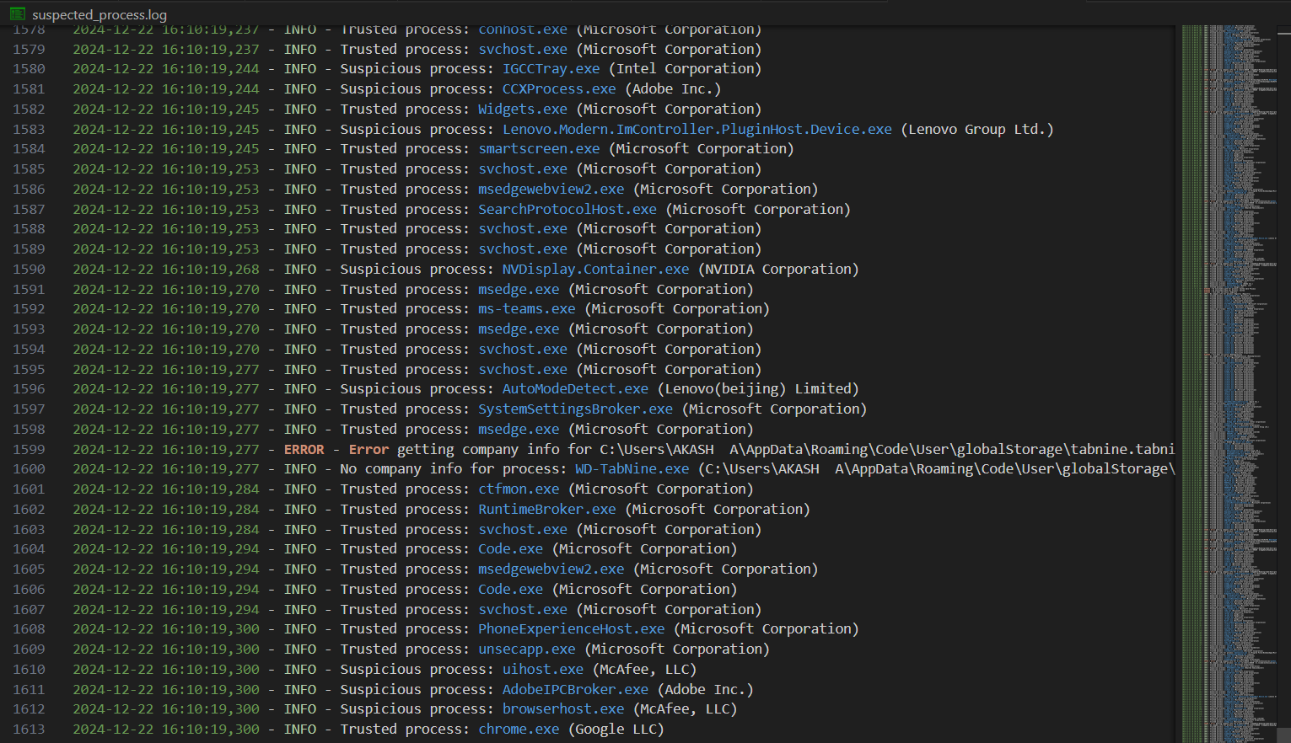
Important Code segments

Slide 14
Important Code segments
import RunningProcess as run_proc
import NetworkDetails as net_det
from ip_checking import is_ip_legitimate
import csv
import os
def main():
suspected_processes = run_proc.info_running_process()
network_details = []
for proc in suspected_processes:
pid, name = proc
source_ips, dest_ips, packet_count = net_det.get_network_details(pid)
# Check each destination IP
legitimate_ips = []
suspicious_ips = []
for ip in dest_ips:
if ip != "N/A":
if is_ip_legitimate(ip, ABUSEIPDB_API_KEY, VIRUSTOTAL_API_KEY):
legitimate_ips.append(ip)
else:
suspicious_ips.append(ip)
network_details.append([pid, name, source_ips, legitimate_ips, suspicious_ips, packet_count])
if __name__ == "__main__":
main()

Slide 15
Important Code segments
import psutil
import SuspectedProcess as susproc
def info_running_process():
suspected_processes = []
for proc in psutil.process_iter(['pid', 'name', 'exe']):
try:
process_info = proc.info
if susproc.susProcess(process_info):
suspected_processes.append([process_info['pid'], process_info['name']])
except (psutil.NoSuchProcess, psutil.AccessDenied, psutil.ZombieProcess):
print(f"Error accessing process information for PID: {proc.pid}")
return suspected_processes

Slide 16
Important Code segments
import requests
def check_ip_abuseipdb(ip, api_key):
url = f"https://api.abuseipdb.com/api/v2/check"
querystring = {"ipAddress": ip, "maxAgeInDays": "90"}
headers = {"Accept": "application/json", "Key": api_key}
response = requests.get(url, headers=headers, params=querystring)
return response.json()
def check_ip_virustotal(ip, api_key):
url = f"https://www.virustotal.com/api/v3/ip_addresses/{ip}"
headers = {"accept": "application/json", "x-apikey": api_key}
response = requests.get(url, headers=headers)
return response.json()
def is_ip_legitimate(ip, abuseipdb_key, virustotal_key):
abuse_result = check_ip_abuseipdb(ip, abuseipdb_key)
vt_result = check_ip_virustotal(ip, virustotal_key)
# Implement your logic to determine if the IP is legitimate based on the API responses
# This is a simple example and should be adjusted based on your specific criteria
is_legitimate = (abuse_result.get('data', {}).get('abuseConfidenceScore', 100) < 50 and
vt_result.get('data', {}).get('attributes', {}).get('last_analysis_stats', {}).get('malicious', 1) == 0)
return is_legitimate

Slide 17
Important Code segments
import psutil
def get_network_details(pid):
source_ips = set()
destination_ips = set()
network_packets = 0
try:
process = psutil.Process(pid)
connections = process.connections(kind='inet')
for conn in connections:
source_ips.add(conn.laddr.ip if conn.laddr else "N/A")
destination_ips.add(conn.raddr.ip if conn.raddr else "N/A")
network_packets += 1 # Placeholder for actual packet count
except (psutil.NoSuchProcess, psutil.AccessDenied, psutil.ZombieProcess):
pass
return [list(source_ips), list(destination_ips), network_packets]

Slide 18
Important Code segments
def is_trusted_company(company_name):
trusted_companies = ["Microsoft Corporation", "Google LLC", "Apple Inc."] # Example list
return company_name in trusted_companies
def susProcess(process_info):
exe_path = process_info.get('exe')
if not exe_path:
logging.warning(f"No executable path for process: {process_info.get('name', 'Unknown')}")
return True # Consider it suspicious if we can't check
company_name = get_company_info(exe_path)
if company_name is None:
logging.info(f"No company info for process: {process_info.get('name', 'Unknown')} ({exe_path})")
return True # Consider it suspicious if we can't get company info
if is_trusted_company(company_name):
logging.info(f"Trusted process: {process_info.get('name', 'Unknown')} ({company_name})")
return False
else:
logging.info(f"Suspicious process: {process_info.get('name', 'Unknown')} ({company_name})")
return True

Slide 19
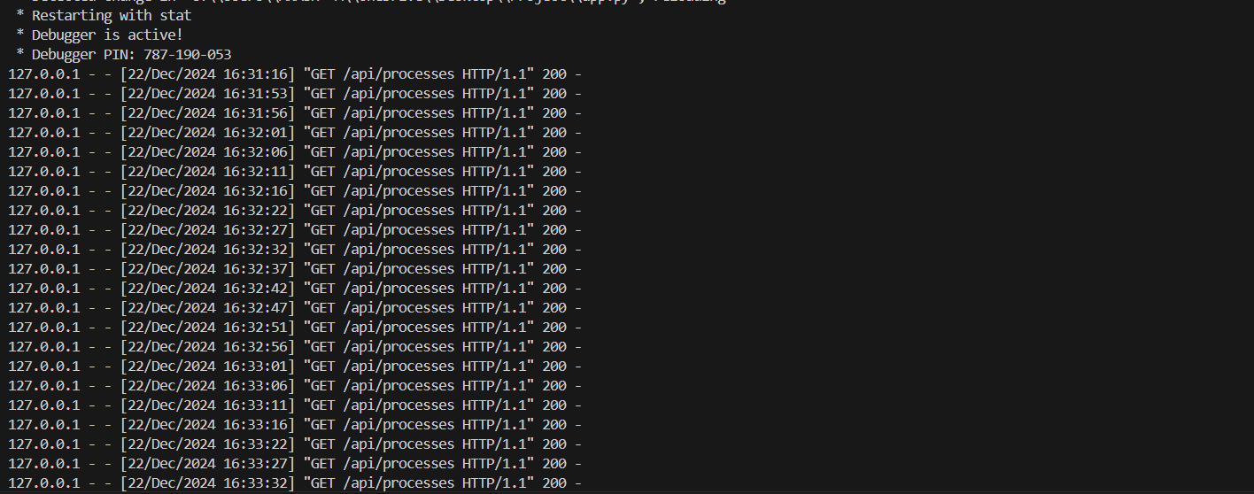
Output

Slide 20
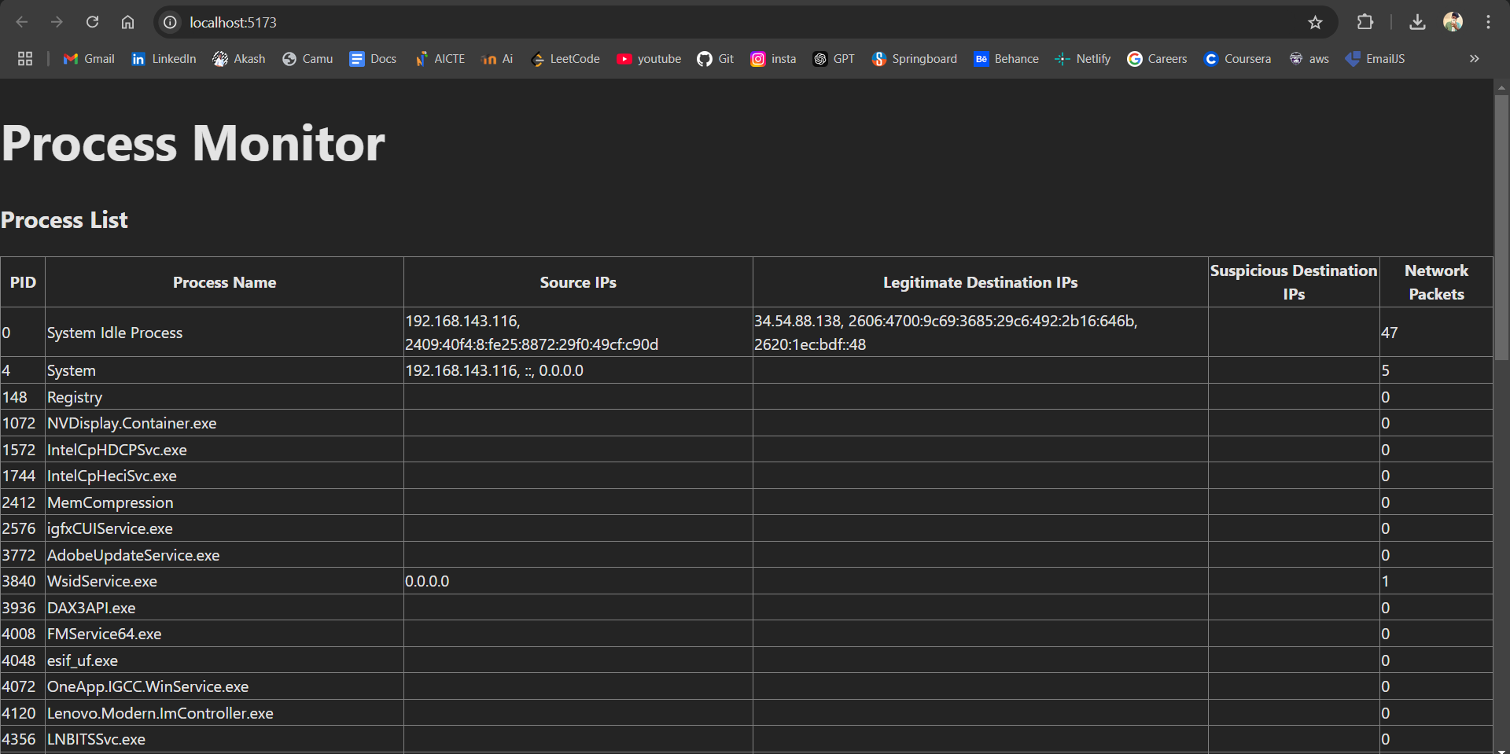
Output

Slide 21
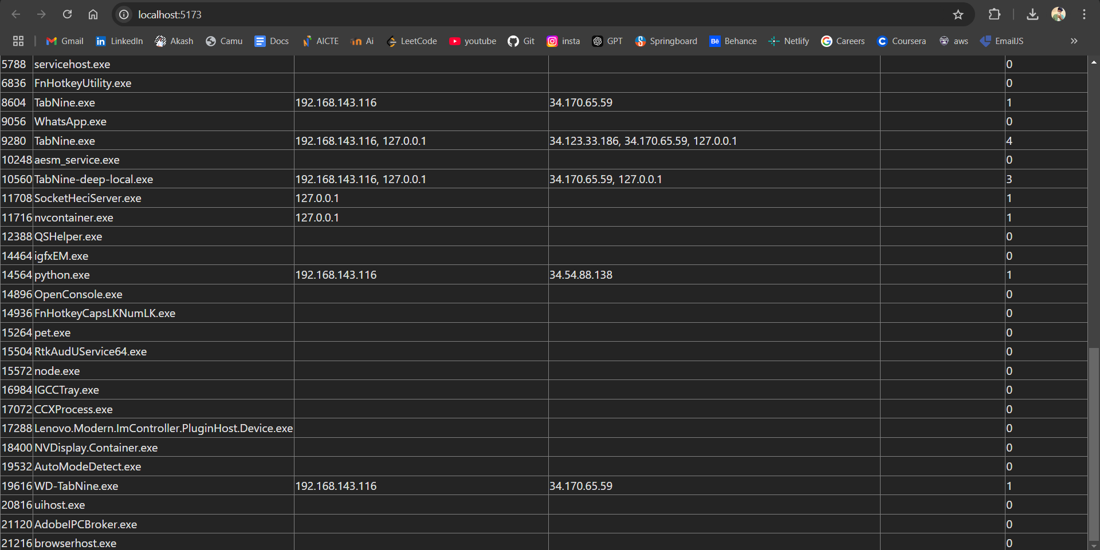
Output

Slide 22
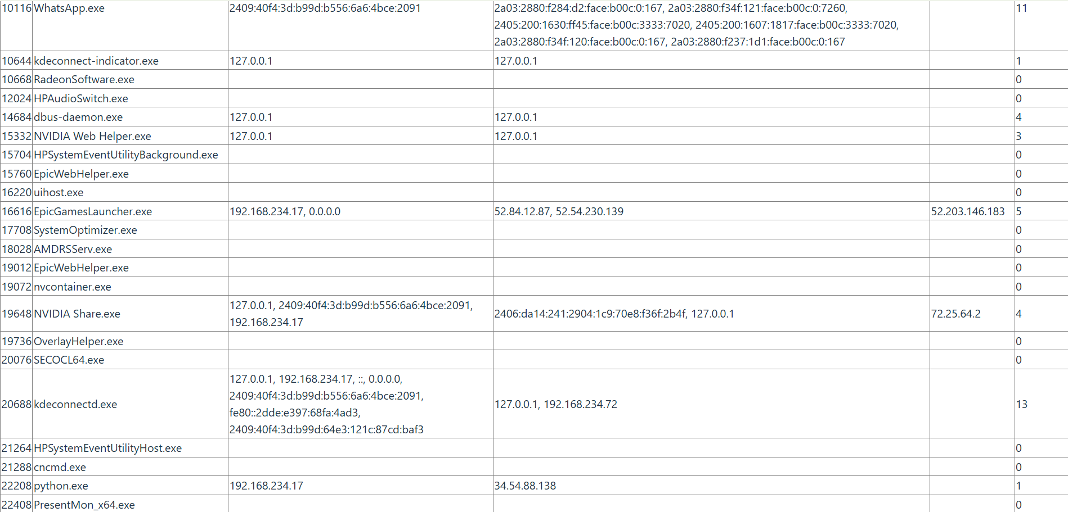
Output - Ip

Slide 23
Conclusion
In conclusion, the Security Posture Evaluation and Threat Intelligence Analysis system we developed using Python demonstrates a significant improvement in real-time threat detection and security monitoring. By integrating advanced machine learning models and threat intelligence feeds, the system is able to accurately identify potential security risks, assess vulnerabilities, and provide actionable insights to strengthen overall security posture. Our implementation offers high accuracy in detecting threats and provides efficient real-time analysis, making it a valuable tool for both small and large-scale security systems.
The system's successful deployment and integration into existing infrastructure can enhance the efficiency of threat detection, allowing organizations to respond swiftly and minimize damage. The real-time analysis feature ensures that immediate actions can be taken, reducing the risk of security breaches. Additionally, the system's versatility paves the way for future enhancements

Slide 24
Future Work
To further enhance the Security Posture Evaluation and Threat Intelligence Analysis system, future work could focus on integrating automated response mechanisms and improving scalability. Automated incident response features can enable the system to take immediate actions, such as isolating compromised systems or blocking malicious traffic, minimizing damage in real time. Additionally, enhancing compatibility with cloud platforms, IoT devices, and edge computing systems would expand the system’s coverage, enabling more comprehensive security analysis. Incorporating advanced machine learning models, such as deep learning and behavioral analytics, can further improve anomaly detection and threat prediction accuracy, ensuring adaptability to evolving cybersecurity threats.
Another promising direction involves strengthening data encryption techniques and enabling real-time threat intelligence sharing with external platforms. Leveraging technologies like blockchain for secure data storage and distributed frameworks for handling large-scale data processing can enhance performance and reliability. The implementation of explainable AI (XAI) could improve transparency, helping security analysts better interpret system decisions and threat patterns.

Slide 25
Project Source
Github link of project- https://github.com/21002624/Security-Posture-Evaluation-and-Threat-Intelligence-Analysis-using-Python
Video link of project demo-

Slide 26
Questions
Any Doubts??

Slide 27
Thank
You

