Slide 1

GE Aviation Enablement
View On-Hand Inventory
GE Aviation Overview
Heading
Clickstreams for Testing Automation
View On-Hand Inventory.udc
Change Log
Date
Change Owner
Description
Table of Contents
xxxx
Responsibilities
Tuesday, January 30, 2024

Slide 2
GE Aviation Enablement
View On-Hand Inventory
•
xxxx
•
xxxx
•
xxxx
Additional Setup
•
xxxx
•
xxxx
•
xxxx
Tuesday, January 30, 2024

Slide 3
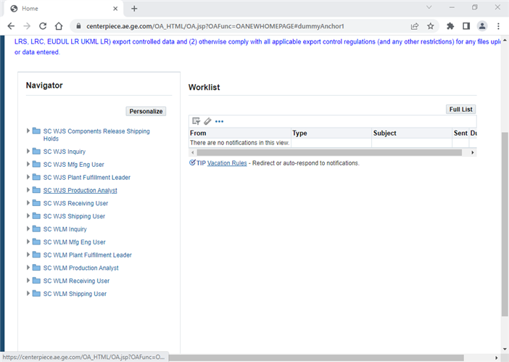
GE Aviation Enablement
View On-Hand Inventory
‪Home - Google Chrome‬
Tuesday, January 30, 2024

Slide 4
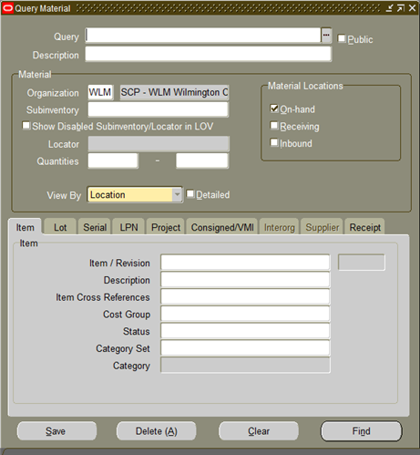
GE Aviation Enablement
View On-Hand Inventory
Query Material
Tuesday, January 30, 2024

Slide 5
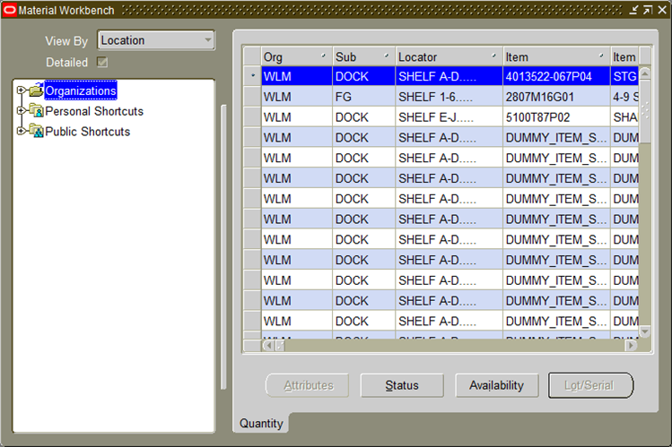
GE Aviation Enablement
View On-Hand Inventory
Material Workbench
Tuesday, January 30, 2024

Slide 6
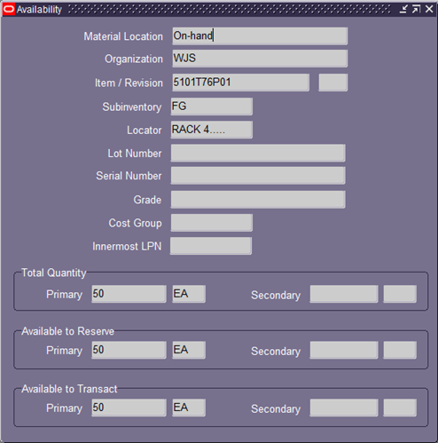
GE Aviation Enablement
View On-Hand Inventory
Availability
Tuesday, January 30, 2024

Slide 7
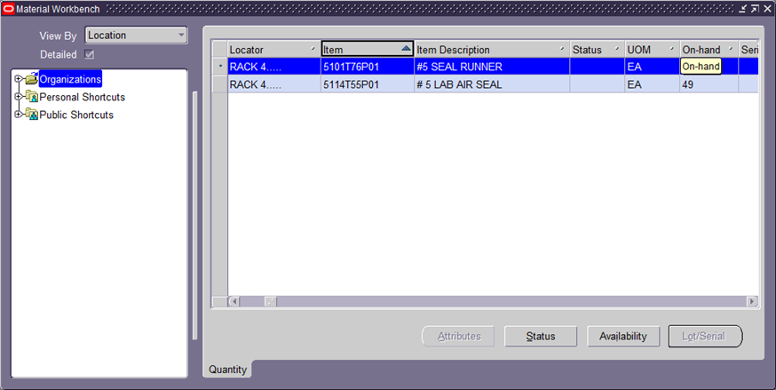
GE Aviation Enablement
View On-Hand Inventory
Material Workbench
Tuesday, January 30, 2024

Slide 8
GE Aviation Enablement
View On-Hand Inventory
Material Workbench
Tuesday, January 30, 2024

Slide 9
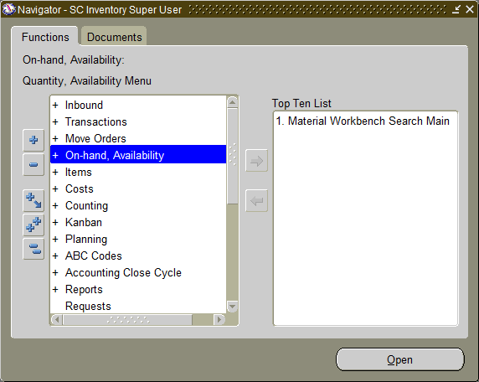
GE Aviation Enablement
View On-Hand Inventory
Navigator - SC Inventory Super User
Tuesday, January 30, 2024

Slide 10

GE Aviation Enablement
View On-Hand Inventory
Query Material
Tuesday, January 30, 2024

Slide 11
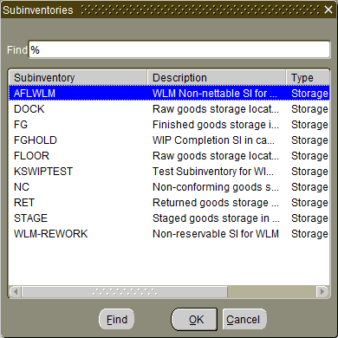
GE Aviation Enablement
View On-Hand Inventory
Subinventories
Tuesday, January 30, 2024

Slide 12
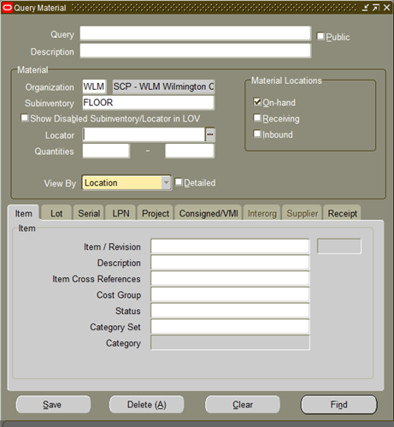
GE Aviation Enablement
View On-Hand Inventory
Query Material
Tuesday, January 30, 2024

Slide 13
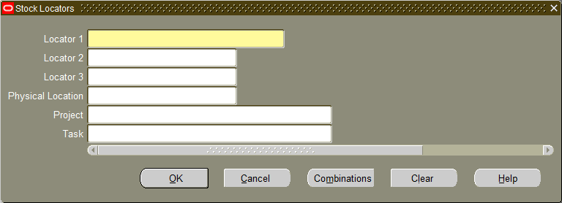
GE Aviation Enablement
View On-Hand Inventory
Stock Locators
Tuesday, January 30, 2024

Slide 14
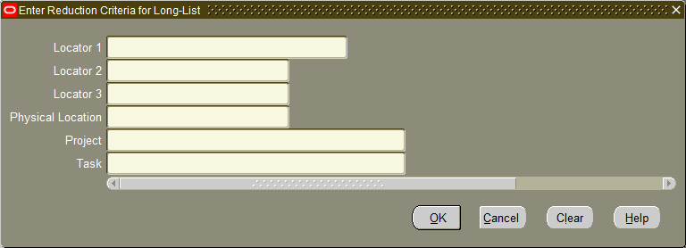
GE Aviation Enablement
View On-Hand Inventory
‪Enter Reduction Criteria for Long-List‬
Tuesday, January 30, 2024

Slide 15

GE Aviation Enablement
View On-Hand Inventory
Enter Reduction Criteria for Long-List
Tuesday, January 30, 2024

Slide 16
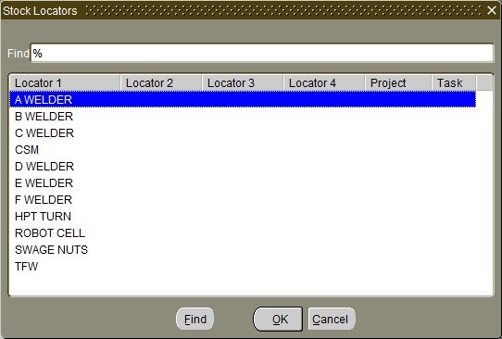
GE Aviation Enablement
View On-Hand Inventory
Stock Locators
Tuesday, January 30, 2024

Slide 17
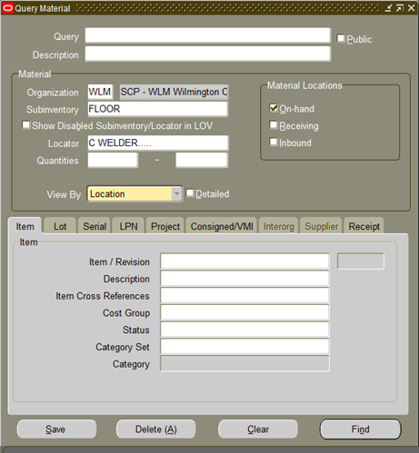
GE Aviation Enablement
View On-Hand Inventory
Query Material
Tuesday, January 30, 2024

Slide 18
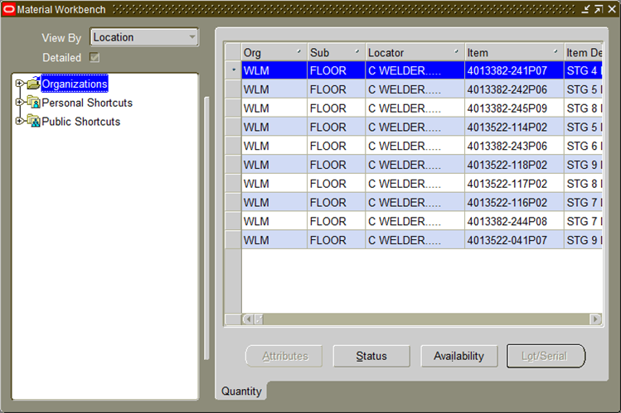
GE Aviation Enablement
View On-Hand Inventory
Material Workbench
Tuesday, January 30, 2024

Slide 19
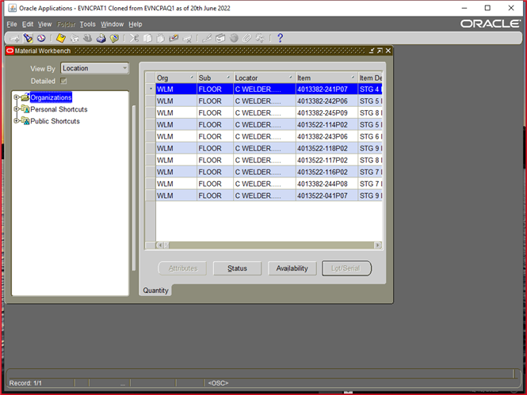
GE Aviation Enablement
View On-Hand Inventory
‪Oracle Applications - EVNCPAT1 Cloned from EVNCPAQ1 as of 20th June 2022‬
Tuesday, January 30, 2024

Slide 20

GE Aviation Enablement
View On-Hand Inventory
Query Material
Tuesday, January 30, 2024

Slide 21
GE Aviation Enablement
View On-Hand Inventory
Query Material
Tuesday, January 30, 2024

Slide 22
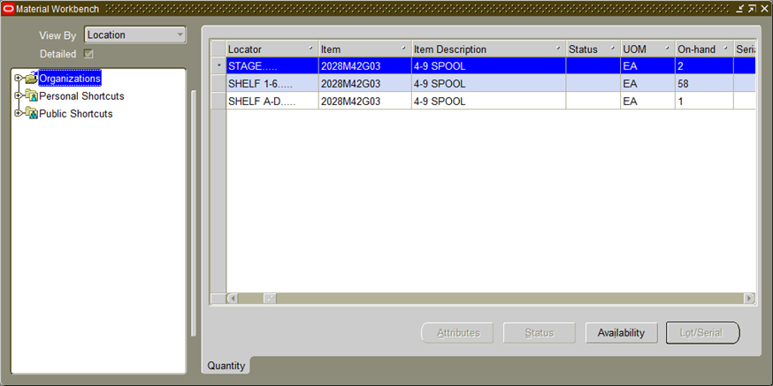
GE Aviation Enablement
View On-Hand Inventory
Material Workbench
Tuesday, January 30, 2024

Slide 23
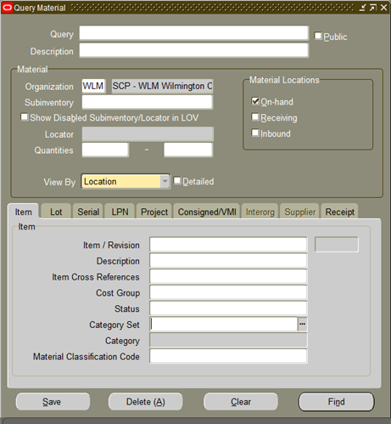
GE Aviation Enablement
View On-Hand Inventory
Query Material
Tuesday, January 30, 2024

Slide 24
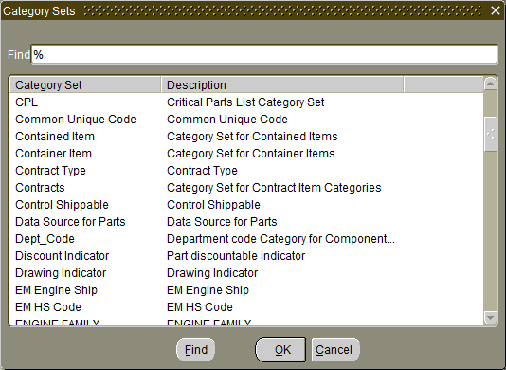
GE Aviation Enablement
View On-Hand Inventory
Category Sets
Tuesday, January 30, 2024

Slide 25
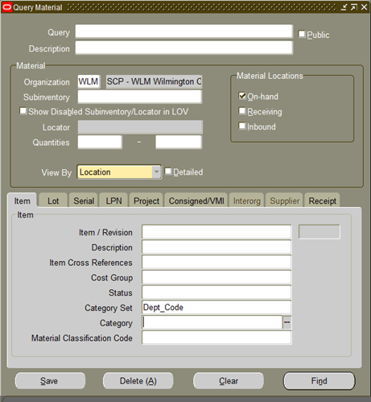
GE Aviation Enablement
View On-Hand Inventory
Query Material
Tuesday, January 30, 2024

Slide 26
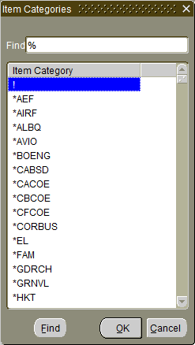
GE Aviation Enablement
View On-Hand Inventory
Item Categories
Tuesday, January 30, 2024

Slide 27
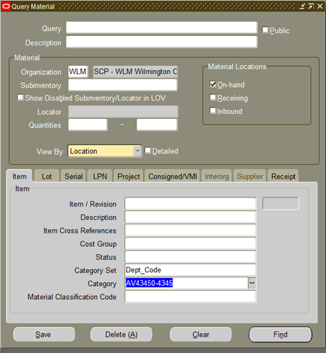
GE Aviation Enablement
View On-Hand Inventory
Query Material
Tuesday, January 30, 2024

Slide 28
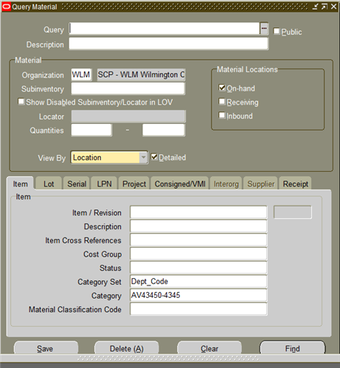
GE Aviation Enablement
View On-Hand Inventory
Query Material
Tuesday, January 30, 2024

Slide 29
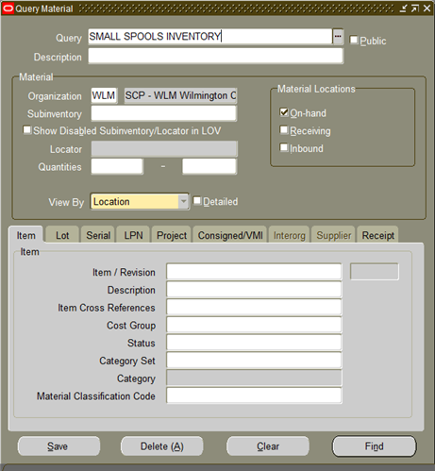
GE Aviation Enablement
View On-Hand Inventory
Query Material
Tuesday, January 30, 2024

Slide 30
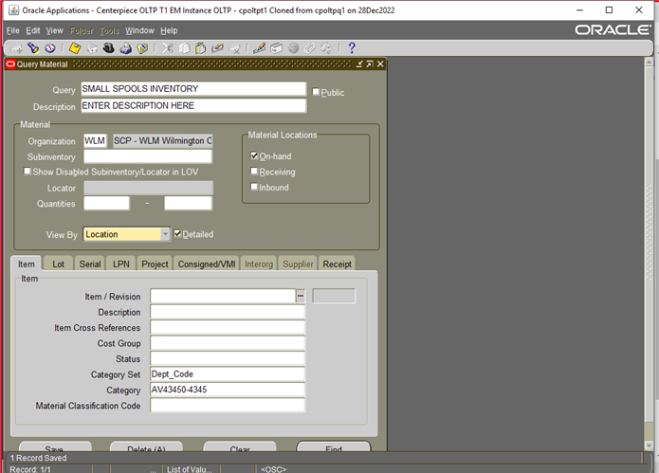
GE Aviation Enablement
View On-Hand Inventory
‪Oracle Applications - Centerpiece OLTP T1 EM Instance OLTP - cpoltpt1 Cloned from cpoltpq1 on 28Dec2022‬
Tuesday, January 30, 2024

Slide 31
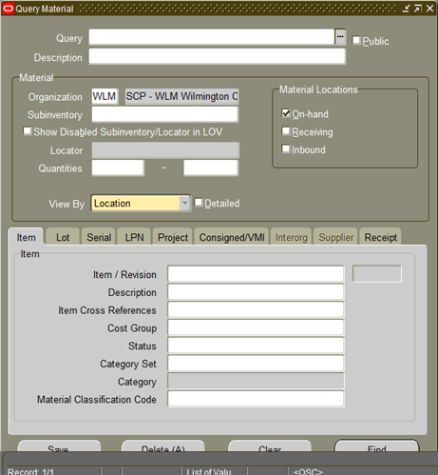
GE Aviation Enablement
View On-Hand Inventory
Query Material
Tuesday, January 30, 2024

Slide 32
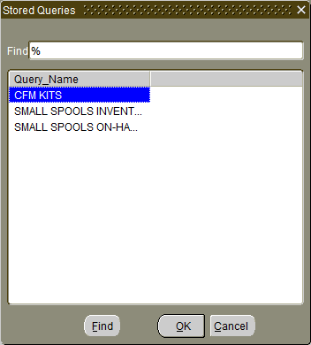
GE Aviation Enablement
View On-Hand Inventory
Stored Queries
Tuesday, January 30, 2024

Slide 33
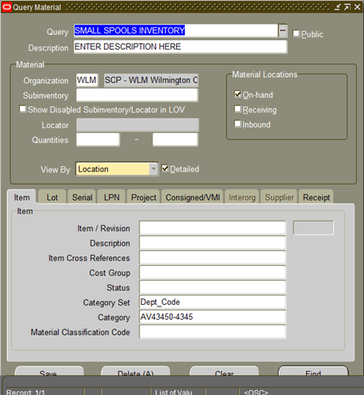
GE Aviation Enablement
View On-Hand Inventory
Query Material
Tuesday, January 30, 2024

