Slide 1

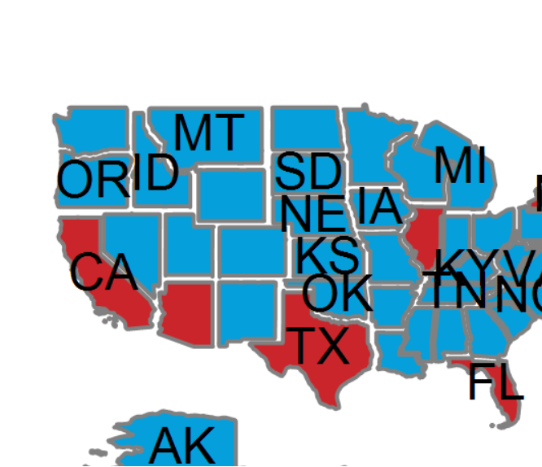
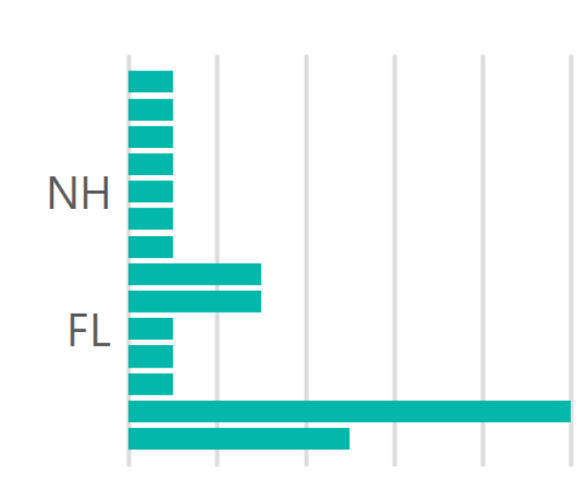
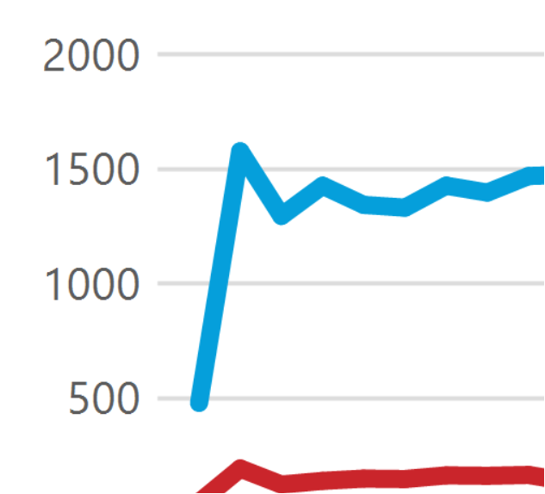
Information on the incidence of COVID19 in the United States

Slide 2
Information on the incidence of COVID19 in the United States

Slide 3
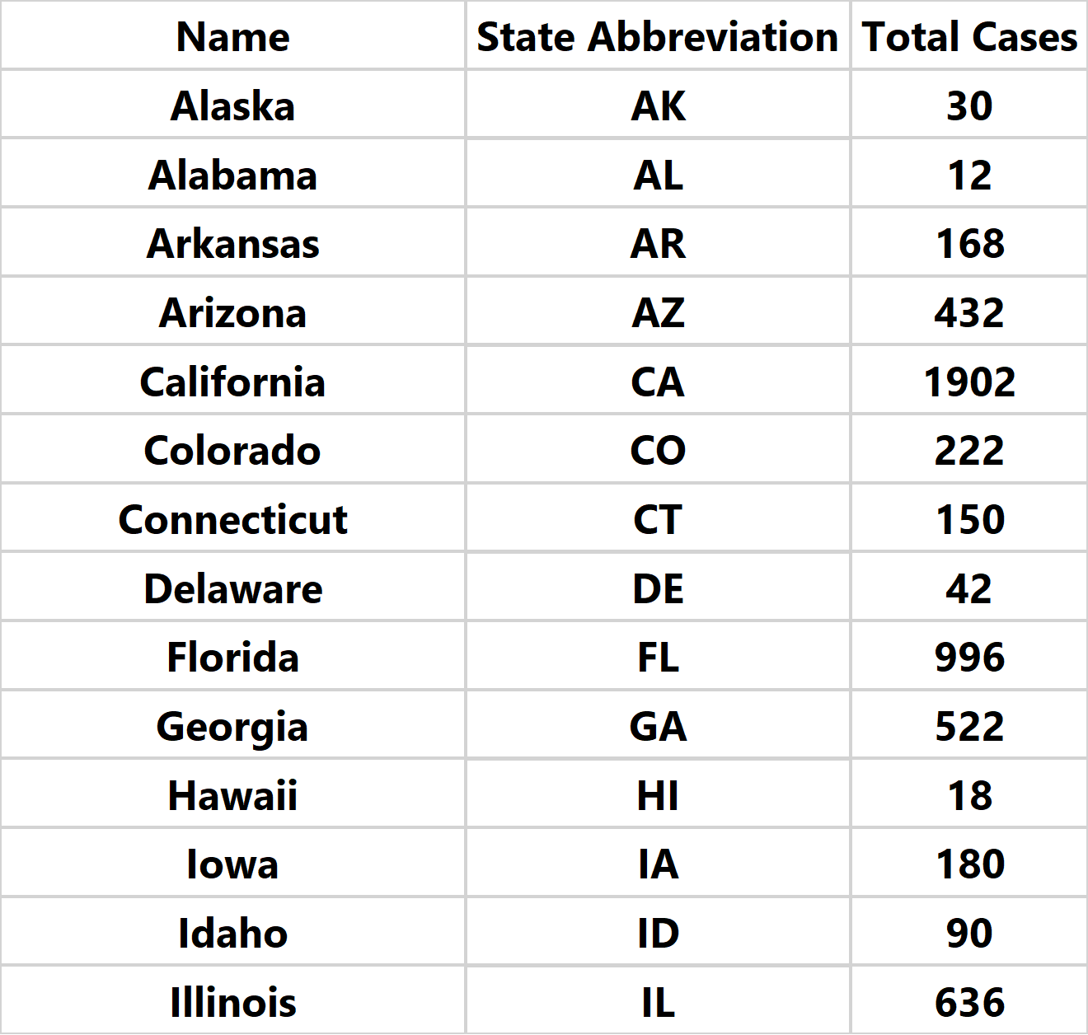
Information on the incidence of COVID19 in the United States

Slide 4
Information on the incidence of COVID19 in the United States

Slide 5
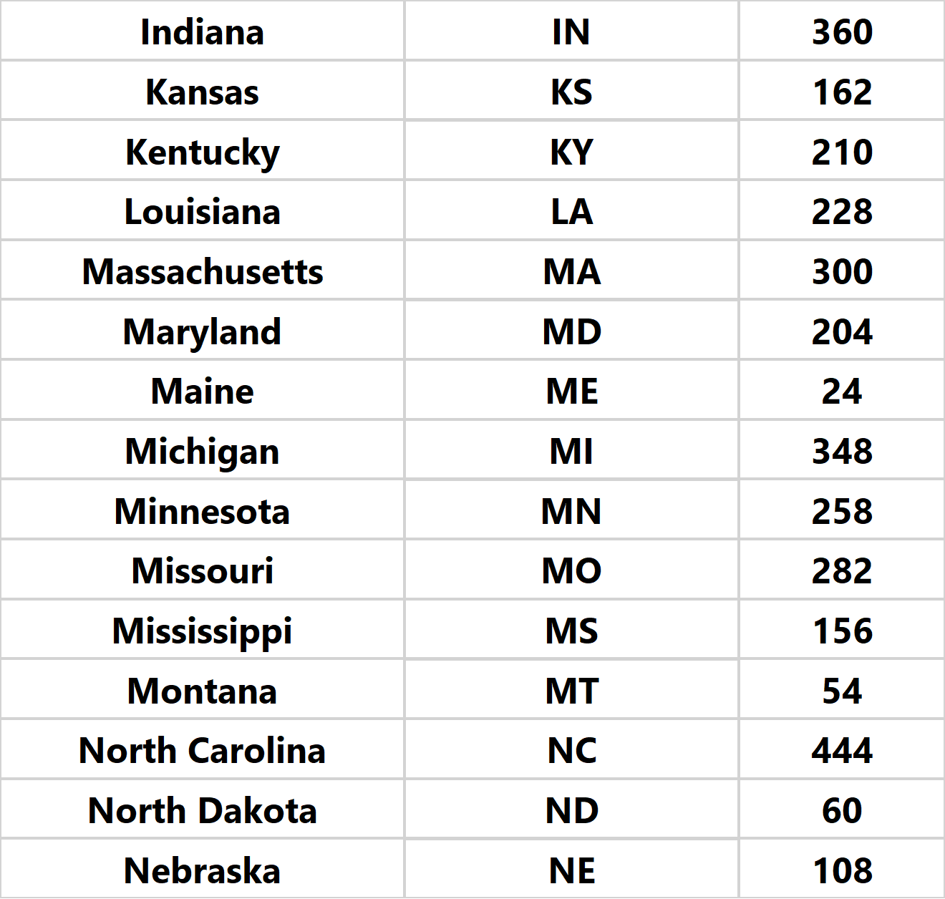
Information on the incidence of COVID19 in the United States

Slide 6
Information on the incidence of COVID19 in the United States

Slide 7
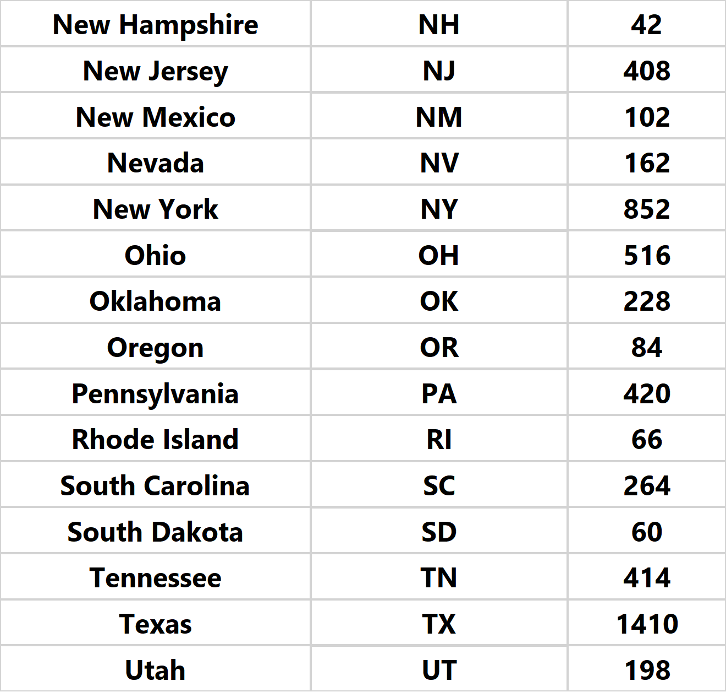
Information on the incidence of COVID19 in the United States

Slide 8
Information on the incidence of COVID19 in the United States

Slide 9
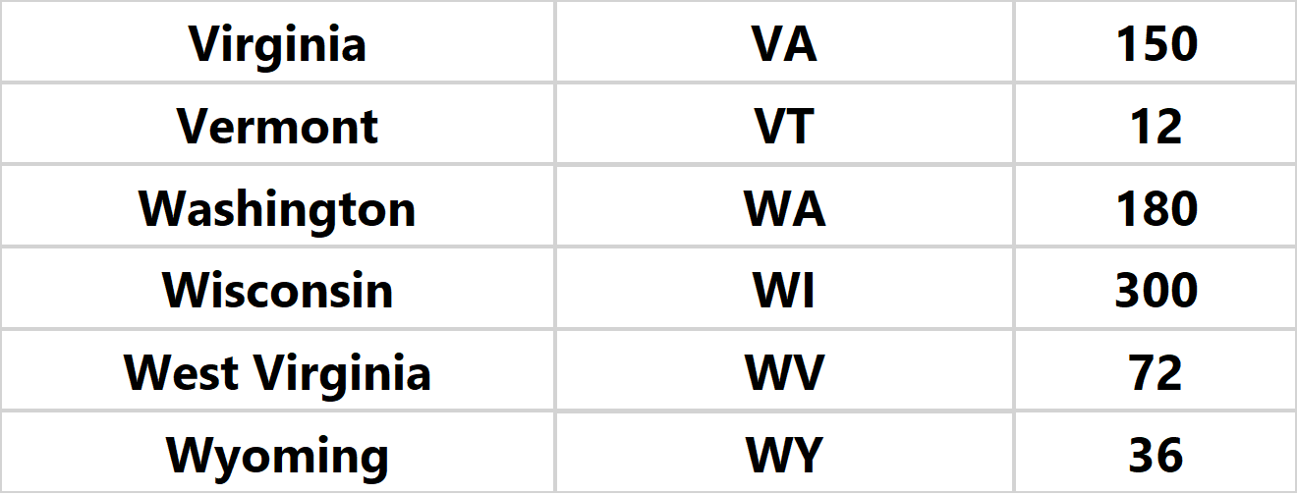
Information on the incidence of COVID19 in the United States

Slide 10
Information on the incidence of COVID19 in the United States

Slide 11
Information on the incidence of COVID19 in the United States

Slide 12
Information on the incidence of COVID19 in the United States

