Slide 1
APPLE Database
Kathleen Labog

Slide 2
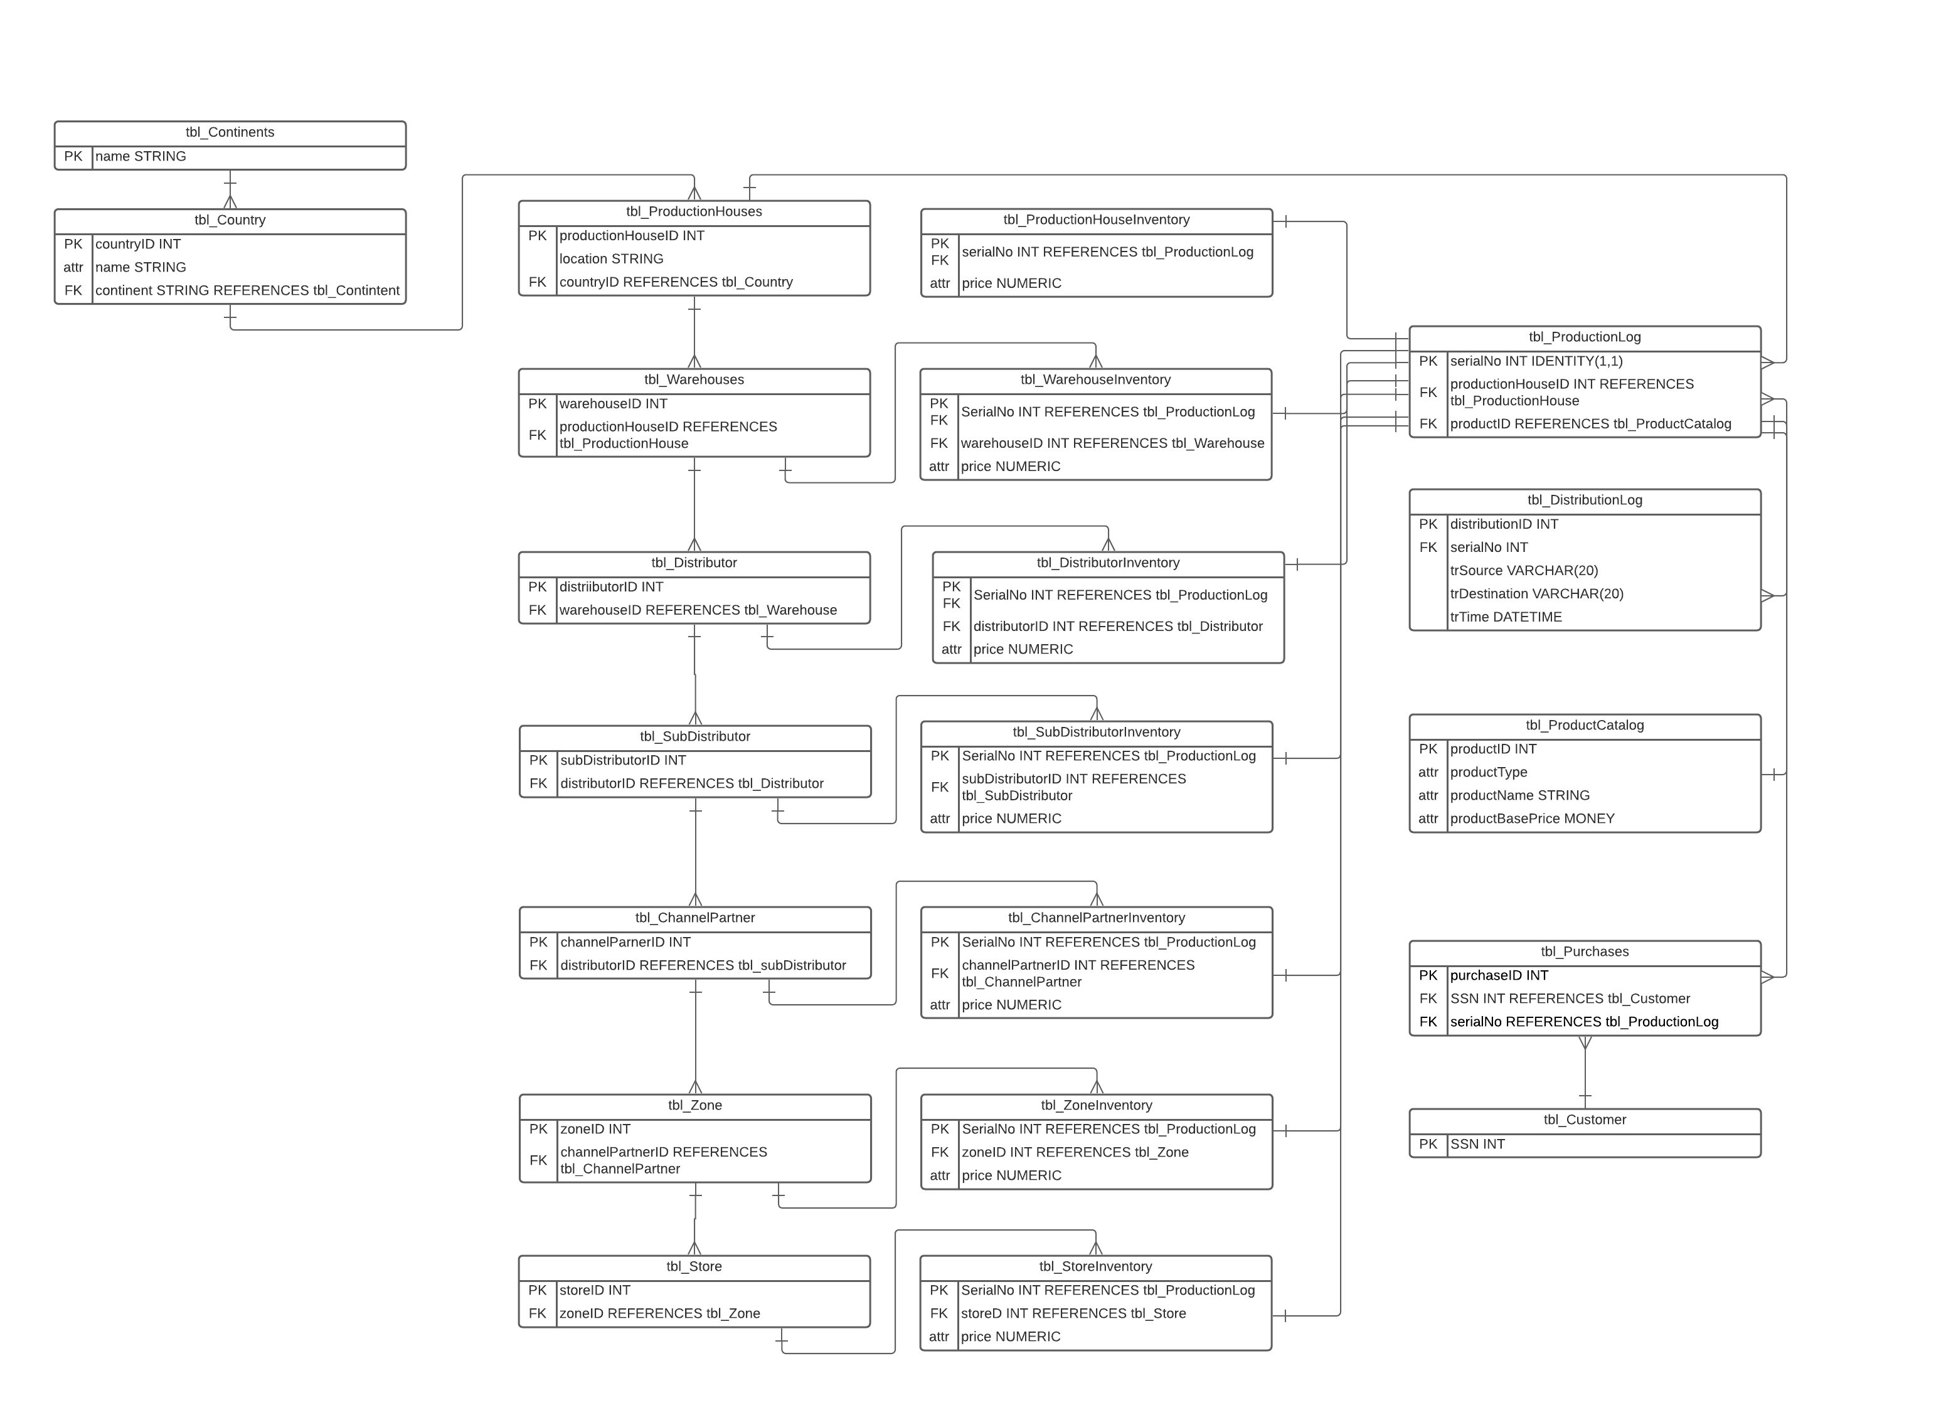
ER Diagram Designing Process

Slide 3
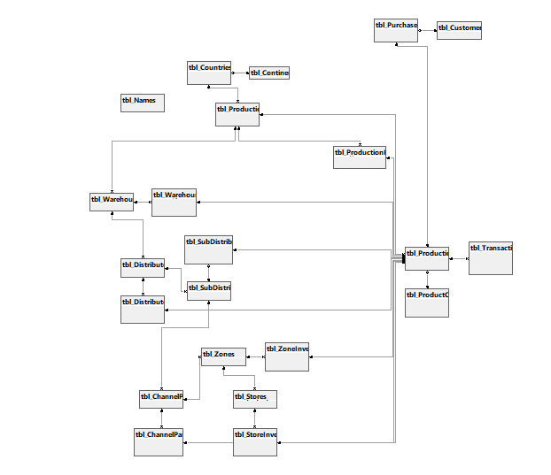
ER Diagram Generated by Microsoft Management Studio

Slide 4
Tables
Setting Up Entities
Customers
ProductCatalog
Continents
Countries
Production Houses
Warehouses
Distributors
SubDistributors
ChannelPartners
Zones
Stores
Inventories
Production Houses Inventories
Warehouses Inventories
Distributors Inventories
SubDistributors Inventories
ChannelPartners Inventories
Zone Inventories
Store Inventories
Purchases
Logs
ProductionLog
TransactionLog
Miscellaneous
Names
Query Listings

Slide 5
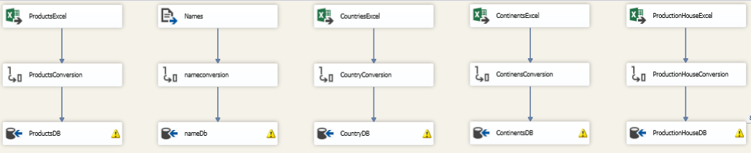
Data Population - SSIS
  Tables Populated with SSIS
ProductCatalog Excel
Names CSV
Countries Excel
Continents
ProductionHouseExcel

Slide 6
Stored Procedures – Data Population
Table Population
Warehouses with ‘EXEC populateWarehouses’
Distributors with ‘EXEC populateDistributors’
SubDistributors with ‘EXEC populateSubDistributors’
ChannelPartners with ‘EXEC populateChannelPartners’
Zones with ‘EXEC populateZones’
Stores with ‘EXEC populateStores’
Customers with ‘EXEC populateCustomers’

Slide 7
StoreProcedures - Functionality
EXEC productHouseProductRequest (productHouseID,serialNo)
EXEC warehouseProductRequest (warehouseID,serialNo)
EXEC distributorProductRequest (distributorID,serialNo)
EXEC subDistributorProductRequest(subDistributorID,serialNo)
EXEC channelPartnerProductRequest (channelPartnerID,serialNo)
EXEC zoneProductRequest 1,100 (zoneID,serialNo)
EXEC storeProductRequest 1, 100 (storeID,serialNo)
EXEC guestPurchase (SSN, storeID, productID)
EXEC guestReturn (serialNo, storeID)

Slide 8
Triggers
trg_sendProductToProductionHouseInventory
trg_deleteProductionHouseInstance
trg_deleteWarehouseInstance
trg_deleteDistributorInstance
trg_deleteSubDistributorInstance
trg_deleteChannelPartnerInstance
trg_deleteZoneInstance
trg_deleteStoreInstance

Slide 9
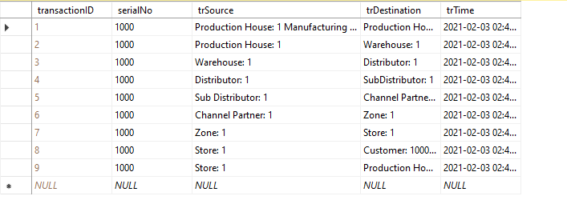
TransactionLog of full cycle

