Slide 1
CBT Vinyls
global record sales
MSBI 2021

Slide 2
Tools
Python
T-SQL
MS SQL Server
VS SSDT (SSIS, SSAS, SSRS)

Slide 3
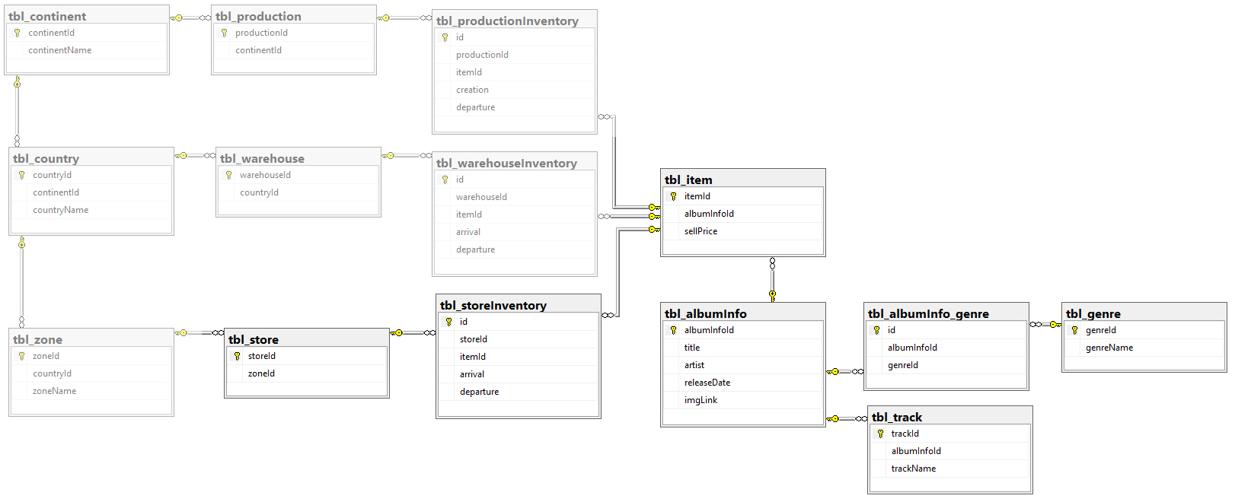
CBT Vinyls DataBase

Slide 4
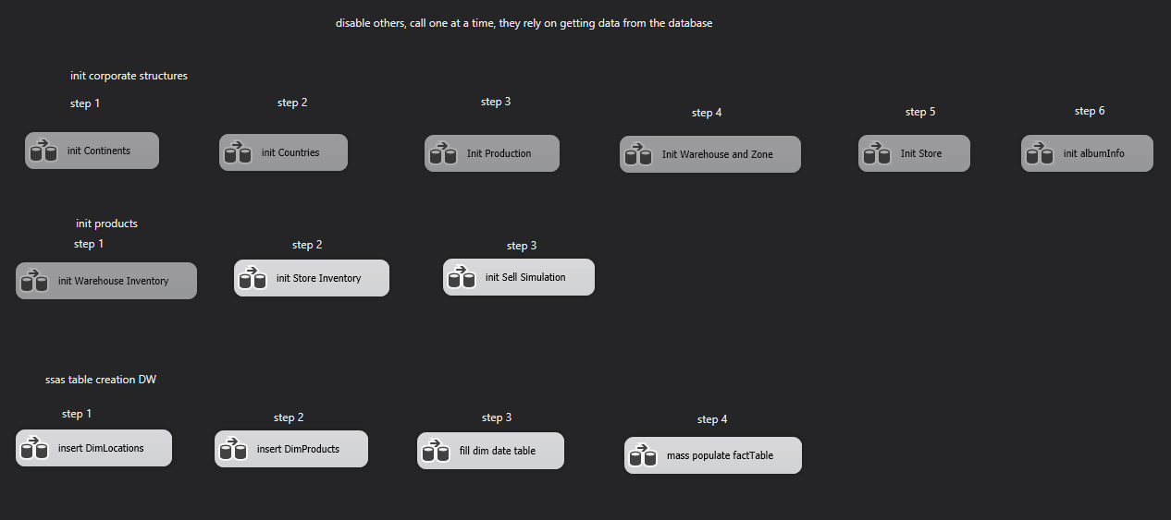
SSIS in the control flow

Slide 5
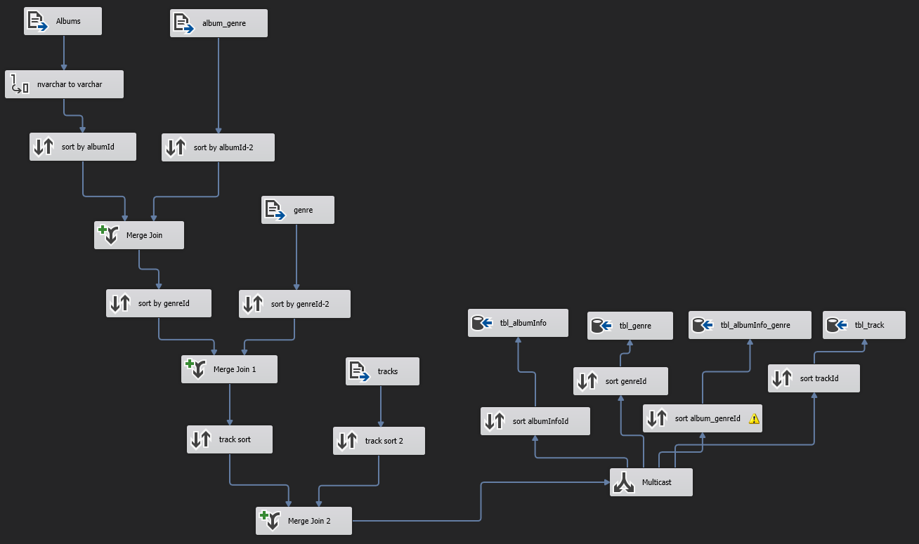
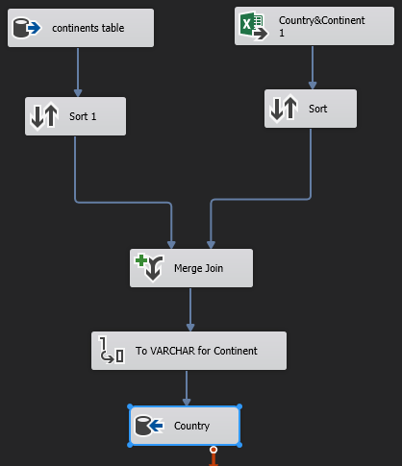
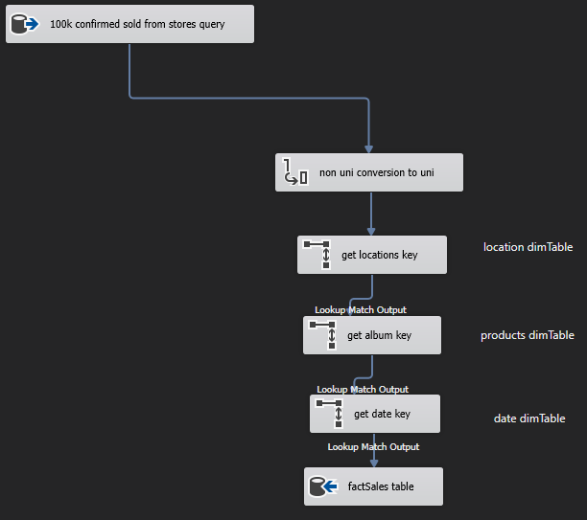
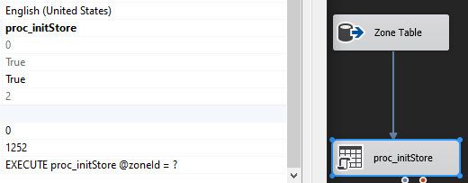
SSIS in the data flow

Slide 6
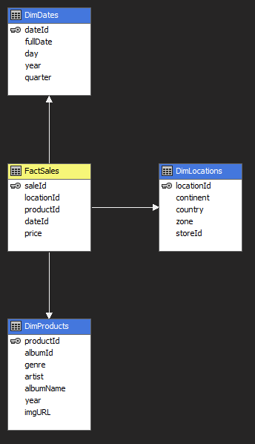
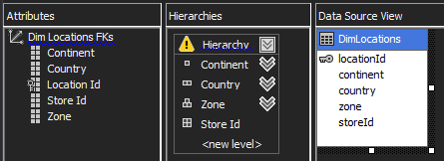

SSAS cube and dimensions

Slide 7
SSRS
Dynamic expressions
Formatted data labels
Custom themed map
Pie chart
Drill down table with hidden column fields
Parameterized linked reports

