Slide 1
C# Events

Slide 2
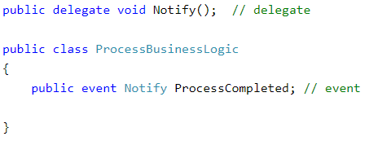
Declaring an Event
Before you can declare your event, you must create a delegate
You would then go into the class that you want to place the event inside of and create the event based on the delegate that you created initially.

Slide 3
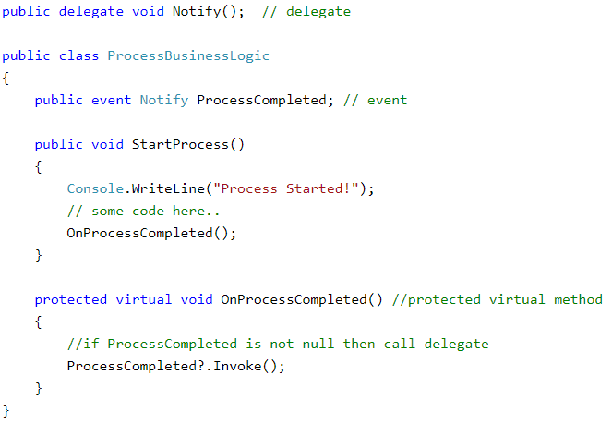
Raising an Event
Once the delegate has been made and the event has been made from that delegate, you have to call, or raise, that event.
Here in our example, you can see that the event is being called by the OnProcessCompleted() function.
When the OnProcessCompleted() function runs and the Invoke() function at the bottom, this will call all event handler methods with the ProcessCompleted event.

Slide 4
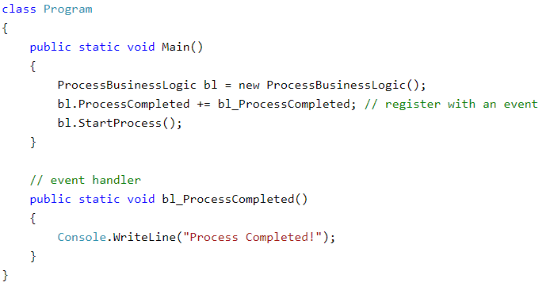
Consume an Event
Subscriber class must register to the event
The method then handles the event it is tied to because it matches the signature of the delegate.

