Slide 1


Slide 2
INTERNET CAFE MANAGEMET SYSTEM
Team Members
2103A51156 – B.Vignesh
2103A51171 – K.Akshith
2103A51176 – MD.Naheed
2103A51178 - M.Sai Teja
Under the guidance of
Mr. Radhakrishnan .P
Assistant Professor
School of CS & AI

Slide 3
Introduction
In many of the internet cafes they have manual book record system to store the user information .
Here the problem is the loss of the users information as well as there is no clue if any illegal works are done using the systems of the cafe.
This application store the user data and later can be automated to store the user history for our security purposes
We can access the user information easily and view the past history of the cafe.

Slide 4
Agenda
1.Problem statement
2.Key Aspects
3.Block Diagram
4.Software Implementation
5.Sample code
6.Sample Output
7.Referrences

Slide 5
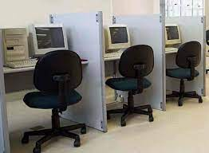
Objection/Problem Statement
Develop a C program to make an application that intends to increase the ease of maintaining an internet cafe ( Using the knowledge of Data structures in our academic schedule).

Slide 6
Key Aspects
Unique id generation for each user.
Easy registration or deletion of users indirectly easy access of user information.
Admin has the option of viewing the customers feedback.

Slide 7
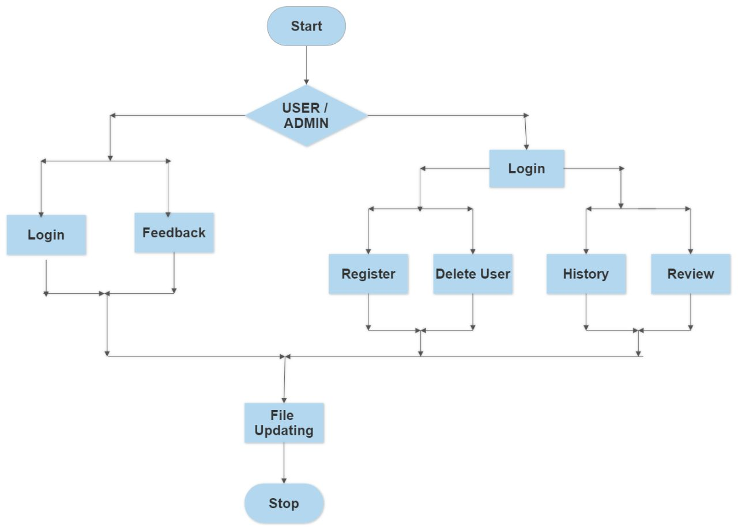
BLOCK DIAGRAM

Slide 8

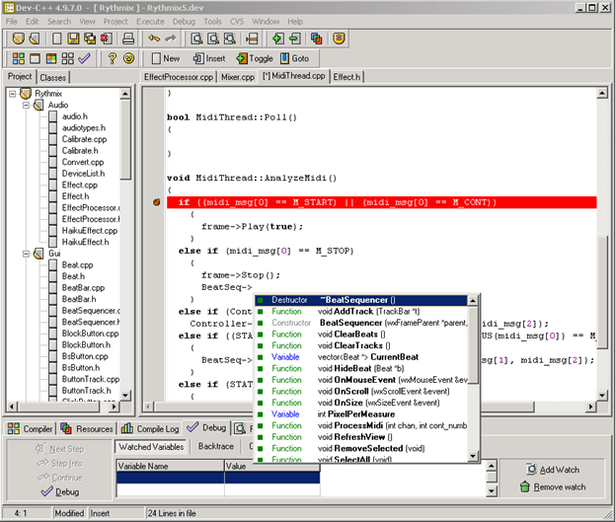
Software Implementation
Dev-C++ is a free full-featured integrated development environment (IDE) distributed under the GNU General Public License for programming in C and C++. It was originally developed by Colin Laplace and first released in 1998. It is written in Delphi.

Slide 9
Software Implemented
We used structures to define Linked List Data Structures to store users.
We used stacks to store the history about the users in previous session
We used STDIO,STDLIB & TIME header files to implement the inbuilt functions.

Slide 10
Hardware Implication
Operating System Windows 2000/NT/XP/Vista
Ram 256 MB or more
HARD DISK 40 GB or more
Processor P3 or High

Slide 11
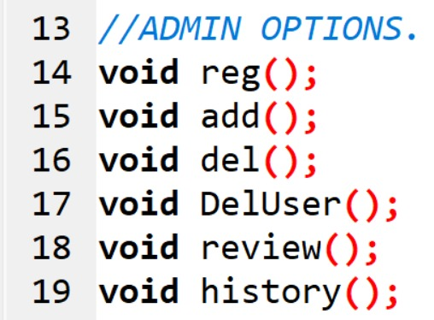
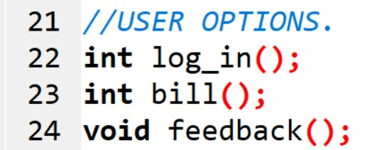
Sample Code

Slide 12
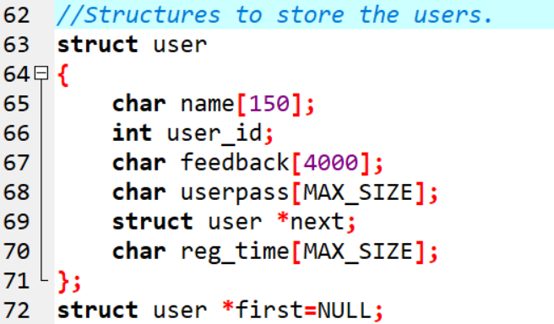
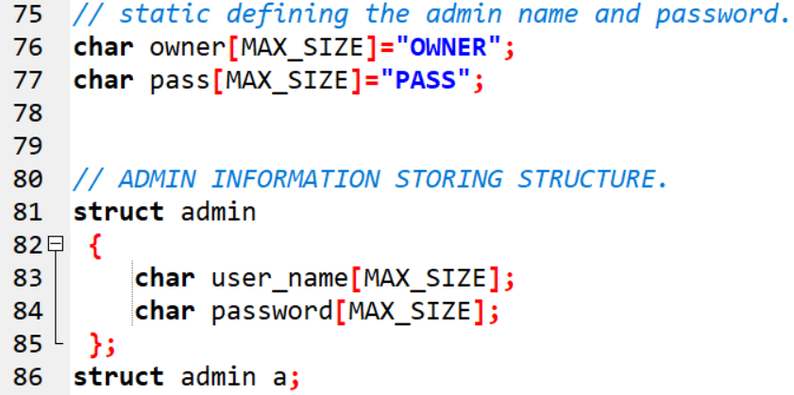
Sample Code

Slide 13
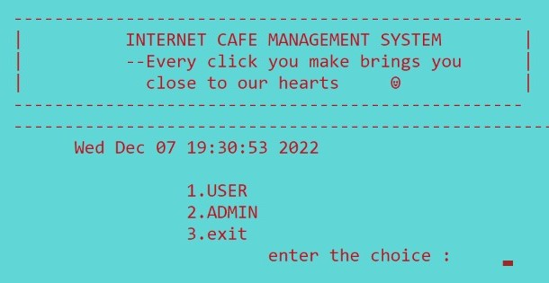
Sample Output
Main Page

Slide 14
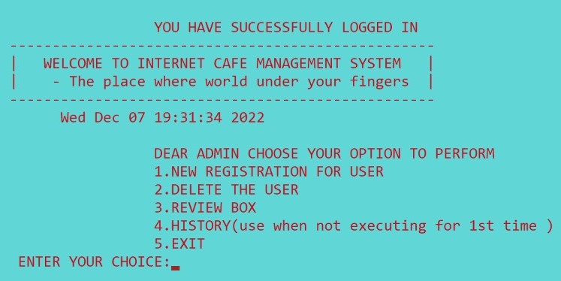
Sample Output
Admin Option

Slide 15
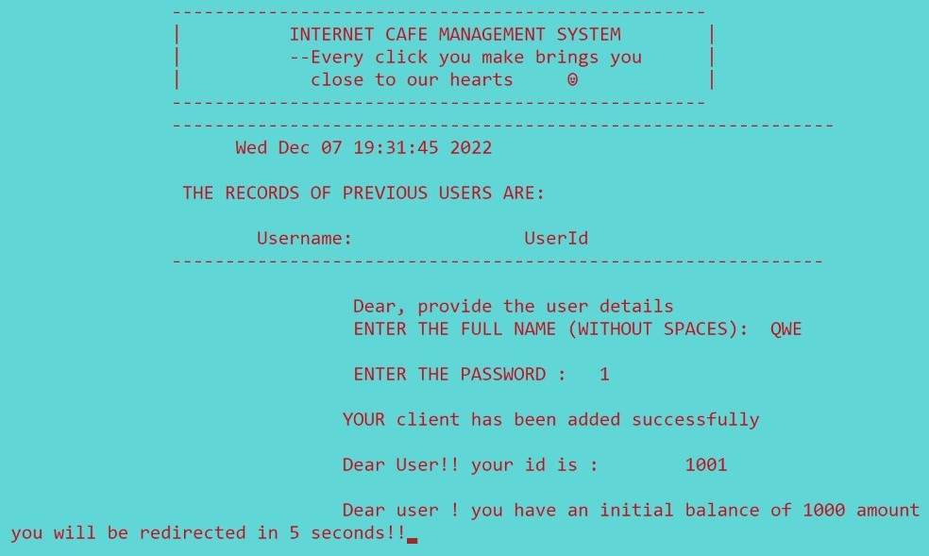
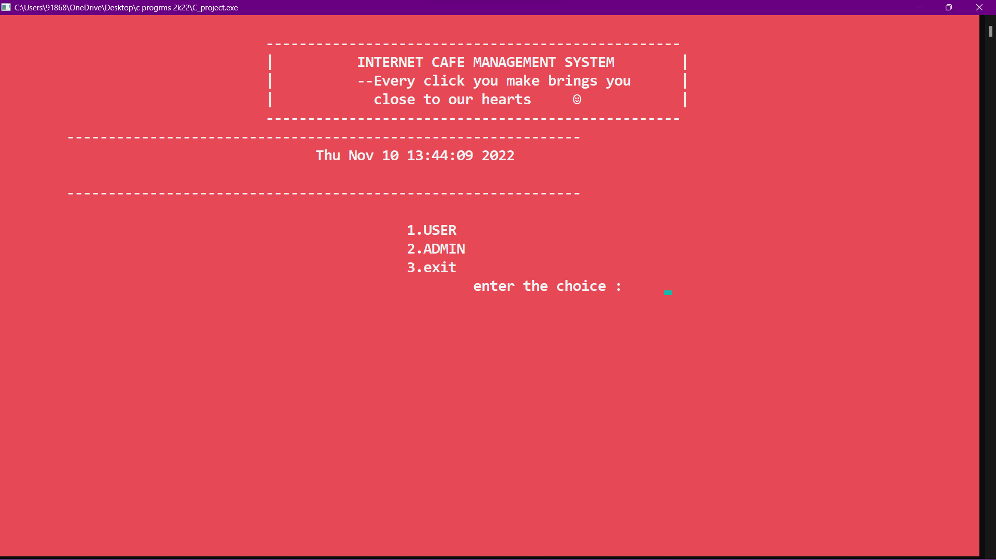
Sample Output
User Registration

Slide 16
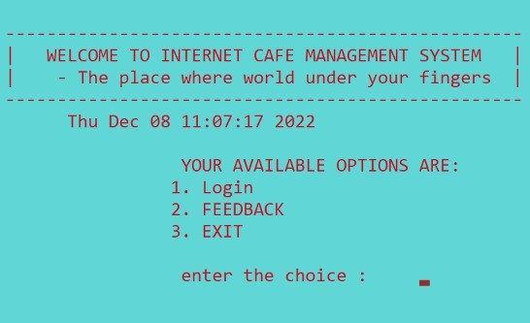
Sample Output
User Options

Slide 17
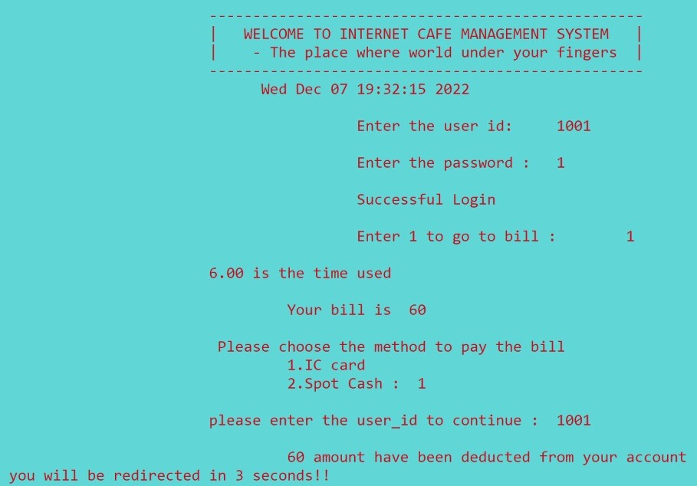
Sample Output
User Login & Bill – IC Card

Slide 18
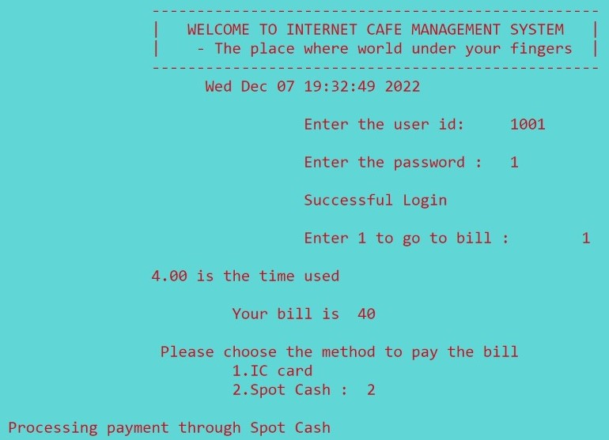
Sample Output
User Login & Bill – Spot Cash

Slide 19
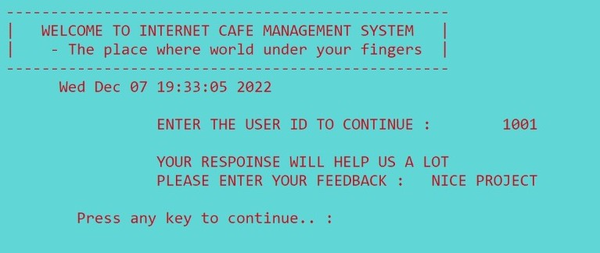
Sample Output
User’s Feedback

Slide 20
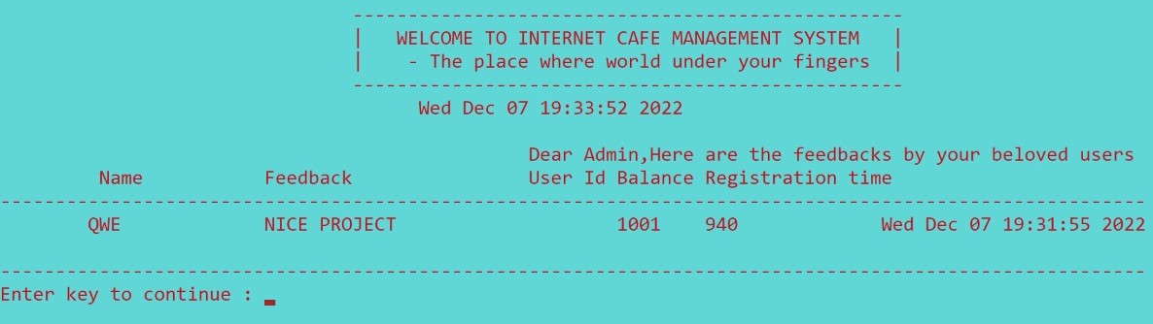
Sample Output
Review Box

Slide 21
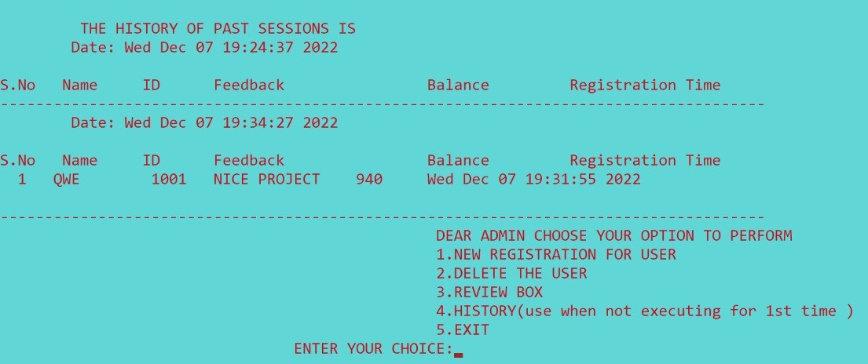
Sample Output
History

Slide 22
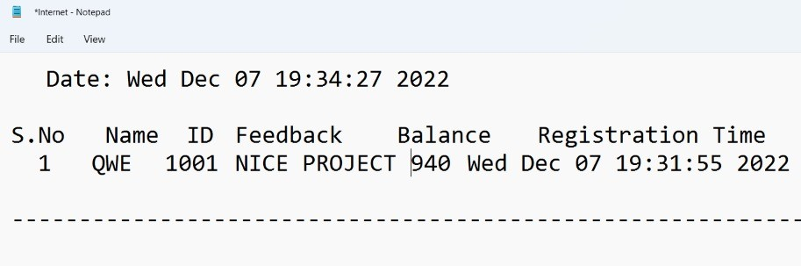
Sample Output
History in Text File

Slide 23
Conclusion
We hereby conclude that the concept of linked lists learnt in our data structures lab ,taught by
MR. Radhakrishnan sir has been successfully implemented in my project
(Internet Cafe Money Management System).
This application can also be extended to implement in other environments like Library, Hotels etc.
In future changes can be done by linking the user mobile number or Aadhar card or their fingerprints and allowed to modify their data whenever needed.

Slide 24
References
Data Structures(Linked List) in Geeks for Geeks.
Problems in most of the Internet cafes ( storing user data).
Data structures and algorithms Text Book by Samanta.
C programming book by Dennis Ritchie.

Slide 25
Thank You

