Slide 1

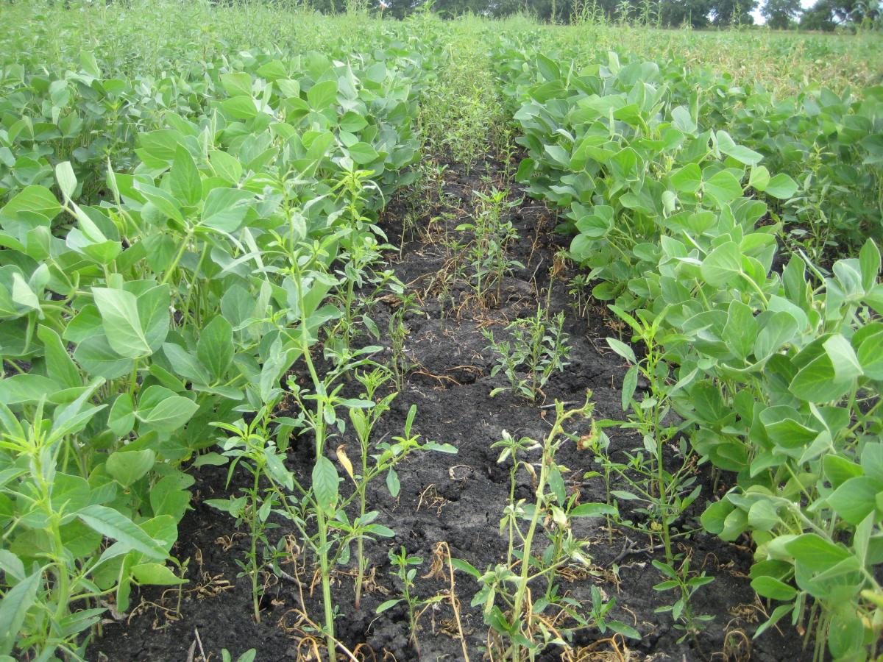
Weed Detection In Soyabean Crops
Artificial Intelligence & Machine learning

Slide 2
Weed Detection In Soyabean Crops
ARTIFICAL INTELLIGENCE
PREETHAM KASARLA (2103A52185)
GOLLA SAI KRISHNA (2103A52189)
Under The Guidance of
MR.D.RAMESH SIR
Asst.Professor
School of CS&AI
SR University

Slide 3
TABLE OF CONTENTS
01
02
03
04
05
06
INTRODUCTION
PROBLEM STATEMENT
PROPOSED SYSTEM
DATASET
OPEN_CV
CONCLUSION

Slide 4
INTRODUCTION
Soybean represents the main oilseed consumed worldwide, both for animal consumption through soybean meal and for human consumption through oil .Weeds are plants that grow spontaneously on agricultural soils where they are unwanted. The growth of these plants competing with economic crops, such as soybeans, causes damages, making it difficult to operate harvesting machines and increasing the impurity and moisture of the grains.

Slide 5
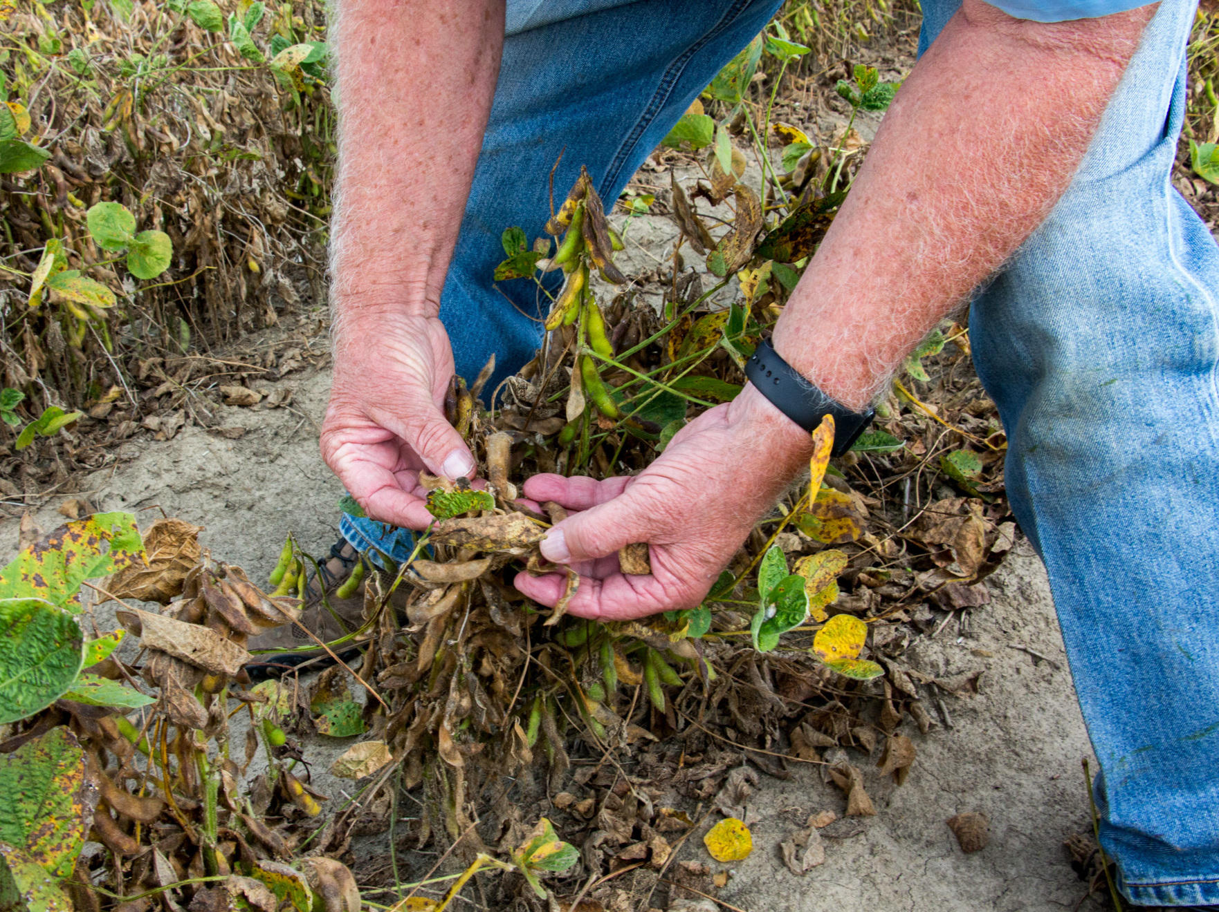
PROBLEM STATEMENT
Many people are facing difficulties in weed detection in soyabean crops. They are getting confused in identifying weeds which are similar to soyabean crops. The problem statement of weed detection in soybean crops involves the identification and classification of weeds that grow alongside soybean plants. Weeds are unwanted plants that can grow in soybean fields and compete with the soybean plants for nutrients, water, and sunlight. They can significantly reduce crop yield and quality if not controlled effectively.

Slide 6
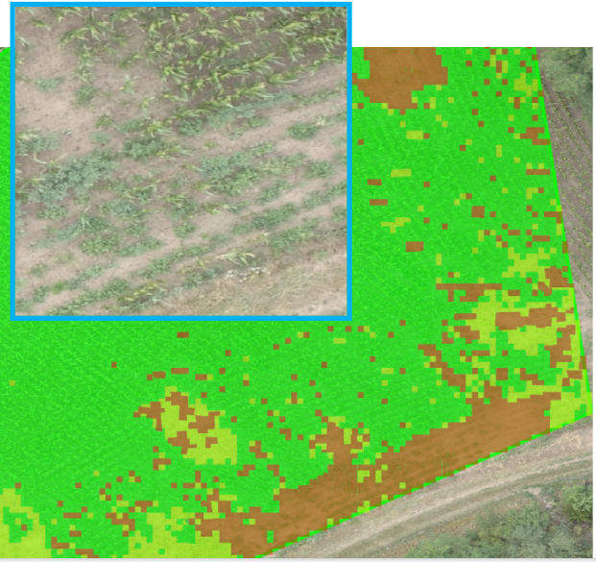
PROPOSED SYSTEM
In olden days weed detection was done by employing some men, especially for weed removal purpose. They will detect the weeds by checking each and every plant field. Then they will pluck them out manually using their hands or spades. In proposed system the weeds can be detected by image processing techniques. The main aim of the project is to identify weed affected area for more seeding.

Slide 7
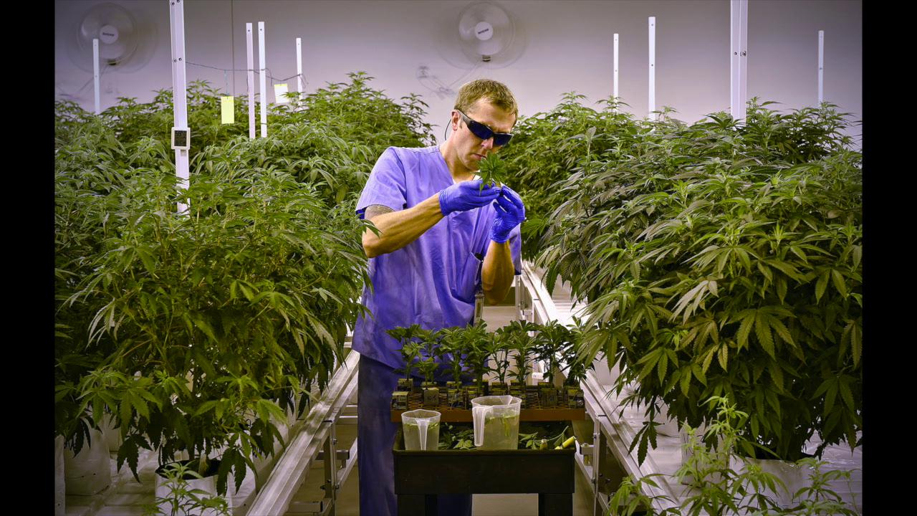
DATA SET
https://drive.google.com/drive/folders/1NZ13FME1dqESyS8NW4kzLod3ZlMUv4FM

Slide 8
.
About the dataset:
The dataset consists of 1240 testing images.
Dataset has 1271 training images.
The dataset contains media of weed (grass) images in all views, and your job is to create an algorithm to detect them.
The x is the array of images and y is the output of whether the weed (grass) is present or not in the image.

Slide 9
IMAGE PROCESSING AND OPEN CV
Image processing is the field of study that involves the use of computer algorithms to manipulate and analyze digital images. It is widely used in various applications, including robotics, surveillance, augmented reality, and medical imaging.
OpenCV (Open Source Computer Vision) is an open-source library that provides tools for image and video processing, including feature detection, object recognition, and machine learning.
OpenCV for Python provides Python bindings for the OpenCV library, making it easier to use OpenCV algorithms in Python. It supports various Python libraries, such as NumPy and SciPy, for image processing and data analysis..

Slide 10
OpenCV for Python provides a simple and efficient API for performing various image processing operations, such as image filtering, thresholding, and edge detection.
OpenCV for Python is a powerful tool for image and video processing that can be used for various applications in computer vision and machine learning. Its easy-to-use API and compatibility with popular Python libraries make it a popular choice among developers and researchers.

Slide 11
CONCLUSION
In this system, we have developed a method by which we can detect weed using Image processing. Due to the use of our system, we can detect and separate out weed affected area from the crop plants. The reason for developing such system is to identify and reuse weed affected area for more seeding. This specific area can be considered for further weed control operations, resulting in more production. Using an image processing algorithm, weeds are identified from the images by shape, color, texture and size features Prior work has documented the high accuracy considering various other parameters such as texture, genes, etc. Weed detection is an important factor for their removal and regulation. Appropriate weed detection algorithm must be used to avoid damaging the crop plants. The proposed system considers the simple edge detection algorithms.

Slide 12
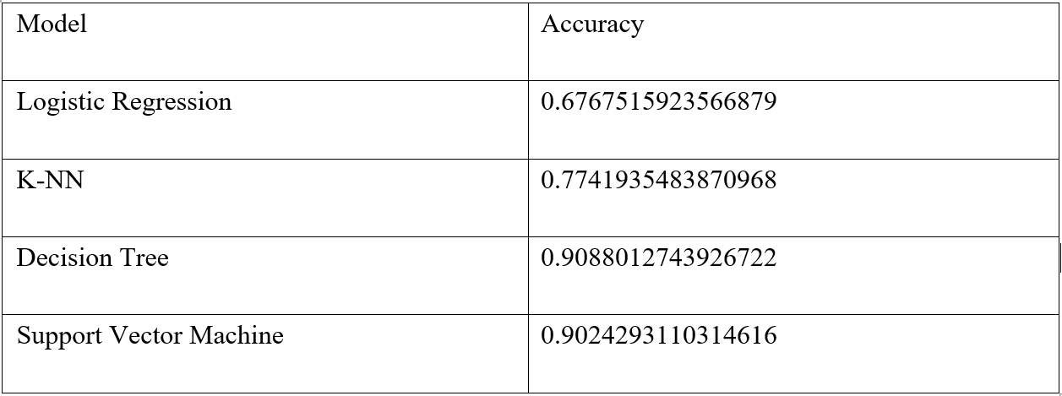
We have used Logistic Regression, KNN, SVM, and Decision Tree to predict the accuracy of the weeds in soyabean crops. We have got better accuracy in Decision Tree than other algorithms.

Slide 13
THANK YOU

