Slide 1
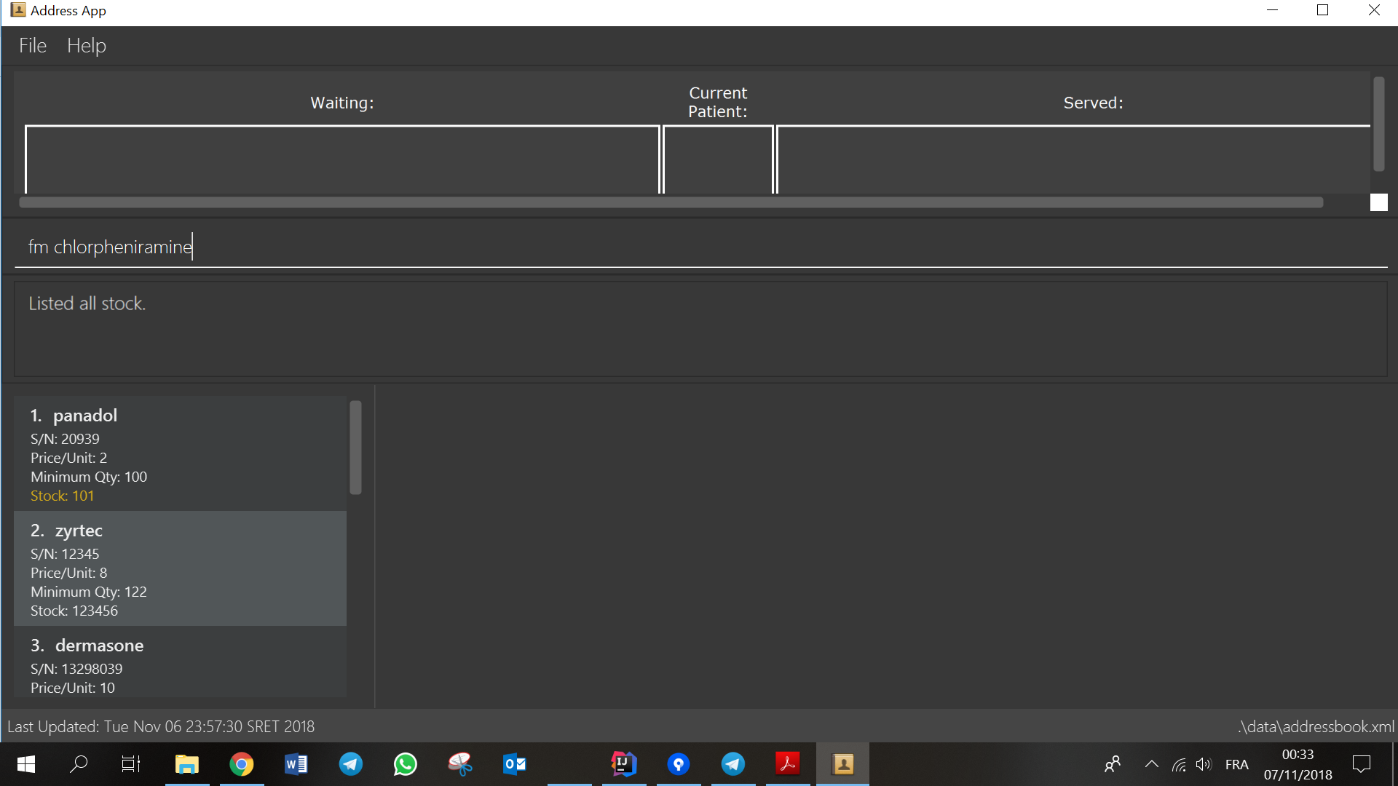

Slide 2
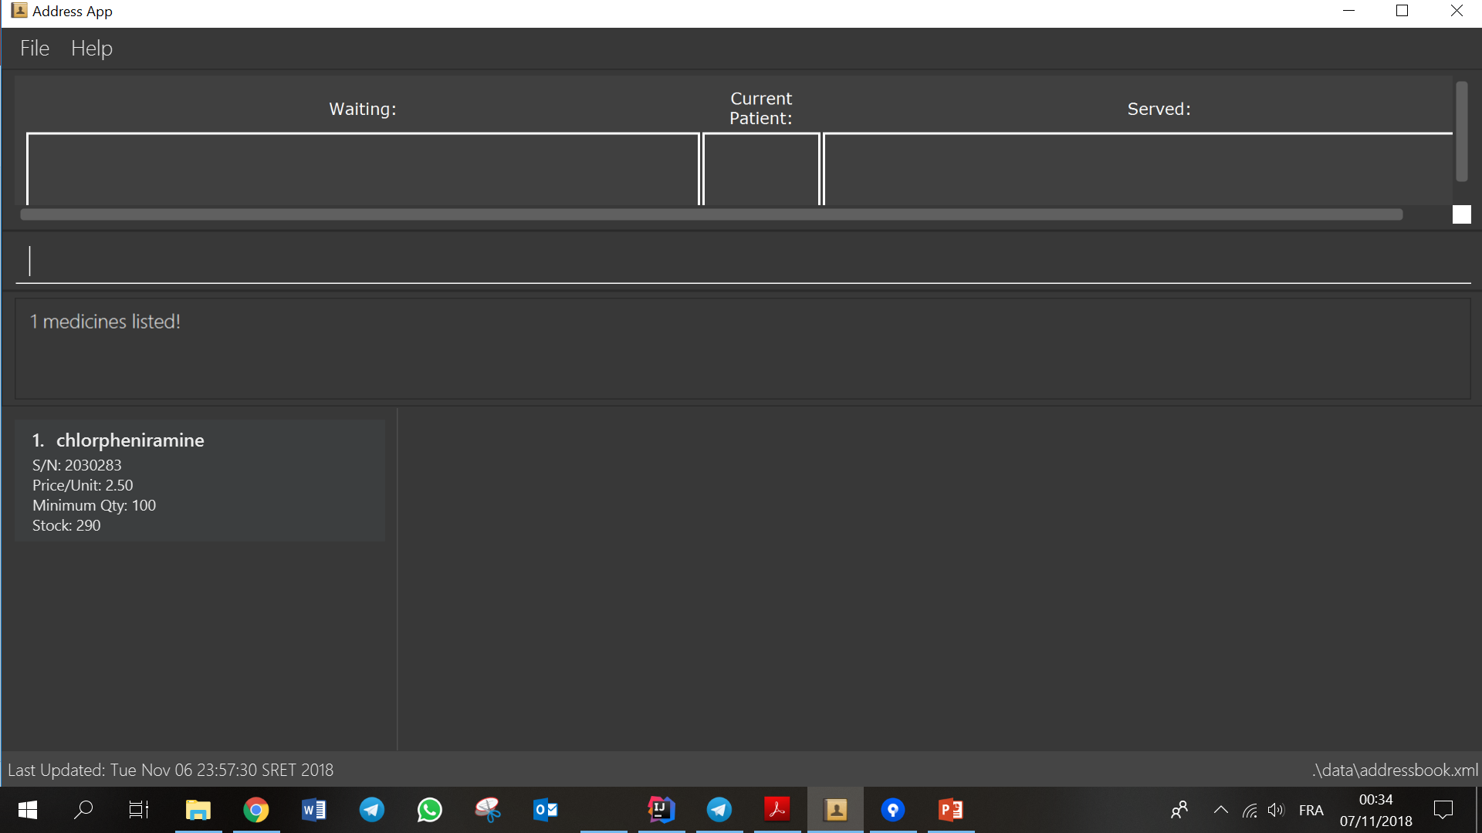
All medicine with name "chlorpheniramine" will be
shown on the medicine panel.

