Slide 1
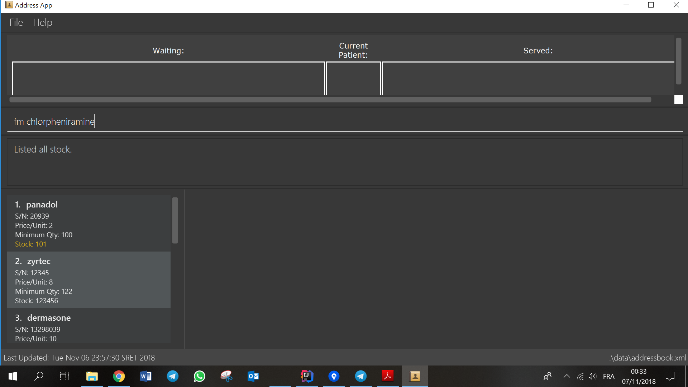

Slide 2
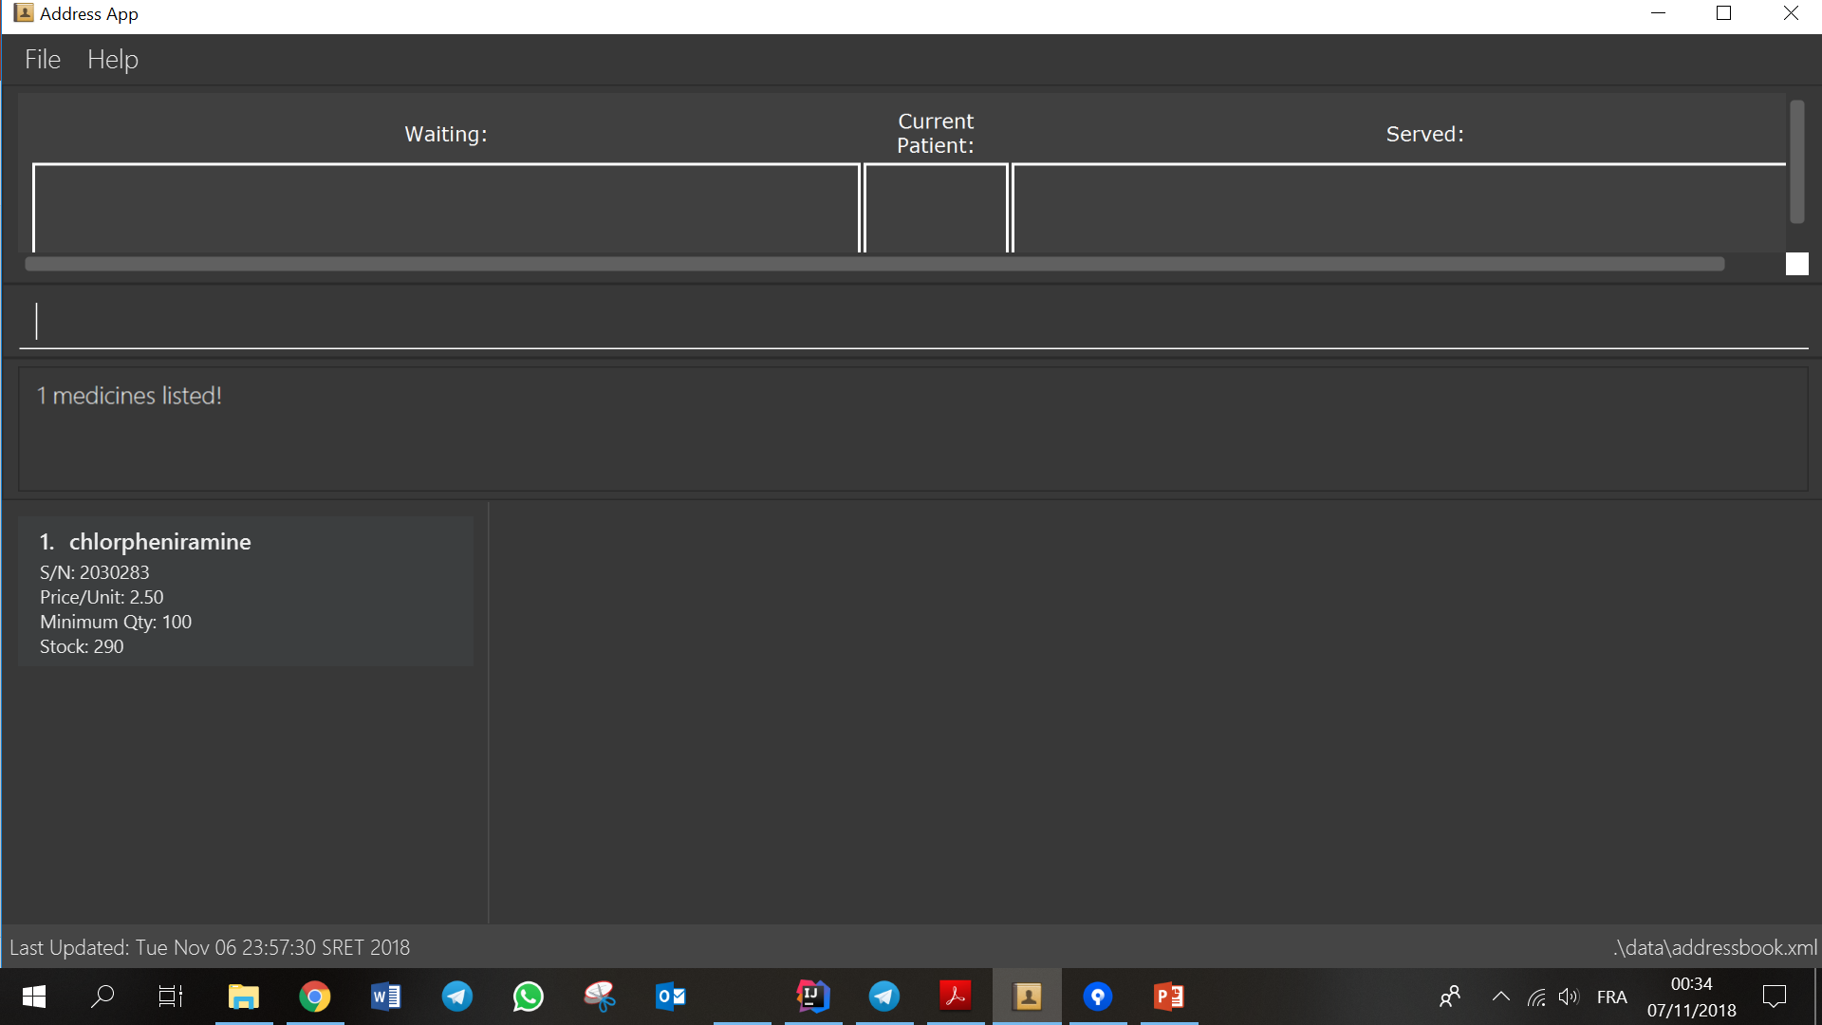
All medicine with name "chlorpheniramine" will be
shown on the medicine panel.

Slide 3
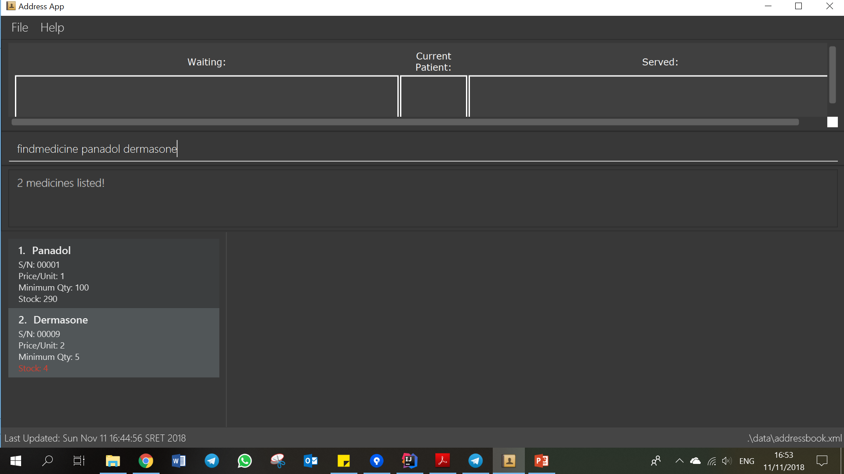
Step 1. Type the findmedicine command with the medicine names.
Step 2. All the medicines with names “panadol” or “dermasone”
will appear in the medicine panel.

