Slide 1
Cors
(Cross Origin Resource Sharing

Slide 2
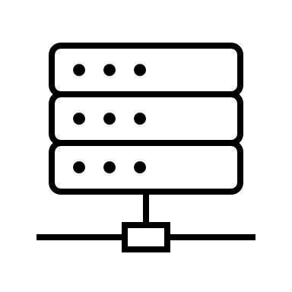

Here you go, index.html
Live-server
GET index.html
127.0.0.1:60000
GET
ourjs.js
Here you go, ourjs.js
The purpose of CORS is to protect the user from accidentally visiting random websites that might send .js files that could send arbitrary HTTP requests to websites the user uses, such as gmail, youtube, etc.
So over on the backend, it is important to enforce that only .js files originating from certain origins are allowed to send those requests (typically origins that that backend owner owns)
GET /pokemon/1
REST-API
Chrome
Browser will ask: This request is coming from a .js file served from some other server (origin: 127.0.0.1:60000), is that allowed?
“No, .js files that send requests to us from those origins are not allowed to do so”

