Slide 1

Node.js
When working Angular, we need to have Node.js installed
Node.js is often used for server-side applications
You would build out a backend and run it using Node
Node.js: We can analogously think of Node as a “JRE” (Java, which has runtime libraries and a JVM)
Node runs JavaScript from a non-browser environment through the V8 engine (which is also the same engine that the Chrome browser)
Node provides various libraries that allow you to do things beyond just the ECMAScript specification for JavaScript

Slide 2

ECMAScript
This is just the standard for JavaScript
But if we want JavaScript to do more things, such as
Process HTTP requests/responses
Read files from the system
Connect to a database
We would need to extend beyond just the ECMAScript specification
In fact, this is what our browser already does
And we have actually encountered this during P1
DOM Manipulation: IS NOT a part of the ECMAScript specification
Our browser is actually extending additional functionality on top of “JavaScript”

Slide 3

How do functionalities get extended on top of Node.js or the Browser?
In the case of Node.js, we are running the V8 engine
In the case of Chrome at least (which is the most popular browser), we are ALSO using V8 (because V8 was designed originally for Chrome by Google)
The V8 engine was written in C++
So, to extend functionality on top of ECMAScript, we can actually write C++ code, and then link that with our JS (to put it simply)

Slide 4
Why do we use Node.js with Angular?
Node.js provides us an entire ecosystem composed of
Npm: node package manager, used to manage our project and various dependencies
Webpack: Angular uses this in the background to bundle together all of our css, html, typescript, etc. into a compact group of .js files and an index.html file (which will then serve as our SPA (single page application)
Angular CLI: a command-line interface that allows us to easily create a base Angular project, or add components, modules, and services to our current Angular project

Slide 5
Demos to reference
Webpack Demo
TypeScript demo
Angular Demo

Slide 6
Angular Versions
The very first “version” of Angular was called AngularJS. AngularJS is completely different from what we now refer to as Angular (without the JS)
AngularJS
Angular 2 through 11 (versions 2 through 11 are much more similar to each other than AngularJS)
You can think of 2, 3, 4, 5, …, 11 as different iterations of the same Angular
Each version here is just adding new features
So, oftentimes you will hear people just refer to Angular 2 v. AngularJS
AngularJS is older, and completely architecturally different

Slide 7

Angular Components
Angular apps are made up of different components
Each component is supposed to do “one thing” in the application that is visible on the screen
Components wrap up all of our styling and html for a single “widget”
Components (except the app component) can be reused multiple times in an application
Components can be nested inside other components
The ‘App’ component is always the most parent component

Slide 8
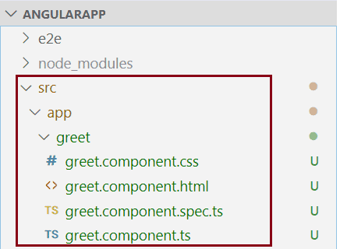
Component Files
Each component has the following files:
<component-name>.component.html: contains the html for that particular component
<component-name>.component.css: contains the styling SPECIFICALLY for the html elements inside of the component template ONLY
<component-name>.component.ts: contains the TypeScript code linked to that component’s behaviors and can be used to pass data between the template and actual programming logic
<component-name>.component.spec.ts: used for writing tests for our component

Slide 9
Component Hierarchy
Whenever you build an Angular application, you should think about what components you want to create, and then create a diagram describing the “nested” structure
App component is always at the top
AppComponent
ExampleComponent
ExampleComponent
ExampleComponent

Slide 10
Angular v. React
Angular:
Considered a framework
Is more opinionated than React (meaning that Angular follows a certain structure of doing things much more strictly than React)
Created by Google
React:
Considered a library (so just something you use with your plain JavaScript)
Is much less opinionated, more freedom to do different things you want to do
Create by Facebook

