Slide 1
@NgModule Decorator
This decorator contains the following properties:
Declarations: an array of components, directives, and pipes that belong to the module
Imports: an array of modules that this current module can make use of
Providers: an array of services that belong to this module
bootstrap: this property ONLY EXISTS for the root module called the AppModule

Slide 2
Angular Bootstrapping Process
“Bootstrapping”: The process of starting up an Angular application
Steps:
main.ts serves as the entry point in the Application
We see code in main.ts that will load up the root module that is known as the AppModule (app.module.ts)
Inside of app.module.ts, we see that AppComponent is designated to be “bootstrapped”
Angular will then analyze the AppComponent to find that it utilizes the `app-root` selector as its element tag
Index.html is then loaded onto the browser and then Angular will render whatever is inside of app-root as well

Slide 3
1-way data binding
There are 3 different ways of doing data binding:
Event Binding: allows us to easily listen for events being emitted from elements in our template, and make use of methods in our component. We can use this to pass data from inputs to variables inside our component (template to component)
String Interpolation: passing values from our component to our template to be displayed (component to template)
Property Binding: passing values from our component to an element’s attribute in our template (component to template)

Slide 4
Directives
Directives are a construct of Angular. They “direct” elements on what to do. There are 3 different types of directives:
Components: components are themselves directives. People don’t usually think of components as being directives, but they essentially “direct” the dom to render the template of the component
Structural Directives: used to manipulate and change the **structure** of the DOM, hence why it is “structural”
Attribute Directives: used to change the look and behavior of elements

Slide 5
Structural Directives
*ngIf: used for conditional rendering. If an element with this directive evaluates to false, it will not display
*ngFor
ngSwitch
[ngSwitch]: attribute directive which controls…
*ngSwitchCase: structural
*ngSwitchDefault: structural

Slide 6
Attribute Directives
The most common attribute directives are
ngClass: used to apply a class to an element. But, ngClass enables us to link classes to our elements based on what is on the component.ts itself
You can pass in a string
An array of strings
An object w/ the properties being the classes and values being a Boolean
ngStyle: used to apply some styling to an element. This takes in an object w/ the css property and a corresponding value (could be a ternary expression if you want to have different styles according to different conditions)

Slide 7
Component Lifecycle Methods
Components have a lifecycle, from the creation of the component to the destruction of the component.
Components are created when they are rendered onto the screen, and destroyed when they are no longer being rendered
We have various methods that can run at different parts of the lifecycle:
Constructor: always executes first, ONCE
ngOnChanges(): whenever input properties of a component change, this is called. Will be called multiple times during the lifetime of a component based on how many input property changes occur.
ngOnInit(): called ONE TIME when the component is first initialized
ngDoCheck(): called immediately after ngOnChanges() and during change detection runs so that we can implement our own custom actions for change detection
ngOnDestroy(): called before Angular destroys a directive or component

Slide 8
While the component is running, and a change occurs w/ an input property,
When we first create a component…
When we are no longer rendering a component to the DOM,
Constructor called
ngOnChanges called
ngOnChanges called
ngOnDestroy called
ngDoCheck called
ngInit called
ngDoCheck called

Slide 9
Component Parent-child communication
In Angular, we have apps composed of MANY different components. Components can be nested inside other components. These nested components are the child components
So naturally, we might want to pass data from one component to another. So far, we have only been using a single component where we pass data from the template to the component object itself.

Slide 10
Password Generator App
Currently has everything in the App component
We can refactor this to the following:
AppComponent
contains
Input Element for passwordLength
ngforexampleComponent
ngswitchexampleComponent
GeneratorComponent
Button for generating

Slide 11

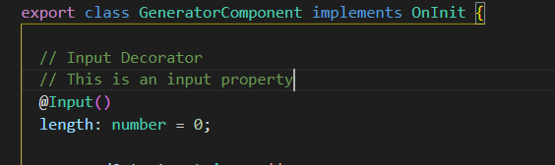
Input Decorator (Parent-to-child communication)
Allows us to use property binding on our components in order to pass data from a parent component to a child component
Inside parent component template:
Property in parent component (passwordLength) being passed to length property in child component
Inside child component:

Slide 12
To introduce child-to-parent, let’s refactor our app again…
AppComponent
Pass data to app component (child-to-parent)
Pass data to generator component (parent-to-child)
renders
renders
LengthInputComponent
GeneratorComponent

Slide 13
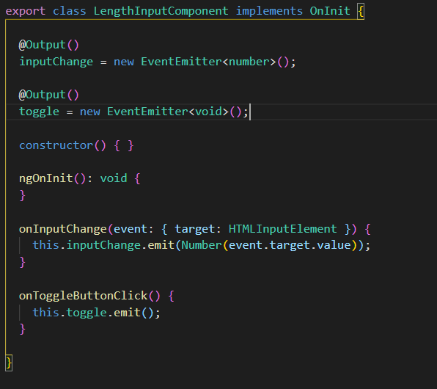
Output Decorator (Child-to-parent communication)
We often want to segregate our application into components that display data, and other components that take some input. These components will often be nested inside of a parent component.
So, we need to both utilize child-to-parent and parent-to-child to have all of the data properly flowing between components
Inside child component
Inside parent component template

Slide 14
Two-way databinding
So far, we have seen 1-way data binding
String interpolation
Event binding
Property binding
But there is also 2-way data binding that looks like this:
[(ngModel)] <- “banana in a box”, but don’t say it in an interview
It links a property in the component with a attribute of an element both ways
So, if the property in the component changes, it will also change the attribute of the element, and vice versa
Mostly used w/ input elements: <input [(ngModel)]=“someVariable” type=“text” />

Slide 15
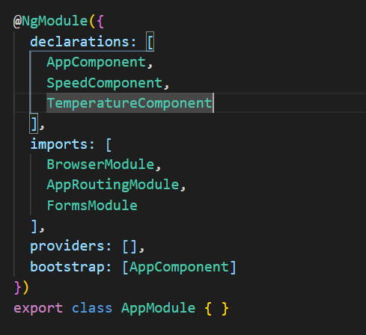
Setting up 2-way databinding
We need to import FormsModule into the Module that contains the components in which we want to use [(ngModel)] with.
So, in this case, the AppComponent, SpeedComponent, and TemperatureComponent all have the ability to utilize [(ngModel)], which comes from the FormsModule

Slide 16
Angular Services
Similar to our design choice on the backend, we should also segregate what is responsible for the “view” of our frontend app from other functionality such as sending HTTP requests and receiving responses.
More complicated business logic will typically go into a “service” layer
You can think of the components as being a “presentation” layer
Angular utilizes dependency injection in order to provide these service objects to components.

Slide 17
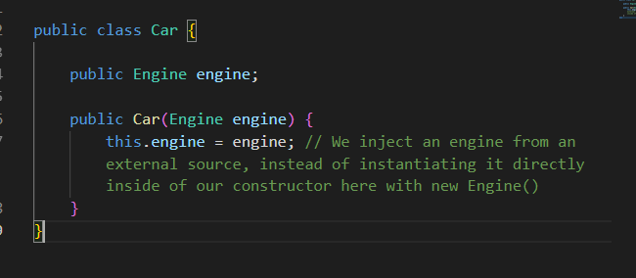
Revisiting Week 1 (Dependency Injection)
Dependency Injection: passing in dependencies from an external source
In week 1, we saw the use of a parameterized constructor to pass in another object from outside into the object that we are currently instantiating with the constructor

Slide 18
RxJS Observables
Similar to promises, but can have multiple values instead of one, OVER TIME
You can process the data through a pipeline using operators
There are TONS of different operators available
Observables can be cancelled, Promises cannot
Overall, however, promises and observables are pretty similar
You can actually convert from an observable to a Promise
But, this should only be done when you are expecting a single value from the Observable (such as when utilizing HttpClient)

Slide 19
RxJs Subjects
Follows the pattern of pub-sub (publisher-subscriber)
We can publish values to a subject (using .next(<value>))
Any subscriber to the subject (subscribers are also known as observers) will then receive that “update”
An analogy would be a weather channel where you publish weather updates to all viewers or listeners

