Slide 1


Serilog!
A .Net logging solution

Slide 2

What Is Logging?
Logging is essential for a software development project, but it’s often disregarded until the program crashes. Logging serves numerous purposes including root cause analysis, bug analysis, and even performance reviews for the application. With Serilog, the programmer can log to several locations and not just a flat file.
Why Log in .NET? Even if you don’t log in your application, Windows will still detect the crash and create an entry in Event Viewer. Logging serves several purposes. First, you can customize your error messages that you store. This makes it much easier to identify bugs in your application. You might need to identify an error from a piece of code that you didn’t write. Instead of spending hours stepping through code with different input scenarios, the right logging can point to the exact piece of code and the input that caused the problem.

Slide 3
Why should I use logs?
Console.WriteLine() can only go so far.
Formatting (Date, time, filename, method, class, transaction, etc.)
Centralized log files
Runtime issues can be hard to debug
Debug integration issues (between projects/namespaces)
Monitor daily operations
Aggregate data on how users interact with your application
Unit testing - You have to put the results somewhere
Context is key!

Slide 4
What is Serilog
Like many other libraries for .NET, Serilog provides diagnostic logging to files, the console, and elsewhere. It is easy to set up, has a clean API, and is portable between recent .NET platforms.
Unlike other logging libraries, Serilog is built with powerful structured event data in mind.

Slide 5
Serilog Features
Format-based logging API with familiar levels like Debug, Information, Warning, Error, and so-on
Discoverable C# configuration syntax and optional XML or JSON configuration support
Logging configuration can be changed at runtime! This means you can change your logs without redeploying the entire application.
Sophisticated enrichment of log events with contextual information, including scoped (LogContext) properties, thread and process identifiers, and domain-specific correlation ids such as HttpRequestId
Zero-shared-state Logger objects, with an optional global static Log class

Slide 6
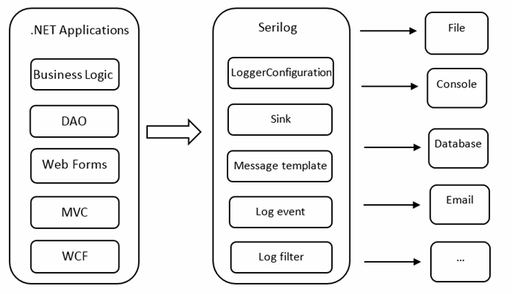
Structure of Serilog

Slide 7
Logging Levels
Level: Usage
Verbose: Tracing information and debugging minutiae; generally only switched on in unusual situations
Debug: Internal control flow and diagnostic state dumps to facilitate pinpointing of recognized problems
Information: Events of interest or that have relevance to outside observers; the default enabled minimum logging level.
Warning: Indicators of possible issues or service/functionality degradation
Error: Indicating a failure within the application or connected system
Fatal: Critical errors causing complete failure of the application

Slide 8
Logging Levels Examples
Method Signatures:
void Log.Information(string messageTemplate)
void Log.Debug<int, int>(string messageTemplate, int propertyValue0, int propertyValue1)
Log.Debug<String, String>("compare {A} with {B}", "a", "b");
void Log.Error(Exception exception, string messageTemplate)

Slide 9
Best Practices
General Rule:
Log entries should be present from every level of your application logic per transaction.
Most of these logs can go to the Debug or Info level unless something goes wrong.
ex:
UI -> BL -> DL -> DB
UI: Logs when an option is selected by the user.
BL: Logs some details about what action is happening
DL: Logs what data is being requested or entered
DB: Logs database transaction details
Good Questions to ask yourself when deciding what to log:
How are we going to log successful requests?
How are we going to log errors?
Are we going to show the complete stacktrace?
What Else?
Enable only high-severity logs in Production
Include Context in Log entries
Redact Sensitive Information

Slide 10
Summary and Best Practices
What is Serilog? Why should you use it, or any C# logging framework?
How to install Serilog via Nuget and get started
Logging sinks: What they are and common sinks you need to know
How to enable Serilog’s own internal debug logging
Make good use of multiple Serilog logging levels and filter by them
How to do structured logging, or log an object or properties with a message
Do not send emails on every exception
How to send alerts for exceptions
How to search logs across servers
Use filters to suppress certain logging statements
You can make your own custom sinks
Customize the output format of your Logs and Enrich your logs with more context
How to correlate log messages by web request transaction
How to view Serilog logs by ASP.NET web request

Slide 11
Setup Serilog
dotnet add package Serilog Add the Serilog package so that “using Serilog;” will import.
dotnet add package Serilog.Sinks.Console Used to print logs to the Console.
dotnet add package Serilog.Sinks.File Used to print logs to Files.
dotnet add package Serilog.Sinks.MSSqlServer Used to push logs to SQL database.
dotnet add package Serilog.Sinks.email Used to push logs to e-mail.

Slide 12
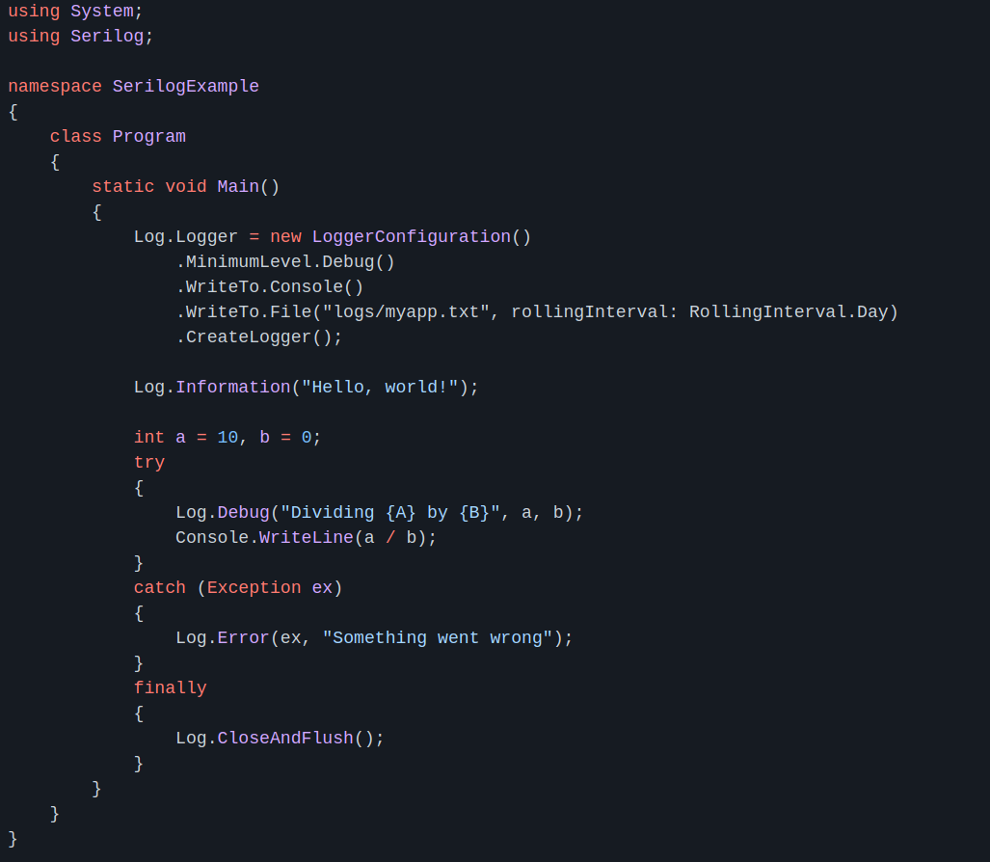
Serilog Example
Example Output:
2021-05-05 14:25:27.095 -04:00 [INF] Hello, world!
2021-05-05 14:25:27.126 -04:00 [DBG] Dividing 10 by 0
2021-05-05 14:25:27.128 -04:00 [ERR] Something went wrong
System.DivideByZeroException: Attempted to divide by zero. at UI.UI.Main(String[] args) in /home/dione/lang/dotNET/Ruffner-Garrett-P0/App/UI/UI.cs:line 20

Slide 13
Configuration Options
Bare minimum configuration:
Log.Logger = new LoggerConfiguration()
.WriteTo.Console()
.CreateLogger();
More suitable configuration:
Log.Logger = new LoggerConfiguration()
.MinimumLevel.Debug()
.WriteTo.Console()
.WriteTo.File("logs/myapp.txt", rollingInterval: RollingInterval.Day)
.CreateLogger();
dotnet add package Serilog
dotnet add package Serilog.Sinks.Console
dotnet add package Serilog.Sinks.File
This Logger will write logs to both the console and the log file located at logs/myapp.txt

Slide 14
More Configuration
Note: The Serilog package must be added to every project it is used in.
The Log object is global
Multiple Log objects can be created and used independently if required.
Sinks:
Think of log entries like water. Each sink is a place for the logs to go.
XML <appSettings> configuration: Github Readme
Install-Package Serilog.Settings.AppSettings
An App.config or Web.config file can be defined using xml to load configuration options for Serilog
JSON appsettings.json configuration: Github Readme
Install-Package Serilog.Settings.Configuration
var configuration = new ConfigurationBuilder()
.AddJsonFile("appsettings.json")
.Build();
var logger = new LoggerConfiguration()
.ReadFrom.Configuration(configuration)
.CreateLogger();

Slide 15
Demo Time!
One last config option:
.MinimumLevel.Information()
You might want to increase the logging level of a logger to diagnose or debug a problem. The default level for all loggers is Inherit, and the default level for the root logger is Info.
Do not turn on Debug or higher logging in production code. Turning on this excessive logging for high volume module like system, query, or exec can rapidly flood your system and cause issues at runtime.

Slide 16
Integration
Many Different Sinks
Time-series Databases like InfluxDB are optimized to store time-based events. This means your logging performance will be better and your logs will take less storage space.
Javascript Support
ASP.NET
AZURE (Cloud Hosting Services)
All of .NET

Slide 17
Searchable Solutions
Store, index, add search capabilities and even visualize your logs data.
Saving logs to a database doesn't scale
Querying a SQL database for logging data is a terrible idea if aren’t using full-text indexing. It is also an expensive place to save logging data.
Logstash + Elastic Search + Kibana (The “Elastic Stack”)
Available on Linux, Macos, and Windows!
Logstash - Server side data storage solution
Elastic Search - Search and analyze structured logs
Kibana - Data visualization suite

Slide 18
Nlog vs Serilog
Both can use both json, XML, and C# configurations.
We will focus on C# configuration for our comparison.
Serilog has a much cleaner C# configuration api (as shown in the next slide)
Both Serilog and Nlog can write logs to many different locations(Console, File, DB, email etc.)

Slide 19
Serilog vs Nlog
var config = new NLog.Config.LoggingConfiguration();
// Targets where to log to: File and Console
var logfile = new NLog.Targets.FileTarget("logfile") { FileName = "${basedir}/logs/Nlog.${shortdate}.log", Layout = "${longdate} ${logger} ${uppercase:${level}} ${message}", Encoding = Encoding.UTF8 };
var logconsole = new NLog.Targets.ConsoleTarget("logconsole") { Layout = "${longdate} ${logger} ${uppercase:${level}} ${message}" };
// Rules for mapping loggers to targets
config.AddRule(LogLevel.Trace, LogLevel.Fatal, logconsole);
config.AddRule(LogLevel.Trace, LogLevel.Fatal, logfile);
// Apply config
LogManager.Configuration = config;
Logger nlogLogger = NLog.Web.NLogBuilder.ConfigureNLog(LogManager.Configuration).GetCurrentClassLogger();
Log.Logger = new LoggerConfiguration()
.MinimumLevel.Verbose()
.WriteTo.Console()
.WriteTo.File("logs\\Serilog..log”
, rollingInterval: RollingInterval.Day)
.CreateLogger();
// self logging setting
Serilog.Debugging.SelfLog.Enable(
msg => File.AppendAllText
("logs\\serilog_internallog.log",
msg, Encoding.UTF8));

Slide 20
Serilog vs Nlog
Serilog and Nlog share the same 6 log levels
Verbose - very detailed logs. This log level is typically only enabled during development.
Debug - debugging information, less detailed than a trace, typically not enabled in the production environment.
Information - information messages, which are normally enabled in the production environment.
Warning - warning messages, typically for non-critical issues, which can be recovered or which are temporary failures.
Error - error messages - most of the time these are Exceptions
Fatal - very serious errors!

Slide 21
N log example
Nlog:-
<nlog>
<targets>
<target xsi:type="File" name="file" fileName="log-file.log"
layout="${longdate} ${level} ${message}" />
</targets>
<rules>
<logger name="*" minlevel="Trace" writeTo="file" />
</rules>
</nlog>

Slide 22
Questions, Comments, Etc.
Links:
https://serilog.net/
https://github.com/serilog/serilog/wiki/Getting-Started
https://github.com/serilog/serilog-sinks-file
https://github.com/serilog/serilog/wiki/Lifecycle-of-Loggers

