Slide 1

TCSWAP
TEAMCOOLGUYS
Notes:
James

Slide 2

The Problem
Don’t have access on the go
Hard to organize trades
Difficult to keep track of your collection
Notes:
It is difficult to keep track of you collection on the go
Create a single platform for

Slide 3
The Solution: Tcswap
Purpose built application for mobile
Platform for traders and sellers
Centralized repository for collection
Notes:
Create a platform for both traders and sellers to engage in the trading and selling of cards.
Provide a way for players to keep track of their collection

Slide 4
Tech stack
Notes:
Charles

Slide 5
Backend
Serverless Architecture
AWS Lambda
RDS PostgreSQL
Node.js
API Gateway

Slide 6
FRONTEND
React Native
Redux
Axios
Expo
GiftedChat API
API’s for different card games
YuGiOh! API
Magic: The Gathering API
Notes:
Albert

Slide 7
User experience
Notes:
Honorine

Slide 8
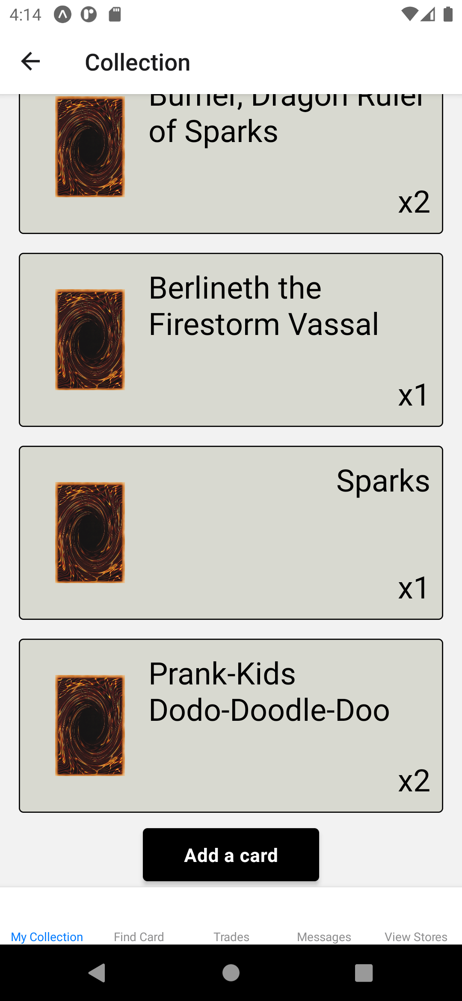
Players
First view when a user signs in
View and add to your collection
Find cards to trade with other players
Engage with other members of the community
View stores to view inventories

Slide 9
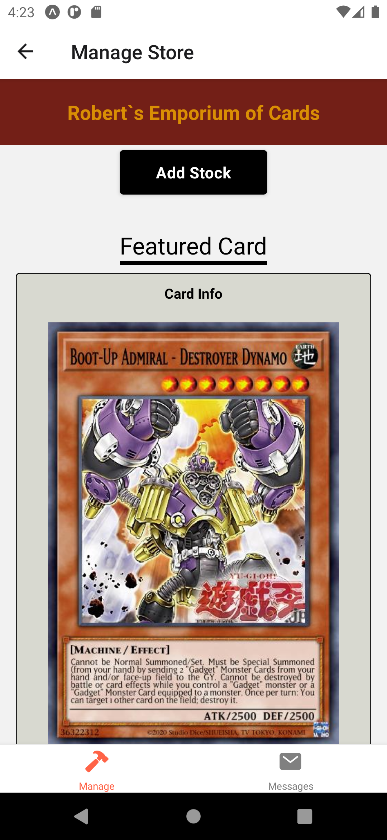
Store owners
View your inventory
First view when a store owner signs in
Message tab to connect to customers
View and edit store’s featured card

Slide 10

Demo

Slide 11
Challenges

Slide 12
Challenges
Handling issues caused by 3rd party APIs
Network issues (CORS, Messenger)
Stripe API platform compatibility
Lambda RDS communication
Notes:
Kyle

Slide 13
Questions
Notes:
No

Slide 14

Thank You

